Slide 1
Interaction Laws Verification Using Knowledge-based Reasoning
Gustavo Carvalho, Anarosa Brandão, Rodrigo Paes & Carlos Lucena
By Regiane Lima

Slide 2
Overview
We have applied a knowledge-based approach to verify design consistency of interaction laws specified by using XMLaw.
We provide a formal description of the XMLaw conceptual model, as well as a reasoning engine that are used together to detect structural inconsistencies in XMLaw specification.
An example of how to check the specification consistency is described using the Contract Net protocol.

Slide 3
Problem Statement
The establishment of the well-formedness of a set of law elements used to design a particular open multi-agent system application can be a difficult problem.
The different elements specified by using XMLaw can present structural inconsistencies. Those inconsistencies result from the interdependencies between law elements.
A conceptual model for XMLaw was defined,but we need to provide some support on the description of a well-formed specification and either to detect and identify if inconsistencies exist.
We need additional support to identify other errors like references to non existent elements, references to elements that are defined in non-visible contexts, and so on.

Slide 4
Proposal
In January, we proposed the use of DL (description logics) and an associated knowledge-based reasoner to verify the consistency of XMLaw specifications.
XMLaw
Interpreter
XMLaw
Execution Model
law
law
Consistency Rules
Reasoner
XMLaw
Interpreter
XMLaw
Execution Model

Slide 5
XMLaw Conceptual Model
In order to proceed with the verification of structural consistencies of XMLaw specifications, we developed an ontology based on the XMLaw conceptual model.
The purpose of this ontology is to describe formally the XMLaw elements and the relationships among them. By doing this, it is possible to verify the properties of laws described using XMLaw.
Therefore, the structural consistency of such laws are verified based on the ontology concepts, properties and axioms. We are using the DL implemented by the RACER system to describe our ontology, to check its consistency and to reason about its instances.

Slide 6
XMLaw Conceptual Model
An ontology is an explicit specification of a conceptualization. In our context, we adopt an ontology as the formal specification of the XMLaw conceptual model, meaning that the MAS regulations described using XMLaw will generate ontology instances.
In general, ontologies are used by knowledge-based systems and, therefore, ontologies are described in some knowledge representation language that can be processed by computer programs.
The XMLaw elements are defined as ontology. The ontology properties are used to associate elements with their intrinsic properties, or to associate the elements that can be used in each law specification. The ontology axioms define the ontology taxonomy and the semantics of its concepts and properties.

Slide 7
XMLaw Conceptual Model
To describe the XMLaw elements, we define the concept element, which is the disjointed union of the concepts lawElement and basicElement. Therefore, we assemble theconcepts message, transition, state, protocol, clock, norm, scene, and organization as subconcepts of lawElement and the concepts performative, role, content, stateType and label as subconcepts of basicElement.
The properties has-msg, has-end1, has-end2, has-sender, has-receiver and has-protocol, among others, are used to define the elements and the relations that can be specified among them in each law specification. Such properties are identified while defining the semantics of any law specification in the axioms.

Slide 8
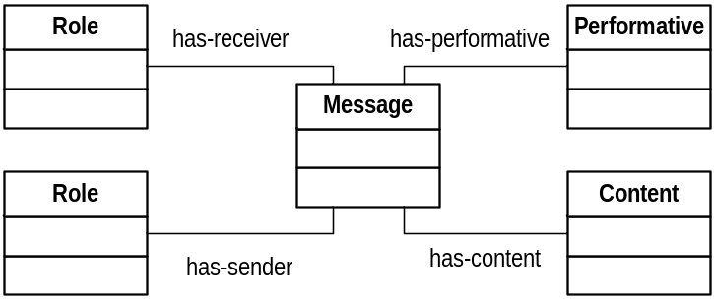
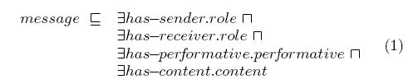
Formalizing
XMLaw Conceptual Model

Slide 9
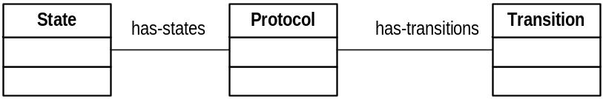

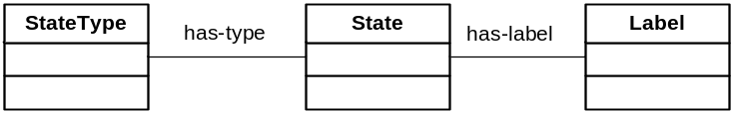

Formalizing – Conceptual Model

Slide 10
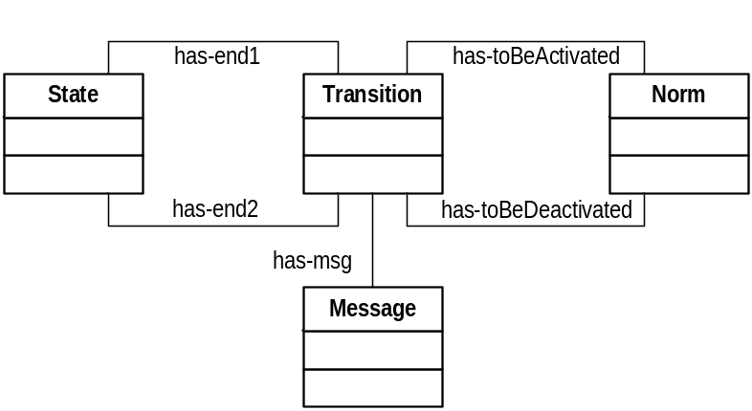
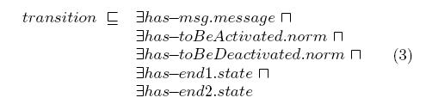
Formalizing – Conceptual Model

Slide 11
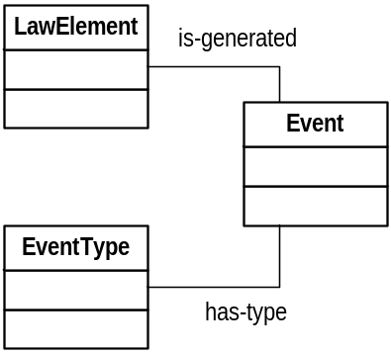

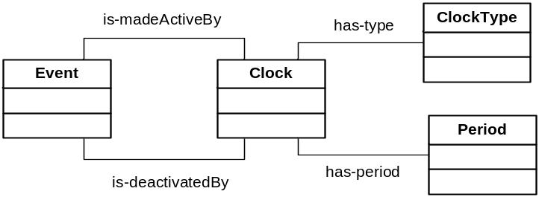
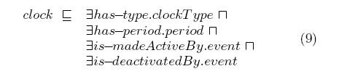
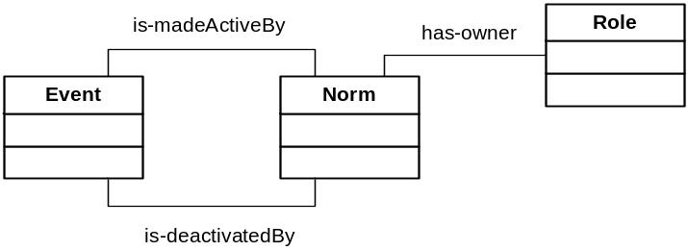

Formalizing – Conceptual Model

Slide 12
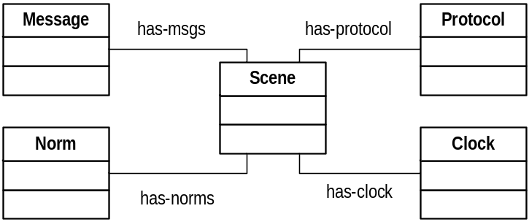
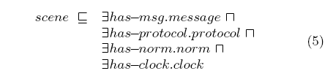
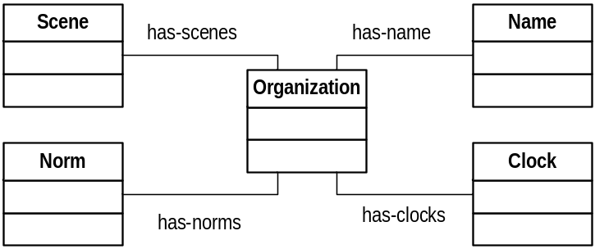

Formalizing – Conceptual Model

Slide 13
Example
Our working example is an ontology instance referring to the Contract Net Protocol specification. Contract Net is a pattern for a simple interaction type. Elaboration on this pattern will almost certainly be necessary in order to specify all cases that might occur in an actual agent interaction. Customizations are related to issues like the effects of cancelling actions, non-synchrony, abnormal or unexpected protocol termination, and nested protocols.
Keeping the law consistency over the development and its specification is fundamental for using and reusing this artifact in different contexts. The KB code below partially represents the law specification of the example. Such specification was described by using RACER.
A RACER code is composed of concepts, concept instances and relations between these instances. For example, the code representing the specification shows the instantiation of an organization called contractNetOrg, a scene called ContractNet, a protocol called contractNetPrtcl, a message element called cfp, a transition element called cfpTransition, and so on. All those elements are defined in the law specificationcontractNetOrg. For space reasons, we will not describe the whole specification.

Slide 14
Ontology - Instance Example
1. (instance contractNetOrg organization)
2. (instance contractNet scene)
3. (instance contractNetPrtcl protocol)
4. (instance cfp message)
5. (instance cfpTransition transition)
6. (instance start state)
7. (instance waiting state)
8. (related contractNet contractNetPrtcl has-protocol)
9. (related contractNet cfp has-msg)
10. (related cfpTransition cfp has-msg)
11. (related cfpTransition start has-end1)
12. (related cfpTransition waiting has-end2)
13. (related ContractNetPrtcl cfpTransition has-transition)
14. (related ContractNetPrtcl start has-state)
15. (related ContractNetPrtcl waiting has-state)
16. (instance propose message)
17. (instance proposeTransition transition)
18. (instance proposed state)
19. (related proposeTransition propose has-msg)
20. (related proposeTransition waiting has-end1)
21. (related proposeTransition proposed has-end2)
22. (instance refuse message)
23. (instance refuseTransition transition)
24. (instance cfprefused state)
25. (related refuseTransition waiting has-end1)
26. (related refuseTransition cfprefused has-end2)

Slide 15
Structural Verification
(retrieve (?trans-no-s1)
(and (?trans-no-s1 transition)
(?s2 state)
(?trans-no-s1 ?s2 has-end2)
(?trans-no-s1 nil has-end1)))
(retrieve (?trans-no-s2)
(and (?trans-no-s2 transition)
(?s1 state)
(?trans-no-s2 ?s1 has-end2)
(?trans-no-s2 nil has-end1)))

Slide 16
Instance Example
22. (instance refuse message)
23. (instance refuseTransition transition)
24. (instance cfprefused state)
25. (related refuseTransition waiting has-end1)
(retrieve (?msg ?scene ?prtcl)
(and (?msg message)
(?scene scene)
(?prtcl protocol)
(?trans transition)
(?scene ?prtcl has-protocol)
(?prtcl ?trans has-transition)
(?trans ?msg has-msg)
(not (?scen ?msg has-msg))))

Slide 17
Conclusion
We have a very basic description of XMLaw elements and a very basic DL knowledge base. Those DL specifications could be enriched with more information. This would also allow the reasoner to make more precise inferences.

Slide 18
Future Work
We will improve the formalization of XMLaw elements including more rules and defining all the structural rules that are possible for XMLaw.
  For instance, the specification presented here does not include any information on the arity of relations.
    To make an example, the definition of the concept message has an unique sender. Similarly a message should have an unique content. T
    These DL constructs are supported by RACER and thus could be easily used in the specification of XMLaw elements.

Slide 19
Future Work
We aim to provide support to propose customizable rules to define explicitly consistency mechanism for governance framework purpose.
  For instance…
    clock events in the domain A can not activate norms…
      If someone extend so… it will be inconsistent.

Slide 20
CROM + XMLaw consistency
Contexto BASE :: A idéia deste tópico é ter uma base de regras que verifiquem a consistência de especificações em XMLaw.
Contexto FRAMEWORK: Ao definir um framework é possível adicionar regras que verificarão a consistência de instâncias de governance frameworks.
Abordagem usada em CROM : BASE + FRAMEWORK
  Todas as instâncias serão verificadas segundo as regras definidas e erros ou avisos serão alertados.

