Slide 1
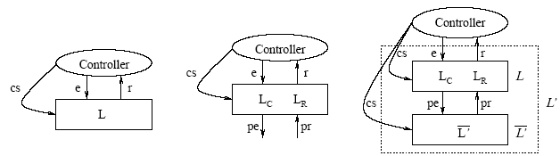
Hierarchy – Extension Mechanism
Minsky proposes a coordination and control mechanism called law governed interaction (LGI). This mechanism is based in two basic principles: the local nature of the LGI laws and a decentralization of law enforcement. It provides a language to specify laws and it is concerned with architectural decisions to achieve a high degree of robustness.
Ao and Minksy (2003) propose an approach to enhance LGI with the concept of policy-hierarchy to support that different internal policies are formulated independently of each other, achieving by this means a flexibility support.
Differently from our approach, Ao and Minsky consider confidentiality as a requirement for their solution. The extensions that we have presented until now has the goal of supporting open system law maintenance, instead of flexibility for confidentiality purpose.
Xuhui Ao and Naftaly Minsky. Flexible Regulation of Distributed Coalitions. In Proc. of the 8th European Symposium on Research in Computer Security (ESORICS). Gjøvik Norway, October 2003.

