Slide 1
Extensions on Interaction Laws in Open Multi-Agent Systems
Seminar
Governance in Open MAS
Gustavo Carvalho

Slide 2
Outline
Open questions
  How to design open systems for extensions?
    How to structure better the law elements?
    Which formalism is better suited to support for law extension consistency?
    Does our event model help extensibility?
Ongoing research status
CARVALHO, Gustavo; PAES, Rodrigo; LUCENA, Carlos. Extensions on Interaction Laws in Open Multi-Agent Systems. In: Software Engineering for Agent-oriented Systems (SEAS 05). Uberlândia, Brasil

Slide 3
Open Multi-Agent Systems
How to design open systems for extensions?
  As software systems need to be customized according to different purposes and peculiarities, it should be possible to express extensions over interactions of software agents.
    Open MAS should be specified and developed to facilitate extensions on interaction protocols.
    Law-governed approaches should also present a solution to this challenge.
      Interaction specification = interaction protocol + law elements

Slide 4
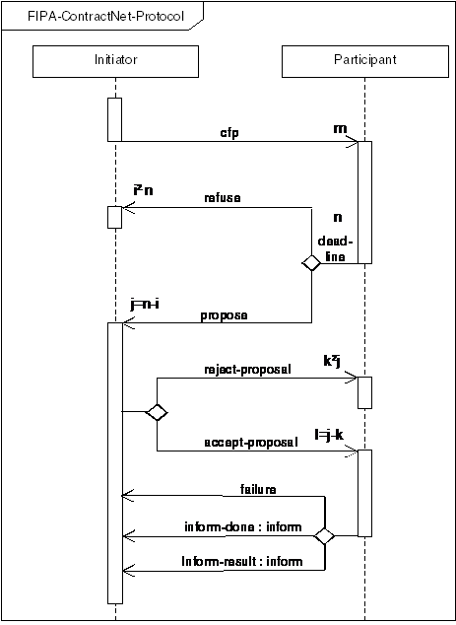
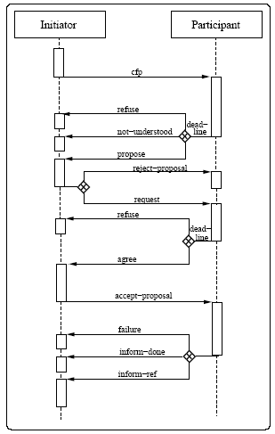
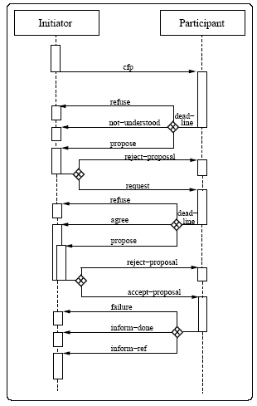
Example
Protocol Extension
Time outs?
Norms?
Filters?
Contract Net with Confirmation Protocol
Holonic Contract Net with Confirmation Protocol

Slide 5
Dimensions
Interaction Model
  Protocol specification
Control infrastructure
Agent implementation

Slide 6
Extension support for laws
Review the separation of law elements
Law lifecycle and consistency
Extension Mechanism

Slide 7
Extension support for laws (I)
How to structure better law elements?
Is it possible to separate the specification of protocol, norms, roles, ...?
V. Dignum, J.-J. Meyer, H. Weigand, and F. Dignum. An organization-oriented model for agent societies. In Proceedings of RASTA (at AAMAS'OZ). 2002.
  Description
  Rules and Interaction Structure
  Time period
  Price / Conditions of action of each agent
  Sanction
J. Vazquez-Salceda, H. Aldewereld, and F. Dignum. Norms in multiagent systems: some implementation guidelines. In Second European Workshop on Multi-Agent Systems, pages 737-748, Barcelona, 2004.
  Norm condition
  Violation condition
  Detection mechanism
  Sanction
  Repair

Slide 8
Extension support for laws (II)
Consistency
Development phase
  Design-time
  Runtime
Law lifecycle
  Inclusion of element
  Removal of element
  Replacement of element
Consistency - Formalism Support for Law Extension
  How state machines + time can support the extension on laws in open MAS?
  How prolog + time can support the extension on laws in open MAS?
    How transaction frame logic can support the extension on laws in open MAS?
  How π-calculus can support the extension on laws in open MAS?
  Joint work with Carol regarding defeasible logic and description logic...

Slide 9
Formalism - Related Work
The SOCS (SOcieties of ComputeeS) project aims at providing a solid scientific foundation for the design of Global Computing systems.
  A computational logic model for the description, analysis and verifi cation of global and open societies of heterogeneous computees
Global Computing is a new technological vision where computing environments are composed of autonomous computational entities whose activity is not centrally controlled but is decentralised instead, either because global control is impossible or at times impractical, or because the entities are created or controlled by different owners. The computational entities may also be mobile, and the environment is open and evolves over time. Moreover, the behaviour of the entities may be heterogeneous and vary over time, and the entities may need to operate with incomplete information about the environment.
SOCS objectives
  To deliver novel descriptions of computational Global Computing entities, with heterogeneous knowledge, goals, and patterns of behaviour and interaction.
  To describe systems of such entities, capable of interacting in a global, open, and dynamically changing Global Computing environment.
  To provide tools for the specification, analysis and verifi cation of properties of entities and their systems.
http://lia.deis.unibo.it/research/socs/

Slide 10
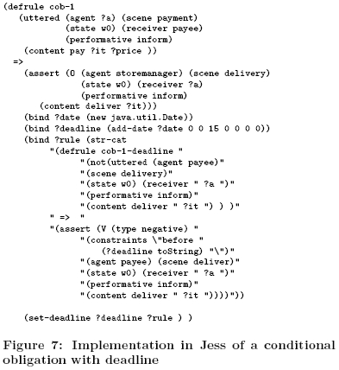
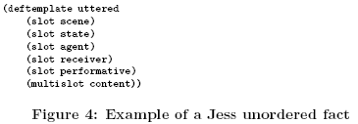
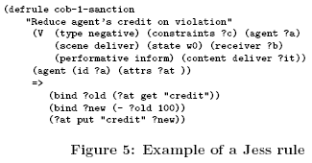
Formalism - Related work
Andres Garcia-Camino, Pablo Noriega, and Juan Antonio Rodriguez-Aguilar. Implementing Norms in Electronic Institutions. In Fourth International Joint Conference on Autonomous Agents and Multiagent Systems, 2005
JESS is used to implement norms

Slide 11
Extension support for laws (III)
Extension Mechanism
Extension Mechanism
  Enabling and disabling elements ( Event Model )
  Inheritance
  Extension by hierarchy
  Extension by completion ( Hooks )

Slide 12
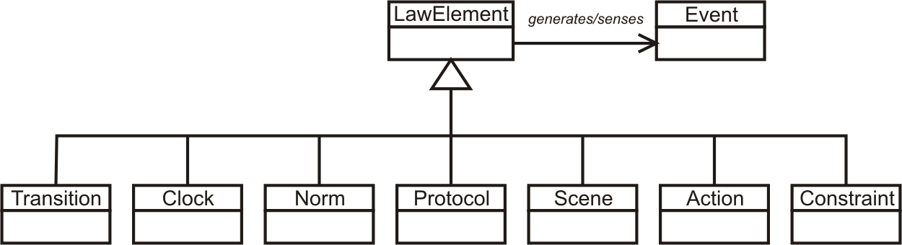
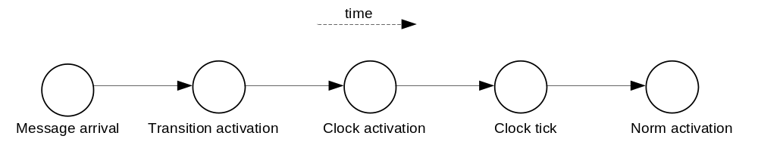
Enabling and Disabling elements
Does our event model help extensibility?

Slide 13
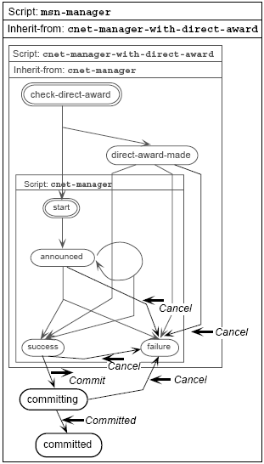
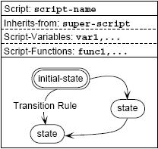
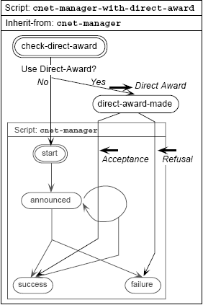
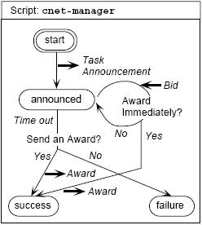
Inheritance - Extension Mechanism
Kuwabara, K., Ishida, T., and Osato, N.: "AgenTalk: Describing Multiagent Coordination Protocols with Inheritance", Proc. 7th IEEE International Conference on Tools with Artificial Intelligence (ICTAI '95) p.460-p.465 (1995)

Slide 14
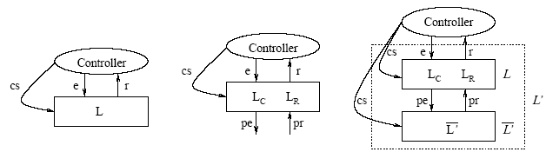
Hierarchy – Extension Mechanism
Minsky proposes a coordination and control mechanism called law governed interaction (LGI). This mechanism is based in two basic principles: the local nature of the LGI laws and a decentralization of law enforcement. It provides a language to specify laws and it is concerned with architectural decisions to achieve a high degree of robustness.
Ao and Minksy (2003) propose an approach to enhance LGI with the concept of policy-hierarchy to support that different internal policies are formulated independently of each other, achieving by this means a flexibility support.
Differently from our approach, Ao and Minsky consider confidentiality as a requirement for their solution. The extensions that we have presented until now has the goal of supporting open system law maintenance, instead of flexibility for confidentiality purpose.
Xuhui Ao and Naftaly Minsky. Flexible Regulation of Distributed Coalitions. In Proc. of the 8th European Symposium on Research in Computer Security (ESORICS). Gjøvik Norway, October 2003.

Slide 15
Extensions on Interaction Laws
We propose that the interaction specification be annotated using extension points and that the expected behavior of the agents be specified using laws.
Independently of extension points, the compliance of the system to the specification must continue to be analyzed by a mechanism that governs the laws of interactions in open MAS.
For this purpose, we extended the XMLaw description language [Paes et al., 2005a] to map the specification of interaction rules into a governance mechanism and we enhanced it with support for extension points.
CARVALHO, Gustavo; PAES, Rodrigo; LUCENA, Carlos. Extensions on Interaction Laws in Open Multi-Agent Systems. In: Software Engineering for Agent-oriented Systems (SEAS 05). Uberlândia, Brasil

Slide 16
Research Status
We have included the notion of extension points in the XMLaw.
The extension points allow the modification of the interaction laws with services (action element) that could be activated by a law and with filters (constraint element) that could validate or not a law.
  This is a first step towards using variations and laws to specify extensions points in open system interactions.
We intend to evaluate how we can use extensions to protocols, norms, scenes, and any other element.

Slide 17
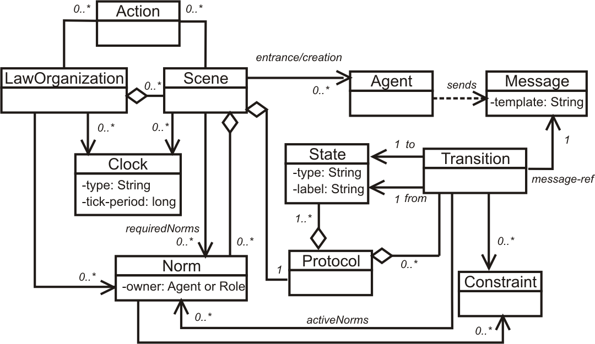
Explanation…
Conceptual Model

Slide 18
Constraint
Constraints are restrictions over norms or transitions and generally specify filters for events, constraining the allowed values for a specific attribute of an event.
  For instance, a constraint can describe what the allowed values for specific attributes are. It can filter the event that is not conform to this rule.

Slide 19
Constraint
Constraints are implemented using Java code.
  Developers are free to build as complex constraints as needed for their applications.
  The Constraint element defines the class attribute that indicates the java class that implements the filter.
    The class is called when a transition or a norm is supposed to fire, and basically the constraint analyzes if the message values or any other events’ attributes are valid.

Slide 20
Constraint Code
public class CheckValidDay extends AbstractConstraint {
public CheckValidDay(InfoCarrier info) {
super(info);
}
public boolean constrain(InfoCarrier info) {
/* manipulate data */
if ( /*check conditions*/ )
return true;
else
return false;
}
}

Slide 21
Transitions and Constraints
<Transition id=”ab”
from=”a”
to=”b”
message-ref=”m”>
<Constraint id="anId" class="aClass"/>
</Transition>
anId = true
anId = false
a
b
a
b
m
m

Slide 22
Norms and Constraints
<Permission id="a-Permission-Id">
<Owner>...</Owner>
<Activations>...</Activations>
<DeActivations>...</DeActivations>
<Constraints>
<Constraint id="anId" class="aClass"/>
</Constraints>
<Actions>...</Actions>
</Permission>
anId = true
anId = false
Norm Activated
Norm
Norm
Norm Deactivated
Norm

Slide 23
Action
Environment actions are domain-specific Java code that runs integrated with XMLaw specifications.
  Actions can be used to plug services in an environment.
  For instance, an environment can call a debit service from a bank agent to automatically charge the purchase of a good in a negotiation.

Slide 24
Action Structure
Since actions are also a XMLaw element, they can be activated by any XMLaw event such as transition activation, norm activation, and even action activation.
  The class attribute of an Action specifies the java class in charge of the functionality implementation.
  The Element tag references the events that activate this action, and as many Element tags as needed can be defined to trigger an action.
<Actions>
<Action id="anActionId“
class="apackage.ActionClass">
<Element ref="generatorReference“
event-type="aType"/>
<Element ref="anotherGeneratorReference“
event-type="anotherType"/>
</Action>
</Actions>

Slide 25
Action Code
public class KeepRFQAction extends ActionExecution {
public KeepRFQAction(Id id, InfoCarrier info, TriggerDescriptor generator) {
super(id, info, generator);
}
public void execute(InfoCarrier infoCarrier) throws LawException {
/* action implementation */
}
}

Slide 26
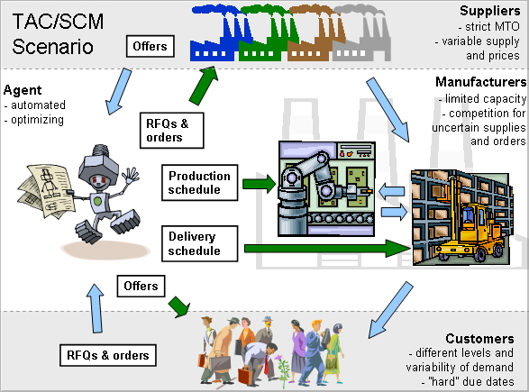
TAC SCM Variability - Summary

Slide 27
Governance Variations in XMLaw
Law customization is done by a step-wise refinement, that is, interaction specification is extensible via law addition, law replacement, or law removal.
Until know, our research was focused on plugging actions and constraints components in the law specification.
  Two phases:
    Other elements definition + specification of hooks
    Hook instantiation → component assignment

Slide 28
Hooks
No class reference
<Actions>
<Action id="anyID">
<Element ref="transition"
event-type="transition_activation"/>
</Action>
</Actions>
<Constraints>
<Constraint id="anyID"/>
</Constraints>
No class reference

Slide 29
Transition with hook
<Transition id="rfqTransition"
from="as1" to="as2“
message-ref="rfq">
<Constraints>
<Constraint id="checkDueDate"/>
</Constraints>
<ActiveNorms>
<Norm ref="AssemblerPermissionRFQ"/>
</ActiveNorms>
</Transition>
No class reference

Slide 30
Constraint Refinement
<Transition id="rfqTransition"
from="as1" to="as2"
message-ref="rfq">
<Constraints>
<Constraint id="checkDueDate“
class="tacscm.constraints.ValiDate2005“ />
</Constraints>
...
</Transition>

Slide 31
Permission with hooks
<Permission id="AssemblerPermissionRFQ">
<Owner>Assembler</Owner>
<Activations>
<Element ref="negotiation" event-type="scene_creation"/>
</Activations>
<Deactivations>
<Element ref="orderTransition" event-type="transition_activation"/>
</Deactivations>
<Constraints>
<Constraint id="checkCounter"/>
</Constraints>
<Actions>
<Action id="permissionRenew“
class="tacscm.norm.actions.ZeroCounter">
<Element ref="nextDay" event-type="clock_tick"/>
</Action>
<Action id="orderID">
<Element ref="rfqTransition" event-type="transition_activation"/>
</Action>
</Actions>
</Permission>
No class reference
No class reference

Slide 32
Permission Refinement
<Permission id="AssemblerPermissionRFQ">
…
<Constraints>
<Constraint id="checkCounter" class="tacscm.norm.constraints.CounterLimit2005"/>
</Constraints>
<Actions>
<Action id="orderID“
class="tacscm.norm.actions.RFQCounter2005">...
</Action>
</Actions>
</Permission>

Slide 33
Obligation
<Obligation id="ObligationToPay">
<Owner>Assembler</Owner>
<Activations>
<Element ref="orderTransition“
event-type="transition_activation"/>
</Activations>
<Deactivations>
<Element ref="payingTransition“
event-type="transition_activation"/>
</Deactivations>
</Obligation>

Slide 34
Obligation - Refinement
<Obligation id="ObligationToPay">
<Owner>Assembler</Owner>
<Activations>
<Element ref="orderTransition“
event-type="transition_activation"/>
</Activations>
<Deactivations>
<Element ref="payingTransition“
event-type="transition_activation"/>
</Deactivations>
<Actions>
<Action id="supplierPayment“
class="tacscm.norm.actions.SupplierPayment">
<Element ref="orderTransition“
event-type="transition_activation"/>
</Action>
</Actions>
</Obligation>
Element inclusion

Slide 35
Next Steps
Continue to identify and evaluate extension mechanisms
  Skeletons from Munindar Singh
  Abstract Laws from Frank Dignum
  Hierarchical levels of specification from Virginia Dignum
Design how this feature can enhance XMLaw
  Review the structure of law elements
“Small Experiment”
  Contract net protocol and its variations
“Formalism Group” - Alberto Sardinha, Carol and Guga
  Evaluation of description/defeasible logic, jess and transaction frame logic
  Guga: Which formalism is better suited to support for law extension consistency?

Slide 36
Questions??
Gustavo Carvalho
guga@les.inf.puc-rio.br

