Slide 1
e-Governance
Regulating Agents’ Interaction in Open Multi-Agent Systems
Rodrigo de Barros Paes

Slide 2
Outline
Goal of this specific work
  Manage agents’ interaction in order to achieve higher degrees of predictability
The Law Approach
The Proposed Solution
  Computational Model
  Declarative Language
  Software Support

Slide 3
Laws acting on interactions
Laws
Can / Should
defines
Organization
Can Not
Should Not
Agent B
Agent A
interaction

Slide 4
Initial steps
Computational conceptual model
Declarative language
  XMLaw
Object oriented framework

Slide 5
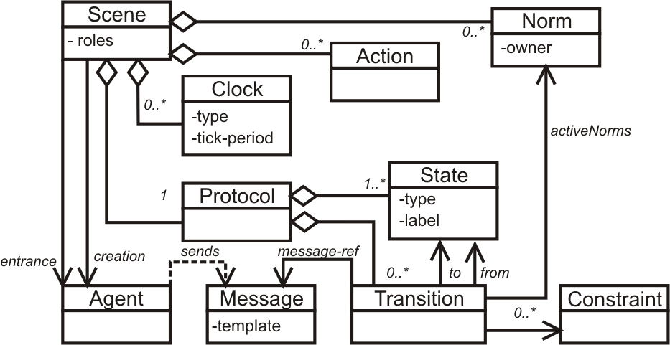
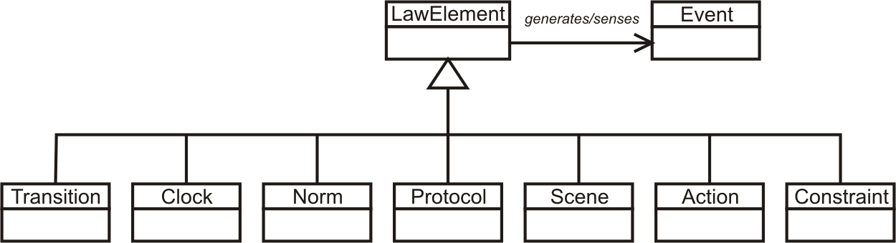
The Computational Conceptual Model
Set of concepts to represent interactions

Slide 6
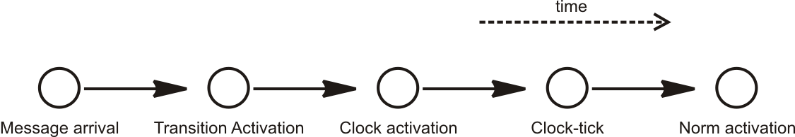
Event model
Relationship among the elements of the conceptual model is mostly based on events
Chain of causes and consequences
Element
generates
Event
perceives
Element

Slide 7
Agent and Message
Agent
  It is defined as any computational entity able to communicate to other entities trough messages.
Message
Performative
Sender
Sender’s role
Addressee
Addressee’s role
Content
request, response, cancel, cfp, agree, propose, any ...
agenteX@Jade.com, any, ...
seller, buyer, any ...
agenteY@Jade.com, any, ...
seller, buyer, any ...
prolog, DAML+OIL, kif ...

Slide 8
XMLaw: messages
<Message id="aMessageId"
template="message(performative,
sender(SenderName,SenderRole),
receiver(ReceiverName,ReceiverRole),
content(SomeContent))."/>

Slide 9


Interaction Protocol
They are interaction alternatives
Representing interactions
What are the services that you offer?
I choose the service of magazines, what are the shops that sell televisions?
FNAC and Carrefour.
Magazines, Movie-theathers and dating!
request
services
reply with
list
inform
selection
and request
shops
reply with
list

Slide 10
Interaction protocols
They are represented using finite non-deterministic automatons.
  Transitions: templates of messages
  States: states of interactions
Example:
  template m1: message(request,
  sender(any, buyer), receiver(any,seller),
  content(listOfProducts)).
buyer
m1
s1
s2
seller

Slide 11
XMLaw: Interaction protocol
Protocol
State
Transition
<Protocol>
<States> ... </States>
<Transitions> ... </Transitions>
</Protocol>
initial
sucess
failure
execution
<State id=“aStateId"
type="success"
label="A state label"/>
<Transition id="anId"
from="anStateId"
to="anotherStateId"
message-ref="aMessageId"/>

Slide 12
Norm
They can be used to capture notions of acquired commitments while interacting.
They say what the permissions, obligations and prohibitions are.
  Examples:
    Every agent playing the buyer role has permission to buy televisions.
    Once an agent makes a deal in an auction, it acquires a obligation to pay for the dealt good. Otherwise, further interactions will be denied.
    Agents playing the role of reviewer in a conference are prohibited of reviewing their own papers.

Slide 13
XMLaw: Norms
<Norms>
<Permission id="aPermissionId">
<Owner>AgentOrRole</Owner>
<Activations>
<Element ref="anId"
event-type="anEventType"/>
</Activations>
<Deactivations>
<Element ref="anotherId"
event-type="anEventType"/>
</Deactivations>
</Permission>
<Obligation
id="anObligationId"> ... </Obligation>
<Prohibition
id="aProhibitionId"> ... </Prohibition>
</Norms>

Slide 14
Transition activations preconditions
Using norms as preconditions
Using message values as preconditions
  Ex.:
    content(television,brand(any),price(Price))
    How can we guarantee, for example, that the value of the variable Price is between 50 and 100?
<Transition id="anId"
from="anStateId"
to="anotherStateId"
message-ref="aMessageId">
<ActiveNorms>
<Norm ref="aNormId"/>
</ActiveNorms>
</Transition>
For example: “You can only
send this message (which is represented by the transition) if you have the permission to do so”.

Slide 15
Constraints
<Transition id=``a-transition-id'' from=``from-state''
to=``to-state'' message-ref=``rfq''>
<Constraints>
<Constraint class=``ajavapackage.RangeValue''>
<Semantic>Amount entre 50 e 100</Semantic>
</Constraint>
</Constraints>
</Transition>
public class RangeValue implements IConstraint{
public boolean constrain(InfoCarrier info) {
String value = (String)info.getValue("Amount");
if (value==null) return true;
int intValue = Integer.parseInt(value);
if (intValue>50 && intValue<100){
return false;
}else{
return true;
}
}
}

Slide 16
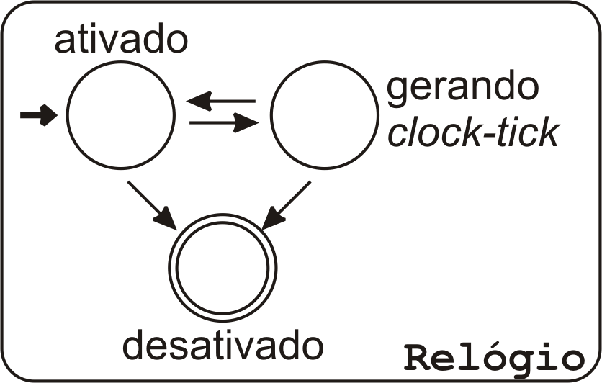
Clock
Motivations to consider the time
  Reply time
  Norms expiration, transitions enabling...
  Fault detection
Clock’s life cycle
Event

Slide 17
XMLaw: Clock
<Clock id="aClockId"
type="regular"
tick-period="1000">
<Activations>
<Element ref="anId"
event-type="anEventType"/>
</Activations>
<Deactivations>
<Element ref="otherId"
event-type="anEventType"/>
</Deactivations>
</Clock>
regular
periodic

Slide 18
Scene
Analogy to a play
  Interactions are specified in pre-defined scripts
Modularize interactions
Composed of:
  1 Interaction protocol
  Set of norms
  Set of clocks
  Actions ( next slides )
Examples
Product
selection
Arrival
Negotiation
Payment
Departure

Slide 19
XMLaw: Scenes
<Scene id="negotiation" time-to-live="infinity">
<Creators>
<Creator agent="any" role="any"/>
</Creators>
<Entrance>
<Participant agent="any" role="anAgentRole">
<StatesRef>
<StateRef ref="aState"/>
</StatesRef>
</Participant>
...
</Entrance>
<Messages>
...
</Messages>
<Protocol>
...
</Protocol>
<Clocks>
...
</Clocks>
<Norms>
...
</Norms>
</Scene>
Defines who can create the scene
Defines who can enter in
the scene and also the point
in which they can enter.

Slide 20

Interaction model
Messages interception
Law enforcement
Redirection
Interception
Law infrastructure

Slide 21

Interaction model
Messages interception
Law enforcement
Redirection
Law infrastructure
Law enforcement

Slide 22
Interaction model
Messages interception
Law enforcement
Redirection
Redirection
Law infrastructure

Slide 23
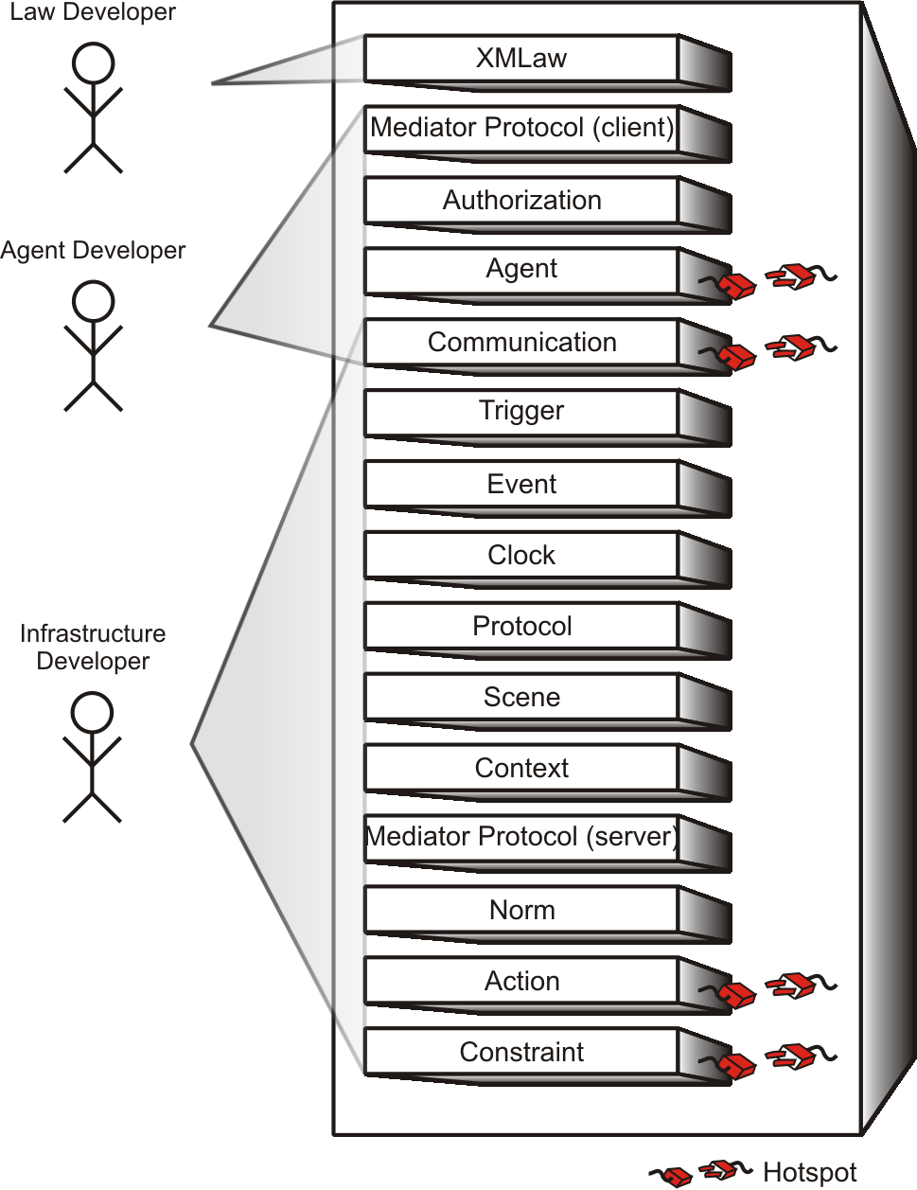
Framework
Law developer
  XMLaw
Agent developer
  API
Infrastructure developer
  Extend framework hotspots

Slide 24
Ping Pong Example – XMLaw
<LawOrganization id="org-ping-pong" name="International Ping Pong Organization">
<Scene id="game" time-to-live="infinity">
<Creators>
<Creator agent="any" role="ping" />
</Creators>
<Entrance>
<Participant agent="any" role="ping" limit="1">
<State ref="s0" />
</Participant>
<Participant agent="any" role="pong" limit="1">
<State ref="s1" />
</Participant>
</Entrance>
<Messages>
<Message id="m1" template="message(request,sender(_,ping),receiver(_,pong),content(ping))." />
<Message id="m2" template="message(inform,sender(_,pong),receiver(_,ping),content(ping-pong))." />
</Messages>
<Protocol>
<States>
<State id="s0" type="initial" label="Initial State" />
<State id="s1" type="execution" label="Ping sent" />
<State id="s2" type="success" label="Pong sent" />
</States>
<Transitions>
<Transition id="t1" from="s0" to="s1" message-ref="m1" />
<Transition id="t2" from="s1" to="s2" message-ref="m2" />
</Transitions>
</Protocol>
</Scene>
</LawOrganization>

