Slide 1
REST & RESTful WEB SERVICES
Prepared By
Purushottam Kumar

Slide 2
In a Nutshell
REST is about resources and how to represent resources in different ways.
REST is about client-server communication.
REST is about how to manipulate resources.
REST offers a simple, interoperable and flexible way of writing web services that can be very different from other techniques.
Comes from Roy Fielding’s Thesis study.

Slide 3
REST is NOT!
A protocol.
A standard.
A replacement for SOAP.

Slide 4
REST
Representational State Transfer
Architectural style (technically not a standard)
Idea: a network of web pages where the client progresses through an application by selecting links
When client traverses link, accesses new resource (i.e., transfers state)
Uses existing standards, e.g., HTTP
REST is an architecture all about the Client-Server communication.

Slide 5
An Architectural Style
REST is the architecture of the Web as it works today and, so it is already used in the web!
It is an software architectural model which is used to describe distributed systems like WWW (World Wide Web).
It has been developed in parallel with HTTP protocol.

Slide 6
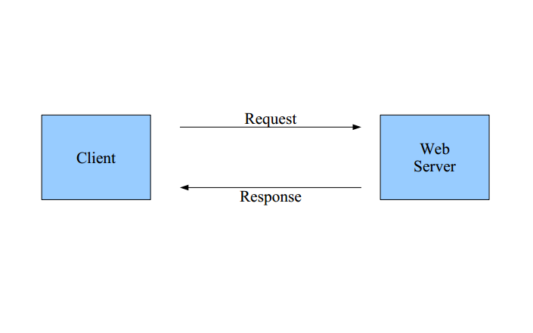
THE WEB

Slide 7
REST
Client requests a specific resource from the server.
The server responds to that request by delivering the requested resource.
Server does not have any information about any client.
So, there is no difference between the two requests of the same client.
A model which the representations of the resources are transferred between the client and the server.
The Web as we know is already in this form!

Slide 8
Resources
Resources are just consistent mappings from an identifier [such as a URL path] to some set of views on server-side state.
Every resource must be uniquely addressable via a URI.
“If one view doesn’t suit your needs, then feel free to create a different resource that provides a better view. ”
“These views need not have anything to do with how the information is stored on the server … They just need to be understandable (and actionable) by the recipient.” Roy T. Fielding

Slide 9
Requests & Responses
REQUEST
GET /news/ HTTP/1.1
Host: example.org
Accept-Encoding: compress, gzip
User-Agent: Python-httplib2
Here is a GET request to «http://example.org/news/»
Method = GET

Slide 10
Requests & Responses
And here is the response…
RESPONSE
HTTP/1.1 200 Ok
Date: Thu, 07 Aug 2008 15:06:24 GMT
Server: Apache
ETag: "85a1b765e8c01dbf872651d7a5"
Content-Type: text/html
Cache-Control: max-age=3600
<!DOCTYPE HTML>
...

Slide 11
Requests & Responses
The request is to a resource identified by a URI (URI = Unified Resource Identifier).
In this case, the resource is «http://example.org/news/»
Resources, or addressability is very important.
Every resource is URL-addressable.
To change system state, simply change a resource.

Slide 12
URI Examples
http://localhost:9999/restapi/books
GET – get all books
POST – add a new book
http://localhost:9999/restapi/books/{id}
GET – get the book whose id is provided
POST – update the book whose id is provided
DELETE – delete the book whose id is provided

Slide 13
REST Characteristics
Resources: Application state and functionality are abstracted into resources.
URI: Every resource is uniquely addressable using URIs.
Uniform Interface: All resources share a uniform
interface for the transfer of state between client and resource, consisting of
Methods: Use only HTTP methods such as GET, PUT, POST, DELETE, HEAD
Representation
Protocol (The constraints and the principles)
Client-Server
Stateless
Cacheable
Layered

Slide 14
HTTP Methods
GET – safe, idempotent, cacheable
PUT - idempotent
POST
DELETE - idempotent
HEAD
OPTIONS

Slide 15
CRUD Operations Mapped to HTTP Methods in RESTful Web Services
OPERATION | HTTP METHOD
Create | POST
Read | GET
Update | PUT or POST
Delete | DELETE

Slide 16
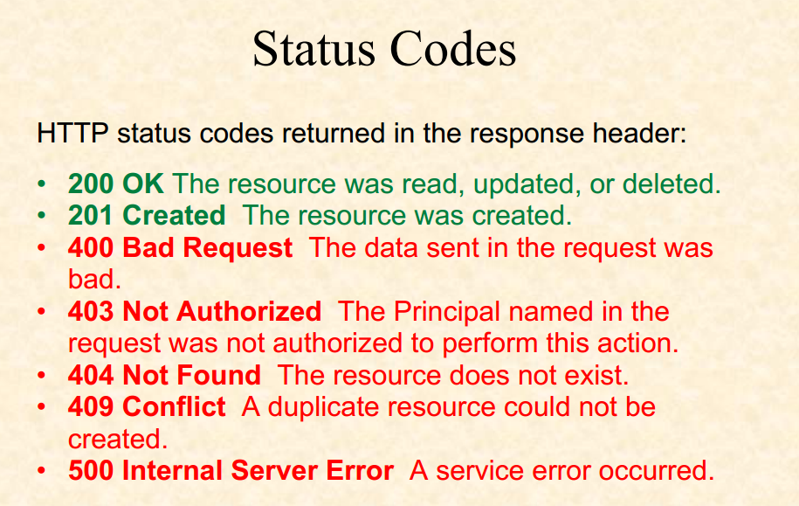

Slide 17
RESTful Web Services
RESTful web services are web services which are REST based.
Stateless & cacheable.
Uses URI & HTTP methods.
Frequently used with SOA projects.
Quiet light, extensible and simple services.
The reason behind the popularity of REST is that the applications we use are browser-based nowadays and top it all, REST is built on HTTP.
Main idea: Providing the communication between client and server over HTTP protocol rather than other complex architectures like SOAP and RPC etc.

Slide 18
RESTful Web Services
You can do anything you already do with normal web services.
No severe restrictions on how the architectural model will be and what properties it will have.
Models like SOAP have severe rules, REST does not.
There are lots of frameworks to develop RESTful web services on platforms like C# and Java, but you can write one easily using some standard libraries.
Inspite of the low bandwidth, large data have been transfered with methods even inflating the size of the data, like XML with SOAP. Why?
Nowadays, the bandwidth is amazingly large, but we still use JSON and it shrinks the size of our data.

Slide 19
RESTful Web Services
Platform independent.
Language independent.
Work on HTTP protocol.
Flexible and easily extendible.
They also have some constraints or principles.
Client-Server
Stateless
Cacheable
Uniform Interface
Layered System
Code on Demand

Slide 20
Client-Server
Seperation of concerns.
Client and server are independent from eachother.
Client doesn’t know anything about the resource which is kept in the server.
Server responds as long as the right requests come in.
Goal: Platform independency and to improve scalability.

Slide 21
Stateless
Each request is independent from other requests.
No client session data or any context stored on the server.
Every request from client stores the required information, so that the server can respond.
If there are needs for session-specific data, it should be held and maintained by the client and transferred to the server with each request as needed.
A service layer which doesn’t have to maintain client sessions is much easier to scale.
Of course there may be cumbersome situations:
The client must load the required information to every request. And this increases the network traffic.
Server might be loaded with heavy work of «validation» of requests.
Scalability

Slide 22
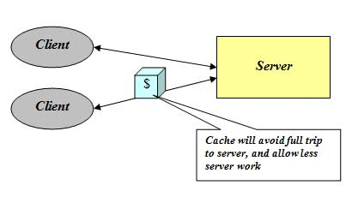
Cacheable
HTTP responses must be cacheable by the clients.
Important for performance.
If a new request for the resources comes within a while, then the cached response will be returned.

Slide 23


Uniform Interface
All resources are accessed with a generic interface (HTTP-based).
This makes it easier to manage the communication.
By the help of a uniform interface, client and server evolve independently from eachother.
E.g. LEGO; eventhough there are different shaped pieces, there are only a few ways to pair up these pieces.

Slide 24
Layered System
There can be many intermediaries between you and the server you are connecting to.
Actually, a client does not know if it is connected to the last server or an intermediary server.
Intermediaries may improve performance by caching and message passing.
Intermediary servers can increase scalability by load-balancing and can force clients to form some sort of security policies.
This structure can be used when encapsulation is needed.

Slide 25
Code on Demand
Servers can send some kind of executable scripts to the client-side in order to increase or change the functionality on the client side.
This may cause low visibility, so it is the only optional constraint.
EXAMPLE
...
<head>
<script src="utility.js"
type="text/javascript">
</script>
...

Slide 26
more
If a service does not include all constraints out of «Code on Demand», it is not a RESTful web service.
The most epic constraint is «Stateless».

Slide 27
What REST actually aims for?
Scalability
Simplicity
Modifiability
Useability
Portability
Reliability

Slide 28
Benefits
Network Performance
Efficiency
Scalability
User Perceived Performance
Other Benefits
Simplicity
Evolvability
Reuseability
Visibility
Extensibility
Configuration
Customizability

Slide 29
Benefits ctd.
HTTP is efficient because of all those caches, your request may not have to reach all the way back to the origin server.
Scalability comes from many areas. The use of layers allows you to distribute traffic among a large set of origin servers based on method, URI or content-type, or any other visible control data or meta-data in the request headers.
Caching also helps scalability as it reduces the actual number of requests that hit the origin server.
Statelessness allows requests to be routed through different gateways and proxies, thus avoiding introducing bottlenecks, allowing more intermediaries to be added as needed. [Scalability]

Slide 30
Will REST Replace Other Technologies ?
There is actually an untold story that both technologies can be mixed and matched. REST is very easy to understand and is extremely approachable, but does lack standards and is considered an architectural approach. In comparison, SOAP is an industry standard with a well-defined protocol and a set of well-established rules to be implemented, and it has been used in systems both big and small.

Slide 31
REST vs SOAP
SOAP is a XML-based message protocol, while REST is an architectural style.
SOAP uses WSDL for communication between consumer and provider, whereas REST just uses XML or JSON to send and receive data.
SOAP invokes services by calling RPC method, REST just simply calls services via URL path.
SOAP doesn't return human readable result, whilst REST result is readable with is just plain XML or JSON.
SOAP is not just over HTTP, it also uses other protocols such as SMTP, FTP, etc, REST is over only HTTP.

Slide 32
SOAP uses WSDL for communication between consumer and provider, whereas REST just uses XML or JSON to send and receive data.
WSDL defines contract between client and service and is static by its nature. In case of REST contract is somewhat complicated and is defined by HTTP, URI, Media Formats and Application Specific Coordination Protocol. It's highly dynamic unlike WSDL.

Slide 33
Performance is broad topic!-1
If you mean the load of the server, REST has a bit better performance because it bears minimal overhead on top of HTTP. Usually SOAP brings with it a stack of different (generated) handlers and parsers. Anyway, the performance difference itself is not that big, but RESTful service is more easy to scale up since you don't have any server side sessions.
If you mean the performance of the network (i.e. bandwidth), REST has much better performance. Basically, it's just HTTP. No overhead. So, if your service runs on top of HTTP anyway, you can't get much leaner than REST. Furthermore if you encode your representations in JSON (as opposed to XML), you'll save many more bytes.
In short, I would say 'yes', you'll be more performant with REST. Also, it (in my opinion) will make your interface easier to consume for your clients. So, not only your server becomes leaner but the client too.

Slide 34
Performance is broad topic!-2 *However, couple of things to consider!
RESTful interfaces tend to be a bit more "chatty", so depending on your domain and how you design your resources, you may end up doing more HTTP requests.
SOAP has a very wide tool support. For example, consultants love it because they can use tools to define the interface and generate the WSDL file and developers love it because they can use another set of tools to generate all the networking code from that WSDL file. Moreover, XML as representation has schemas and validators, which in some cases may be a key issue. (JSON and REST do have similar stuff coming but the tool support is far behind)

Slide 35
Complements or Competitors ?
There is some competition between proponents of each approach.
Yet both have value.
The challenge is to determine when to use each one !

Slide 36
So the areas that REST works really well are:
Limited bandwidth and resources; remember the return structure is really in any format (developer defined). Plus, any browser can be used because the REST approach uses the standard GET, PUT, POST, and DELETE verbs. Again, remember that REST can also use the XMLHttpRequest object that most modern browsers support today, which adds an extra bonus of AJAX.
Totally stateless operations; if an operation needs to be continued, then REST is not the best approach and SOAP may fit it better. However, if you need stateless CRUD (Create, Read, Update, and Delete) operations, then REST is it.
Caching situations; if the information can be cached because of the totally stateless operation of the REST approach, this is perfect.

Slide 37
So if you have the following then SOAP is a great solution:
Asynchronous processing and invocation; if your application needs a guaranteed level of reliability and security then SOAP 1.2 offers additional standards to ensure this type of operation. Things like WSRM – WS-Reliable Messaging.
Formal contracts; if both sides (provider and consumer) have to agree on the exchange format then SOAP 1.2 gives the rigid specifications for this type of interaction.
Stateful operations; if the application needs contextual information and conversational state management then SOAP 1.2 has the additional specification in the WS* structure to support those things (Security, Transactions, Coordination, etc). Comparatively, the REST approach would make the developers build this custom plumbing.

Slide 38
THANK YOU!

