Slide 1
An Introduction To Hardware Hacking, UART and Serial Interfaces
By r0guer4t and [mbm]
Philly Mesh Week
August 20th, 2022
Iffy Books
These are opinions and statements of ourselves and not our current nor potential employers.

Slide 2
Whoms’t
[mbm] – Of exploiteers fame, a personal role model and mentor
R0guer4t – The cryptid of trashpanda village
Exploitee.rs – Was GTVhacker, now they hack all the things. A good gang of yokels

Slide 3
Whats’t
“The single biggest problem in communication is the illusion that it has taken place.” - George Bernard Shaw
Serial communication – Transmitting data bit by bit over a single wire. Two wires enable us to talk back and forth with, for example, embedded hardware.
UART – Universal Asynchronous Receiver/Transmitter

Slide 4
Withs’t
Baud rate – The rate at which information is transferred in a communication channel. 115200 baud can also be represented as 11.5200 kilobytes per second when talking about UART in the most common conditions.
Some devices change baud between bootloader and operating system.
Logic level – One of the finite number of states that a digital signal can inhabit. Usually represented by voltages. There are 3 logic levels seen in embedded systems, 1.8v, 3.3v and 5v.

Slide 5
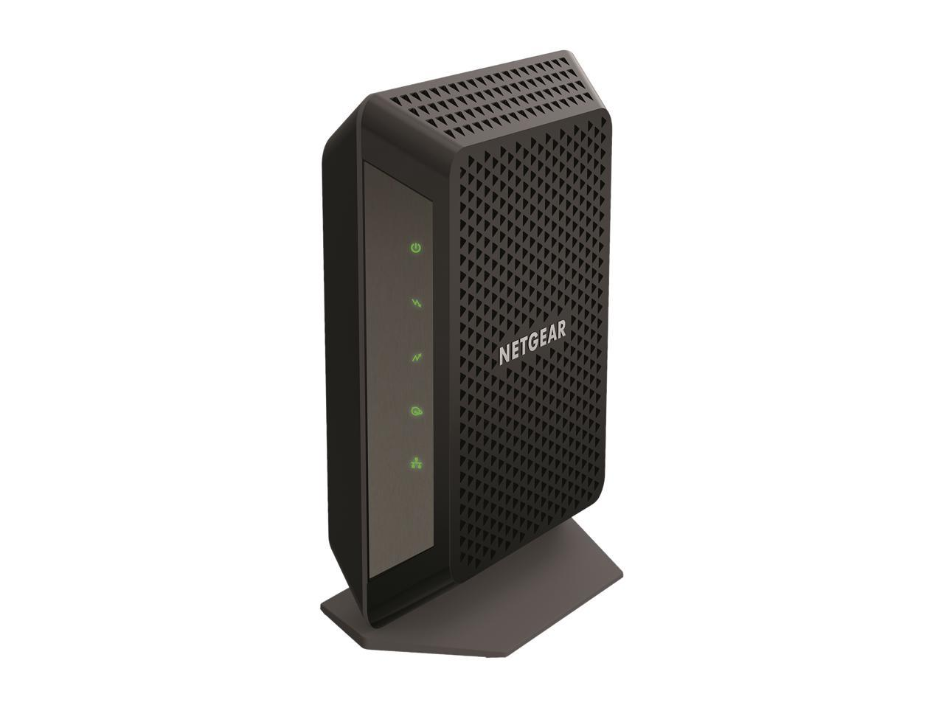
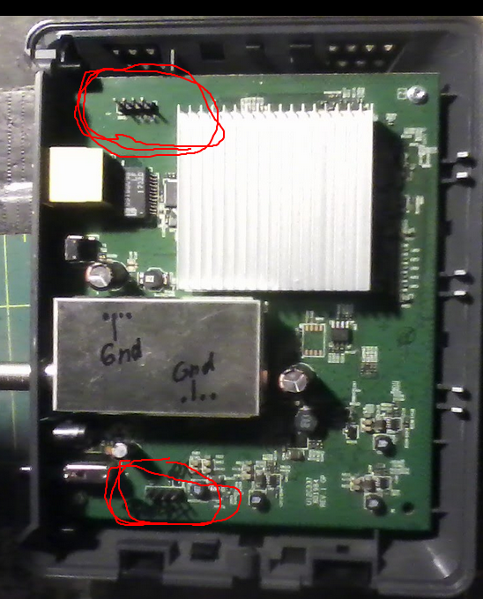
Wheres’t
The netgear CM700 modem
Opening the device, you find
2 different serial ports.

Slide 6
Where to start?
Finding ground
Using a multimeter that can read continuity, you can use the RF shielding or barrel connector and test each pin.
Finding the transmit contact of the port
An analog multimeters needle will bounce when the voltage of the transmit pin fluctuates.
Connecting to a computer

Slide 7
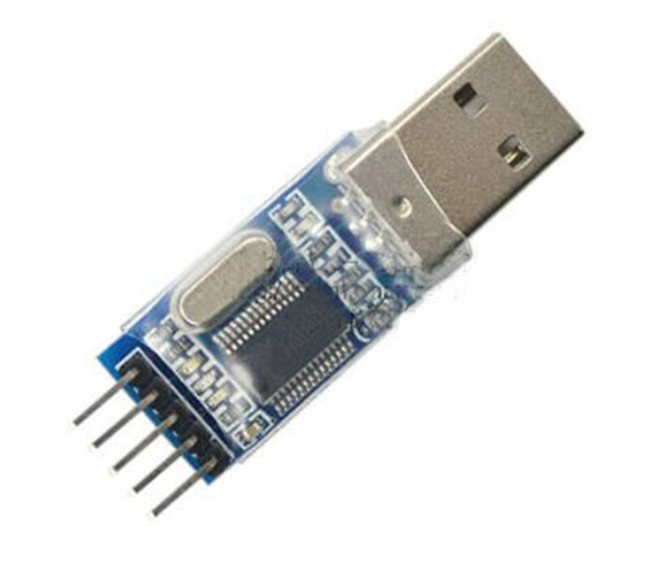
USB to Serial
Universal Serial Bus is a protocol that eliminates noise through using a comparison signal while UART serial I/O does not.
There is a dongle that is used that converts USB signal to UART signal and vise versa

Slide 8
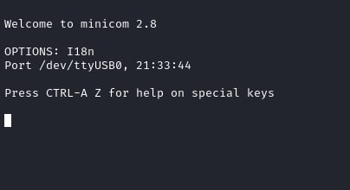
Interfacing with a computer
The USB to serial dongle creates a device node in GNU/Linux that you can display in minicom.

Slide 9
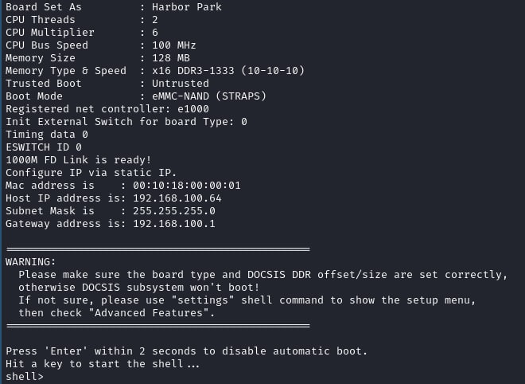
Interfacing with a computer
Once the ground and transmit pins have been found, connect the ground and receive pin of the dongle to the device with dupont leads and powercycle the device.

Slide 10
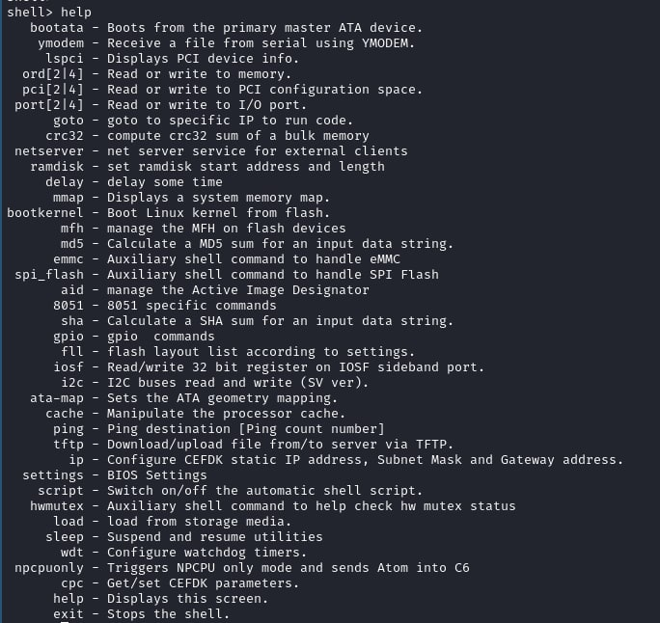
Transmitting to the device
Once you can receive data through the UART, now its basic process of elimination to transmit data to the UART.

Slide 11
How to make the box listen
Sometimes manufacturers make it fun and don’t allow commands to be issued by default
Ol’ reliable is making the flash have such a catastrophic error that it drops back to the bootloader shell
Other tricks involve interrupting the boot sequence with ctrl+c, a specific keypress or keycombo and interacting with the bootloaders shell.

Slide 12

Making the device do your bidding
Goal: get a root shell with persistence.
The jawn runs the u-boot bootloader
Das U-Boot is an open-source, primary boot loader used in embedded devices to package the instructions to boot the device's operating system kernel. It is available for a number of computer architectures, including 68k, ARM, Blackfin, MicroBlaze, MIPS, Nios, SuperH, PPC, RISC-V and x86.
Also it has a command shell.

Slide 13
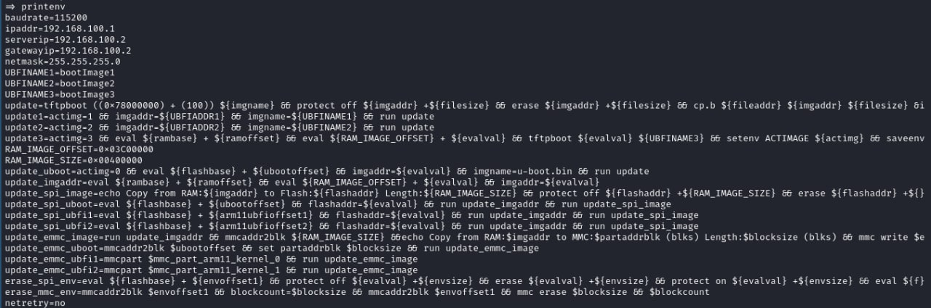
Making it do your bidding cont.
U-boot shell allows us to change environment variables and boot parameters
There are several variables we can change to /bin/sh
At this point after rebooting, we get this

Slide 14
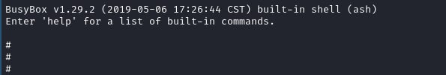
Really getting to the root of the problem
Thats pretty neat. The thing runs busybox.
Whats busybox you might ask?
Its a package of standard unix utilities bundled into one script.
It also has this handy shell.

Slide 15
Well, what now?
In our example, we are using a cable modem which usually have 2 different UARTs for the 2 different aspects of a cable modem, DOCSIS and ethernet packet routing.
In terms of impact, you probably wont be getting free internet with this example.
There are other magic boxes that do this kinda thing with higher stakes though.

Slide 16
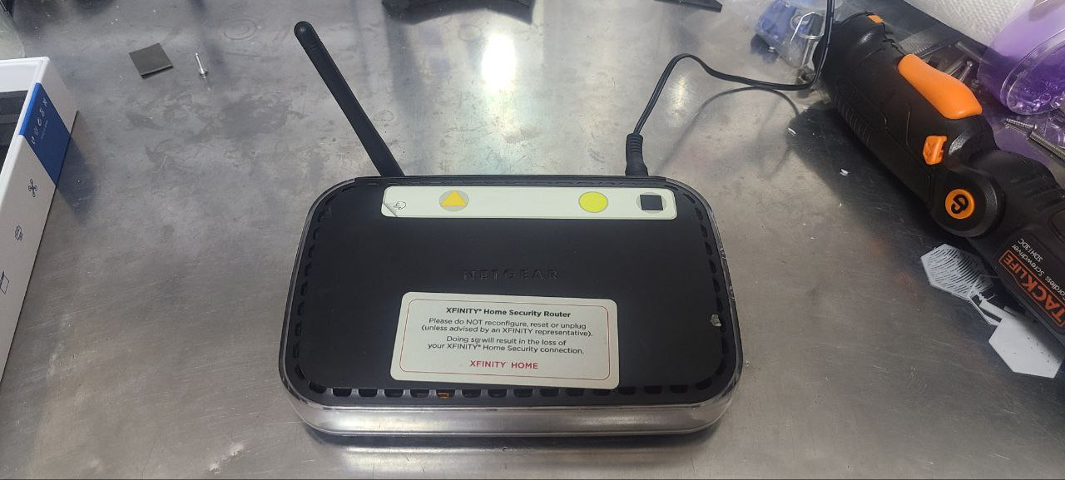
Raising the stakes
This here is the router of a home security system
It talks to various door sensors and ip cameras

Slide 17
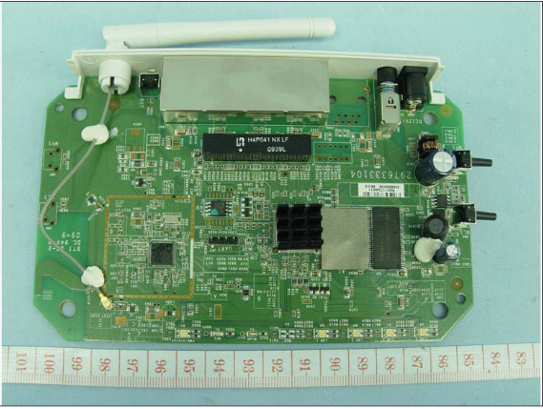
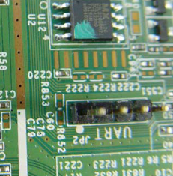
The thing also talks UART
Thats neat
They even labeled it for us

Slide 18

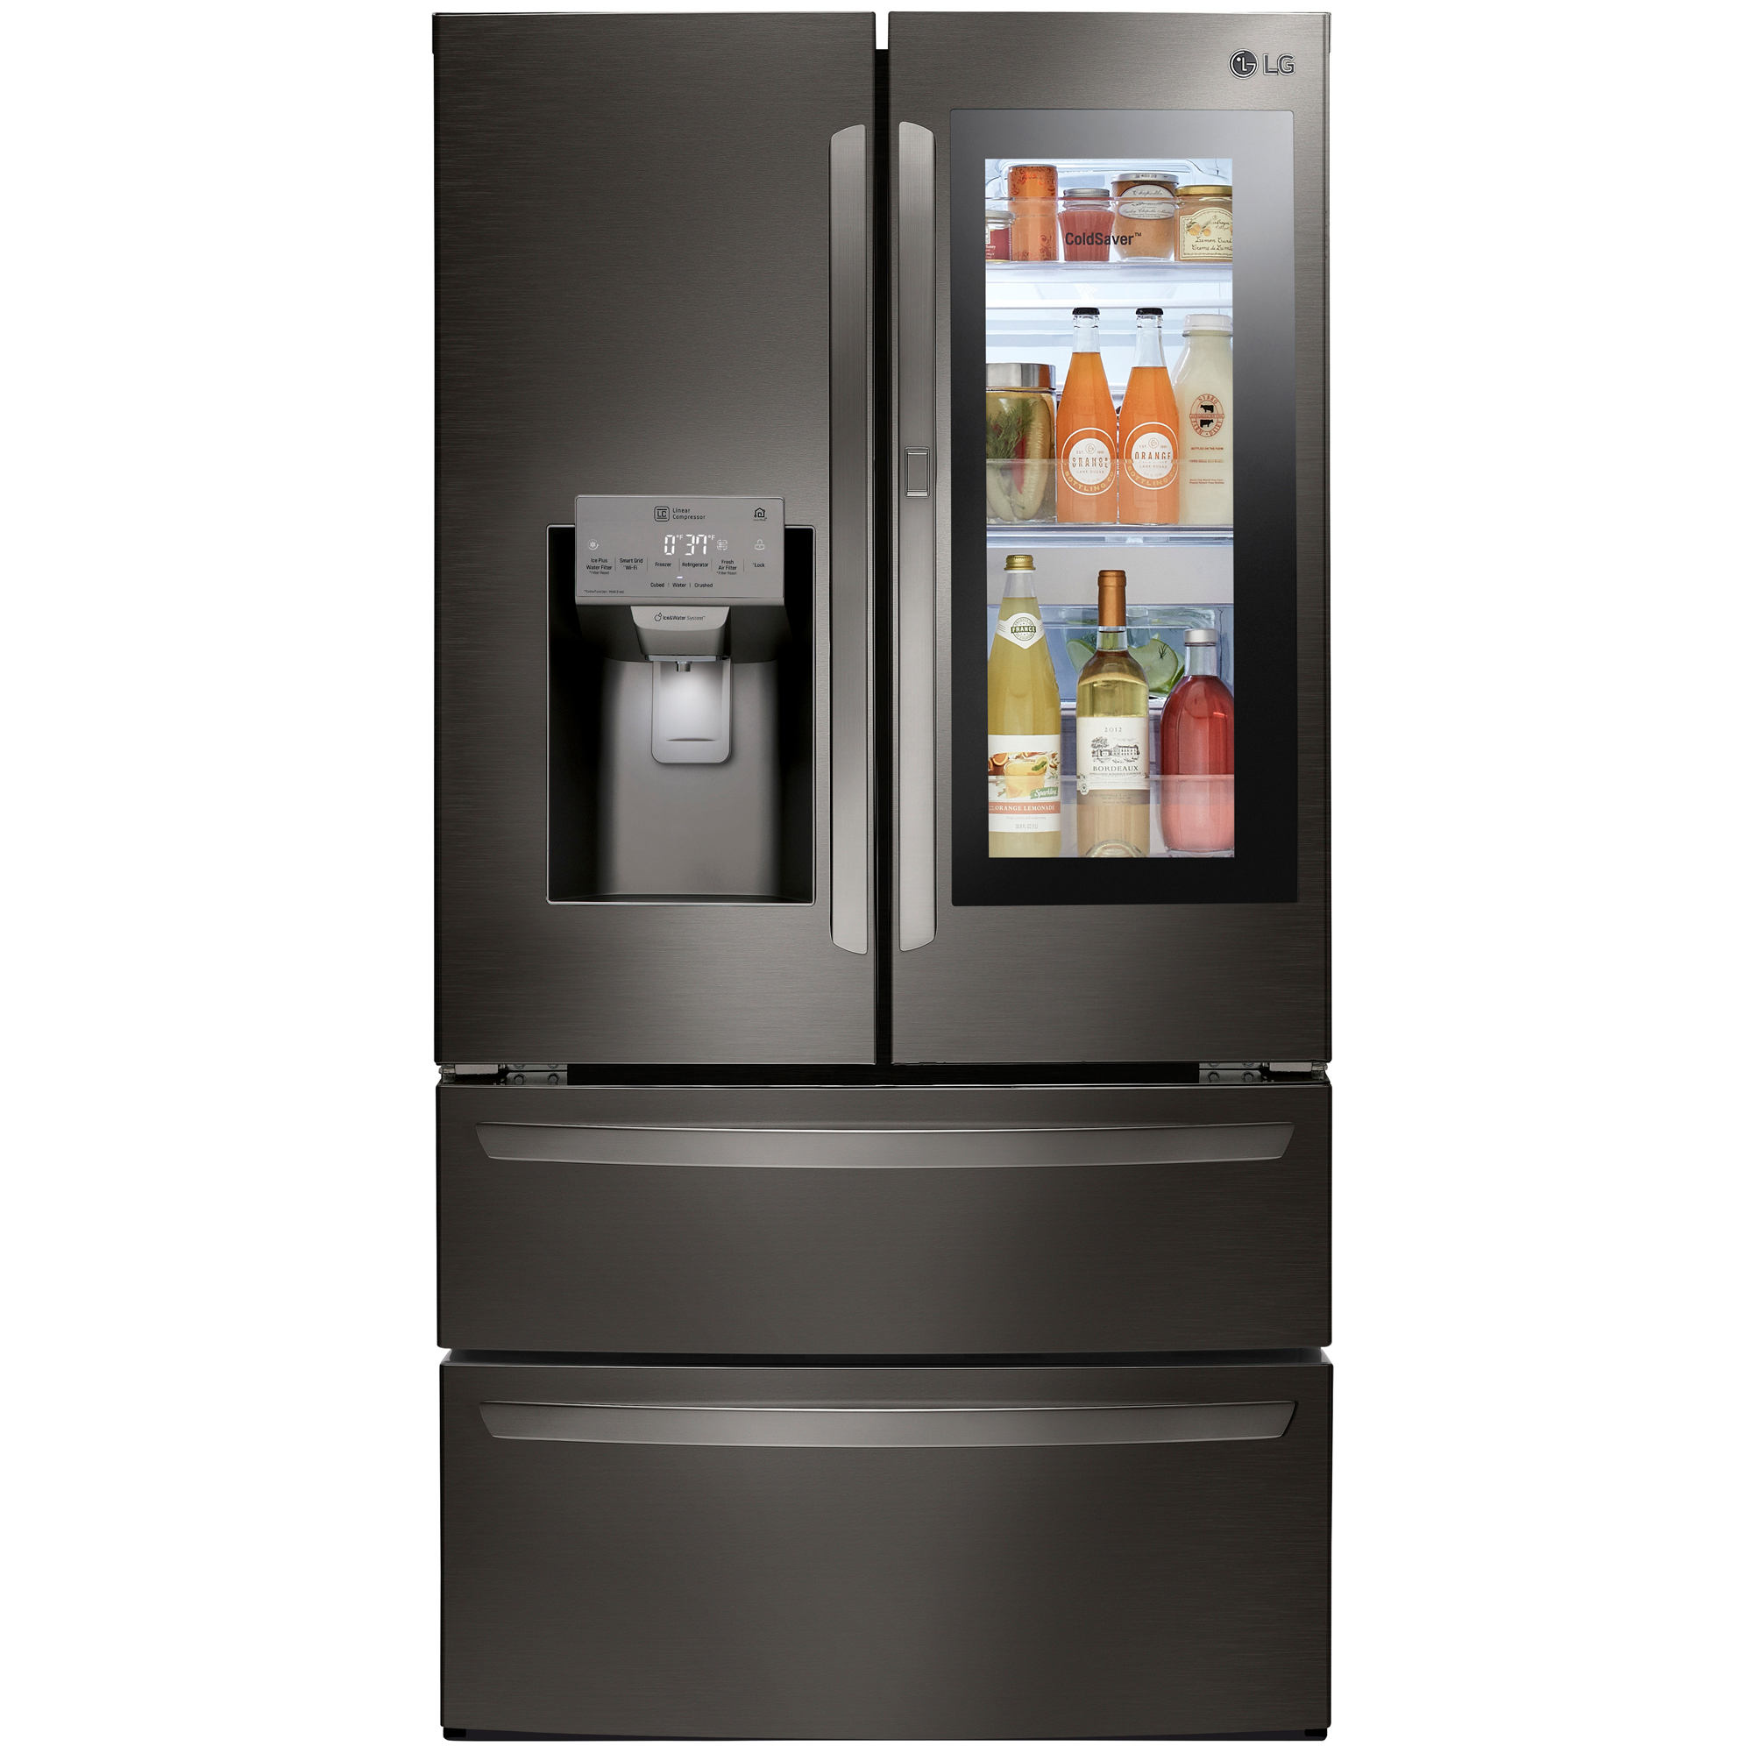

There you have it!
Now the device is yours to do what you will.
There are different kinds of shells but all have help commands
If they don’t, google it
Have fun!
Here are some pictures of other devices u can hack

Slide 19
endif
http://Exploitee.rs
Fcc.io
https://discord.com/invite/uJ77fQT
@nomadpather
@mbmwashere
Philly2600.net
Iffybooks.net

