Slide 1
Rohit Kumar Naicker

Slide 2
Why Engineering
1. developing, designing or reverse engineering.
2. adaptable and a good conversationalist
3. Professionally 9 years of diverse experience in Full Stack Development.
4. Ever evolving Technology - reading feeds, blogs, HackerNews etc..
5. TimePass
Coding Competition
Topcoder Development Challenges
And to reenergize my self some console Games.

Slide 3
Acheivments

Slide 4
Toyota Automations
Why
Issue Resolving Time Reduced from Days to seconds
Man power reduced
Effective Management
Happy Client
Role
Identified and Volunteered
Understood Current Model and Defined Scope

Slide 5
Sena.com
Role
Why
2 Member Team
Managed everything
Development and Deployment
PHP
Wordpress, Themes
Plugins Development
Client Interaction

Slide 6
SAT Demo App

Slide 7
Framework
Dropwizard - Rest API
AngularJS – Web
Docker – Deployment and Managing
MySQL
Hibernate - ORM
Python smtpd process – Dummy SMTP

Slide 8
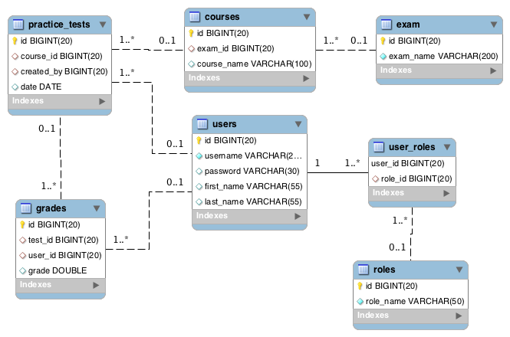
DB Model

Slide 9
Docker Container Images
Docker Daemon
Rest API
Sat - Web
MySQL
smtpd
Jetty: 8080
http-server: 8000
3306
25

Slide 10
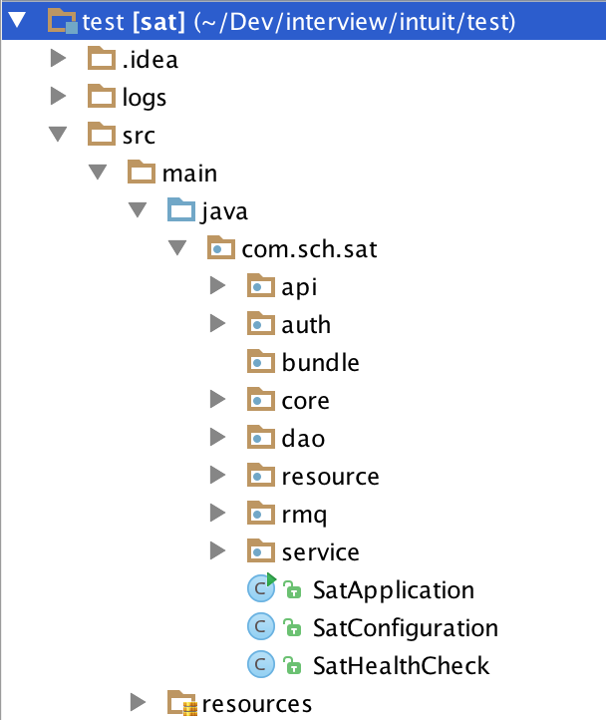
API Structure

Slide 11
API Structure
POST /api/register (com.sch.sat.resource.RegistrationResource)
For new registration
POST /api/authenticate (com.sch.sat.resource.LoginResource)
To login and validate
GET /api/courses (com.sch.sat.resource.CourseResource)
Get Available Courses
GET /api/exams (com.sch.sat.resource.ExamResource)
Get Available Exams
GET /api/grades (com.sch.sat.resource.GradesResource)
POST /api/grades (com.sch.sat.resource.GradesResource)
GET /api/grades/{id} (com.sch.sat.resource.GradesResource)
Grades get and update. TEACHER authorization required

Slide 12
API Structure
GET /api/schedule (com.sch.sat.resource.ScheduleTestResource)
POST /api/schedule (com.sch.sat.resource.ScheduleTestResource)
GET /api/schedule/{id} (com.sch.sat.resource.ScheduleTestResource)
Get available Practice tests
GET /api/users (com.sch.sat.resource.UserResource)
GET /api/users/{username} (com.sch.sat.resource.UserResource)
User Information

Slide 13
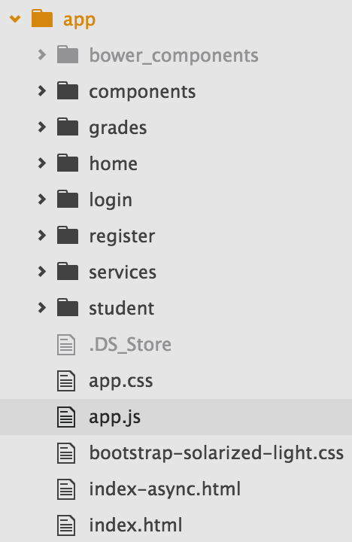
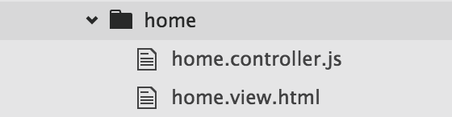
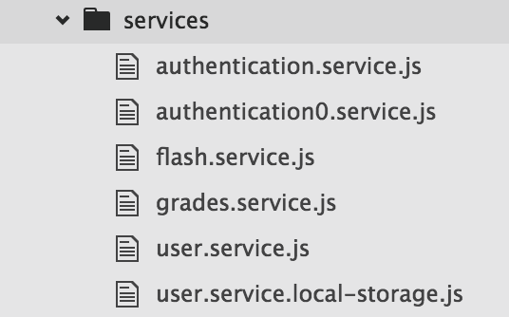
Web Structure
Controllers and Views
Grades, home, login, register, student
Services
API services

Slide 14
How it Works
Basic Authentication
Rest API CORS enabled
Redirected based on the role
Teacher schedule test and enter scores
Students receive mail
AngularJS seperated base on MVVM patern

Slide 15
I wish I could have done
Make this presentation with Deck.js and D3.js
Validations

Slide 16
Thank You

