Slide 1


Bank of Baroda Hackathon - 2022
Technology Partner
^{Your Team Name : Coder Heist}
Your team bio : Coder Heist
Team members Rohith
Praveen Raj
Prajith kumar
Navaneethan
Date : 15/09/2022

Slide 2
Problem Statement?
Why did you decide to solve this Problem statement?
By implementing 3D avatars can enable the user to sense of trust by making communication with the customers direct and easy.
Their use on various platforms is significant, as they convey a sense of seriousness. The use of a digital human that smoothly communicates the values of the company in a specific way, will convert these visitors into faithful customers.
Most people who converse with a virtual avatar smile at some point, which creates a dopamine release, even when they know the interaction is not real and that speaks volumes!

Slide 3
User Segment & Pain Points
Which user /advertiser segment would be early adopter of your product & why?
Cortana in Microsoft help’s me to create account without any trouble
Like talking tom it help to creates a dopamine release, even when they know the interaction is not real and that speaks volumes

Slide 4
Pre-Requisite
What are the alternatives/competitive products for the problem you are solving?
According to Digital Banking Report , the abandonment rate for Digital Account Opening stands at 19%.
This rate increases exponentially as the time required to complete the application increases.
Ideally, the online account opening process should take less than ten minutes with help of very little documentation and via better user experience.
By implementing virtual avatar it makes the user while opening the bank account instant of spend their time in bank..

Slide 5
Azure tools or resources
Azure tools or resources which are likely to be used by you for the prototype, if your idea gets selected
Azure developer portal
Azure datalake
Azure DevOps Server
Azure AI Services

Slide 6
Any Supporting Functional Documents
Present your solution, talk about methodology, architecture & scalability
It Helps to Save Time on Typing or filling form in Bank By implementing the voice assistant in the app
Make Simple Transactions By Virtual voice assistant
It supports multiple Languages
In current stage it running on all Android Devices In future we going to test it on all major
Enviroiments ie (IOS,WINDOES,LINUX)

Slide 7
Key Differentiators & Adoption Plan
How is your solution better than alternatives and how do you plan to build adoption?
1. Create an unforgettable first-time user experience
2. User friendly
3. Easily understand the user requirements and solve their problems while
Opening a account with Voice Interaction..

Slide 8
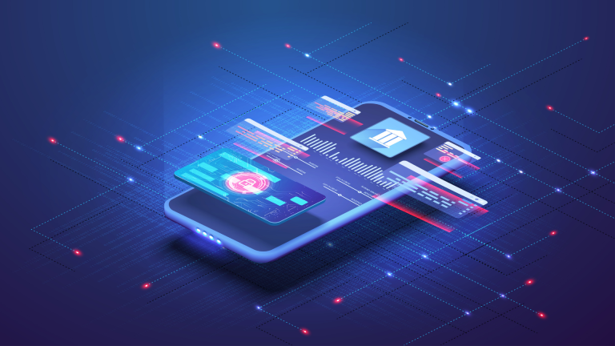
GitHub Repository Link & supporting diagrams, screenshots, if any
How far it can go?
Please refer the above github repository for more details
https://github.com/r0h1th0x11/bob-hackathon-submission-template

Slide 9
Thank You
Team member names
ROHITH P
PRAJITH KUMAR S.R
PRAVEEN RAJ R
NAVANEETHAN G

