Slide 1

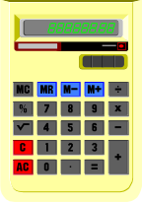
Clarifier Calculations
Prepared By
Michigan Department of Environmental Quality
Operator Training and Certification Unit

Slide 2
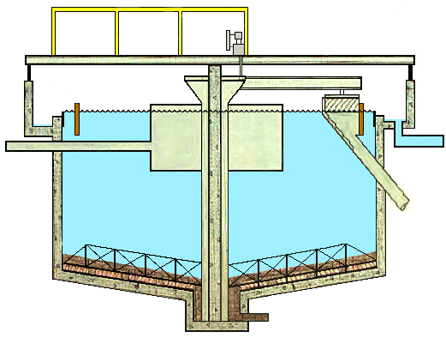
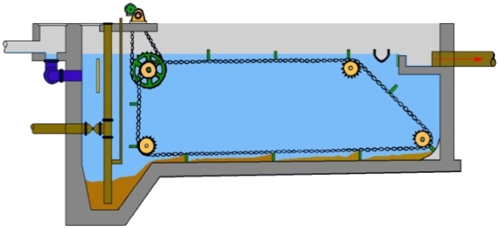
Clarifier Calculations
Hydraulic Loading
Solids Loading

Slide 3
Clarifier Loading Calculations
Detention Time (DT)
Tank Volume, MG X 24
Flow into Tank, MGD
=
Flow, gallons/day
Surface Overflow Rate (SOR)
=
Surface Area, ft²
Weir Overflow Rate (WOR)
=
Flow, gallons/day
Length of Weir, ft
Solids, lbs/day
Surface Area, ft²
Solids Loading
=

Slide 4
But First

Slide 5
Area
and
Volume
Calculations

Slide 6
Surface Area Calculations
Rectangles
Surface Area, ft² = Length, ft X Width, ft
Example 1:
If a tank is 10 ft long and 5 ft wide,
what is the surface area?
SA, ft² = 10 ft X 5 ft = 50 ft²

Slide 7
Surface Area Calculations
Rectangles
Surface Area, ft² = Length, ft X Width, ft
Example 2:
If a tank is 10 ft 6 inches long
and 5 ft 9 inches wide,
what is the surface area in sq. ft.?
NOT
SA, ft² = 10.6 ft X 5.9 ft

Slide 8
Converting Inches to Feet
6 inches
12 in/ft
6 inches =
= 0.5 ft
So:
10 ft 6 inches = 10.5 ft
9 inches
12 in/ft
9 inches =
= 0.75 ft
So:
5 ft 9 inches = 5.75 ft

Slide 9
Surface Area Calculations
Rectangles
Surface Area, ft² = Length, ft X Width, ft
Example 2:
If a tank is 10 ft 6 inches long
and 5 ft 9 inches wide,
what is the surface area in sq. ft.?
SA, ft² = 10.5 ft X 5.75 ft = 60.4 ft²

Slide 10
Surface Area Calculations
Rectangles
Surface Area, ft² = Length, ft X Width, ft
Work Calculations on Separate Paper
Answers Given on Next Slides
Practice 1:
If a clarifier is 25 ft long and 9 ft wide,
what is the surface area in sq. ft.?
Practice 2:
If a clarifier is 22 ft 3 inches long
and 7 ft 7 inches wide,
what is the surface area in sq. ft.?

Slide 11
Surface Area Calculations
Rectangles
Surface Area, ft² = Length, ft X Width, ft
Practice 1:
If a clarifier is 25 ft long and 9 ft wide,
what is the surface area in sq. ft.?
SA, ft² = 25 ft X 9 ft = 225 ft²

Slide 12
Surface Area Calculations
Rectangles
Surface Area, ft² = Length, ft X Width, ft
Practice 2:
If a clarifier is 22 ft 3 inches long
and 7 ft 7 inches wide,
what is the surface area in sq. ft.?

Slide 13
Converting Inches to Feet
3 inches
12 in/ft
3 inches =
= 0.25 ft
So:
22 ft 6 inches = 22.25 ft
7 inches
12 in/ft
7 inches =
= 0.58 ft
So:
7 ft 7 inches = 7.58 ft

Slide 14
Surface Area Calculations
Rectangles
Surface Area, ft² = Length, ft X Width, ft
Practice 2:
If a clarifier is 22 ft 3 inches long
and 7 ft 7 inches wide,
what is the surface area in sq. ft.?
SA, ft² = 22.25 ft X 7.58 ft = 60.4 ft²

Slide 15
Surface Area Calculations
Circles
Diameter
Diameter:
Radius
The distance across a circle,
going through the center.
Radius:
The distance from the center a circle
to the perimeter.
Radius =
Diameter
2

Slide 16
Surface Area Calculations
Circles
Circumference
Diameter
Circumference =
distance around circle
Radius

Slide 17

Surface Area Calculations
Circles
Diameter
pie
Radius

Slide 18
Surface Area Calculations
Circles
Diameter
pi
= π
Radius
Circumference
Diameter
=
= 3.14 for any circle

Slide 19
Surface Area Calculations
Circles
Diameter
Radius
Surface Area = π r²
= 3.14 X radius X radius

Slide 20
Surface Area Calculations
Circles
Surface Area = π r²
= 3.14 X r²
OR
A = 3.14 X (D/2)²
=
X D²
= 3.14 X D²
4
3.14
2²
OR
A =
3.14
4
X D²
= 0.785 X D²
Any on the Three Formulas Can Be Used

Slide 21
Surface Area Calculations
Circles
Surface Area = π r²
Diameter
Radius
Example 1:
If a tank has a radius of 15 feet,
what is the surface area?
S A = π r²
= 3.14 X 15 ft. X 15 ft.
= 707 ft²

Slide 22
Surface Area Calculations
Circles
Surface Area = π r²
Diameter
Radius
Example 2:
If a tank has a diameter of 25 feet,
what is the surface area?
S A = π r²
= 3.14 X 12.5 ft. X 12.5 ft.
= 491 ft²

Slide 23
Surface Area Calculations
Circles
Surface Area = π r²
Diameter
Radius
Work Calculations on Separate Paper
Answers Given on Next Slides
Practice 1:
If a tank has a diameter of 50.5 feet,
what is the surface area?
Practice 2:
If a tank has a diameter of
50 feet 7 inches, what is the surface area?

Slide 24
Surface Area Calculations
Circles
Surface Area = π r²
Diameter
Radius
Practice 1:
If a tank has a diameter of 50.5 feet,
what is the surface area?
S A = π r²
= 3.14 X 25.25 ft. X 25.25 ft.
= 2002 ft²

Slide 25
Surface Area Calculations
Circles
Surface Area = π r²
Diameter
Radius
Practice 2:
If a tank has a diameter of
50 feet 7 inches, what is the surface area?
7 inches
12 in/ft
7 inches =
= 0.58 ft
50 feet 8 inches = 50.58 ft
Radius = 50.58 ft ÷ 2 = 25.29 ft

Slide 26
Surface Area Calculations
Circles
Surface Area = π r²
Diameter
Radius
Practice 2:
If a tank has a diameter of
50 feet 7 inches, what is the surface area?
S A = π r²
= 3.14 X 25.29 ft. X 25.29 ft.
= 2008 ft²

Slide 27
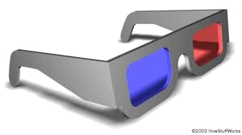

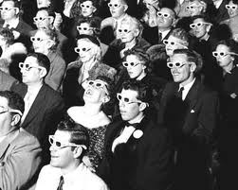
Volume Calculations
Volume – Three D

Slide 28
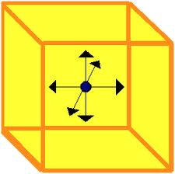
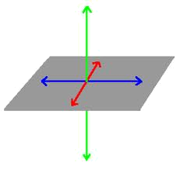
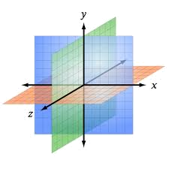
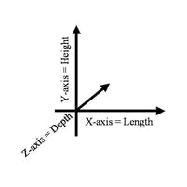
Volume Calculations
Volume – Three Dimensions
Depth
Width
Length

Slide 29

Volume Calculations
Rectangular Tanks
Volume = Length X Width X Height (or Depth)
Example 1:
If a tank is 10 feet long, 5 feet wide, and 5 feet
deep, what is the volume in cubic feet?
Vol. = 10 ft X 5 ft X 5 ft = 250 ft³

Slide 30
Volume Calculations
Rectangular Tanks
Volume = Length X Width X Height (or Depth)
Example 2:
If a tank is 20 ft. long, 7 ft. wide, and 5.5 ft.
deep, what is the volume in cubic feet?
Vol. = 20 ft X 7 ft X 5.5 ft = 770 ft³

Slide 31
Volume Calculations
Rectangular Tanks
Volume = Length X Width X Height (or Depth)
Example 3:
If a tank is 25 ft. long, 9 ft. 3 inches wide, and 7.5 ft. deep, what is the volume in gallons?
Vol. = 25 ft X 9.25 ft X 7.5 ft = 1734 ft³

Slide 32
Volume Calculations
Rectangular Tanks
Volume = Length X Width X Height (or Depth)
Example 3:
If a tank is 25 ft. long, 9 ft. 3 inches wide, and 7.5 ft. deep, what is the volume in gallons?
There are 7.48 gallons in one cubic foot
OR 7.48 gal/ft³

Slide 33
Volume Calculations
Rectangular Tanks
Volume = Length X Width X Height (or Depth)
Example 3:
If a tank is 25 ft. long, 9 ft. 3 inches wide, and 7.5 ft. deep, what is the volume in gallons?
Vol. = 25 ft X 9.25 ft X 7.5 ft = 1734 ft³
1734 ft³
X
7.48 gal/ft³
= 12,970 gallons

Slide 34
Volume Calculations
Rectangular Tanks
Work Calculations on Separate Paper
Answers Given on Next Slides
Practice 1:
If a tank is 21 feet long, 9 feet wide, and 7 feet deep, what is the volume in cubic feet?
Practice 2:
If a tank is 22 ft. long, 9 ft. wide, and 7.5 ft. deep, what is the volume in cubic feet?
Practice 3:
If a tank is 35 ft. long, 12 ft. 3 inches wide, and 9.5 ft. deep, what is the volume in gallons?

Slide 35
Volume Calculations
Rectangular Tanks
Volume = Length X Width X Height (or Depth)
Practice 1:
If a tank is 21 feet long, 9 feet wide, and 7 feet
deep, what is the volume in cubic feet?
Vol. = 21 ft X 9 ft X 7 ft = 1323 ft³

Slide 36
Volume Calculations
Rectangular Tanks
Volume = Length X Width X Height (or Depth)
Practice 2:
If a tank is 22 ft. long, 9 ft. wide, and 7.5 ft.
deep, what is the volume in cubic feet?
Vol. = 22 ft X 9 ft X 7.5 ft = 1485 ft³

Slide 37
Volume Calculations
Rectangular Tanks
Volume = Length X Width X Height (or Depth)
Practice 3:
If a tank is 35 ft. long, 12 ft. 3 inches wide, and 9.5 ft. deep, what is the volume in gallons?
Vol. = 35 ft X 12.25 ft X 9.5 ft = 4073 ft³

Slide 38
Volume Calculations
Rectangular Tanks
Volume = Length X Width X Height (or Depth)
Practice 3:
If a tank is 35 ft. long, 12 ft. 3 inches wide, and 9.5 ft. deep, what is the volume in gallons?
There are 7.48 gallons in one cubic foot
OR 7.48 gal/ft³

Slide 39
Volume Calculations
Rectangular Tanks
Volume = Length X Width X Height (or Depth)
Practice 3:
If a tank is 35 ft. long, 12 ft. 3 inches wide, and 9.5 ft. deep, what is the volume in gallons?
Vol. = 35 ft X 12.25 ft X 9.5 ft = 4073 ft³
4073 ft³
X
7.48 gal/ft³
= 30,466 gallons

Slide 40

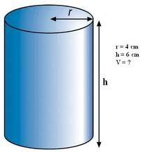
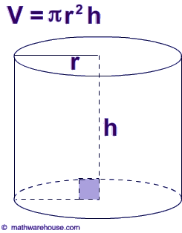
Volume Calculations
Round (Cylinder) Tanks
Volume – Three Dimensions
V = π r²h
π = 3.14
r = Radius of circle
h = Height (or Depth)

Slide 41
Volume Calculations
Round (Cylinder) Tanks
Example 1
Find the Volume in cubic feet of a tank having a radius of 10 feet and a depth of 8 feet.
V = πr²h
= 3.14 X 10 ft X 10 ft X 8 ft
= 3.14 X 800 ft³
= 2512 ft³

Slide 42
Volume Calculations
Round (Cylinder) Tanks
Example 2
Find the Volume in cubic feet of a tank having a diameter of 30 feet and a depth of 8 feet.
V = πr²h = 3.14 X 15 ft X 15 ft X 8 ft
= 3.14 X 1800 ft³
= 5652 ft³

Slide 43
Volume Calculations
Round (Cylinder) Tanks
Example 3
Find the Volume in gallons of a tank having a diameter of 50 feet and a depth of 9 feet.
V = πr²h = 3.14 X 25 ft X 25 ft X 9 ft
= 17,662.5 ft³
X 7.48 gal/ft³
= 132,116 gallons

Slide 44
Volume Calculations
Round (Cylinder) Tanks
Volume – Three Dimensions
π = 3.14
r = Radius of circle
h = Height (or Depth)

Slide 45
Volume Calculations
Round (Cylinder) Tanks
Work Calculations on Separate Paper
Answers Given on Next Slides
Practice 1
Find the Volume in cubic feet of a tank having a radius of 22 feet and a depth of 10 feet.
Practice 2
Find the Volume in cubic feet of a tank having a diameter of 28 feet
and a depth of 7.5 feet.
Practice 3
Find the Volume in gallons of a tank having a diameter of 48 feet
and a depth of 7 feet.

Slide 46
Volume Calculations
Round (Cylinder) Tanks
Practice 1
Find the Volume in cubic feet of a tank having a radius of 22 feet and a depth of 10 feet.
V = πr²h
= 3.14 X 22 ft X 22 ft X 10 ft
= 3.14 X 4840 ft³
= 15,198 ft³

Slide 47
Volume Calculations
Round (Cylinder) Tanks
Practice 2
Find the Volume in cubic feet of a tank having a diameter of 28 feet and a depth of 7.5 feet.
V = πr²h = 3.14 X 14 ft X 14 ft X 7.5 ft
= 3.14 X 1470 ft³
= 4616 ft³

Slide 48
Volume Calculations
Round (Cylinder) Tanks
Practice 3
Find the Volume in gallons of a tank having a diameter of 48 feet and a depth of 7 feet.
V = πr²h = 3.14 X 24 ft X 24 ft X 7 ft
= 12,660 ft³
X 7.48 gal/ft³
= 94,700 gallons

Slide 49
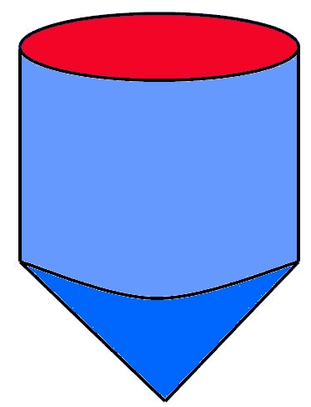
Volume Calculations
What about a Round Tank
with a Cone Bottom
?

Slide 50
Volume Calculations
Cylinder with Cone Bottom
h₁
V_{cylinder} = πr²h₁
h₂
πr²h₂
3
V_{cone} = 1/3 πr²h or
V_{total} = V_{cylinder} + V_{cone}

Slide 51
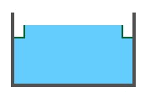
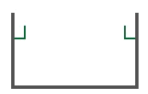
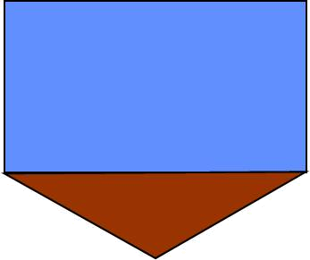
Volume Calculations
Cylinder with Cone Bottom
Side Water
Depth
For Secondary Clarifiers
Volume of Cone Not Considered
Insignificant Compared to Total Volume
(Filled with Sludge)

Slide 52

Clarifier Loading
Hydraulic Loading
Detention Time (DT)
The time it takes for a drop of water to travel from inlet to outlet

Slide 53
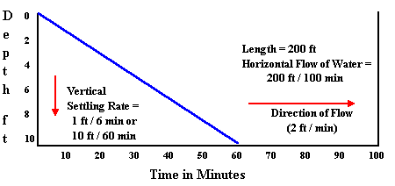
Clarifier Detention Time
Must Have Detention Time Long Enough for Solids to Settle

Slide 54
Sedimentation Efficiency
100
80
Percent Removal
60
40
20
0
1 2 3 4
Time, Hrs.
Too Long – No Increase in Removal

Slide 55
Clarifier Loading
Hydraulic Loading
Detention Time (DT)
The time it takes for a drop of water to travel from inlet to outlet
Typical Design Value = 2 – 3 Hours

Slide 56
Hydraulic Loading
Tank Volume
Influent Rate
Detention Time =
Example 1a:
Calculate the Detention Time in for a clarifier with a volume of 25,000 gallons that receives a flow of 310,000 gal/day.
Volume
Detention Time =
Flow
25,000 gallons
=
= 0.08 Days
310,000 gallons/day

Slide 57
Hydraulic Loading
Tank Volume
Influent Rate
Detention Time =
Example 1b:
Calculate the Detention Time in HOURS for a clarifier with a volume of 25,000 gallons that receives a flow of 310,000 gal/day.
Volume
Detention Time =
Flow
25,000 gallons
=
= 0.08 Days
310,000 gallons/day
0.08 Days
X 24 hours/days
= 1.9 Hours

Slide 58
Clarifier Loading
Hydraulic Loading
Detention Time (DT)
The time it takes for a drop of water to travel from inlet to outlet
Tank Volume
Flow into Tank
Detention Time =

Slide 59
Clarifier Loading
Hydraulic Loading
Detention Time (DT)
The time it takes for a drop of water to travel from inlet to outlet
DT, hrs =
Tank Volume, (MG or Gallons) X 24
Flow into Tank, (MG/D or Gal/D)

Slide 60

Detention Time
Example 1. Find the detention time in hours of a circular sedimentation tank having a volume of 75,000 gallons and a flow of 900,000 gallons per day.
Tank Volume, gallons
X 24 hr/day
DT, hrs =
Flow into Tank, gallons/day
75,000 gallons
X 24 hr/day
DT, hrs =
900,000 gallons/day
= 2 hour

Slide 61
Detention Time
Example 2. Find the detention time in hours of a circular sedimentation tank having a volume of 55,000 gallons and a flow of 0.75 MGD.
Tank Volume, gallons
X 24 hr/day
DT, hrs =
Flow into Tank, gallons/day
0.75 MGD = 750,000 gal/day

Slide 62
Detention Time
Example 2. Find the detention time in hours of a circular sedimentation tank having a volume of 55,000 gallons and a flow of 0.75 MGD.
Tank Volume, gallons
X 24 hr/day
DT, hrs =
Flow into Tank, gallons/day
55,000 gallons
X 24 hr/day
DT, hrs =
750,000 gallons/day
= 1.8 hour

Slide 63
Detention Time
Work Calculations on Separate Paper
Answers Given on Next Slides
Practice 1. Find the detention time in hours of a clarifier having a volume of 52,000 gallons and a flow of 520,000 gallons per day.
Practice 2. Find the detention time in hours of a rectangular sedimentation tank having a volume of 16,400 gallons and a flow of 0.225 MGD.

Slide 64
Detention Time
Practice 1. Find the detention time in hours of a clarifier having a volume of 52,000 gallons and a flow of 520,000 gallons per day.
Tank Volume, gallons
X 24 hr/day
DT, hrs =
Flow into Tank, gallons/day
52,000 gallons
X 24 hr/day
DT, hrs =
520,000 gallons/day
= 2.4 hour

Slide 65
Detention Time
Practice 2. Find the detention time in hours of a rectangular sedimentation tank having a volume of 16,400 gallons and a flow of 0.225 MGD.
Tank Volume, gallons
X 24 hr/day
DT, hrs =
Flow into Tank, gallons/day
0.225 MGD = 220,000 gal/day

Slide 66
Detention Time
Practice 2. Find the detention time in hours of a rectangular sedimentation tank having a volume of 16,400 gallons and a flow of 0.225 MGD.
Tank Volume, gallons
X 24 hr/day
DT, hrs =
Flow into Tank, gallons/day
16,400 gallons
X 24 hr/day
DT, hrs =
225,000 gallons/day
= 1.75 hour

Slide 67
Clarifier Loading
Hydraulic Loading
Detention Time (DT)
The time it takes for a drop of water to travel from inlet to outlet
Tank Volume
Flow into Tank
Detention Time =
DT, hrs =
Tank Volume, (MG or Gallons) X 24
Flow into Tank, (MG/D or Gal/D)
Typical Design Value = 2 – 3 Hours

Slide 68
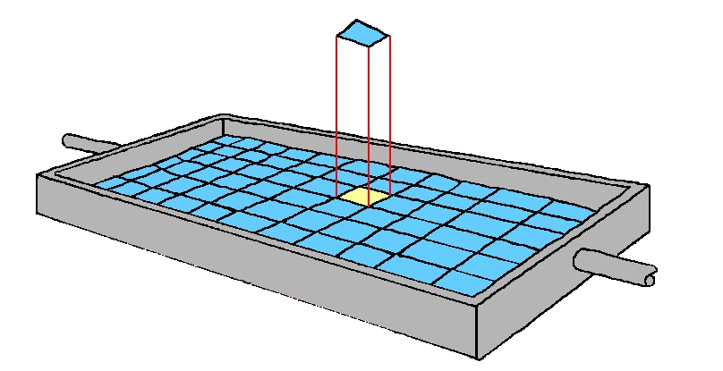
Clarifier Loading
Hydraulic Loading
Surface Overflow Rate (SOR)
OR
Surface Loading Rate (SLR)
The flow in gallons per day into the clarifier per square foot of surface area

Slide 69
Clarifier Loading
Hydraulic Loading
Surface Overflow Rate (SOR)
OR
Surface Loading Rate (SLR)
The flow in gallons per day into the clarifier per square foot of surface area
Flow, gallons/day
SOR, gpd/ft² =
Surface Area, ft²

Slide 70
Clarifier Loading
Hydraulic Loading
Surface Overflow Rate (SOR)
Flow, gallons/day
SOR, gpd/ft² =
Surface Area, ft²
Need:
Flow in gallons/day
and
Surface Area, ft²
SA = πr²
SA = L X W

Slide 71
Clarifier Loading
Hydraulic Loading
Surface Overflow Rate (SOR)
Flow, gallons/day
SOR, gpd/ft² =
Surface Area, ft²
Typical Design Value = 400 - 800 gal/day/ft²

Slide 72
Clarifier Loading
Hydraulic Loading -
Surface Overflow Rate (SOR)
Example 1.
Calculate the Surface Overflow Rate for a clarifier that is 50 ft long, 15 ft wide, 12 ft deep, and receives a flow of 338,000 gallons per day.
Flow, gallons/day
SOR, gpd/ft² =
Surface Area, ft²
Surface Area, ft²
= 50 ft X 15 ft = 750 ft²
338,000 gallons per day
750 ft²
SOR, gpd/ft² =
= 451 gpd/ft²

Slide 73
Clarifier Loading
Hydraulic Loading -
Surface Overflow Rate (SOR)
Example 2.
Calculate the Surface Overflow Rate for a clarifier that has a diameter of 60 ft, and receives an influent flow of 1.65 MGD.
Flow, gallons/day
SOR, gpd/ft² =
Surface Area, ft²
Flow, gallons/day =
1.65 MGD X 1,000,000
= 1,650,000 gallons per day
Surface Area, ft² = πr²
= 3.14 X 30 ft X 30 ft
= 2826 ft²

Slide 74

Clarifier Loading
Hydraulic Loading -
Surface Overflow Rate (SOR)
Example 2.
Calculate the Surface Overflow Rate for a clarifier that has a diameter of 60 ft, and receives an influent flow of 1.65 MGD.
Flow, gallons/day
SOR, gpd/ft² =
Surface Area, ft²
1,650,000 gallons per day
2826 ft²
SOR, gpd/ft² =
= 584 gpd/

Slide 75
Clarifier Loading
Hydraulic Loading -
Surface Overflow Rate (SOR)
Work Calculations on Separate Paper
Answers Given on Next Slides
Practice 1.
Calculate the Surface Overflow Rate for a clarifier that is 35 ft long, 9 ft wide, 7 ft deep, and receives a flow of 235,000 gallons per day.
Practice 2.
Calculate the Surface Overflow Rate for a clarifier that has a diameter of 45 ft. and receives an influent flow of 0.65 MGD.

Slide 76
Clarifier Loading
Hydraulic Loading -
Surface Overflow Rate (SOR)
Practice 1.
Calculate the Surface Overflow Rate for a clarifier that is 35 ft long, 9 ft wide, 7 ft deep, and receives a flow of 235,000 gallons per day.
Flow, gallons/day
SOR, gpd/ft² =
Surface Area, ft²
Surface Area, ft²
= 35 ft X 9 ft = 315 ft²
235,000 gallons per day
315 ft²
SOR, gpd/ft² =
= 746 gpd/ft²

Slide 77
Clarifier Loading
Hydraulic Loading -
Surface Overflow Rate (SOR)
Practice 2.
Calculate the Surface Overflow Rate for a clarifier that has a diameter of 45 ft. and receives an influent flow of 0.65 MGD.
Flow, gallons/day
SOR, gpd/ft² =
Surface Area, ft²
Flow, gallons/day =
0.65 MGD X 1,000,000
= 650,000 gallons per day
Surface Area, ft² = πr²
= 3.14 X 22.5 ft X 22.5 ft
= 1590 ft²

Slide 78
Clarifier Loading
Hydraulic Loading -
Surface Overflow Rate (SOR)
Practice 2.
Calculate the Surface Overflow Rate for a clarifier that has a diameter of 45 ft, and receives an influent flow of 0.65 MGD.
Flow, gallons/day
SOR, gpd/ft² =
Surface Area, ft²
650,000 gallons per day
1590 ft²
SOR, gpd/ft² =
= 409 gpd/ft²

Slide 79
Clarifier Loading
Hydraulic Loading
Surface Overflow Rate (SOR)
Flow, gallons/day
SOR, gpd/ft² =
Surface Area, ft²
Typical Design Value = 300 - 1200 gal/day/ft²
(800 gal/day/ft²)

Slide 80
Clarifier Loading
Hydraulic Loading
Weir Overflow Rate (WOR)
The flow in gallons per day per
linear foot of weir
Flow, gallons/day
WOR, gal/d/ft =
Length of Weir, ft
Typical Design Value = ~10,000 gal/day/ft

Slide 81
Clarifier Loading
Hydraulic Loading -
Weir Overflow Rate (WOR)
Flow, gallons/day
WOR, gal/d/ft =
Length of Weir, ft
Rectangular Tanks - Length of Weir, ft

Slide 82
Clarifier Loading
Hydraulic Loading -
Weir Overflow Rate (WOR)
Flow, gallons/day
WOR, gal/d/ft =
Length of Weir, ft
Rectangular Tanks - Length of Weir, ft
= Width
= 2 X Width
= 4 X Width
FLOW
FLOW
FLOW

Slide 83
Clarifier Loading
Hydraulic Loading -
Weir Overflow Rate (WOR)
Example 1
A primary clarifier is 20 feet wide, 60 feet long, and has a SWD of 12 feet. The clarifier has two effluent troughs across the width that allow the water to flow over both sides of each trough. The average flow to the clarifier is 0.65 MGD. Calculate the weir over flow rate for this clarifier.
Flow, gallons/day
WOR, gal/d/ft =
Length of Weir, ft
Flow, gallons/day =
0. 65 MGD X 1,000,000 = 650,000 gal/day
Length of Weir, ft
= 4 X Width
= 4 X 20 ft
FLOW
= 80 ft

Slide 84
Clarifier Loading
Hydraulic Loading -
Weir Overflow Rate (WOR)
Example 1
A primary clarifier is 12 feet wide, 40 feet long, and has a SWD of 8 feet. The clarifier has two effluent troughs across the width that allow the water to flow over both sides of each trough. The average flow to the clarifier is 0.65 MGD. Calculate the weir over flow rate for this clarifier.
Flow, gallons/day
WOR, gal/d/ft =
Length of Weir, ft
650,000 gal/day
=
80 ft
= 8,125 gal/day/ft
FLOW

Slide 85
Clarifier Loading
Hydraulic Loading -
Weir Overflow Rate (WOR)
Flow, gallons/day
WOR, gal/d/ft =
Length of Weir, ft
Work Calculations on Separate Paper
Answers Given on Next Slides
Practice 1
A primary clarifier is 18 feet wide, 45 feet long, and has a SWD of 9 feet. The clarifier has an effluent trough across the end. The average flow to the clarifier is 0.085 MGD. Calculate the weir over flow rate for this clarifier.
Practice 2
A primary clarifier is 12 foot wide, 40 foot long, and has a SWD of 8 feet. The clarifier has two effluent troughs across the width that allow the water to flow over both sides of each trough. The average flow to the clarifier is 0.41 MGD. Calculate the weir over flow rate for this clarifier.

Slide 86
Clarifier Loading
Hydraulic Loading -
Weir Overflow Rate (WOR)
Practice 1
A primary clarifier is 18 feet wide, 45 feet long, and has a SWD of 9 feet. The clarifier has an effluent trough across the end. The average flow to the clarifier is 0.085 MGD. Calculate the weir over flow rate for this clarifier.
Flow, gallons/day
WOR, gal/d/ft =
Length of Weir, ft
Flow, gallons/day =
0. 085MGD X 1,000,000 = 85,000 gal/day
Length of Weir, ft
= Width
WOR, gal/d/ft =
85,000 gal/day
9 ft
FLOW
= 9,444 gal/day/ft

Slide 87
Clarifier Loading
Hydraulic Loading -
Weir Overflow Rate (WOR)
Practice 2
A primary clarifier is 12 foot wide, 40 foot long, and has a SWD of 8 feet. The clarifier has two effluent troughs across the width that allow the water to flow over both sides of each trough. The average flow to the clarifier is 0.41 MGD. Calculate the weir over flow rate for this clarifier.
Flow, gallons/day
WOR, gal/d/ft =
Length of Weir, ft
Flow, gallons/day =
0. 41 MGD X 1,000,000 = 410,000 gal/day
Length of Weir, ft
= 4 X Width
= 4 X 12 ft
FLOW
= 48 ft

Slide 88
Clarifier Loading
Hydraulic Loading -
Weir Overflow Rate (WOR)
Practice 2
A primary clarifier is 12 foot wide, 40 foot long, and has a SWD of 8 feet. The clarifier has two effluent troughs across the width that allow the water to flow over both sides of each trough. The average flow to the clarifier is 0.41 MGD. Calculate the weir over flow rate for this clarifier.
Flow, gallons/day
WOR, gal/d/ft =
Length of Weir, ft
410,000 gal/day
=
48 ft
= 8,542 gal/day/ft
FLOW

Slide 89
Clarifier Loading
Hydraulic Loading -
Weir Overflow Rate (WOR)
Flow, gallons/day
WOR, gal/d/ft =
Length of Weir, ft
Weir Length for a Circular Clarifier
?

Slide 90
Surface Area Calculations
Circles
Circumference
Diameter
Circumference =
distance around circle
Radius

Slide 91
Surface Area Calculations
Circles
Circumference
Diameter
Circumference =
distance around circle
Radius
Circumference
Diameter
C
D
=
= π
= 3.14 for any circle
C = π D

Slide 92
Surface Area Calculations
Circles
Circumference
Diameter
Circumference =
distance around circle
Radius
For Weir Length
D = Diameter of the Weir
(May Not be same as Tank)
C = π D

Slide 93
Clarifier Loading
Hydraulic Loading -
Weir Overflow Rate (WOR)
Flow, gallons/day
WOR, gal/d/ft =
Length of Weir, ft
Weir Length for a Circular Clarifier

Slide 94
Clarifier Loading
Hydraulic Loading -
Weir Overflow Rate (WOR)
Example 1.
The flow to a circular clarifier is 690,000 gallons per day. The clarifier is 24 feet in diameter with the weirs set 1 foot from the outside wall, for a weir diameter of 22 feet. Calculate the weir overflow rate.
22 feet
Flow, gallons/day
WOR, gal/d/ft =
Length of Weir, ft
Length of Weir, ft = π X Weir Diameter
= 3.14 X 22 ft
= 69.08 ft

Slide 95
Clarifier Loading
Hydraulic Loading -
Weir Overflow Rate (WOR)
Example 1.
The flow to a circular clarifier is 690,000 gallons per day. The clarifier is 24 feet in diameter with the weirs set 1 foot from the outside wall, for a weir diameter of 22 feet. Calculate the weir overflow rate.
22 feet
Flow, gallons/day
WOR, gal/d/ft =
Length of Weir, ft
690,000 gpd
WOR, gpd/ft =
69.08 ft
= 9,988 gpd/ft

Slide 96
Hydraulic Loading -
Weir Overflow Rate (WOR)
Example 2.
The flow to a circular clarifier is 1.65 MGD. The clarifier is 60 feet in diameter with the weir set in 1 foot from the outside wall. Calculate the weir overflow rate.
58 feet
Flow, gallons/day
WOR, gal/d/ft =
Length of Weir, ft
Length of Weir, ft = π X Weir Diameter
= 3.14 X 58 ft
= 182 ft
1,650,000 gpd
WOR, gpd/ft =
= 9,066 gpd/ft
182 ft

Slide 97
Hydraulic Loading -
Weir Overflow Rate (WOR)
Work Calculations on Separate Paper
Answers Given on Next Slides
Practice 1.
The flow to a circular clarifier is 0.80 MGD. The clarifier is 30 feet in diameter with the weir set in 1 foot from the outside wall. Calculate the weir overflow rate.
Practice 2.
The flow to a circular clarifier is 1.4 MGD. The clarifier is 54 feet in diameter with the weir set in 1 foot from the outside wall. Calculate the weir overflow rate.
Practice 3.
The flow to a circular clarifier is 2.1 MGD. The clarifier is 75 feet in diameter with the weir set in 18 inches from the outside wall. Calculate the weir overflow rate.

Slide 98
Hydraulic Loading -
Weir Overflow Rate (WOR)
Practice 1.
The flow to a circular clarifier is 0.80 MGD. The clarifier is 30 feet in diameter with the weir set in 1 foot from the outside wall. Calculate the weir overflow rate.
28 feet
Flow, gallons/day
WOR, gal/d/ft =
Length of Weir, ft
Length of Weir, ft = π X Weir Diameter
= 3.14 X 28 ft
= 88 ft
800,000 gpd
WOR, gpd/ft =
= 9,091 gpd/ft
88 ft

Slide 99
Hydraulic Loading -
Weir Overflow Rate (WOR)
Practice 2.
The flow to a circular clarifier is 1.4 MGD. The clarifier is 54 feet in diameter with the weir set in 1 foot from the outside wall. Calculate the weir overflow rate.
52 feet
Flow, gallons/day
WOR, gal/d/ft =
Length of Weir, ft
Length of Weir, ft = π X Weir Diameter
= 3.14 X 52 ft
= 163 ft
1,400,000 gpd
WOR, gpd/ft =
= 8,589 gpd/ft
163 ft

Slide 100
Hydraulic Loading -
Weir Overflow Rate (WOR)
Practice 3.
The flow to a circular clarifier is 2.1 MGD. The clarifier is 75 feet in diameter with the weir set in 18 inches from the outside wall. Calculate the weir overflow rate.
72 feet
Flow, gallons/day
WOR, gal/d/ft =
Length of Weir, ft
Length of Weir, ft = π X Weir Diameter
= 3.14 X 72 ft
= 226 ft
2,100,000 gpd
WOR, gpd/ft =
= 9,292 gpd/ft
226 ft

Slide 101

Clarifier Loading
Hydraulic Loading
Weir Overflow Rate (WOR)
The flow in gallons per day per linear foot
of weir
Flow, gallons/day
WOR, gal/d/ft =
Length of Weir, ft
Typical Design Value = ~10,000 gal/day/ft

Slide 102
Clarifier Loading
Solids Loading
- Solids Loading Rate (SLR)
The pounds per day of solids in the clarifier influent per square foot of surface area
Solids, lbs/day
SLR, lbs/d/ft² =
Surface Area, ft²
Same Calculations as for Hydraulic Loading
SA = πr²
SA = L X W

Slide 103
Clarifier Loading
Solids Loading
- Solids Loading Rate (SLR)
The pounds per day of solids in the clarifier influent per square foot of surface area
Solids, lbs/day
SLR, lbs/d/ft² =
Surface Area, ft²
“Pounds Equation”

Slide 104
“Pounds Equation”
Pounds =
Conc. x Flow (or Volume) x 8.34 Lbs/gallon
Concentration
Of STUFF
In the
Water
Quantity
Of Water
The STUFF
Is In
Weight
Of The
Water
X
X

Slide 105
“Pounds Equation”
Flow (volume) and concentration must be
expressed in specific units.
    Flow or volume must be expressed
    as millions of gallons:
    gallons _
    1,000,000 gal/MG
= MG
    i.e.) A tank contains 1,125,000 gallons of water. How many million gallons are there?
    1,125,000 gal = 1.125 MG
    1,000,000 gal/MG

Slide 106
“Pounds Equation”
    Concentration must be expressed
    as parts per million parts.
    Concentration usually reported as
    milligrams per liter.
    This unit is equivalent to ppm.
    1 mg = 1 mg = 1 mg = ppm
    liter 1000 grams 1,000,000 mg
Parts
Mil Parts
Lbs.
Mil Lbs.
ppm =
=

Slide 107
“Pounds Equation”
    When flow (volume) is expressed as
    MG and conc. is in ppm, the units
    cancel to leave only pounds.
Lbs. =
Concentration x Flow (or volume) x 8.34 lbs/gallon
Lbs.
Lbs.
X
M gal
X
M Lbs.
gal

Slide 108
“Pounds Equation”
    If the flow rate is entered in M gal per day (MG/D), the answer will be in lbs/day.
    Example:
    The flow to a clarifier is 1.2 MGD and the concentration of suspended solids in the flow is 2500 mg/L. How many pounds of suspended solids come into the clarifier each day?
    Lbs/day = conc. (mg/L) x flow (MGD) x 8.34 lbs
    gal
    Lbs/day = 2500 mg/L x 1,200,000 gal/day x 8.34 lbs
    1,000,000 gal/MG gal
= 2500 x 1.2 x 8.34
= 25,020 Lbs/day

Slide 109

Clarifier Loading
Solids Loading
- Solids Loading Rate (SLR)
The pounds per day of solids in the clarifier influent per square foot of surface area
Solids, lbs/day
SLR, lbs/d/ft² =
Surface Area, ft²
Typical Design Value = Max 30 lbs/d/ft²

Slide 110
Clarifier Loading
Solids Loading
- Solids Loading Rate (SLR)
Example 1.
Calculate the Solids Loading Rate for a clarifier with a 50 ft diameter and a depth of 12 feet, and receives a flow of 2.4 MGD with a suspended solids concentration of 1800 mg/L.
Solids, lbs/day
SLR, lbs/d/ft² =
Surface Area, ft²
Solids, lbs/day =
1800 mg/L X 2.4 MGD X 8.34 lbs/gal = 36,029 lbs/d
SA = 3.14 X 25 ft X 25 ft = 1962.5 ft²
36,029 lbs/day
1962.5 ft²
= 18.4 lbs/d/ft²
SLR, lbs/d/ft² =

Slide 111
Clarifier Loading
Solids Loading
- Solids Loading Rate (SLR)
Example 2.
Calculate the Solids Loading Rate for a clarifier with a 31 ft diameter and a depth of 9 feet, and receives a flow of 750,000 gallons per day with a suspended solids concentration of 2600 mg/L.
Solids, lbs/day
SLR, lbs/d/ft² =
Surface Area, ft²
Solids, lbs/day =
2600 mg/L X 0.75 MGD X 8.34 lbs/gal = 16,263 lbs/d
SA = 3.14 X 15.5 ft X 15.5 ft = 754 ft²
16,263 lbs/day
754 ft²
SLR, lbs/d/ft² =
= 21.6 lbs/d/ft²

Slide 112
Clarifier Loading
Solids Loading
- Solids Loading Rate (SLR)
Work Calculations on Separate Paper
Answers Given on Next Slides
Practice 1.
Calculate the Solids Loading Rate for a clarifier with a 12 ft width and a length of 50 feet, and receives a flow of 600,000 gallons per day with a suspended solids concentration of 3400 mg/L.
Practice 2.
Calculate the Solids Loading Rate for a clarifier with a 22 ft radius and a depth of 8.5 feet, and receives a flow of 1,450,000 gallons per day with a suspended solids concentration of 3400 mg/L.
Practice 3.
Calculate the Solids Loading Rate for a clarifier with a 22 ft diameter and a depth of 7 feet, and receives a flow of 0.82 MGD
with a suspended solids concentration of 1950 mg/L.

Slide 113
Clarifier Loading
Solids Loading
- Solids Loading Rate (SLR)
Practice 1.
Calculate the Solids Loading Rate for a clarifier with a 12 ft width and a length of 50 feet, and receives a flow of 600,000 gallons per day with a suspended solids concentration of 3400 mg/L.
Solids, lbs/day
SLR, lbs/d/ft² =
Surface Area, ft²
3400 mg/L X 0.6 MGD X 8.34 lbs/gal = 17,014 lbs/d
SA = 12 ft X 50 ft = 600 ft²
17,014 lbs/day
600 ft²
SLR, lbs/d/ft² =
= 28.4 lbs/d/ft²

Slide 114
Clarifier Loading
Solids Loading
- Solids Loading Rate (SLR)
Practice 2.
Calculate the Solids Loading Rate for a clarifier with a 22 ft radius and a depth of 8.5 feet, and receives a flow of 1,450,000 gallons per day with a suspended solids concentration of 3400 mg/L.
Solids, lbs/day
SLR, lbs/d/ft² =
Surface Area, ft²
3400 mg/L X 1.45 MGD X 8.34 lbs/gal = 41,116 lbs/d
SA = 3.14 X 22 ft X 22 ft = 1520 ft²
41,116 lbs/day
1520 ft²
SLR, lbs/d/ft² =
= 27.1 lbs/d/ft²

Slide 115
Clarifier Loading
Solids Loading
- Solids Loading Rate (SLR)
Practice 3.
Calculate the Solids Loading Rate for a clarifier with a 22 ft diameter and a depth of 7 feet, and receives a flow of 0.82 MGD with a suspended solids concentration of 1950 mg/L.
Solids, lbs/day
SLR, lbs/d/ft² =
Surface Area, ft²
1950 mg/L X 0.82 MGD X 8.34 lbs/gal = 13,336 lbs/d
SA = 3.14 X 11 ft X 11 ft = 380 ft²
13,336 lbs/day
380 ft²
SLR, lbs/d/ft² =
= 35.1 lbs/d/ft²

Slide 116
Clarifier Loading
Solids Loading
- Solids Loading Rate (SLR)
The pounds per day of solids in the clarifier influent per square foot of surface area
Solids, lbs/day
SLR, lbs/d/ft² =
Surface Area, ft²
Typical Design Value = 25 - 30 lbs/d/ft²

Slide 117

Clarifier Loading Calculations
Detention Time (DT)
Tank Volume, MG X 24
Flow into Tank, MGD
DT, hrs =
Typical Design Value = 2 – 3 Hours
Surface Overflow Rate (SOR)
Flow, gallons/day
SOR, gpd/ft² =
Surface Area, ft²
Typical Design Value = 400 - 800 gal/d/ft²
Weir Overflow Rate (WOR)
WOR, gal/d/ft =
Flow, gallons/day
Length of Weir, ft
Typical Design Value = ~10,000 gal/d/ft
Solids Loading
Solids, lbs/day
Surface Area, ft²
SLR, lbs/d/ft² =
Typical Design Value = 25 - 30 lbs/d/ft²

Slide 118
Clarifier Calculations
Prepared By
Michigan Department of Environmental Quality
Operator Training and Certification Unit

