Slide 1
sPi
Camera surveillance system

Slide 2
User (customer) needs
Solution description
User requirements and features
System overview
Circuit design
Software design
Results and further work
References

Slide 3
3.User requirements and features
- A system providing information about the environment
- Alerts during user specified periods, if there is any change in the environment
- Communication with the user through an app or a website
- Providing a 24/7 access
- Recognistion of objects or persons
- may providing access to history data for a certain period of time
- may be weatherproof

Slide 4
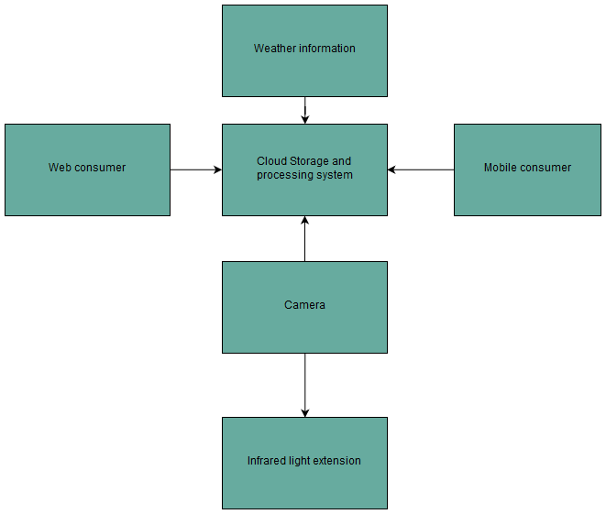
4. System overview

Slide 5
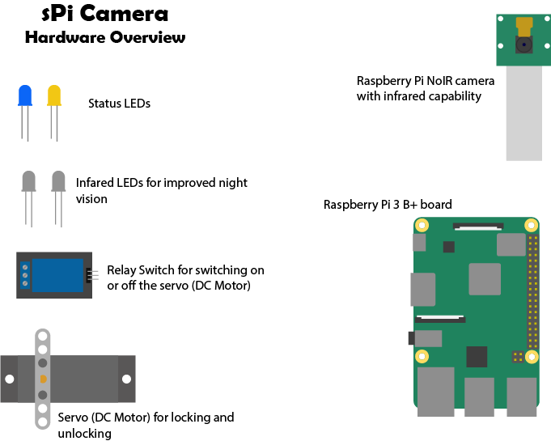

Slide 6
5.Hardware description
Rasberry Pi 3 B+ board used as compute system for handling as precessing and handling data and the connected hardware
Pi NoIR camera for capturing a video feed for the system to process also capanle of capturin infra-red light for improved nightvison
LEDs for indicating the status. Infra-red LEDs for lighting the face during nightime so it won’t be necessary to blind the person at the front door wit visible light.(future)
Relay switch to turn on or off the Servo(future, actual DC motor)
Servo(future, actual DC motor) to lock or unlock the door

Slide 7
6. Software design
Used python modules:
Smtplib
email.mime
RPi.GPIO
NumPy
OpenCV
Pillow lib
Using OpenCV for image captuire, Pillow for image processing and again OpenCV for the AI, the software determines if there’s a known face and unlocks using Raspberry Pi’s library to unlock the door, else, if the user is away or doesn’t want to be disturbed, he/she will be notified using smtplin and email.mime through email that there’s someone undesired at his/hers front door.

Slide 8
7.Features: now and future
Now:
Facial recognition
Unlocking the door
Email notification system
Future:
Locking the door(requieres servo)
Video feed alongside the intruder notification
Live feed widely available
Audio interaction(speaker for the system)
Voice recognition(being able to leave a message)
Mobile and web application for system intercation
Cloud storage for surveilance backup
Camera expusre parameters acknowledgement to determine if infra-red ligts are needed
Wather api integration to determine wather conditions and reacting accordingly
Trained data to be shared with similar systems

Slide 9
8.References
1.OpenCV: https://opencv.org
2.DrawIO: https://draw.io
3.smtplib: https://docs.python.org/3/library/smtplib.html
4.Email.mime: https://docs.python.org/2/library/email.mime.html
5.NumPy: https://www.numpy.org
6.Face Recognition: https://circuitdigest.com/microcontroller-projects/raspberry-pi-and-opencv-based-face-recognition-system

