Slide 1
sPi
Camera surveillance system

Slide 2
User (customer) needs
Solution description
User requirements and features
System overview
Circuit design
Software design
Results and further work
References

Slide 3
3.User requirements and features
- A system providing information about the environment
- Alerts during user specified periods, if there is any change in the environment
- Communication with the user through an app or a website
- Providing a 24/7 access
- Recognistion of objects or persons
- may providing access to history data for a certain period of time
- may be weatherproof

Slide 4
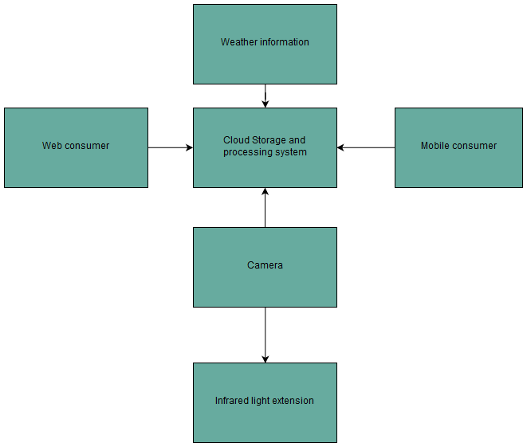
4. System overview

Slide 5
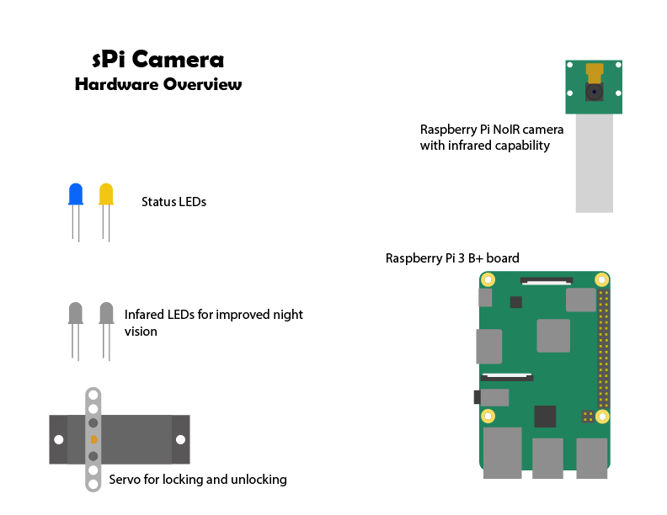
5. Circuit Components

Slide 6
6. Software design
Used python modules:
Smtplib
email.mime
RPi.GPIO
NumPy
OpenCV
Pillow lib

Slide 7
8.References
1.OpenCV: https://opencv.org
2.DrawIO: https://draw.io
3.smtplib: https://docs.python.org/3/library/smtplib.html
4.Email.mime: https://docs.python.org/2/library/email.mime.html
5.NumPy: https://www.numpy.org
6.Face Recognition: https://circuitdigest.com/microcontroller-projects/raspberry-pi-and-opencv-based-face-recognition-system

