Slide 1
Discuss Methods for Measuring the Similarity between Texts

Slide 2
Contents
Cosine Similarity
Simple Matching
Jaccard Index

Slide 3
Cosine Similarity
ID : 221-15-5976

Slide 4

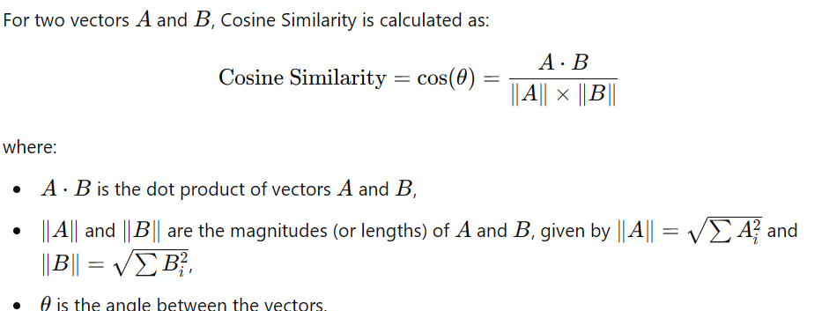
What is Cosine Similarity
In data analysis, cosine similarity is a measure of similarity between two non-zero vectors defined in an inner product space.

Slide 5
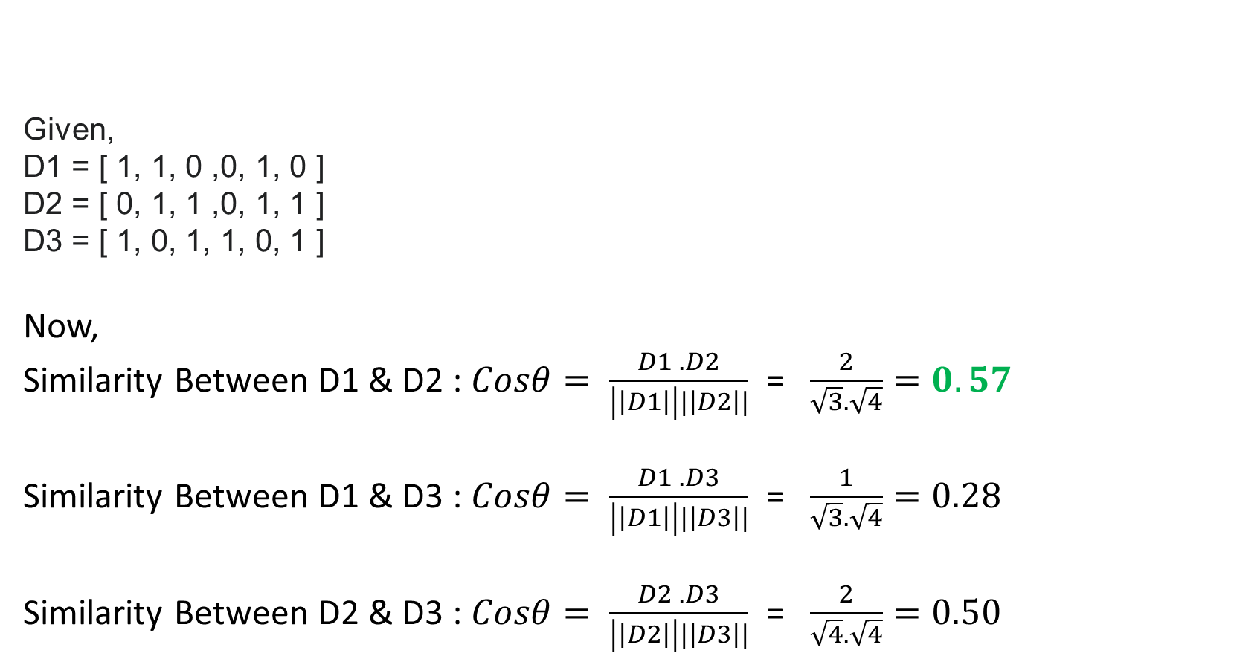
Example
Given,
D1 = [ 1, 1, 0 ,0, 1, 0 ]
D2 = [ 0, 1, 1 ,0, 1, 1 ]
D3 = [ 1, 0, 1, 1, 0, 1 ]
Now,
Similarity Between D1 & D2 : $Cosθ= \frac{D1 . D2}{\left|\left|D1\right|\right||\left|D2\right||}$ = $\frac{2}{\sqrt{3}.\sqrt{4}}=0.57$
Similarity Between D1 & D3 : $Cosθ= \frac{D1 . D3}{\left|\left|D1\right|\right||\left|D3\right||}$ = $\frac{1}{\sqrt{3}.\sqrt{4}}=0.28$
Similarity Between D2 & D3 : $Cosθ= \frac{D2 . D3}{\left|\left|D2\right|\right||\left|D3\right||}$ = $\frac{2}{\sqrt{4}.\sqrt{4}}=0.50$

Slide 6
Example
D3
D2
D1
Here, D1D2 is more similar than other pair(D1D3, D2D3)

Slide 7
Simple Matching
ID : 221-15-4983

Slide 8
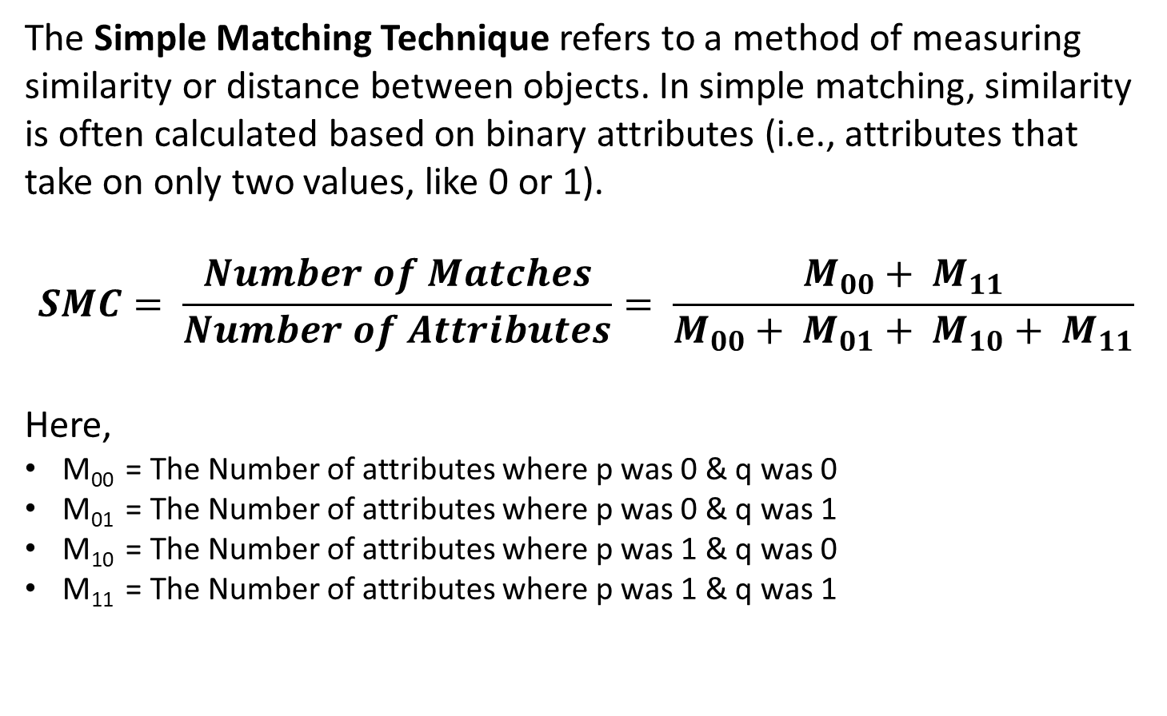
What is Simple Matching?
The Simple Matching Technique refers to a method of measuring similarity or distance between objects. In simple matching, similarity is often calculated based on binary attributes (i.e., attributes that take on only two values, like 0 or 1).
$$SMC= \frac{Number of Matches}{Number of Attributes}= \frac{M_{00}+ M_{11}}{M_{00}+ M_{01}+ M_{10}+ M_{11}}$$
Here,
M₀₀ = The Number of attributes where p was 0 & q was 0
M₀₁ = The Number of attributes where p was 0 & q was 1
M₁₀ = The Number of attributes where p was 1 & q was 0
M₁₁ = The Number of attributes where p was 1 & q was 1

Slide 9

Example
Let,
p = 1 0 0 1 0 1 1 1 0 0 1
q = 0 1 1 0 0 1 1 0 0 0 1
Now,
M₀₀ = 3 M₀₁ = 2 M₁₀ = 3 M₁₁ = 3
$SMC= \frac{Number of Matches}{Number of Attributes}= \frac{M_{00}+ M_{11}}{M_{00}+ M_{01}+ M_{10}+ M_{11}}$
= $\frac{3 + 3 }{3 + 2 + 3 + 3}$
= $\frac{6}{11}$ = 0.55

Slide 10
Jaccard Index
ID : 221-15-4920

Slide 11
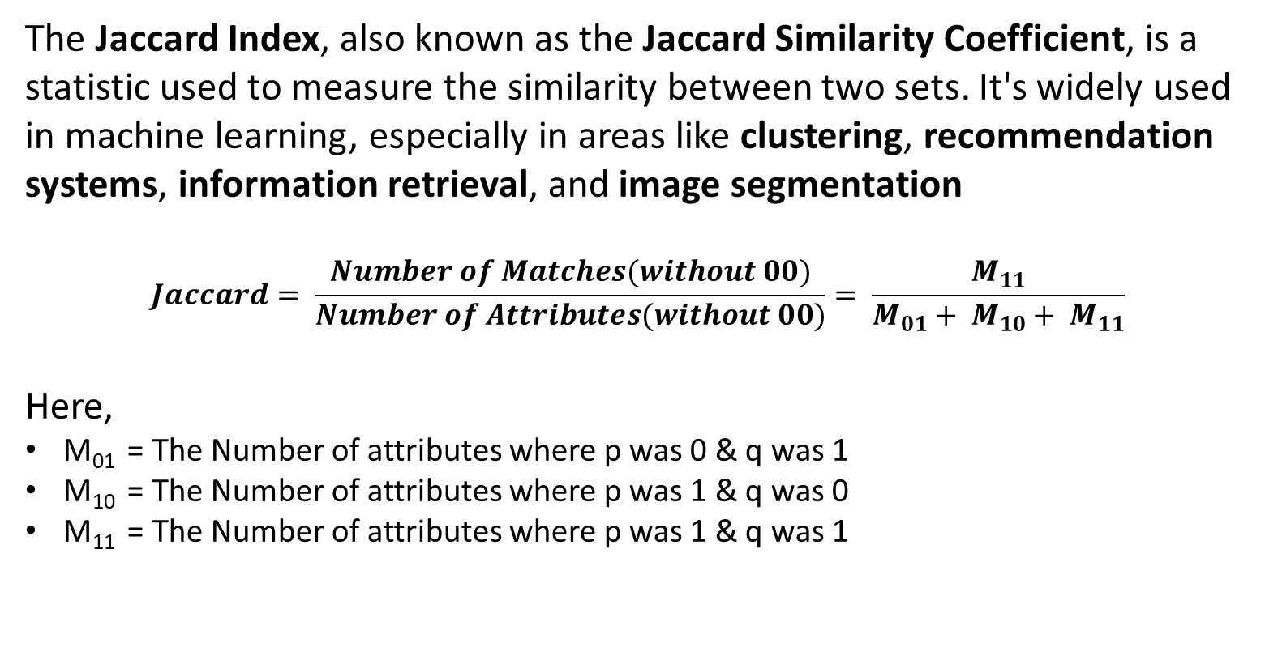
What is Jaccard Index?
The Jaccard Index, also known as the Jaccard Similarity Coefficient, is a statistic used to measure the similarity between two sets. It's widely used in machine learning, especially in areas like clustering, recommendation systems, information retrieval, and image segmentation
$$Jaccard= \frac{Number of Matches(without 00)}{Number of Attributes(without 00)}= \frac{M_{11}}{M_{01}+ M_{10}+ M_{11}}$$
Here,
M₀₁ = The Number of attributes where p was 0 & q was 1
M₁₀ = The Number of attributes where p was 1 & q was 0
M₁₁ = The Number of attributes where p was 1 & q was 1

Slide 12

Example
Let,
p = 1 0 0 1 0 1 1 1 0 0 1
q = 0 1 1 0 0 1 1 0 0 0 1
Now,
M₀₁ = 2 M₁₀ = 3 M₁₁ = 3
$Jaccard= \frac{Number of Matches(without 00)}{Number of Attributes(without 00)}= \frac{M_{11}}{M_{01}+ M_{10}+ M_{11}}$
= $\frac{3 }{2 + 3 + 3}$
= $\frac{3}{8}$ = 0.375

Slide 13
Applications
ID : 221-15-5868

Slide 14
Applications of Cosine Similarity
Text Similarity and Document Retrieval:
Cosine similarity is extensively used to measure similarity between documents in text mining, such as finding similar articles, clustering news, or detecting plagiarism.
Recommendation Systems:
It helps identify items similar to a user’s past preferences. For example, in collaborative filtering, it can find users with similar preferences based on ratings or item interactions.
Image Analysis:
In some cases, image data can be represented as feature vectors, and cosine similarity helps determine how similar two images are based on their feature representation.

Slide 15
Applications of Simple Matching
Simple matching is widely used in:
Document retrieval
Finding documents with similar keywords.
Recommendation systems
Identifying users or products with similar characteristics.
Customer segmentation
Clustering customers based on shared traits for targeted marketing.

Slide 16
Applications of Jaccard Index
Clustering:
Jaccard similarity is used to group similar items into clusters, especially in cases where the data is binary or categorical.
Recommendation Systems:
In content-based filtering, it identifies users or items with similar characteristics, recommending items that have a high Jaccard similarity.
Image Segmentation:
In computer vision, the Jaccard Index is used to measure the overlap between two regions in an image, such as predicted and actual segmentations, where it's often called the Intersection over Union (IoU).
Text Analysis and Document Retrieval:
The Jaccard Index helps to find documents with similar keywords or phrases, aiding in tasks like document clustering or similarity search.

Slide 17
Thank you

