Slide 1

Delay Predictor for Logic Synthesis using GCN & CNN
Group 7
Iit Guwahati

Slide 2
Agenda
1. Previous Work
2. Architecture
3. Differences from the base paper
4. Results
5. Future Scope
6. Conclusion

Slide 3
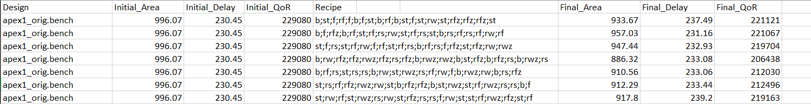
Previous Work
Implemented a script to generate 500 delay, area QoR values given an AIG design.
Execution time of creating a dataset with 11 designs (9 small+1 medium+1 large) was 4.5 hours.
Preview of the dataset (11x500) –

Slide 4
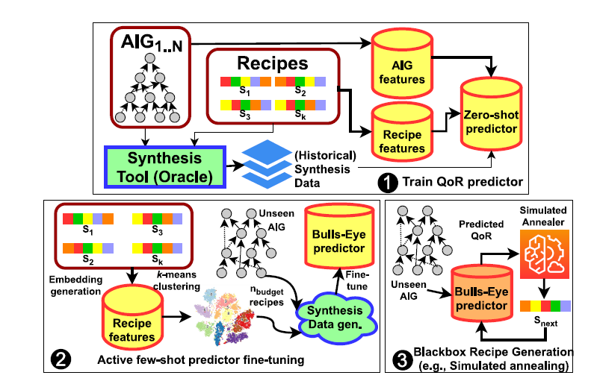
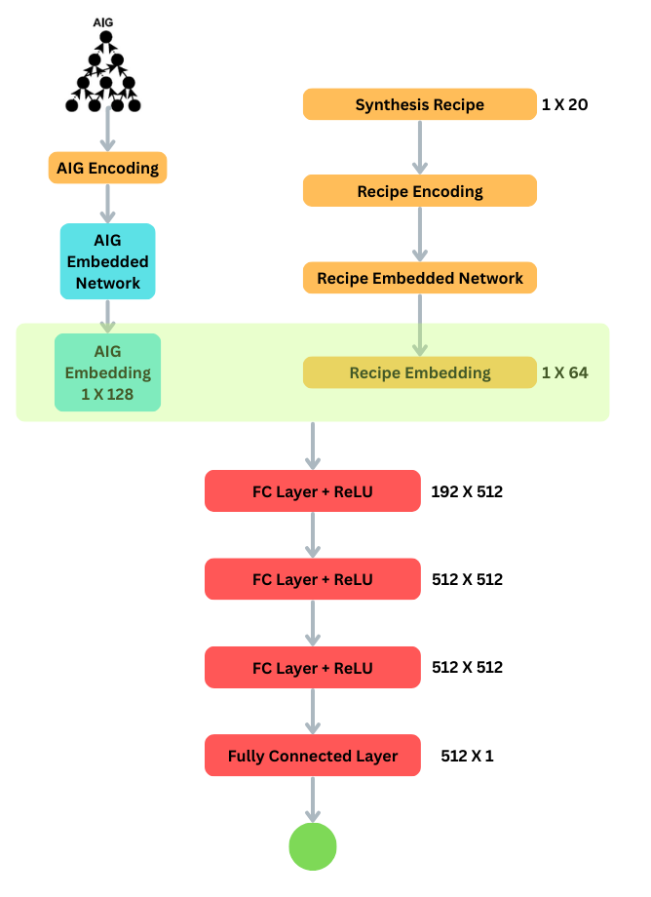
Architecture (Main & Zero Shot)

Slide 5
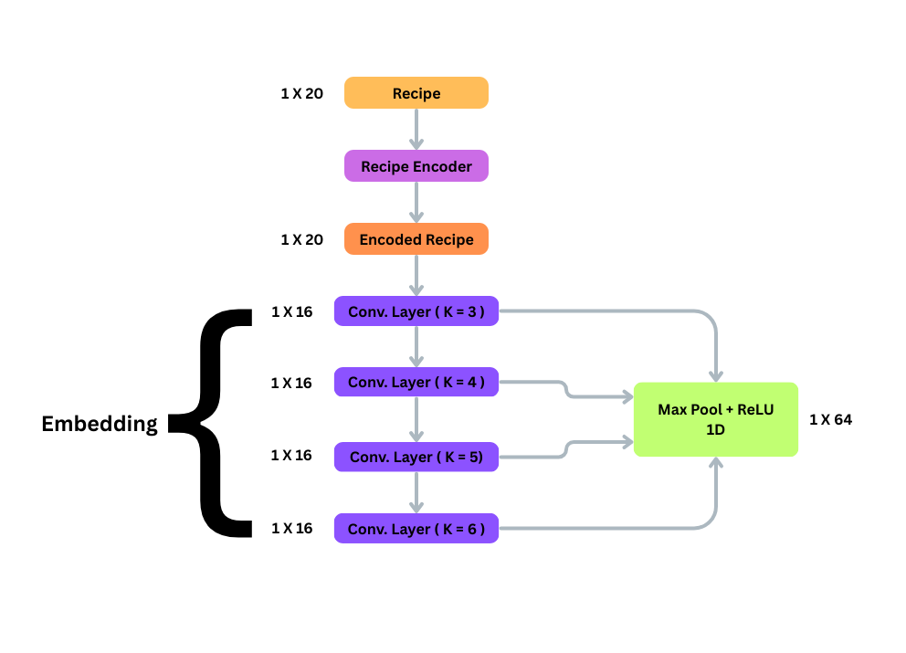
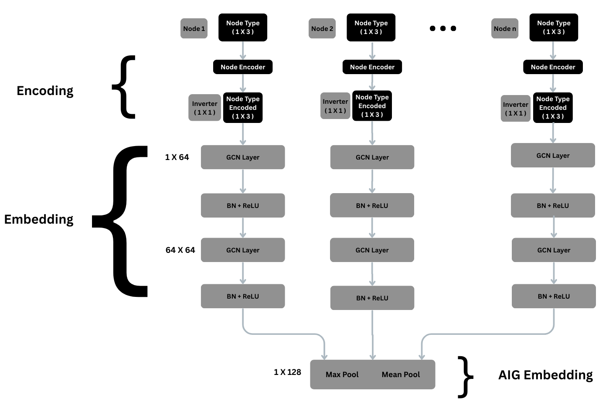
Architecture (Embedders)

Slide 6
Differences from the base paper
Hyper-Parameter Tuning
K fold cross validation for better model
Deeper 1D convolution network with maxpool concatenation
Various data visualization graphs to visualize difference in zero shot and fine tuning steps
Displaying the predicted values with zero shot predictor and fine tuned predictor, to highlight the change in accuracy

Slide 7
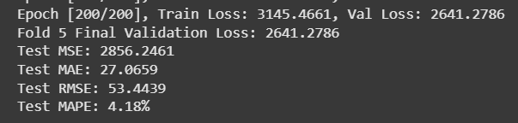
Results(Zero Shot Delay Predictor)
Trained the model on 9x400 recipes with the hope of achieving a good predictor.
The testing is done on 5-fold architecture.
The 9 designs used are all “small” designs
Tested the optimized model on the rest of 9x100 recipes all generated on ABC using the script files

Slide 8
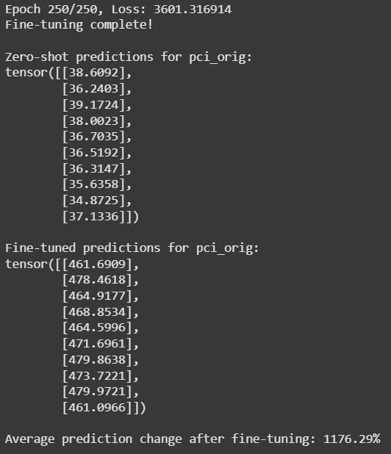
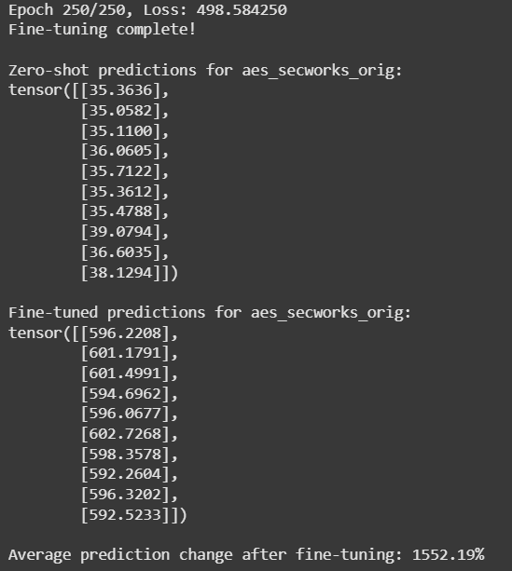
Results (Fine Tuning)
Before & after fine tuning on M
Before & after fine tuning on L

Slide 9
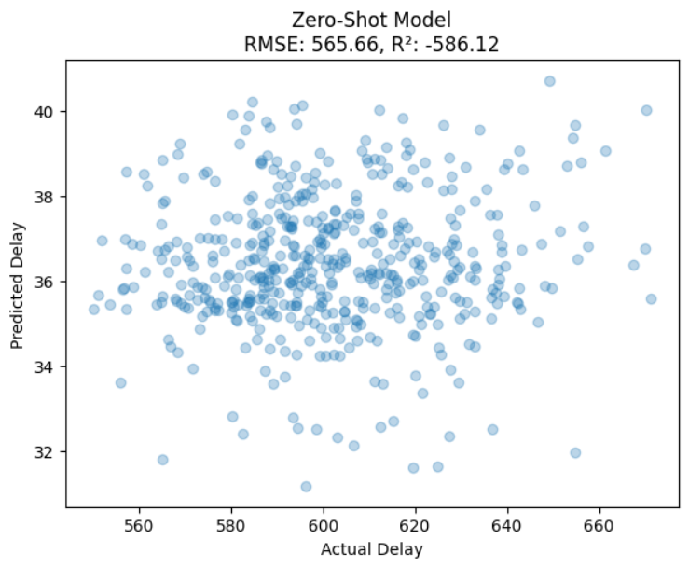
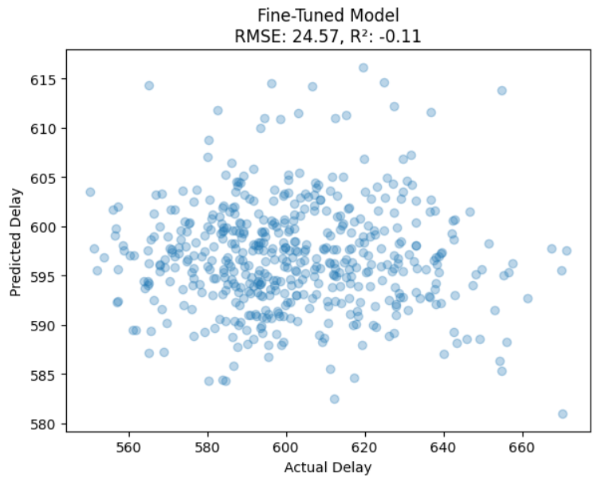
Results (Fine Tuning)

Slide 10
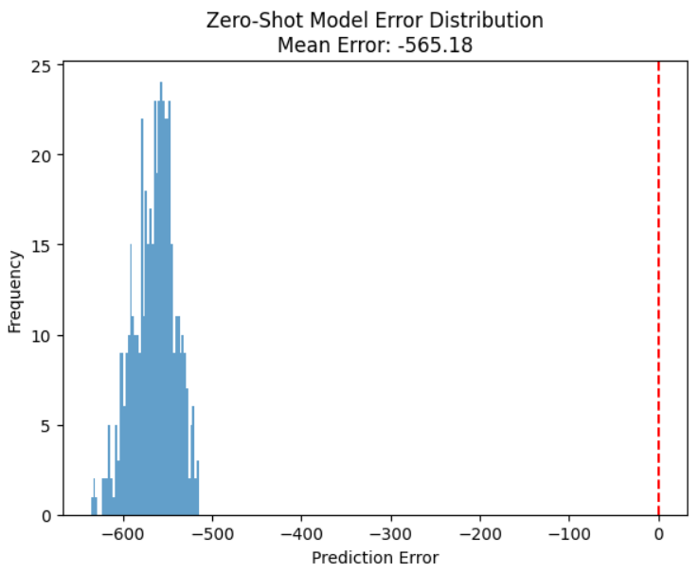
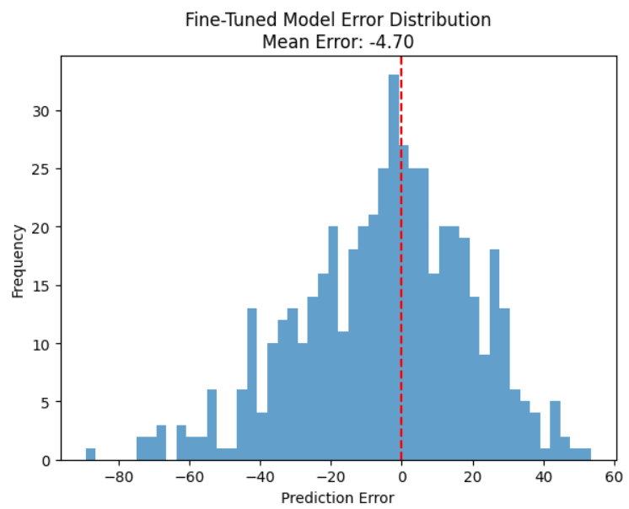
Results (Fine Tuning)

Slide 11
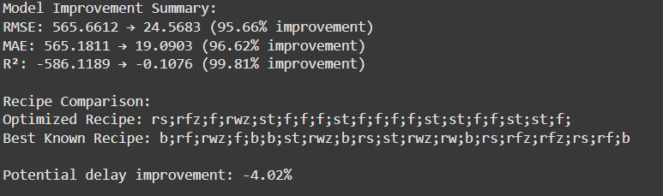
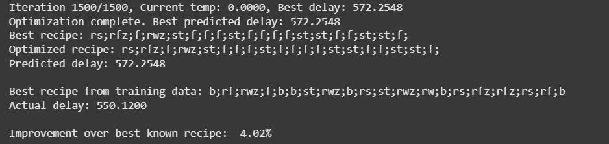
Result (Bonus)
Ran Simulated Annealing for the “Large” aes_secwork_orig.bench file which predicted the best recipe with a difference of 4%
This execution of SA took mere seconds while the execution onto ABC took us 40 mins.

Slide 12
Future Scope
Multi-objective optimization (area, power).
Active sampling enhancements.
Larger-scale industrial design validation.

Slide 13
Conclusion
Bulls-Eye is efficient for delay prediction in logic synthesis.
Combines GCN, CNN, and few-shot learning.
Reduces synthesis effort while maintaining accuracy.

Slide 14
Thank You

