Slide 2
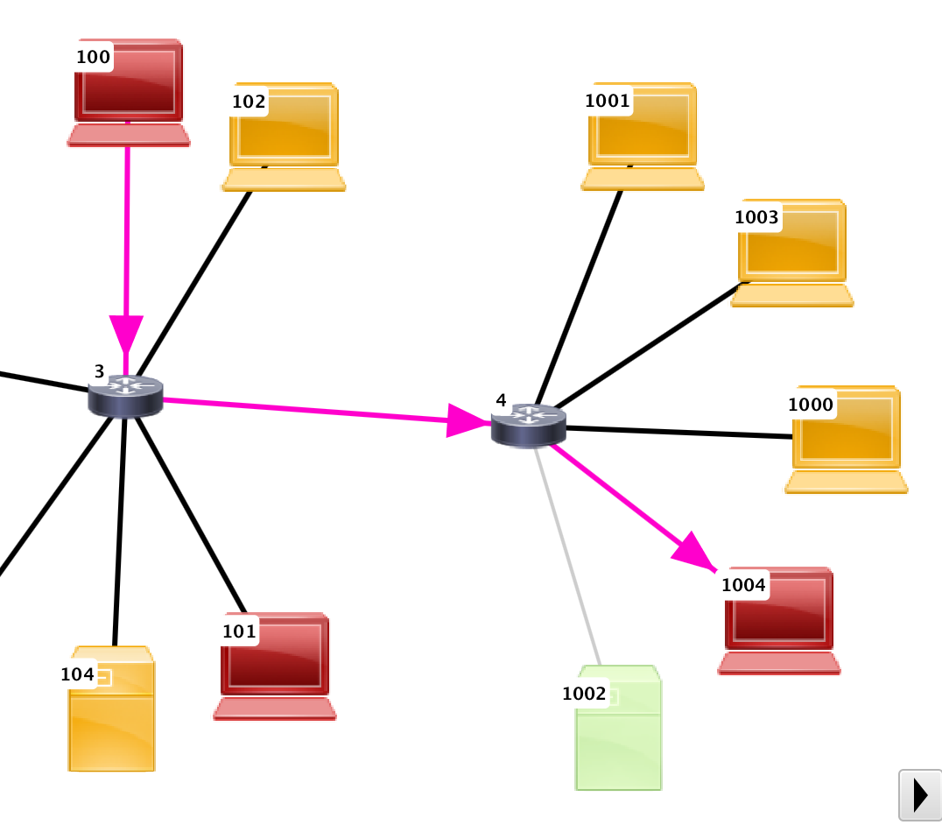
Compromised
Service Scanned
Undiscovered

