Slide 1

DriverPass System Analysis
Rosalie Reblora
Notes:
Hello, and thank you for the opportunity to present the proposed DriverPass system design. This design is based on the needs discussed during the DriverPass interview. The goal is to provide customers with convenient online training and scheduling while also giving DriverPass staff the tools they need to manage lessons, users, vehicles, reports, and updated DMV information.

Slide 2

System Requirements
Functional: Customers can schedule, modify, and cancel driving lessons.
Functional: Customers can access online courses and DMV practice tests.
Nonfunctional: Secure role-based access protects customer and business information.
Nonfunctional: Cloud-based access supports computers and mobile devices.
Notes:
The system requirements focus on making DriverPass services easier for customers and staff to use. Customers will be able to manage appointments online and use training materials and practice tests from their own devices. The system will also separate access based on each person's job or role so that users only see the information they need. Because the system is cloud-based, the same up-to-date information can be accessed from computers, tablets, and phones with an internet connection.

Slide 3
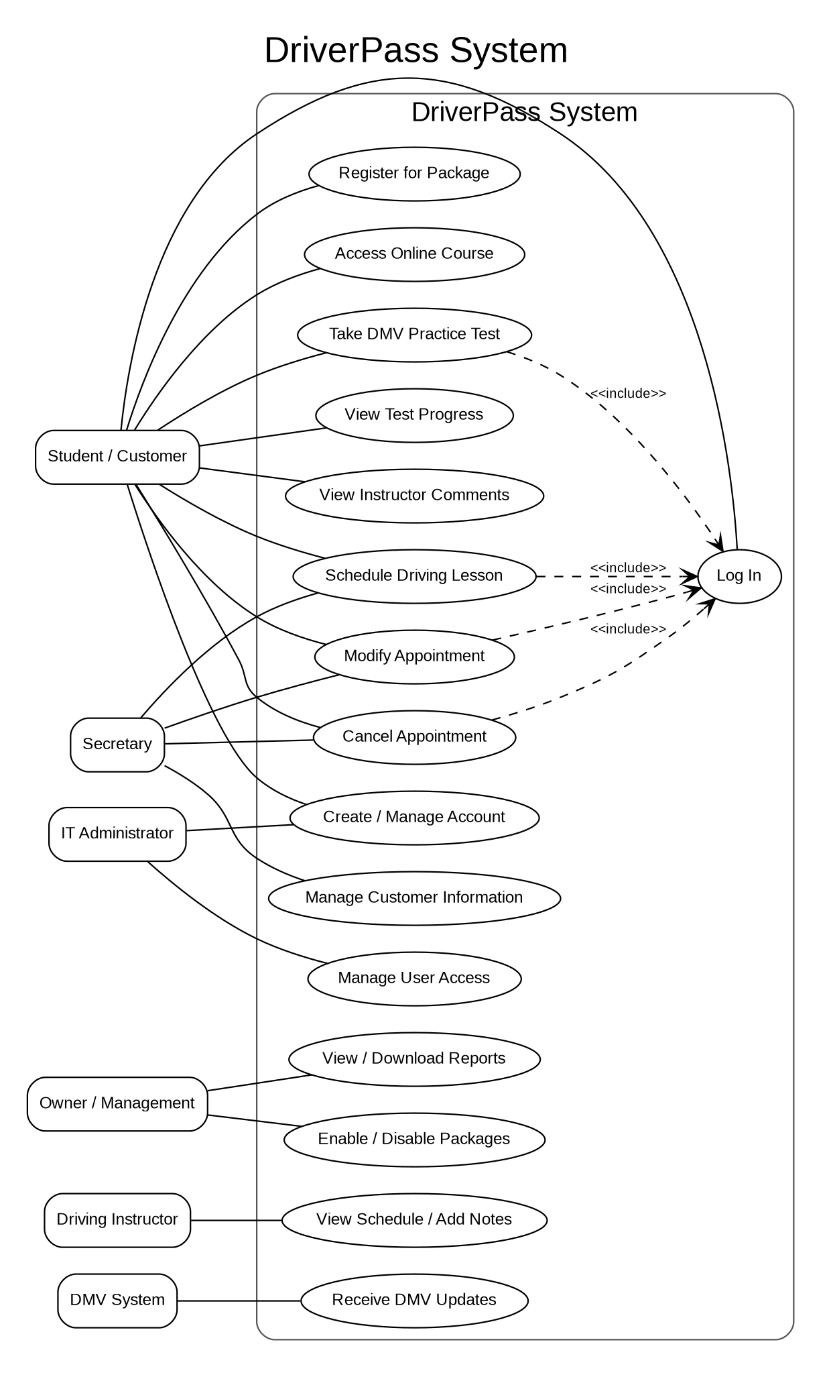
Use Case Diagram
Notes:
This diagram provides a simple overview of who will use DriverPass and what each person needs to do. Customers can manage accounts, choose packages, schedule lessons, take online courses and practice tests, and review progress. Secretaries can help manage customer information and appointments. Instructors can view schedules and record lesson notes. Management can review reports and manage packages, while the IT administrator manages user access. The DMV is also represented because DriverPass needs current rules and practice-test information.

Slide 4
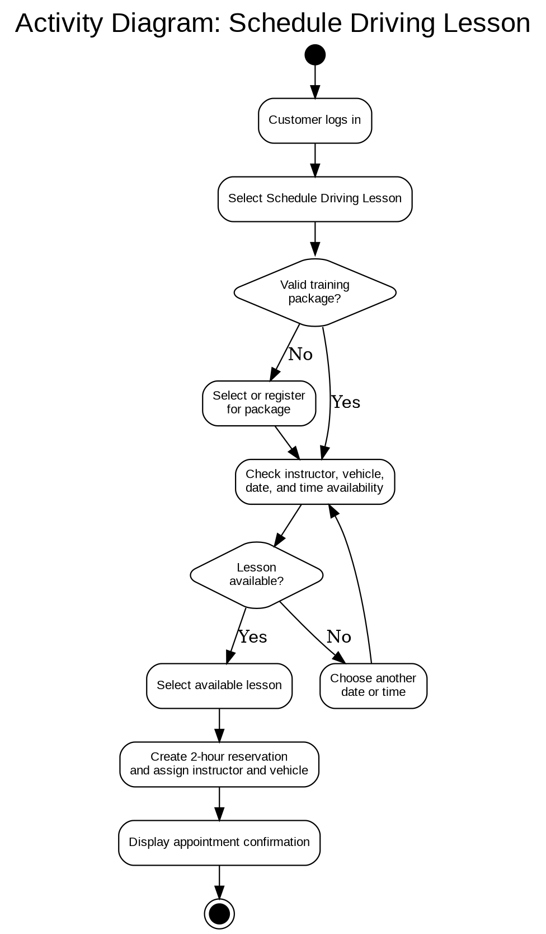
Activity Diagram
Notes:
This activity diagram explains the customer experience when scheduling a driving lesson. After logging in, the customer selects the scheduling option. The system confirms that the customer has an appropriate training package and then checks for an available instructor, vehicle, date, and time. If the requested lesson is unavailable, the customer can choose another option. When an available time is selected, the system creates the two-hour reservation and provides confirmation. This process helps DriverPass avoid scheduling conflicts and keeps the customer informed.

Slide 5
Security
Unique usernames and passwords
Role-based access for customers and staff
Encrypted connections protect data in transit
Temporary lockout after repeated failed logins
Audit logs and administrator alerts for suspicious activity
Notes:
Security is important because DriverPass will store personal information, appointment records, and payment-related information. Each user will have a unique account, and access will be based on the user's role. Information sent between a user's device and the DriverPass system will be encrypted. Repeated failed login attempts will result in a temporary lockout and will be recorded so that suspicious activity can be reviewed. The system will also keep an activity history to support accountability.

Slide 6
System Limitations
Internet access is required for online updates and scheduling.
Customers cannot make changes while offline.
Major system changes require developer or systems analyst support.
Version 1.0 is limited by project time, budget, and available resources.
Practice tests depend on DMV updates for current content.
Notes:
The first version of DriverPass will have some practical limitations. Because it is an online system, customers and employees will need internet access to make updates or manage appointments. Larger changes, such as adding new modules or major features, will require technical support. The first release will also be limited by the available project time, budget, and development resources. In addition, the accuracy of DMV practice materials depends on DriverPass receiving current updates from the DMV.

