Slide 1

Final Project CIS 5300
Gokul Nair, Rohan Saraogi, Shivani Prasad Bondapalli, Yash Agrawal

Slide 2
Introduction
Our Final Project focuses on developing a multimodal classifier for analyzing disaster-related tweets. Social media, particularly X, formerly Twitter, has become a key platform for sharing real-time updates during disasters. Our goal is to create a tool that distinguishes between informative and non-informative tweets for humanitarian aid purposes.
The core of our project is to leverage the CrisisMMD: Multimodal Crisis Dataset, featuring thousands of annotated tweets and images from major 2017 natural disasters. This dataset provides a comprehensive basis for training our classifier.
Our approach involves integrating advanced techniques in machine learning and multimodal data analysis, such as Logistic Regression, CLIP, Salesforce BLIP, to process and categorize tweets. The classifier is designed to evaluate both textual and visual content, ensuring a robust analysis of each tweet's relevance to disaster response efforts.
We anticipate our project will offer valuable insights into the application of multimodal classification in real-world scenarios, specifically in the context of emergency management and humanitarian aid.

Slide 3
Motivation
Social media platforms are vital for disseminating information during disaster events. Through platforms like Twitter, individuals share multimedia content on various aspects of the unfolding situation, such as updates on casualties, infrastructure damage, the status of missing or found individuals etc. Numerous studies have highlighted the value of this online information for humanitarian organizations, as when processed swiftly and efficiently, it significantly enhances their situational awareness, enabling them to plan and execute relief operations more effectively. To this end, our goal in this project is to build a multi-modal classifier to determine if a given tweet and/or image is useful for humanitarian aid or not.

Slide 4
Motivation
Opportunity to …
Apply our learnings from this course on a multimodal (text, image) problem
Explore the interplay of text and image data such as fusion of text and image embeddings, augmenting text with image captions etc.

Slide 5
Problem Statement
Binary classification task to determine whether a given tweet (text, image) pair is useful for humanitarian aid purposes (“Informative”) or not (“Not informative”).
(The authors consider a tweet/image as “Informative” if it reports/shows one or more of the following: cautions, advice, and warnings, injured, dead, or affected people, rescue, volunteering, or donation request or effort, damaged houses, damaged roads, damaged buildings; flooded houses, flooded streets; blocked roads, blocked bridges, blocked pathways; any built structure affected by earthquake, fire, heavy rain, strong winds, gust, etc., disaster area maps. Images showing banners, logos, and cartoons are not considered as “Informative”.)

Slide 6
Related Work
CrisisMMD: Uses CNNs for both text and images from social media in disaster response, employing early fusion for integrating features from both modalities. Achieves F1-scores of 0.842 in informativeness task.
Image4Act: Develops a pipeline for classifying Twitter images aiding disaster response, combining deep neural networks and human computation for high accuracy. Demonstrated precision between 0.67-0.92 in cyclone image filtering.
COVID-19 Tweets: Focuses on identifying informative COVID-19 tweets with limited data. Applies data augmentation and transformer-based models like CT-BERT. Achieves an impressive F1-score of 0.912 with only a fraction of the dataset.

Slide 7
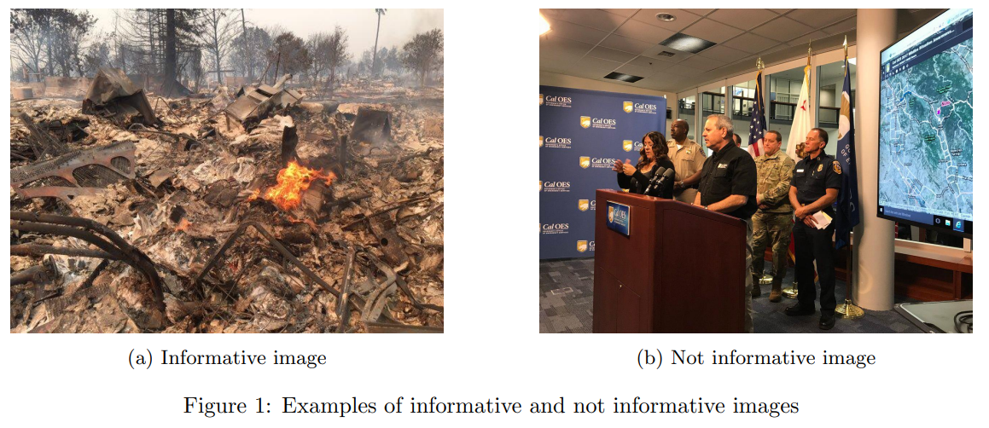
Dataset
CrisisMMD 2.0: Multimodal Crisis Dataset
Thousands of tweets and images collected during seven major natural disasters.
Goal: Informative vs Not informative
 | Informative | Non Informative
Train | 8341 | 5267
Dev | 1407 | 830
Test | 1373 | 864
Class distribution

Slide 8
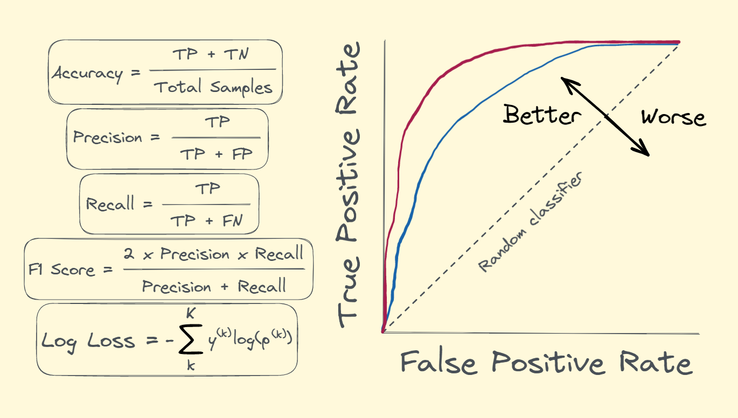
Evaluation Metric
Standard classification metrics:
Accuracy
Precision
Recall
F1 Score
ROC curve

Slide 9
Model baselines
Weak Baseline - Majority classifier
Strong Baseline - Text only classification using Sentence Bert
Extension 1 - Comparison of 2 embedding strategies :
CLIP (Contrastive Language-Image Pre-Training) image and text embeddings followed by sklearn logistic model
BLIP (Bootstrapping Language-Image Pre-training for Unified Vision-Language Understanding and Generation) generated image captions appended to tweets followed by sklearn logistic model

Slide 10
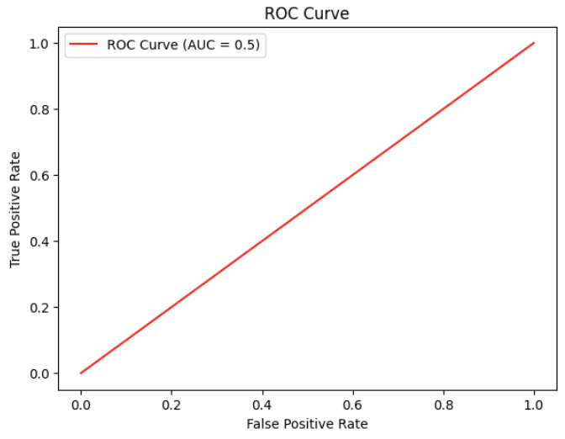
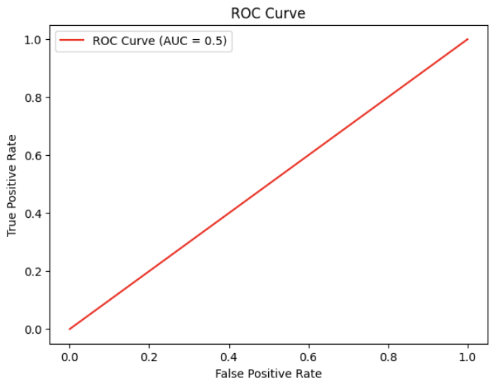

Weak Baseline: Majority Class Classifier
The weak baseline relies on the majority class classifier, predicting labels based solely on data distribution. Among the 13608 examples, 8341 were informative tweets, resulting in an accuracy of approximately 61%.
Metric | Train | Dev | Test
Accuracy | 61% | 63% | 61%
Macro-F1 Score | 0.38 | 0.39 | 0.38
Figure 1: Simple baseline classification report and ROC curve for train (left), dev (middle), and
test (right) data

Slide 11
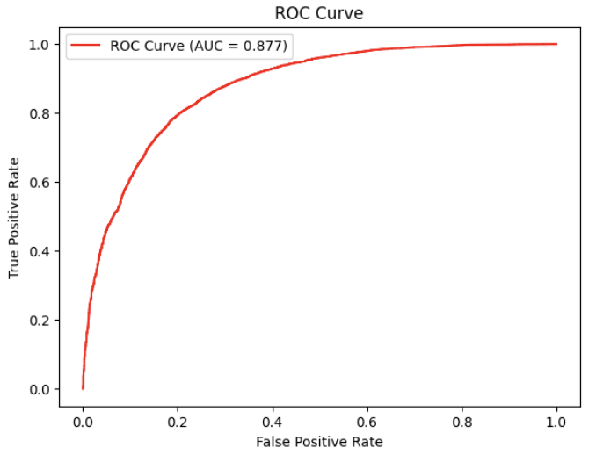
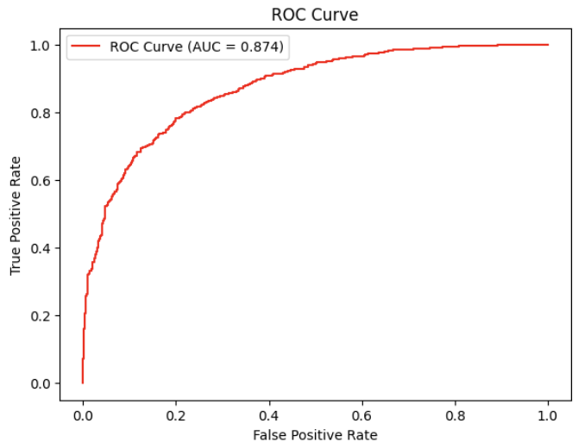
Strong Baseline: Sentence-Transformer Model
The text-only strong baseline utilizes the 'all-MiniLM-L6-v2' Sentence Transformer, achieving significant improvements in accuracy and F1 scores. We generate embeddings for the tweet text and train a logistic regression classifier on it.
Metric | Train | Dev | Test
Accuracy | 83.1% | 82.1% | 84.1%
Macro-F1 Score | 0.78 | 0.76 | 0.78
Figure 2: Strong baseline classification report and ROC curve for train (left), dev (middle), and
test (right) data

Slide 12
Extension 1: Embedding Generation Strategies
Embedding Strategies: We experimented with CLIP-Concat and Text + Captions + S-BERT for generating embeddings.
Performance Dominance: CLIP-Concat consistently outperforms Text + Captions + S-BERT.
Baseline Surpassing: Both models surpass the simple baseline, emphasizing the effectiveness of embeddings in the classification task.
Comparative Strength: CLIP-Concat shows performance comparable to the strong baseline, underscoring its competitive capability in the context of our experiment.
Embeddings | Data | Accuracy | Precision | Recall | F-Score | AUC
CLIP-Concat | Train | 0.829 | 0.82 | 0.81 | 0.82 | 0.909
CLIP-Concat | Dev | 0.806 | 0.79 | 0.79 | 0.79 | 0.869
CLIP-Concat | Test | 0.785 | 0.77 | 0.77 | 0.77 | 0.860
Text + Captions + S-BERT | Train | 0.783 | 0.78 | 0.76 | 0.76 | 0.850
Text + Captions + S-BERT | Dev | 0.759 | 0.75 | 0.72 | 0.73 | 0.829
Text + Captions + S-BERT | Test | 0.766 | 0.76 | 0.74 | 0.74 | 0.837

Slide 13
Extension 2

Slide 14
Conclusion

Slide 15
Challenges & Future Work

Slide 16
References

