Slide 1
POSTMAN
Postman is used by 5 million developers and more than 100,000 companies to access 130 million APIs every month.
Wipro DO&P

Slide 2
Topics to be covered.
1. What is postman?
2. What is a http request and status code?
3. What is an environment in postman?
4. What is a collection and how we can utilize it properly?
5. How to generate API documentation.
6. how to add tests to postman requests?
7. And more...

Slide 3
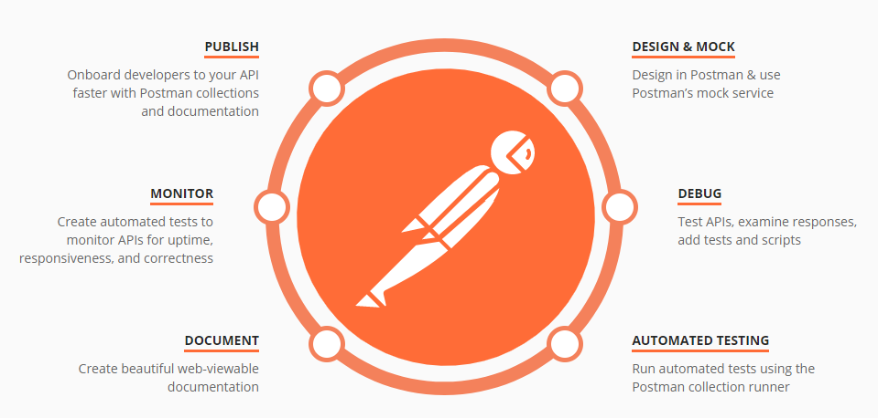
What is postman?

Slide 4
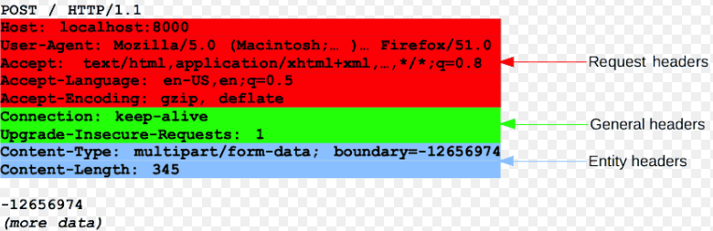
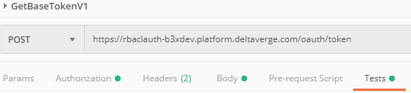

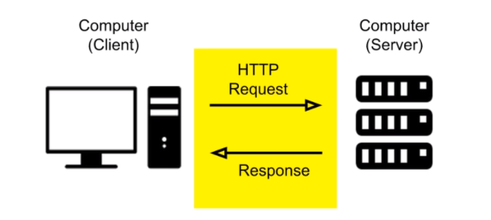
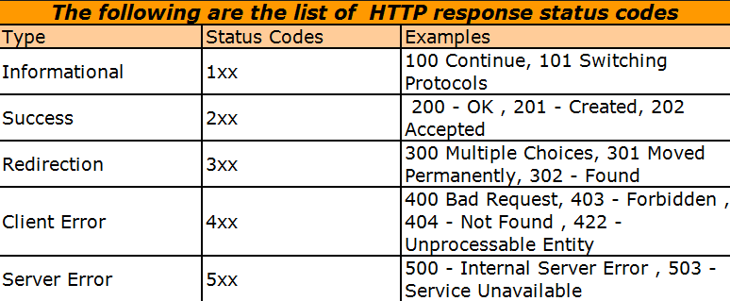

What is a http request and status codes?

Slide 5
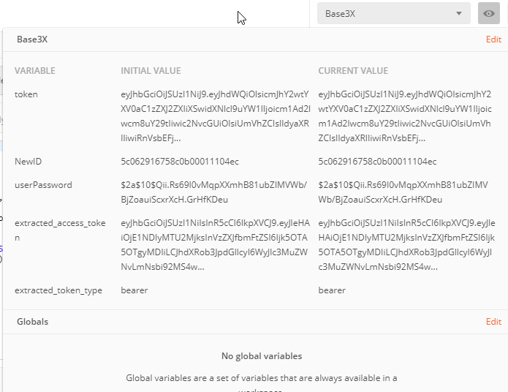
What is an environment in postman?
Environment is a space where we can store related variables. E.g. Dev, QA, Pre-Production and Production.

Slide 6
How to create & remove variables in Postman.
To get response body, parse it and finally save it to a variable.
var jsonData = JSON.parse(responseBody);
To add variable to environment we can use below line of code.
pm.environment.set("token", jsonData.access_token);
For Debugging purposes, we can use below line of code:
console.log(jsonData);
To remove variables after test completion:
pm.environment.unset("token");

Slide 7
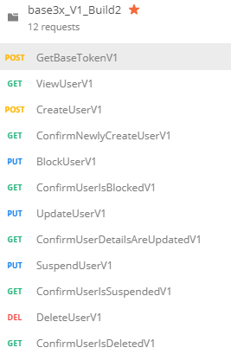
What is a collection?
Collection is a group of requests chained together so that a flow or complete test case could be achieved.
E.g.: ACL related requests.

Slide 8
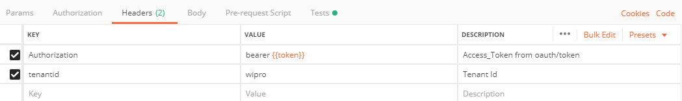
How to pass variables across multiple requests?
First step is to extract value and assign it as environment variable.
var jsonData = JSON.parse(responseBody);
pm.environment.set("token", jsonData.access_token);
To use extracted variable, we need to access it using below syntax:
{{variable_name}}

Slide 9
How to add tests to postman requests?
We need to add tests to the Tests section of postman request.
Status code validation:
pm.test("Status code is 200", function () {
pm.response.to.have.status(200);
});
Postman Documentation:
https://www.getpostman.com/docs/v6/postman/scripts/postman_sandbox_api_reference

Slide 10
Adding Tests contd…
To Validate response time expectations for specific request.
pm.test("Response time within 1 Second", function () { pm.expect(pm.response.responseTime).to.be.below(1000);
});
To validate Boolean values present in response:
pm.test("New User is Suspended", function () { pm.expect(jsonData.userList[jsonData.userList.length-1].isSuspended).to.eql(true);
});

Slide 11
Adding Tests contd…
Check for text in response:
pm.test("Updated skills found in the response", function () { pm.expect(jsonData.userList[jsonData.userList.length-1].skills).to.eql(‘Text');
});
Check if some text is not to be found in response:
pm.test("User is Deleted Successfully", function () { pm.expect(pm.response.text()).to.not.include("fl1@wipro.com");
});

Slide 12
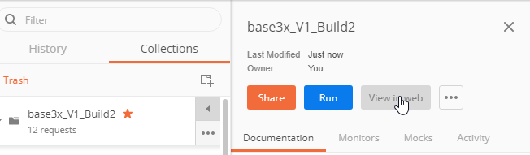
Generating API Documentation.
To create API documentation, click on play button which is beside collection name.
Before generating API documentation, Please add info in description section of each request.
Select View in Web
Finally, save it as PDF.

Slide 13
Running test using command prompt.
Node -> npm
Newman:
npm install -g newman
Newman html reporter:
npm install -g newman-reporter-html
To Generate HTML report use below command:
newman run base3x_V1_Build2.postman_collection_V4.json -e Base3X.postman_environment.json -n 10 --reporters html
To Generate Junit Report:
newman run base3x_V1_Build2.postman_collection_V4.json -e Base3X.postman_environment.json -n 10 --reporters cli,junit --reporter-junit-export newman/myreport.xml

Slide 14
Thank You

