Slide 1
Web Advanced
Jest

Slide 2
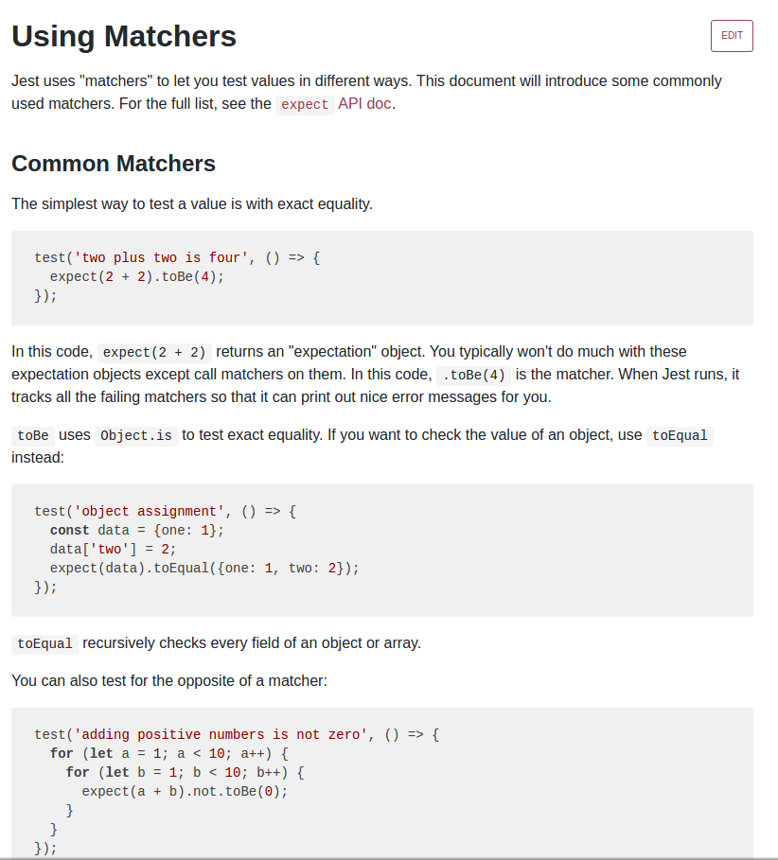
https://jestjs.io/docs/using-matchers

Slide 3
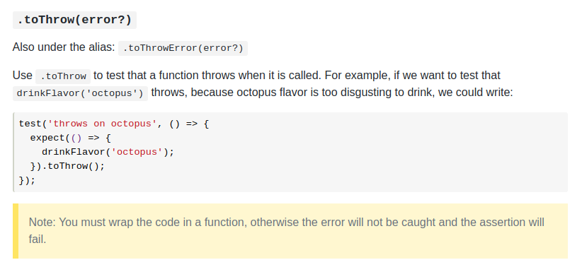

Slide 4
import Point from '../../../src/js/drawing/Point';
test('constructor to generate a Point object',
() => {
let point = new Point(1,1);
expect(point).toBeInstanceOf(Point);
});
test('constructor to throw error if 1st param. not a number',
() => {
expect(() => {
new Point("a", 1);
}).toThrow(Error);
});
test('constructor to throw error if 2nd parameter not a number',
() => {
expect(() => {
new Point(1, "a");
}).toThrow(Error);
});

Slide 5
test('getX to return the correct value',
() => {
let point = new Point(1, 2);
let x = point.x;
expect(x).toBe(1);
});
test('toString to return the correct value', () => {
let point=new Point(1,2);
let returnedString = point.toString();
expect(returnedString).toBe("(1,2)");
});

Slide 6
describe: de 3 tests van de constructor worden samengevoegd
import Point from '../../../src/js/drawing/Point';
describe('constructor',
() => {
it('should generate a Point-object for valid args',
() => {
let point = new Point(1, 1);
expect(point).toBeInstanceOf(Point)
}
)
it('should throw error if 1st parameter is not a number',
() => {
expect(() => {
new Point("a", 1);
}).toThrow(Error)
})
it('should throw error if 2d parameter is not a number',
() => {
expect(() => {
new Point(1, "a");
}).toThrow(Error)
})
}
);

Slide 7
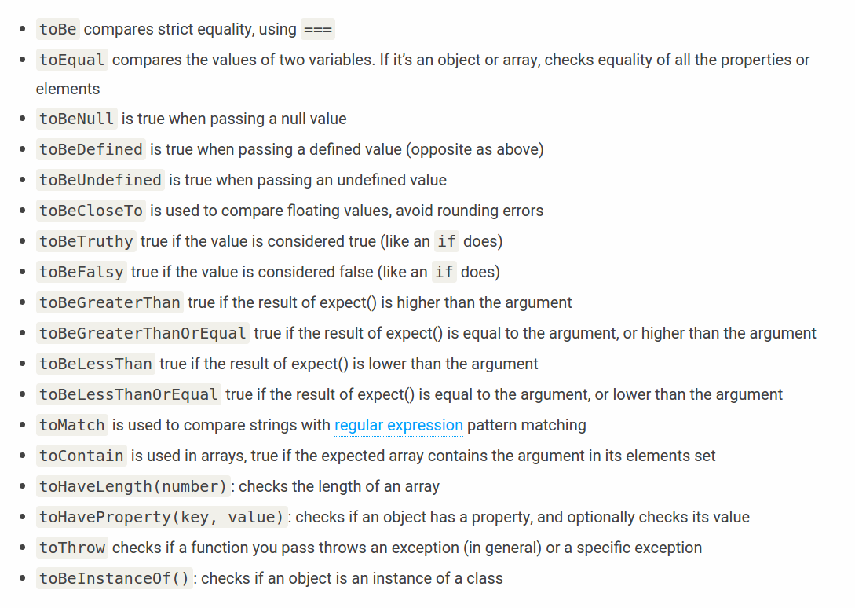

Slide 8
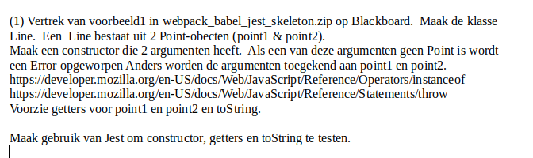
Oefening1

Slide 9
Voorbeeld2
game/Game.js
gooi N aantal dobbelstenen
als alle dobbelstenen allemaal zijn: winst = N
dependency:
util/Randomgenerator.js
Hoe Game testen die afhankelijk is van Randomgenerator?
-> dependency injection
-> mock van Randomgenerator

Slide 10
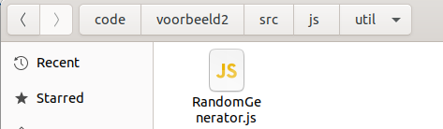
Voorbeeld2
"use strict";
export default class RandomGenerator{
constructor(){}
next(min, max){
return Math.floor(min + ( max - min ) * Math.random());
}
}

Slide 11
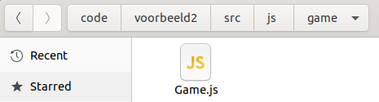
import RandomGenerator from '../util/RandomGenerator';
export default class Game{
#randomGenerator;
constructor( randomGenerator ){
if (! (randomGenerator instanceof RandomGenerator)){
throw new Error('Not a RandomGenerator');
}
this.#randomGenerator = randomGenerator;
}
throwDice( numberOfDice ){
if (!Number.isInteger(numberOfDice)) {
throw new Error('Not an integer');
}
if ( numberOfDice < 2 ) {
return 0;
}
let firstThrow = this.#randomGenerator.next(1, 6);
for (let i = 1 ; i < numberOfDice ; i++){
let newThrow = this.#randomGenerator.next(1, 6);
if( newThrow != firstThrow){
return 0;
}
}
return numberOfDice;
}
}
d.i.
constructor injection

Slide 12
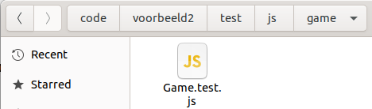
const invalidArguments = [[1], [null], ["a"]];
describe('constructor',
() => {
it('should generate a Game-object if a valid argument is provided',
() => {
let randomGenerator = new RandomGenerator();
let game = new Game(randomGenerator);
expect(game).toBeInstanceOf(Game);
}
)
test.each(invalidArguments)(
'should throw an Error given an invalid argument',
(argument) => {
expect(() => {
let game = new Game(argument);
}).toThrow(Error)
});
it('should throw error when 1st parameter is not provided',
() => {
expect(() => {
let game = new Game();
}).toThrow(Error)
})
}
);

Slide 13
describe('throwDice',
() => {
it('should return 4 if 4 times the same value is thrown',
() => {
let randomGenerator = new RandomGenerator();
let spy =
jest.spyOn(randomGenerator, 'next').mockImplementation(() => 1);
let game = new Game(randomGenerator);
let result = game.throwDice(4);
expect(result).toBe(4);
expect(spy).toHaveBeenCalled();
spy.mockRestore();
}
)
Via jest.spyOn wordt een ‘neppe’ randomGenerator gemaakt (mock)
de methode next geef altijd waarde 1 terug

Slide 14
it('should return 0 if two dice throws are not equal',
() => {
let randomGenerator = new RandomGenerator();
let spy = jest.spyOn(randomGenerator, 'next').mockImplementation(() => 2)
.mockImplementationOnce(() => 1)
.mockImplementationOnce(() => 1);
let game = new Game(randomGenerator);
let result = game.throwDice(4);
expect(result).toBe(0);
expect(spy).toHaveBeenCalled();
spy.mockRestore();
}
)
Via jest.spyOn wordt een ‘neppe’ randomGenerator gemaakt
de methode next geef altijd waarde 2 terug
behalve de eerste aanroep (1)
de tweede aanroep (1)

Slide 15
$ npm run test
constructor
✓ should generate a Game-object if a valid argument is provided (3 ms)
✓ should throw an Error given an invalid argument (2 ms)
✓ should throw an Error given an invalid argument (1 ms)
✓ should throw an Error given an invalid argument
✓ should throw error when 1st parameter is not provided (1 ms)
throwDice
✓ should return 4 if 4 times the same value is thrown (1 ms)
✓ should return 0 if two dice throws are not equal (1 ms)
Test Suites: 1 passed, 1 total
Tests: 7 passed, 7 total
Snapshots: 0 total
Time: 1.17 s
Ran all test suites.

Slide 16
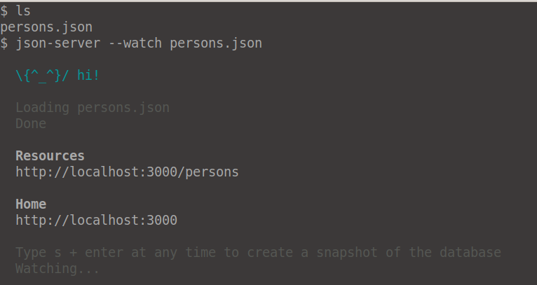
Voorbeeld3
services/PersonService
methode retrieveNameById
is afhankelijk van
repositories/PersonRepository
PersonRepository stuurt een request naar json-server

Slide 17
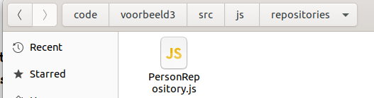
import axios from "axios";
const url = 'http://localhost:3000/persons/';
export default class PersonRepository{
async findById(id){
if(!Number.isInteger(id) || id<=0){
throw new Error();
}
const response = await axios.get(`${url}${id}`);
return response.data;
}
}

Slide 18
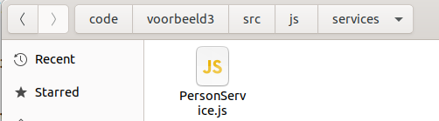
"use strict";
import PersonRepository from '../repositories/PersonRepository';
export default class PersonService{
#personRepository;
constructor( personRepository ){
if (! (personRepository instanceof PersonRepository)){
throw new Error('Not a PersonRepository');
}
this.#personRepository = personRepository;
}
async retrieveNameById(id){
let person = await this.#personRepository.findById(id);
return person.name.toUpperCase();
}
}
d.i.
constructor injection

Slide 19
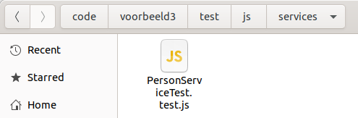
import PersonService from '../../../src/js/services/PersonService';
import PersonRepository from '../../../src/js/repositories/PersonRepository';
const persons = [[{id:1, name:"test1"}],[{id:2, name:"test2"}]];
describe('retrieveNameById',
() => {
test.each(persons)(
'given a person the name in uppercase is returned',
async (person) => {
let personRepository = new PersonRepository();
let spy = jest.spyOn(personRepository, 'findById')
.mockImplementation(() => person);
let personService = new PersonService(personRepository);
let name = await personService.retrieveNameById(person.id);
expect(spy).toHaveBeenCalledWith(person.id);
expect(name).toBe(person.name.toUpperCase());
spy.mockRestore();
});
}
);

