Slide 1
EV Charging Demand Forecasting Report
Forecasting EV charging demand using weather, time, and traffic parameters.
Includes insights from Python forecasting models and Tableau-style visualizations.

Slide 2
Key Performance Insights
- Average Charging Demand across stations.
- Peak Demand Hour and Weather conditions.
- Traffic Level impact on demand.
- Forecast vs Actual comparison accuracy.
- Optimal charging strategy recommendations.

Slide 3
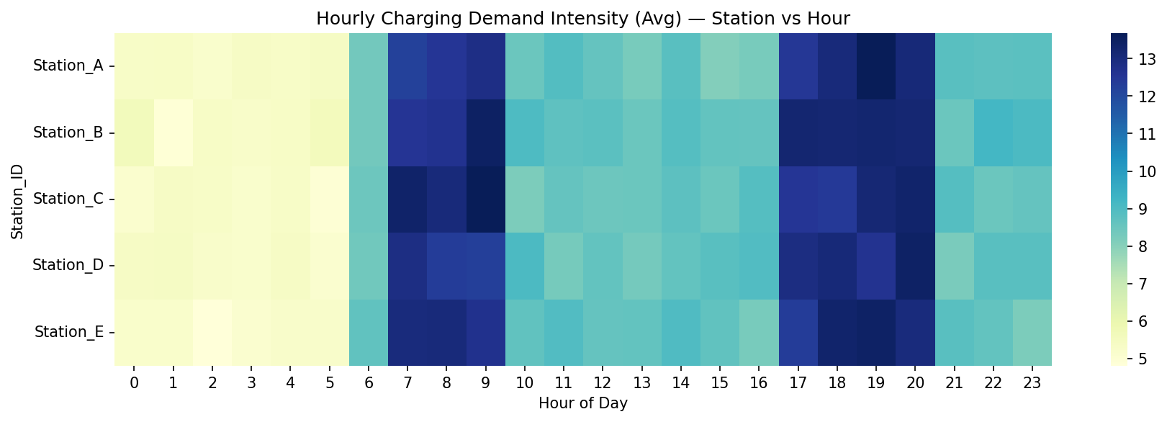
Hourly Demand Heatmap

Slide 4
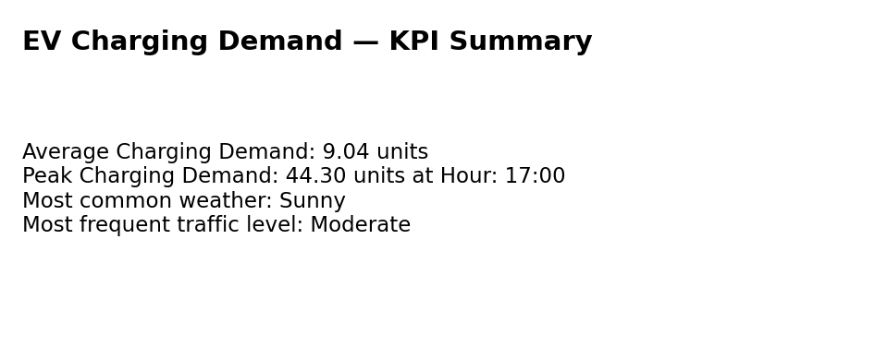
KPI Summary

Slide 5
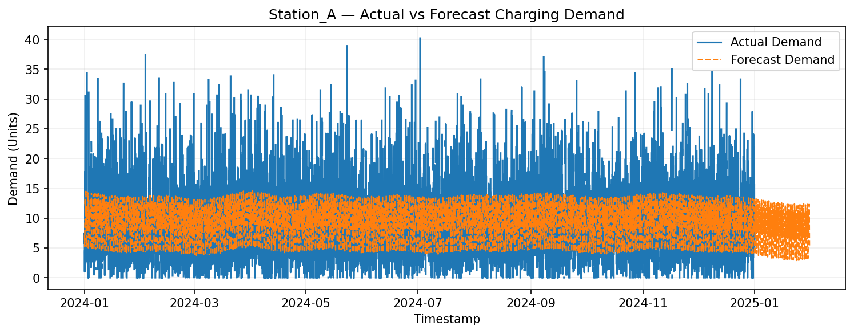
Station A Actual vs Forecast

Slide 6
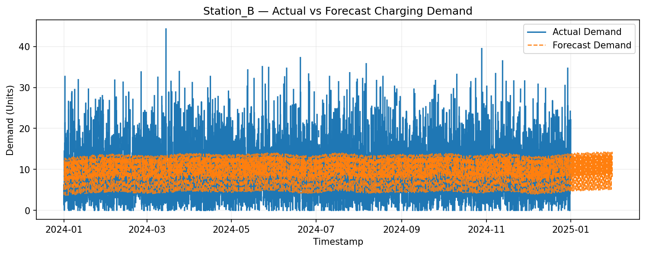
Station B Actual vs Forecast

Slide 7
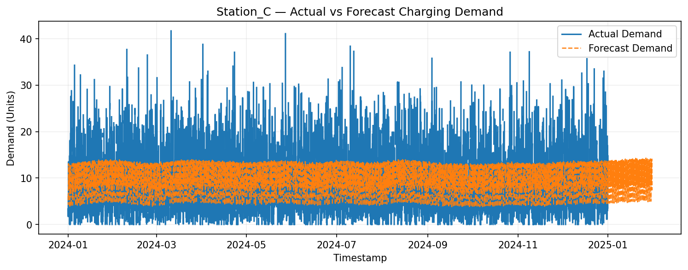
Station C Actual vs Forecast

Slide 8
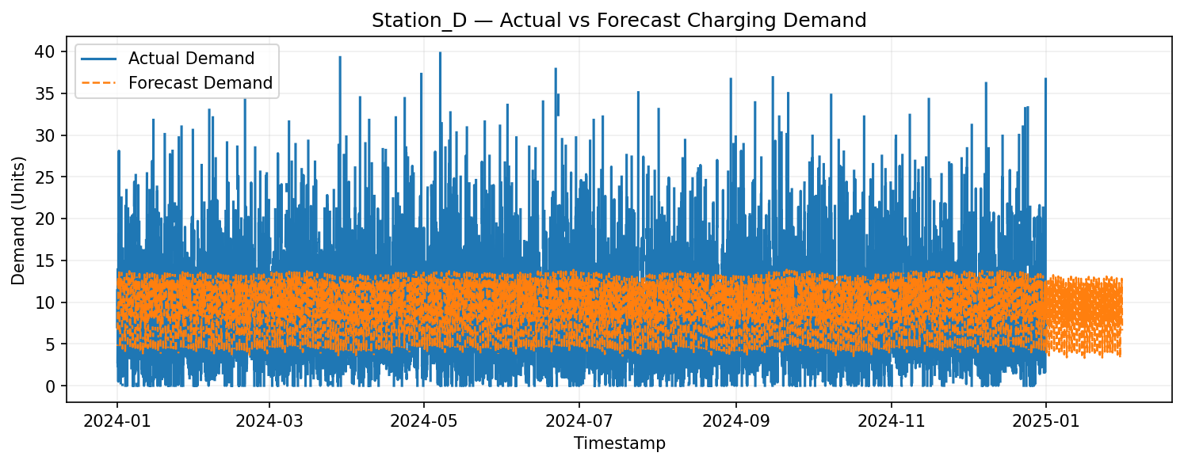
Station D Actual vs Forecast

Slide 9
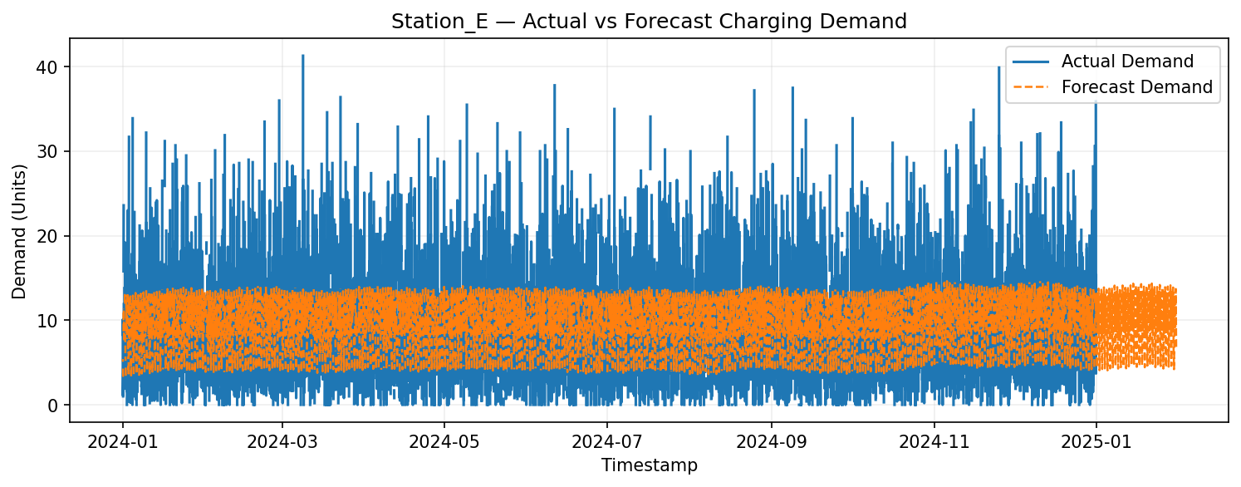
Station E Actual vs Forecast

Slide 10
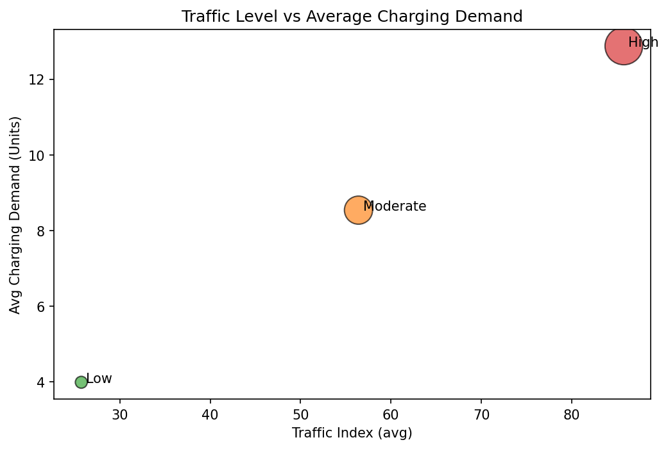
Traffic Impact

Slide 11
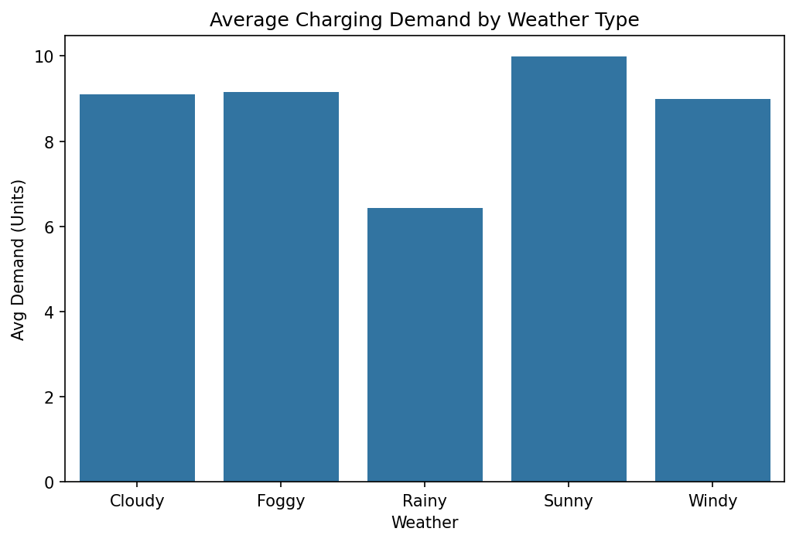
Weather Impact

