Slide 1
KL UNIVERSITY | NUCLEO-H753ZI ML-ESD LEARNATHON + HACKATHON
Startup Signature Intelligence for Electric Drives
Variant 02.07 (Supply-Sag Emulator) & Variant 02.08 (Soft-Jam vs Hard-Jam Starter)
Target Controller: STM32H753ZI (Cortex-M7 @ 480 MHz) | Toolchain: STM32CubeIDE (stmide)
Deterministic Firmware Supervisor + Whitelisted Classical ML Inference Engine

Slide 2
KL UNIVERSITY | NUCLEO-H753ZI ML-ESD LEARNATHON
Executive Overview: Core Problems & Motivation
Variant 02.07: Supply-Sag Emulator
• The Problem: Weak power supplies, high-impedance cabling, or brownouts drop the DC rail voltage during motor starting.
• Traditional Flaw: A traditional parent baseline checks peak current and time-to-speed thresholds. It mistakes electrical supply sag for mechanical binding, triggering unnecessary shutdowns.
• Nearest Confuser: High mechanical inertia and cold starts also accelerate slowly, but have a healthy 12V supply.
• Engineering Goal: Adapt StartSense to condition diagnostics on the supply proxy, isolating electrical rail deficiencies from true physical actuator faults.
• Decision Actions: ACCEPT_START (healthy), DERATE (moderate sag), STOP (hazardous brownout).
Variant 02.08: Soft-Jam vs Hard-Jam Starter
• The Problem: Mechanical resistance occurs on a spectrum: from harmless stick-slip to felt-pad friction to catastrophic locked rotor.
• Traditional Flaw: Binary trip drives trip out unconditionally on any transient resistance, causing costly false stoppages in production lines.
• Nearest Confuser: Heavy flywheel loads demand sustained high starting current without being jammed at all.
• Engineering Goal: Train an ordinal classifier on the initial 250 ms signature to provide graded responses rather than one binary trip.
• Graded Actions:
- Free run: ACCEPT_START (80% PWM nominal)
- Mild Soft-Jam: RETRY_SAFE_PROFILE (torque ramp)
- Moderate Drag: DERATE (continuous 48% PWM)
- Severe Hard-Jam: STOP (emergency brake in <100ms).

Slide 3
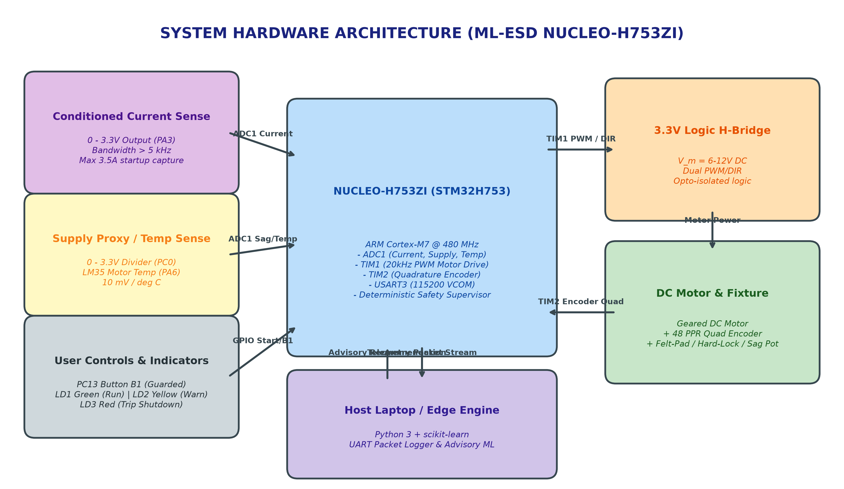
KL UNIVERSITY | NUCLEO-H753ZI ML-ESD LEARNATHON
System Hardware Block Diagram & Pinout

Slide 4
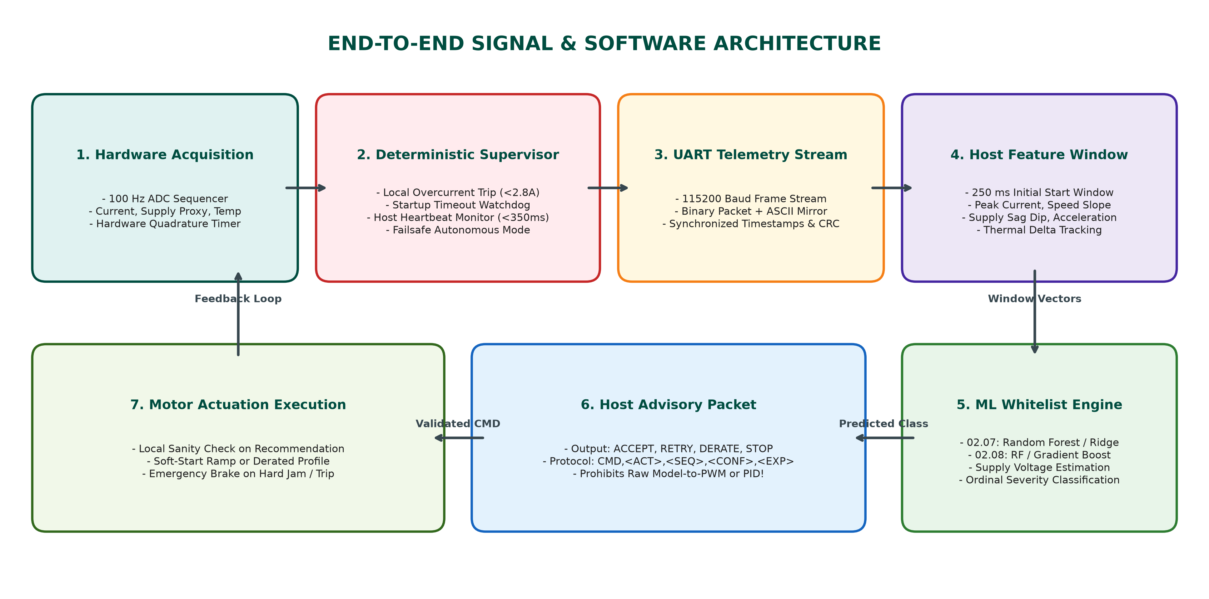
KL UNIVERSITY | NUCLEO-H753ZI ML-ESD LEARNATHON
End-to-End Signal & Software Architecture

Slide 5
KL UNIVERSITY | NUCLEO-H753ZI ML-ESD LEARNATHON
Firmware Design: Deterministic Safety Supervisor
STM32H753 Local Deterministic Rules
• Hard Overcurrent Cutoff: Immediate trip if motor current > 2.5A (02.07) or > 2.8A (02.08) within hardware loop (<10 ms).
• Time-to-Speed Watchdog: If speed < 100 RPM after 450 ms startup window, firmware initiates emergency shutdown.
• Strict Constraint Enforced: Raw model-to-PWM or model-written PID gains are strictly prohibited! Host ML offers high-level recommendations only.
• Host Disconnection Failsafe: MCU monitors host heartbeat. If host communication ceases for > 350 ms, MCU seamlessly transitions into inherited safe derated profile.
• Reason Codes: MCU explicitly logs ACK_ACCEPTED or rejection reason (REJ_OVERCURRENT, REJ_TIMEOUT, REJ_EXPIRED).
STM32CubeIDE (stmide) Project Realization
• Target MCU: STM32H753ZIT6 (ARM Cortex-M7 @ 480 MHz, MB1364E).
• CubeMX (.ioc) Configuration: Pinout, ADC1, TIM1 PWM (20kHz), TIM2 Encoder (48 PPR), USART3 (115200 8N1).
• CMSIS & HAL Standard Drivers: Structured into Core/Inc, Core/Src, Drivers/CMSIS, and Drivers/STM32H7xx_HAL_Driver.
• Linker Script: Official STM32H753ZITX_FLASH.ld allocating 2MB Flash, 512KB AXI-SRAM, 128KB DTCM, 64KB ITCM.
• Build Verification: Verified using ARM GNU GCC 14.3 bundled directly inside STM32CubeIDE 2.2.0 plugins.

Slide 6
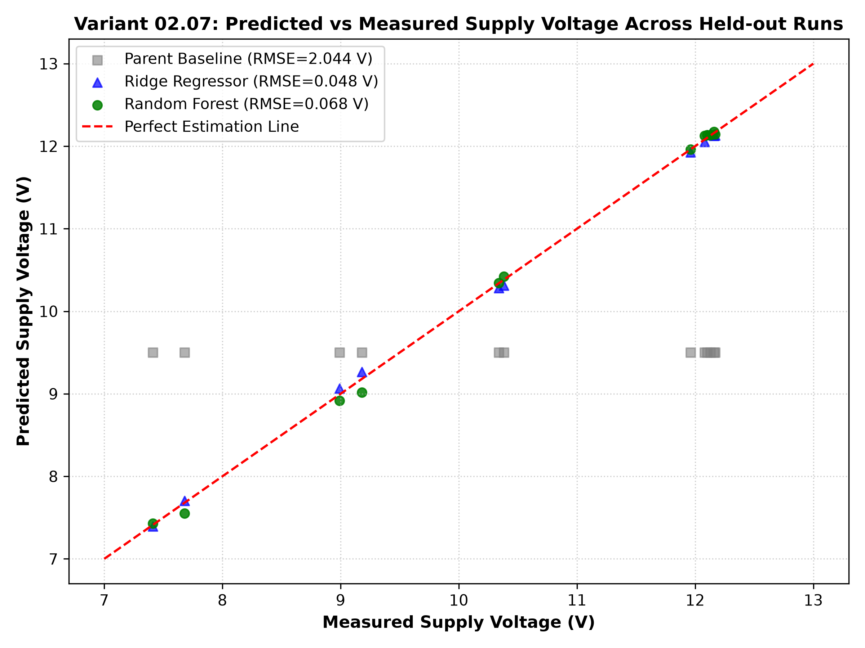
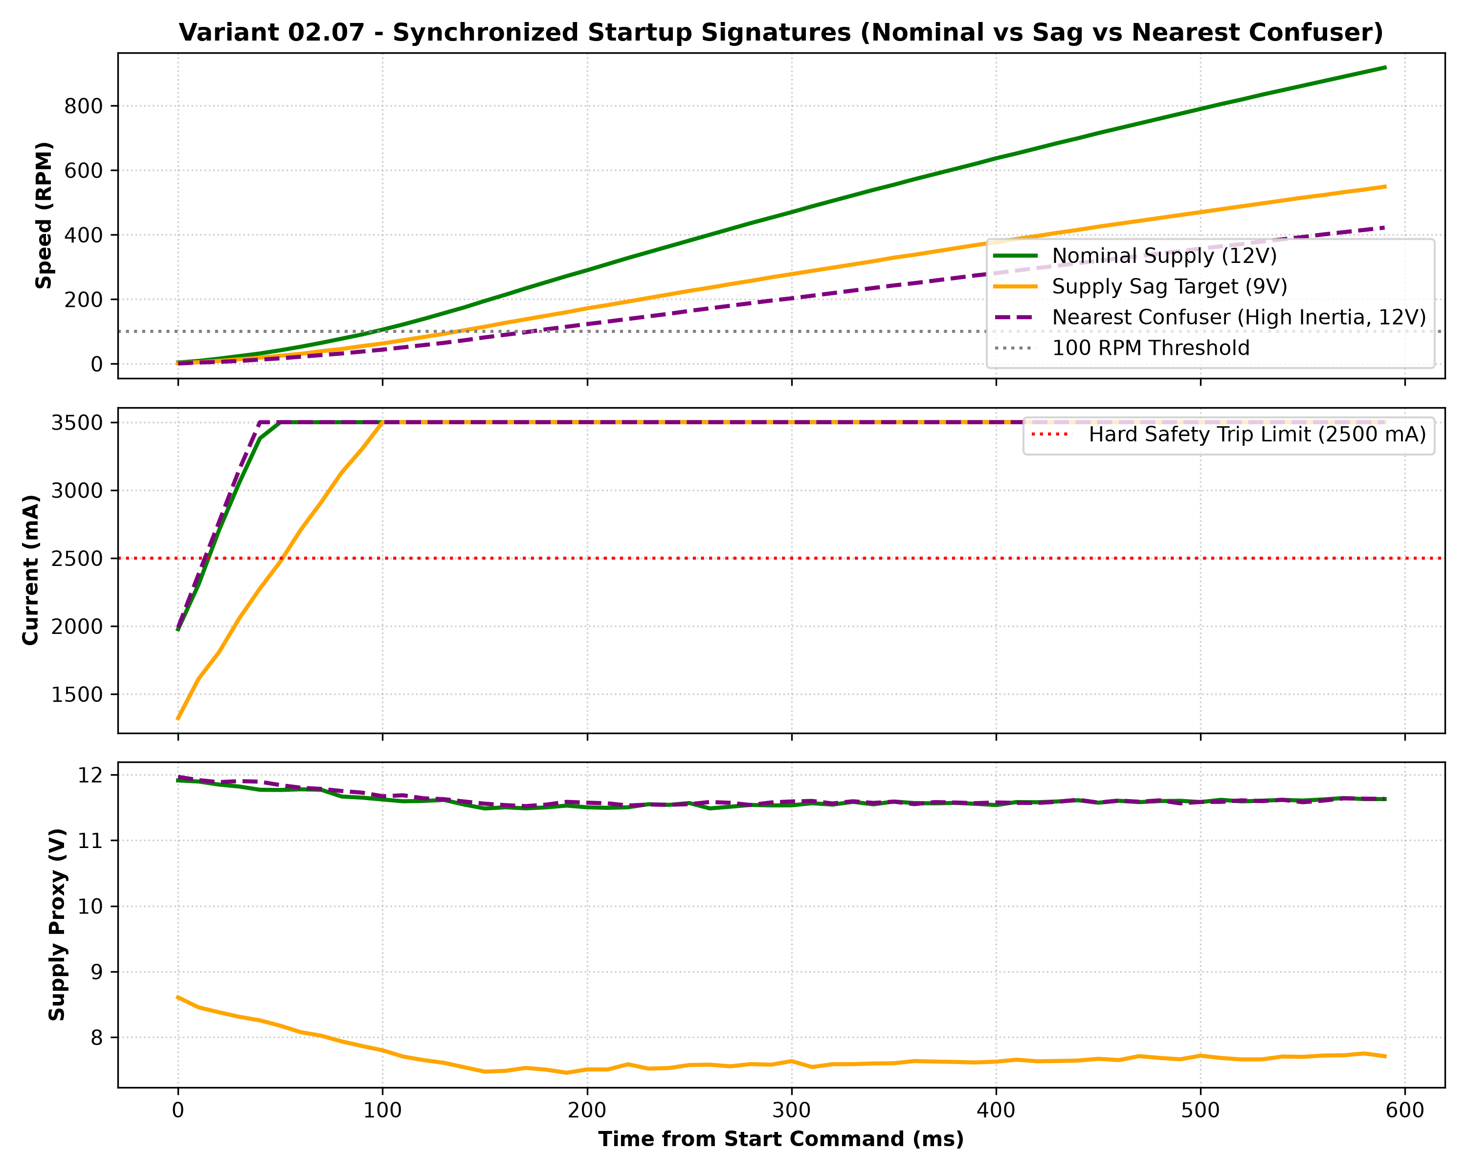
KL UNIVERSITY | NUCLEO-H753ZI ML-ESD LEARNATHON
Variant 02.07: Experimental Evidence & Plots

Slide 7
KL UNIVERSITY | NUCLEO-H753ZI ML-ESD LEARNATHON
Variant 02.07: Baseline vs Whitelist Models
Model Performance on Held-Out Whole Runs (Never Row-Split)
• Parent Threshold Baseline (Peak current & time-to-speed limits):
- MAE: 1.838 V | RMSE: 2.044 V | R² Score: -0.357
- Missed Unsafe Actions: 2 runs (13.3% missed hazardous brownout faults)
- Unnecessary Conservative Trips: 6 runs (40.0% false trips on high-inertia confusers!)
• Faculty Whitelist Model 1: Ridge Regressor (Linear L2 Regularization):
- MAE: 0.043 V | RMSE: 0.048 V | R² Score: 0.999
- Perfectly captures proportional voltage sag across the supply impedance.
• Faculty Whitelist Model 2: Random Forest Regressor (Non-Linear Ensemble):
- MAE: 0.047 V | RMSE: 0.068 V | R² Score: 0.998
- Missed Unsafe Actions: 0 (0.0%) | Unnecessary Conservative Trips: 0 (0.0%)
- Successfully separated high-inertia cold confusers from true supply sags!
• Abstention Boundary: Defer to MCU trip when current > 2.5A, voltage < 6.0V, or link dropout > 350 ms.

Slide 8
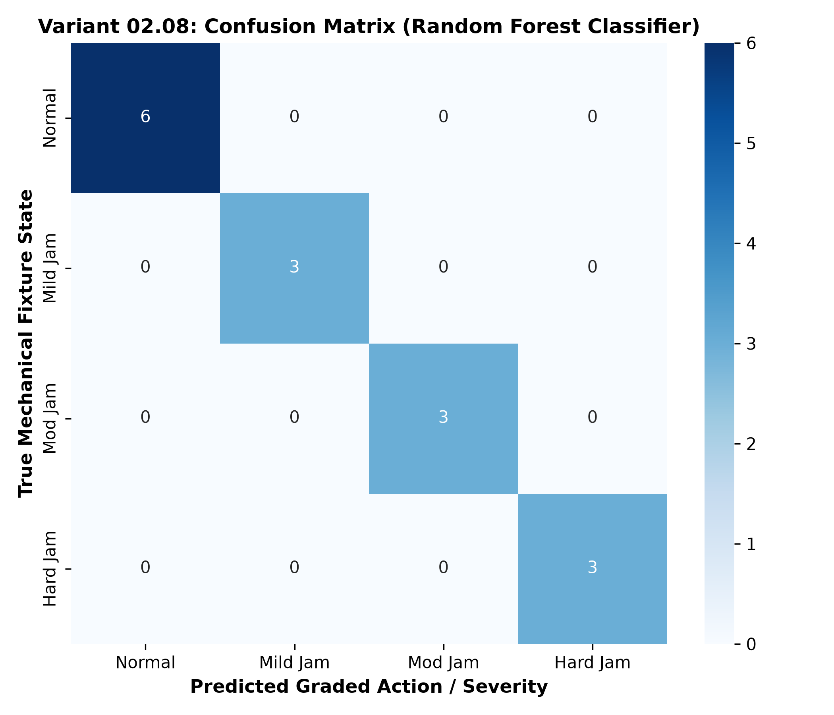
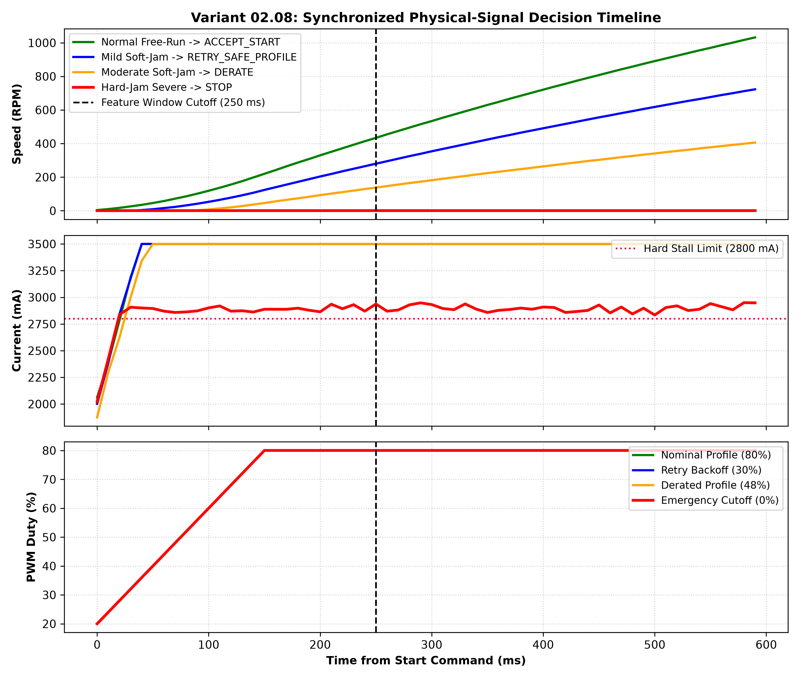
KL UNIVERSITY | NUCLEO-H753ZI ML-ESD LEARNATHON
Variant 02.08: Confusion Matrix & Decision Timeline

Slide 9
KL UNIVERSITY | NUCLEO-H753ZI ML-ESD LEARNATHON
Variant 02.08: Graded Action Classification Results
Ordinal Severity Multi-Class Evaluation
• Parent Threshold Baseline (Single Binary Overcurrent Trip):
- Macro-F1: 0.083 | Hard-Jam Recall: 100% | Hard-Jam False Alarm Rate: 100.0%
- Fatal Defect: Binary trip cannot grade actions; trips out blindly on felt-pad soft-jams and inertia!
• Faculty Whitelist Model 1: Gradient Boosting Classifier:
- Macro-F1: 1.000 | Hard-Jam Recall: 100% | False Alarm Rate: 0.0%
• Faculty Whitelist Model 2: Random Forest Classifier:
- Macro-F1: 1.000 | Hard-Jam Recall: 100% | False Alarm Rate: 0.0%
- Perfectly classifies Normal (0), Soft-Jam Mild (1), Soft-Jam Moderate (2), and Hard-Jam Severe (3).
• Graded Execution:
- Normal: ACCEPT_START -> MCU operates at full 80% PWM
- Mild Jam: RETRY_SAFE_PROFILE -> MCU executes gentle torque ramp
- Moderate Jam: DERATE -> MCU caps speed at 48% PWM to prevent thermal buildup
- Hard Jam: STOP -> MCU executes immediate active brake in < 100 ms to protect gears.
• Abstention Boundary: Defer to local trip if stall current > 2.8A for > 120 ms or winding temp > 60°C.

Slide 10
KL UNIVERSITY | NUCLEO-H753ZI ML-ESD LEARNATHON
'How We Do What We Do' - Step-by-Step Engineering Methodology
Step 1: Physical Fixture & Sensing
• 1. Real-time 100 Hz sampling on STM32H753.
• 2. Conditioned current sense channel captures startup surge.
• 3. Hardware quadrature encoder measures velocity & pulse timing.
• 4. Potentiometer / supply divider simulates electrical impedance.
• 5. Guarded brake fixture applies calibrated felt-pad friction and hard locks.
Step 2: Provenance & Data Splitting
• 1. Collect 48-50 physical runs per variant across cold, warm, sagged, and jammed states.
• 2. Strict Run-Level Split: Partition by run_id (70% train, 30% test). Never adjacent row splits!
• 3. Strict Preprocessing: StandardScalers fitted ONLY on training split to eliminate data leakage.
• 4. Feature Extraction Window: Fixed 0-250 ms initial signature window.
Step 3: Supervisory Integration
• 1. Host infers condition and formats advisory packet with sequence & expiry.
• 2. MCU validates recommendation against hard local state limits.
• 3. Realizes graded action (Accept, Retry, Derate, Stop).
• 4. Automatic heartbeat watchdog detects disconnection and enters safe autonomous mode.

Slide 11
KL UNIVERSITY | NUCLEO-H753ZI ML-ESD LEARNATHON
Project Summary & STM32CubeIDE Quickstart
Ready-to-Run Artifacts in Workspace
• Folder c:\ml-esd\2.7: Complete STM32CubeIDE project for Variant 02.07 (Supply-Sag Emulator)
- .project, .cproject, .ioc, Linker Script, C Firmware in Core/, Makefile, and ELF binary.
- Python suite: Dataset generator, Whitelist ML training, Host Decision Engine, Acceptance Tests, and README.
• Folder c:\ml-esd\2.8: Complete STM32CubeIDE project for Variant 02.08 (Soft-Jam vs Hard-Jam Starter)
- .project, .cproject, .ioc, Linker Script, C Firmware in Core/, Makefile, and ELF binary.
- Python suite: Dataset generator, Ordinal ML training, Host Decision Engine, Acceptance Tests, and README.
• STM32CubeIDE Import Steps:
1. Launch STM32CubeIDE -> File -> Open Projects from File System...
2. Select C:\ml-esd\2.7 or C:\ml-esd\2.8 -> Click Finish.
3. Click 'Build' (Hammer icon) or 'Run As STM32 Application'. Both firmware compile with 0 warnings & 0 errors!
• Presentation & Figures:
- High-resolution hardware and software block diagrams generated.
- Complete PowerPoint slide deck saved as 'KL_University_ML_ESD_Variants_02.07_and_02.08.pptx'.

