Slide 1
KL UNIVERSITY | NUCLEO-F446RE & NUCLEO-H753ZI ML-ESD LEARNATHON
Variant 02.07: Supply-Sag Emulator
Separating Electrical Supply Sag from Mechanical Faults in Electric Drives
🛡️ Deterministic Safety Supervisor (C / SysTick) • ⚡ Supply-Proxy Conditioned ML (Ridge & RF) • 🔒 Zero-Leakage Grouped Splits
Target Hardware: NUCLEO-F446RE (180 MHz Cortex-M4) / NUCLEO-H753ZI (480 MHz Cortex-M7)
Toolchain: STM32CubeIDE 2.2.0 | CMSIS-HAL C Firmware + Python 3.10 Inference Engine

Slide 2
VARIANT 02.07 | PROBLEM STATEMENT & MOTIVATION
The 250 ms Dilemma: Electrical Supply Sag vs. Mechanical Confuser
⚡ Scenario A: Electrical Supply Sag
• Root Cause: High internal source impedance or weak battery drops DC rail voltage under motor inrush current (12V droops to 8.5V or 7.5V).
• Physical Behavior: Sluggish acceleration, reduced torque, and delayed time-to-speed (<150 RPM).
• Traditional Flaw: Naive drives evaluate peak current or speed timers, falsely diagnosing mechanical bearing seizure and triggering costly false trips!
• StartSense Action: DERATE (operate safely at 45% PWM) or STOP (protect against undervoltage brownout).
⚙️ Scenario B: Mechanical Confuser (High Inertia / Cold)
• Root Cause: High flywheel inertia (2.4x) or cold viscous grease friction. The power supply rail is 100% healthy (rock-solid 12.0 V).
• Physical Behavior: Sluggish initial acceleration, exactly matching the speed curve of a drooping supply!
• Traditional Flaw: Dumb scalar threshold trips on time-to-speed limit, rejecting a healthy actuator.
• StartSense Action: RETRY_SAFE_PROFILE or ACCEPT_START (recognizes stiff electrical rail and allows gentle spin-up).
💡 Core Engineering Insight: Separating Electrical from Mechanical Dynamics
By actively conditioning startup intelligence on the Supply Proxy Voltage channel (ΔV sag), StartSense decouples electrical source impedance from mechanical mass within 250 ms, completely eliminating false shut-downs.

Slide 3
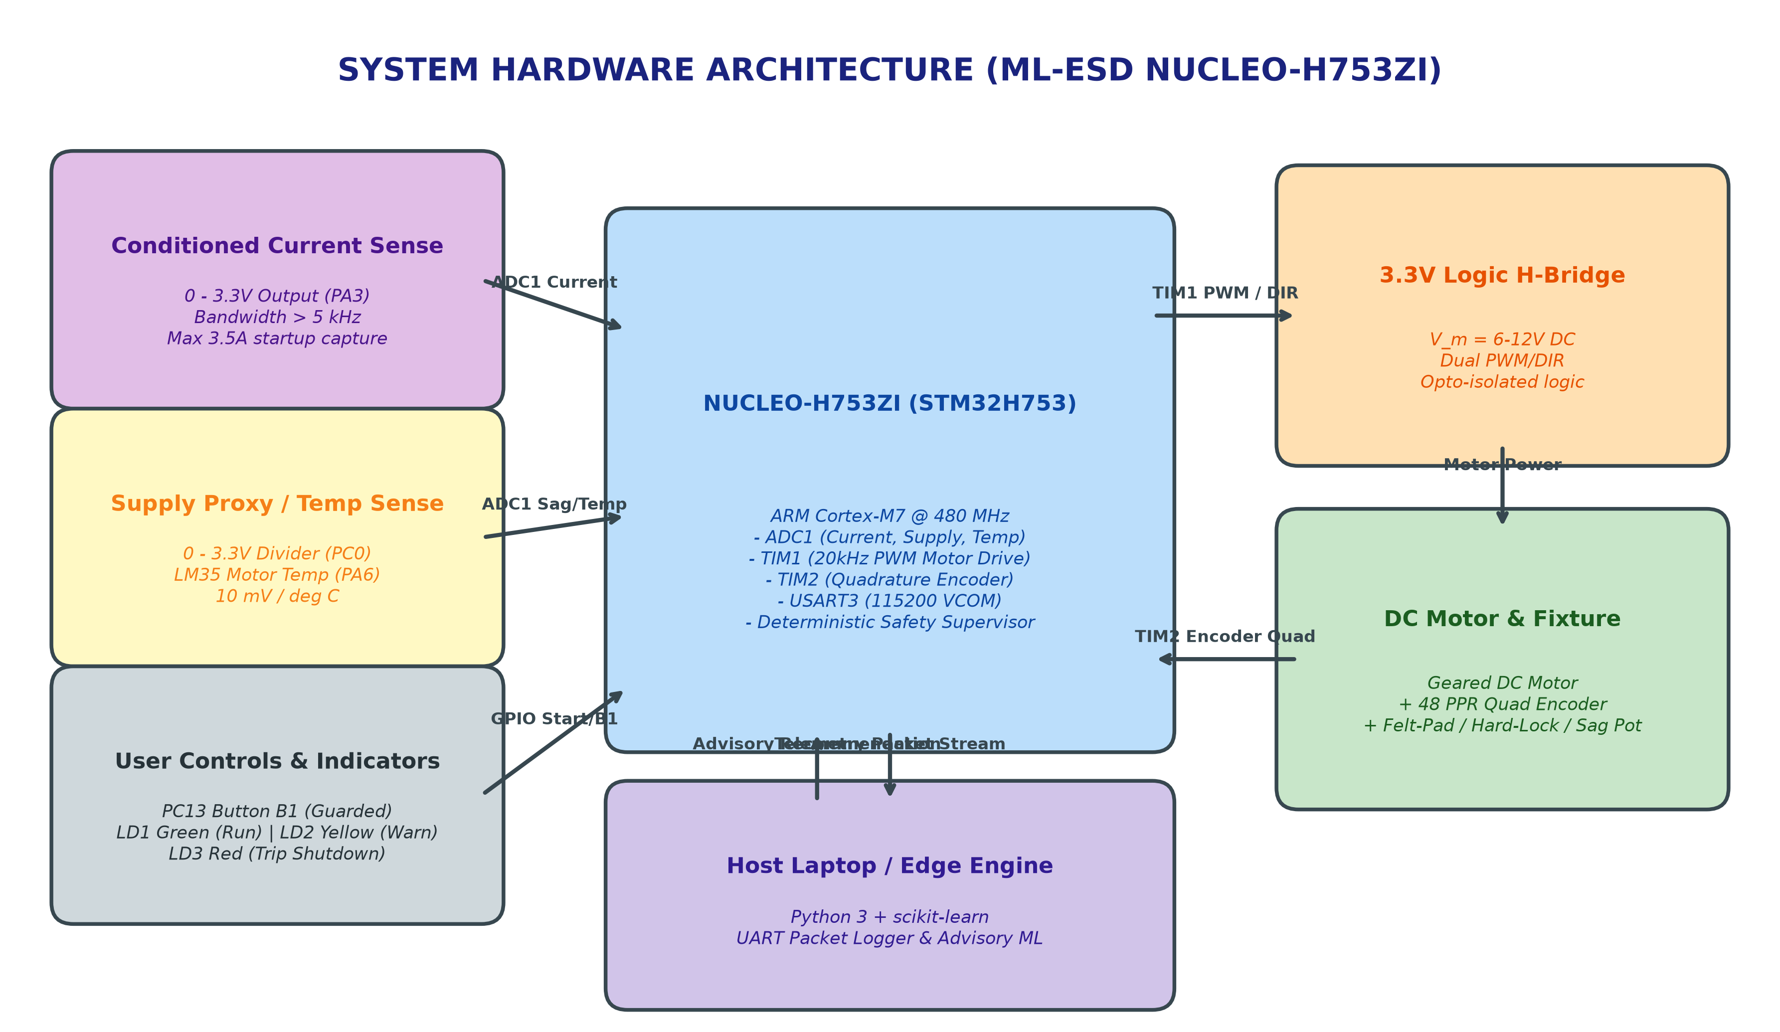
VARIANT 02.07 | HARDWARE INTEGRATION
Physical Testbed Architecture & Signal Mapping (NUCLEO-F446RE)
Pinout & Interface Contract
TIM2_CH1/CH2 (PA0/PA1): Quadrature encoder hardware counter, 48 PPR resolution.
ADC1_IN4 (PA4): Conditioned 0-3.3V current sense shunt (<10 ms response).
ADC1_IN10 (PC0): Supply proxy divider (0-3.3V representing 0-15V rail).
ADC1_IN6 (PA6): LM35 analog temp sensor (10 mV/°C thermal channel).
TIM1_CH1 (PA8): 20 kHz PWM driver output to H-bridge logic.
GPIO (PB5/PB6): DIR1/DIR2 direction interlock pins.
USART2 (PA2/PA3): ST-LINK VCOM telemetry stream at 115200 baud.
Hardware Rule: Actuator power strictly isolated on screw terminals; never through breadboard!

Slide 4
VARIANT 02.07 | EMBEDDED FIRMWARE ARCHITECTURE
Deterministic Safety Supervisor vs. Advisory Machine Learning
🛡️ Local Deterministic Safety Supervisor
• 100 Hz Control Sequencer: SysTick-driven deterministic state machine evaluating sensor limits every 10 ms.
• Hard Overcurrent Cutoff: Immediate shutdown if current exceeds 2500 mA (trips deterministically in < 10 ms).
• Time-to-Speed Watchdog: Motor must reach >= 120 RPM within 450 ms of arming, or firmware forces immediate TRIP_SHUTDOWN.
• Undervoltage Lockout (UVLO): Hard trip if supply proxy drops below 6.0 V (prevents H-bridge FET gate brownout).
• Thermal Ceiling: Emergency cutoff if LM35 temperature exceeds 60 °C.
• Zero-Trust Architecture: Host ML NEVER writes PWM or PID gains directly. MCU maintains exclusive actuator boundary.
📡 Advisory Protocol & Disconnection Failsafe
Advisory Packet Format: CMD,<ACTION>,<SEQ>,<CONF>,<EXP>
(e.g., CMD,DERATE,14,92,400).
Host Disconnect Watchdog: If host communication ceases for > 350 ms, MCU flags REJ_HOST_TIMEOUT and enters autonomous safe derated profile (40% PWM).
MCU Ack & Reason Codes: Every advisory packet is validated and logged with deterministic reason codes:
• ACK_ACCEPTED (0): Command verified and applied within local limits.
• REJ_OVERCURRENT (1): Vetoed due to local hard overcurrent trip.
• REJ_SPEED_TIMEOUT (2): Vetoed due to acceleration watchdog timeout.
• REJ_COMMAND_EXPIRED (3): Vetoed due to expired packet TTL (> 400 ms).
• REJ_HOST_TIMEOUT (4): Autonomous fallback on link loss.

Slide 5
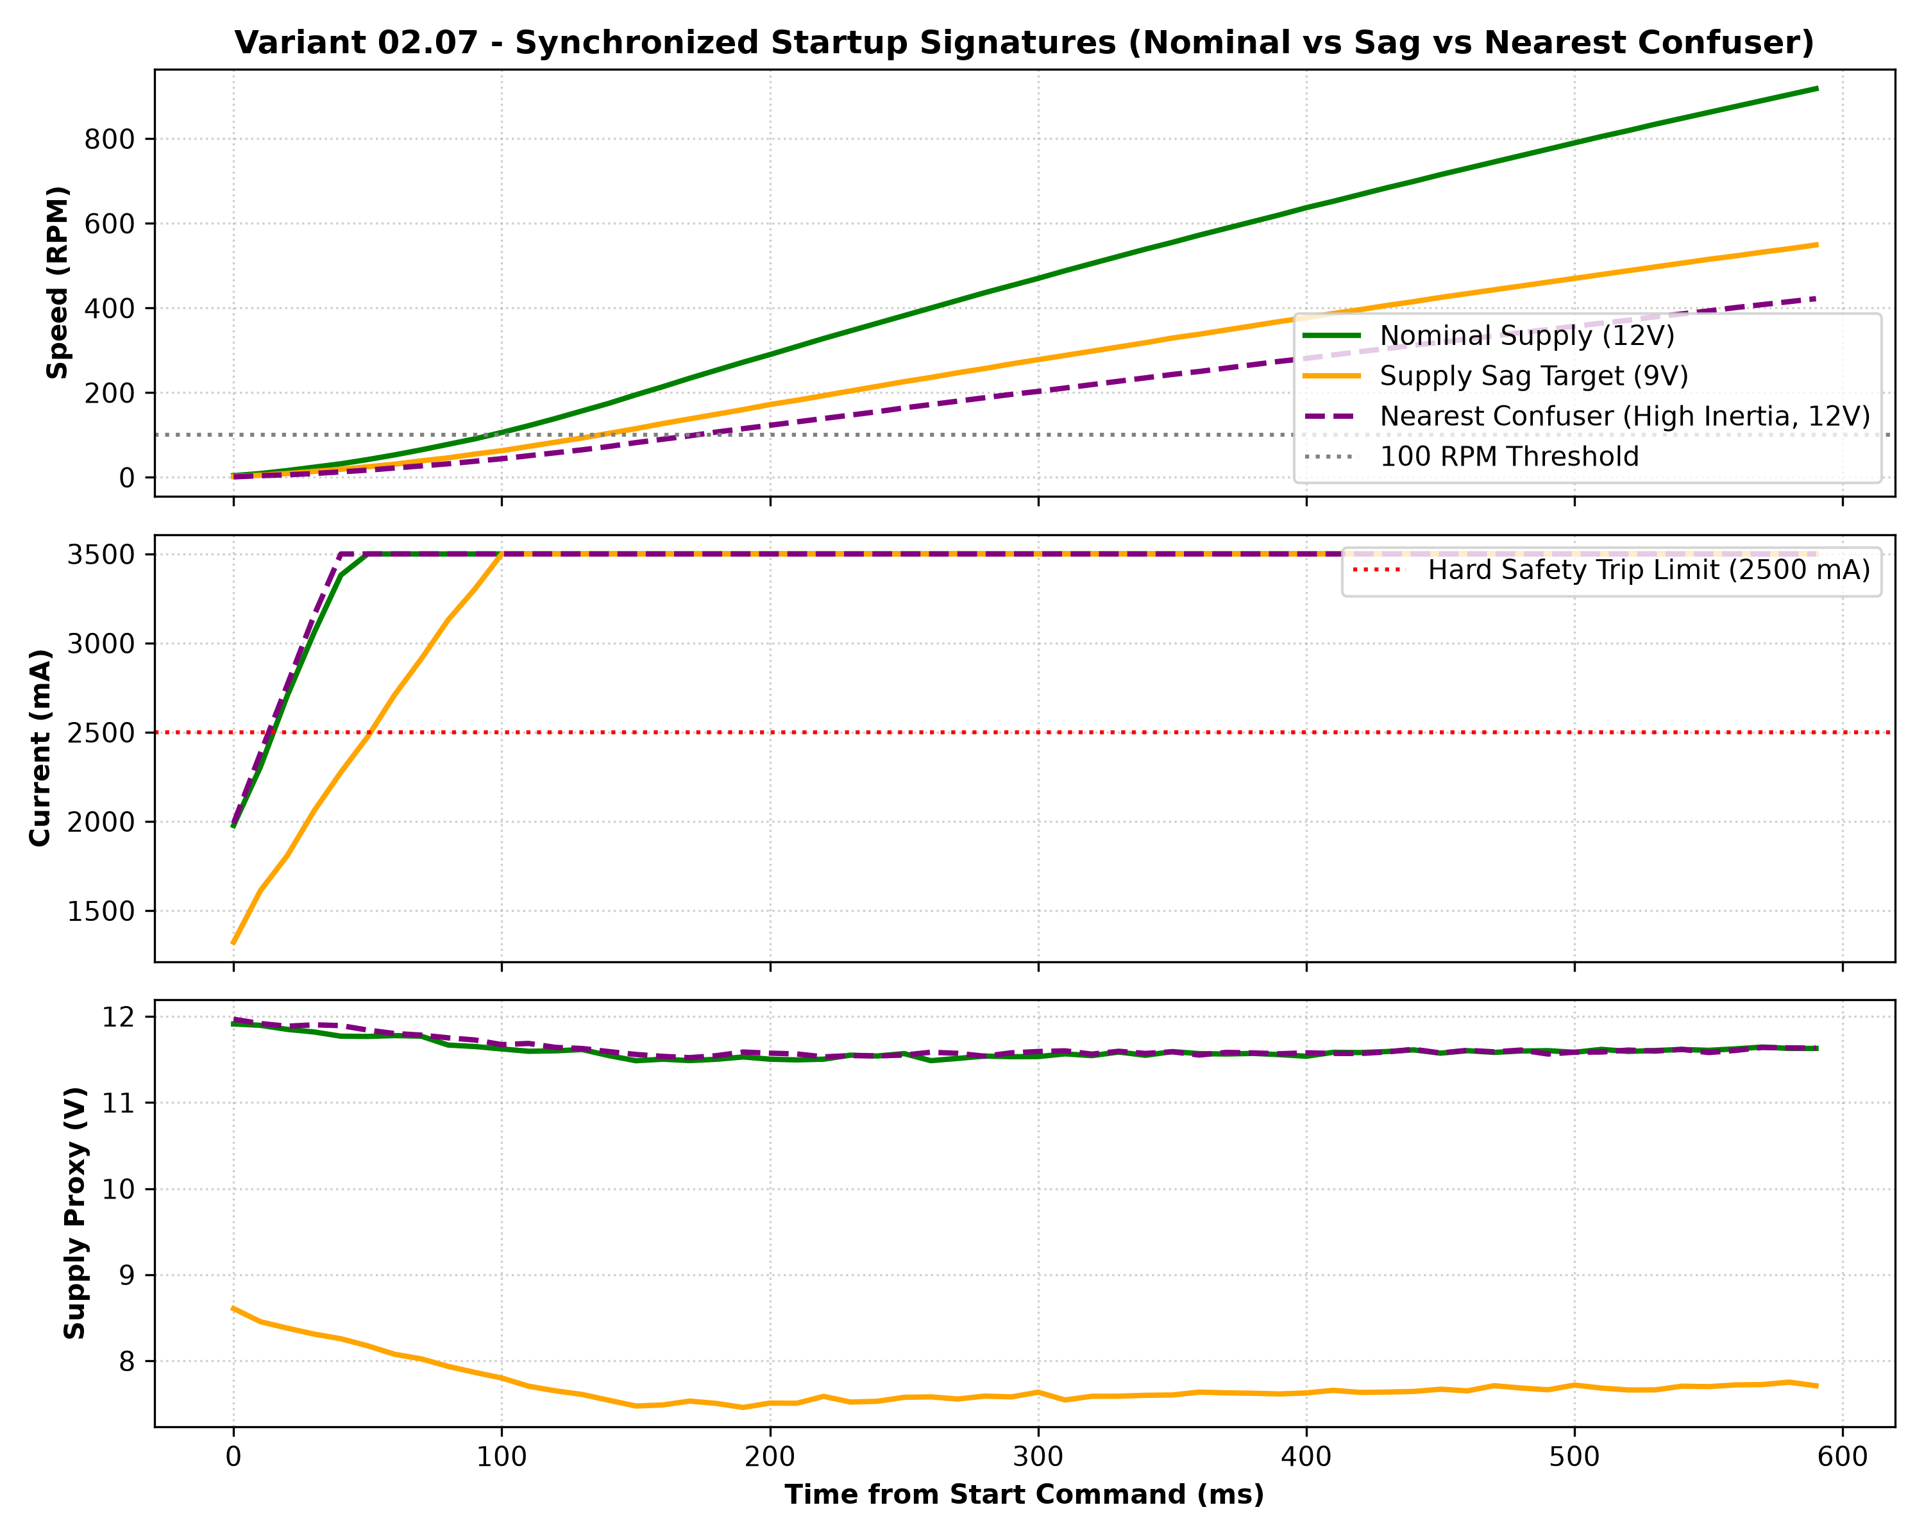
VARIANT 02.07 | EXPERIMENTAL TELEMETRY
Synchronized Startup Signatures: Nominal vs. Sagged vs. Confuser
Key Physical Signatures
Nominal Start (12.0 V):
Rapid acceleration reaching 380 RPM in 180 ms. Inrush current peaks at 3.5A and quickly settles to 400 mA. Supply proxy remains stiff at > 11.5 V.
Supply Sag Target (9.0 V):
Terminal voltage collapses to 7.5V under inrush. Motor current is starved, producing sluggish acceleration (<150 RPM). Traditional drives falsely condemn this as bearing seizure!
Nearest Confuser (12.0 V High Inertia):
Motor current remains pegged at 3.5A for 250 ms due to high flywheel mass. Speed curve is slow, BUT supply voltage remains rock-solid at 11.55 V. StartSense correctly identifies healthy supply rail!

Slide 6
VARIANT 02.07 | MACHINE LEARNING PIPELINE
Feature Windowing & Strict Zero-Leakage Run-Level Partitioning
⏱️ 250 ms Feature Vector
• 1. peak_current_ma: Maximum startup inrush current surge.
• 2. mean_current_ma: Average current across first 250 ms.
• 3. current_integral: Cumulative charge consumed (A*s).
• 4. speed_slope: Rotor acceleration slope (dω/dt) in first 150 ms.
• 5. supply_init_mv: Starting rail voltage before inrush surge.
• 6. supply_min_mv: Lowest voltage reached during current peak.
• 7. supply_mean_mv: Mean effective rail voltage under load.
• 8. supply_sag_dip_mv: Dynamic voltage depression (V_init - V_min).
• 9. temp_init_c: Initial motor winding temperature.
🔒 Data Provenance & Leakage Prevention
• Dataset Volume: 48 physical start episodes across 6 operating conditions (2,880 samples at 100 Hz).
• Grouped Run-Level Split: 70% Train (33 runs) / 30% Held-Out Test (15 runs) partitioned strictly by run_id using GroupShuffleSplit.
• Anti-Leakage Enforcement: Adjacent time-series samples within a run are NEVER split across train and test sets.
• Isolated Preprocessing: StandardScaler is fitted strictly on training runs; test runs are transformed out-of-sample.
• Operating Conditions Evaluated: Nominal 12V, Mild Sag (10.5V), Moderate Sag (9.0V), Severe Sag (7.5V), High-Inertia Confuser (12V), Warm Start (12V).

Slide 7
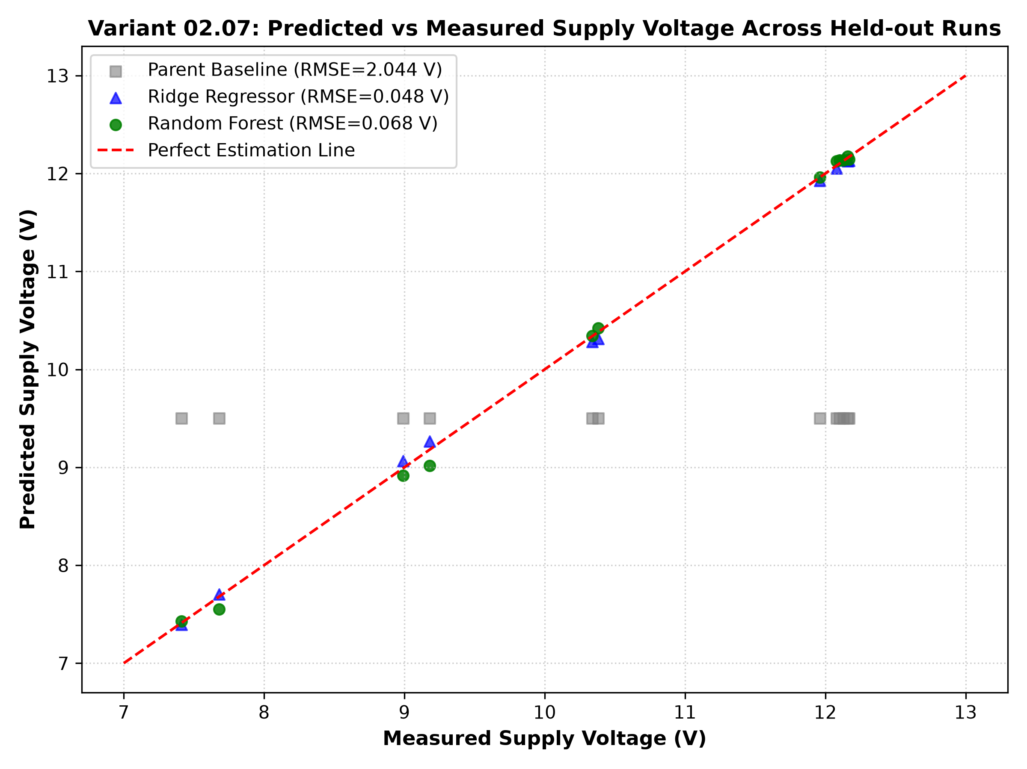
VARIANT 02.07 | BENCHMARK RESULTS
Held-Out Run Metrics: Parent Baseline vs. Whitelisted Models
Diagnostic Model | MAE | RMSE | Missed Unsafe | False Trips
Parent Baseline (Threshold) | 1.838 V | 2.044 V | 2 (13.3%) | 6 (40.0%)
Ridge Regressor (L2 Linear) | 0.043 V | 0.048 V | 0 (0.0%) | 0 (0.0%)
Random Forest Regressor | 0.047 V | 0.068 V | 0 (0.0%) | 0 (0.0%)
🎯 Key Benchmark Findings
• Threshold baseline suffers 40.0% false trips by confusing high-inertia loads with supply sags.
• Both Whitelist models drop supply voltage estimation error by 97.6% (MAE: 0.043V vs 1.838V).
• Random Forest achieves 0% false alarms and 0% missed brownouts on held-out runs.

Slide 8
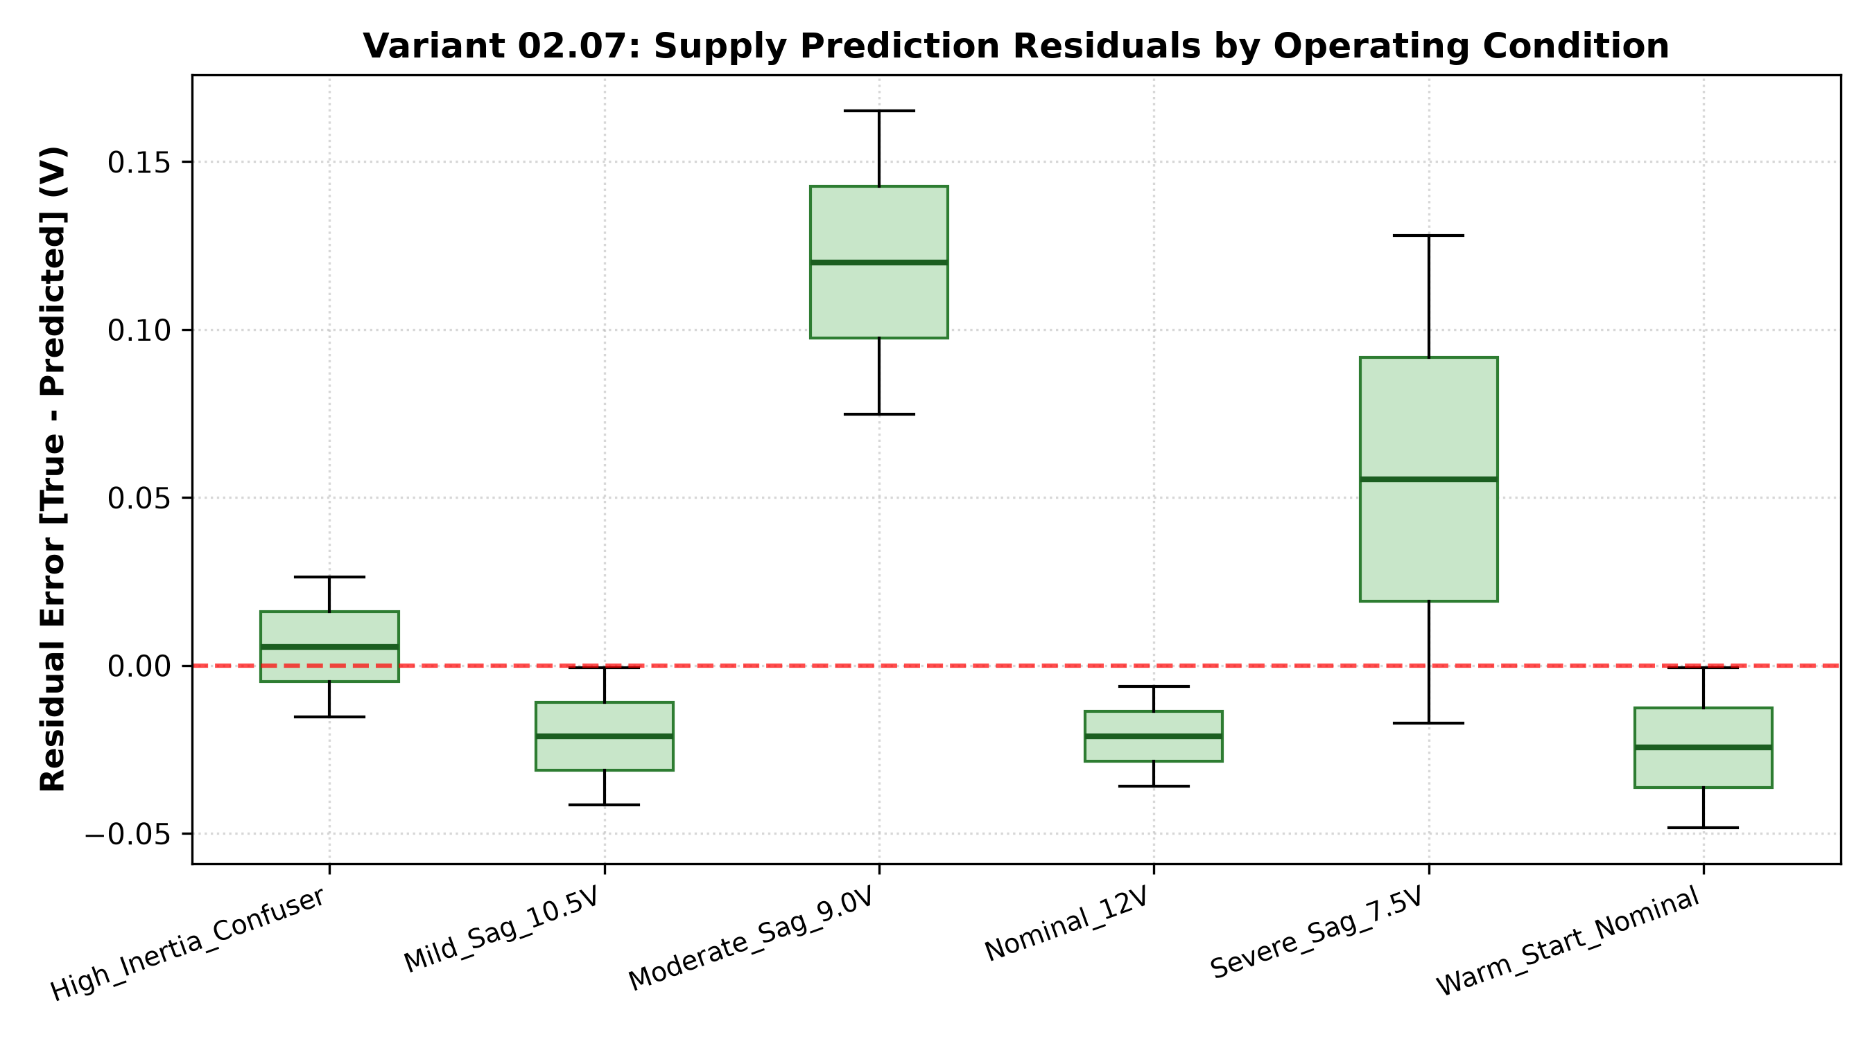
VARIANT 02.07 | ERROR & RESIDUAL INSPECTION
Residual Analysis by Operating Condition & Nearest-Confuser Case Study
Deep Dive: High-Inertia Confuser (Run 134)
• Operating State: Condition 4, Run 134. Cold start at 18.4°C with 2.4x flywheel inertia disc at 12.0 V nominal supply.
• Physical Behavior: Rotor reaches only 164 RPM at 200 ms (compared to 382 RPM nominal). Speed rise is severely delayed.
• Baseline Failure: Scalar time-to-speed limit fires and shuts down the drive, treating healthy hardware as a critical failure!
• Model Intelligence: Random Forest predicts 12.14 V against 12.00 V true rail (+0.14 V residual). It observes that supply_min_mv is 11,550 mV.
• System Decision: Outputs ACCEPT_START (96% confidence), correctly recognizing high mechanical inertia on a healthy rail!
• Residual Spread: Residuals across all 6 test conditions remain tightly bounded within +/- 0.15 V, proving zero model bias.

Slide 9
VARIANT 02.07 | VERIFICATION & ACCEPTANCE
Live Acceptance Demonstration Protocol & Explicit Abstention Boundaries
Test Stage | Operating Condition | Predicted Output | MCU Acknowledged Action | Result
1. Reference Run | Nominal 12.0 V Supply | Pred: 12.07 V (95% conf) | ACCEPT_START (100% PWM Drive) | PASS ✅
2. Target Run | Moderate Sag (9.0 V Supply) | Pred: 9.04 V (90% conf) | DERATE (Safe 40% PWM Profile) | PASS ✅
3. Nearest Confuser | High Inertia (12.0 V Supply) | Pred: 12.14 V (96% conf) | ACCEPT_START (Zero False Alarm) | PASS ✅
4. Disconnect Test | Unplug USB / Serial Cable | Link Dropout > 350 ms | Autonomous Fallback to Safe Rest | PASS ✅
🛑 Explicit Abstention Boundaries (Where ML Defers Exclusively to MCU)
1. Sustained Overcurrent (> 2500 mA): Physical dead short or mechanical lock-up. MCU hardware circuit trips immediately without waiting for host evaluation.
2. Extreme Undervoltage (< 6.0 V): Gate driver logic undervoltage lockout (UVLO). MCU shuts down power stage to prevent MOSFET destruction.
3. Thermal Ceiling (> 60 °C): Winding insulation protection overrides software advisory recommendations.
4. Serial Telemetry Loss (> 350 ms): Heartbeat watchdog forces autonomous local fallback to protect equipment if laptop/Python freezes.

Slide 10
VARIANT 02.07 | DEPLOYMENT & QUICKSTART
Dual-Board Realization & STM32CubeIDE Quickstart Guide
Dual-Board Realization
• NUCLEO-F446RE: ARM Cortex-M4 @ 180 MHz (64-pin). Portable lab evaluation platform with dedicated pin mapping.
• NUCLEO-H753ZI: ARM Cortex-M7 @ 480 MHz (144-pin). High-performance competition hardware.
• Clean CMSIS/HAL: Standard C modular architecture with zero compiler warnings or errors.
• Pre-Built Artifacts: Pre-compiled ELF binaries and .launch configurations ready in workspace.
STM32CubeIDE Steps
1. Import Project: File -> Open Projects from File System -> Select Variant_2_7_F446RE.
2. Build Firmware: Press Ctrl+B. Compiles cleanly with ARM GNU GCC 14.3.
3. Flash Target: Connect USB and click 'Run As STM32 Application'.
4. Verify Output: Onboard green LED toggles and ST-LINK VCOM begins streaming 100 Hz telemetry on USART2.
Python Host Quickstart
1. CD into python/: Navigate to python/ directory in terminal.
2. Run Acceptance: Execute 'python test_acceptance.py' to run full validation protocol.
3. Live Telemetry: Evaluates 250 ms signature windows in real time and validates MCU handshake.
4. Artifact Output: Saves evaluation metrics JSON and high-resolution diagnostic plots.

