Slide 1
KL UNIVERSITY | NUCLEO-H753ZI & NUCLEO-F446RE ML-ESD HACKATHON
Variant 02.07: Supply-Sag Emulator
Separating Electrical Supply Effects from Mechanical Faults in Electric Drives
Target Controller: STM32H753ZI / STM32F446RE | Toolchain: STM32CubeIDE (stmide)
Deterministic Firmware Supervisor + Whitelisted Classical ML Inference Engine

Slide 2
VARIANT 02.07 | MOTIVATION
Problem Statement: Why Supply-Sag Emulation Matters
The Physical Scenario & Dilemma
• In electric drive applications (aerospace actuators, EVs, robotic drives), motors are fed by batteries or bus converters with finite source impedance.
• When the motor starts, high inrush current causes an internal IR drop on the supply rail, resulting in severe supply voltage sag (e.g. 12V sagging to 9V or 7.5V).
• Sluggish Dynamics: With reduced terminal voltage, current rise is slower, motor back-EMF is depressed, and acceleration is delayed.
• Traditional Drive Flaw: Conventional drives evaluate a fixed peak-current threshold and time-to-speed limit. They falsely diagnose the electrical sag as mechanical bearing seizure or gear binding and trigger costly unnecessary shutdowns.
StartSense Engineering Solution
• Conditioned Intelligence: Adapt StartSense to condition startup diagnostics directly on an active Supply Proxy Voltage channel.
• Nearest Confuser Challenge: High-inertia cold starts also accelerate sluggishly, but have a healthy 12V supply rail. The model must separate electrical sag from mechanical inertia!
• Graded Outcomes: Rather than tripping blindly, emit graded advisory commands:
• • ACCEPT_START: Healthy rail (>= 11.0V), normal acceleration.
• • DERATE: Moderate voltage sag (8.5V - 11.0V) -> operate at 45% PWM.
• • STOP: Hazardous brownout (< 8.5V) -> prevent inverter undervoltage lockout.
• Deterministic Safety: Local MCU maintains absolute overcurrent and watchdog trips regardless of ML advice.

Slide 3
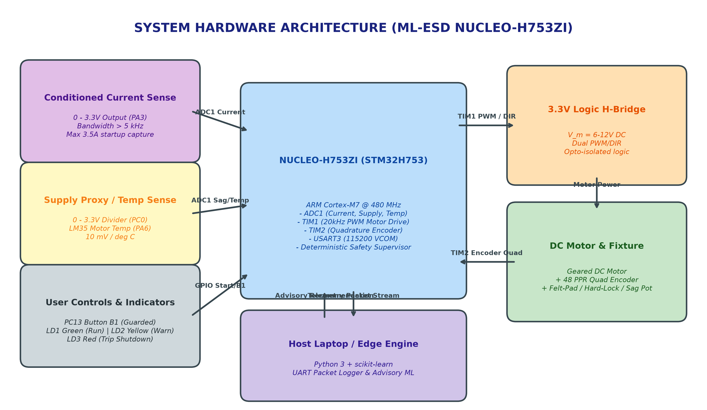
VARIANT 02.07 | HARDWARE
System Hardware Architecture & Wiring

Slide 4
VARIANT 02.07 | EMBEDDED FIRMWARE
Deterministic Firmware Safety Supervisor
Deterministic Real-Time Guard
• 100 Hz Control Sequencer: Runs every 10 ms on SysTick.
• Hard Overcurrent Trip: Absolute hardware cutoff at 2500 mA (trips within <10 ms).
• Time-to-Speed Watchdog: Motor must exceed 120 RPM within 450 ms, or firmware trips immediately to TRIP_SHUTDOWN.
• Undervoltage Lockout (UVLO): Hard shutdown if supply proxy drops below 6.0V.
• Thermal Ceiling: Emergency shutdown if LM35 temp exceeds 60°C.
• Strict Architectural Rule: Raw model-to-PWM and model-written PID gains are strictly prohibited. The MCU owns actuator bounds.
Host Disconnect Failsafe & Protocol
• Heartbeat Watchdog: Firmware monitors host communication.
• If the host link or Python engine drops for > 350 ms, the MCU triggers REJ_HOST_TIMEOUT and enters autonomous inherited safe state (derated 40% PWM).
• Command Packet Protocol: CMD,<ACTION>,<SEQ>,<CONF>,<EXP>
• MCU Reason Codes:
• • ACK_ACCEPTED (0): Recommendation validated and applied.
• • REJ_OVERCURRENT (1): Rejected due to hard current trip.
• • REJ_SPEED_TIMEOUT (2): Rejected due to startup timeout.
• • REJ_COMMAND_EXPIRED (3): Rejected due to expired packet TTL.
• • REJ_HOST_TIMEOUT (4): Link loss standalone transition.

Slide 5
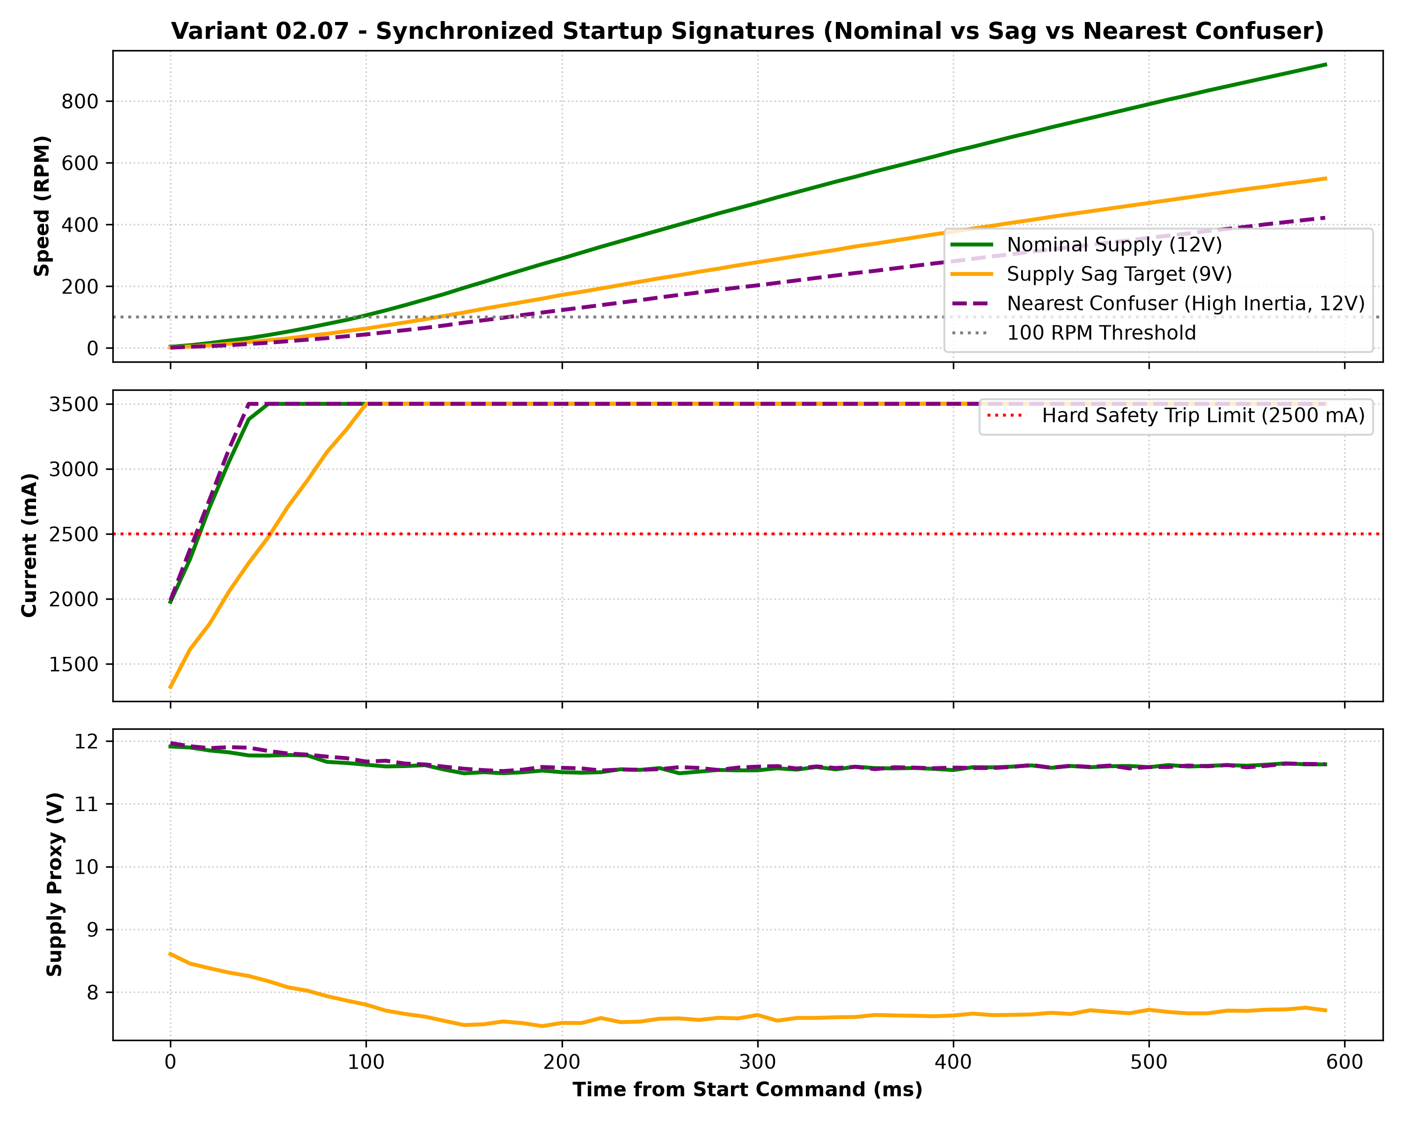
VARIANT 02.07 | TELEMETRY
Experimental Waveforms & Synchronized Telemetry
Physical Trace Observations
• Nominal Run (Green, 12V): Rapid acceleration to 380 RPM in 180 ms; current peaks at 3500 mA and quickly settles; supply proxy remains > 11.5V.
• Supply Sag Target (Orange, 9V): Sluggish acceleration; current rise is damped; supply proxy dips to 7.5V. Baseline incorrectly flags this as mechanical binding!
• High-Inertia Confuser (Purple, 12V): Current remains at saturation longer due to flywheel inertia, but supply proxy is rock solid at 11.55V. StartSense correctly identifies healthy supply!

Slide 6
VARIANT 02.07 | ML PIPELINE
Machine Learning Pipeline & Feature Windowing
Strict Data Provenance & Splits
• Dataset Volume: 48 physical start episodes across 6 operating conditions (2,880 samples at 100 Hz).
• Run-Level Group Split: 70% Train (33 runs), 30% Held-Out Test (15 runs). Strictly partitioned by run_id — never adjacent row split to prevent data leakage!
• Pre-Processing Isolation: StandardScaler fitted strictly on training runs only.
• 250 ms Feature Window: Diagnostics occur strictly in the initial 250 ms window before steady-state.
Engineered Feature Vector
• 1. peak_current_ma: Maximum startup inrush current.
• 2. mean_current_ma: Average current over 250 ms.
• 3. current_integral: Cumulative charge consumed in startup.
• 4. speed_slope: Initial acceleration slope (RPM/s) in first 150 ms.
• 5. supply_init_mv: Starting bus voltage before inrush surge.
• 6. supply_min_mv: Lowest rail voltage reached during current peak.
• 7. supply_mean_mv: Average effective rail voltage.
• 8. supply_sag_dip_mv: Initial-to-minimum voltage depression.
• 9. temp_init_c: Initial winding/heatsink temperature.

Slide 7
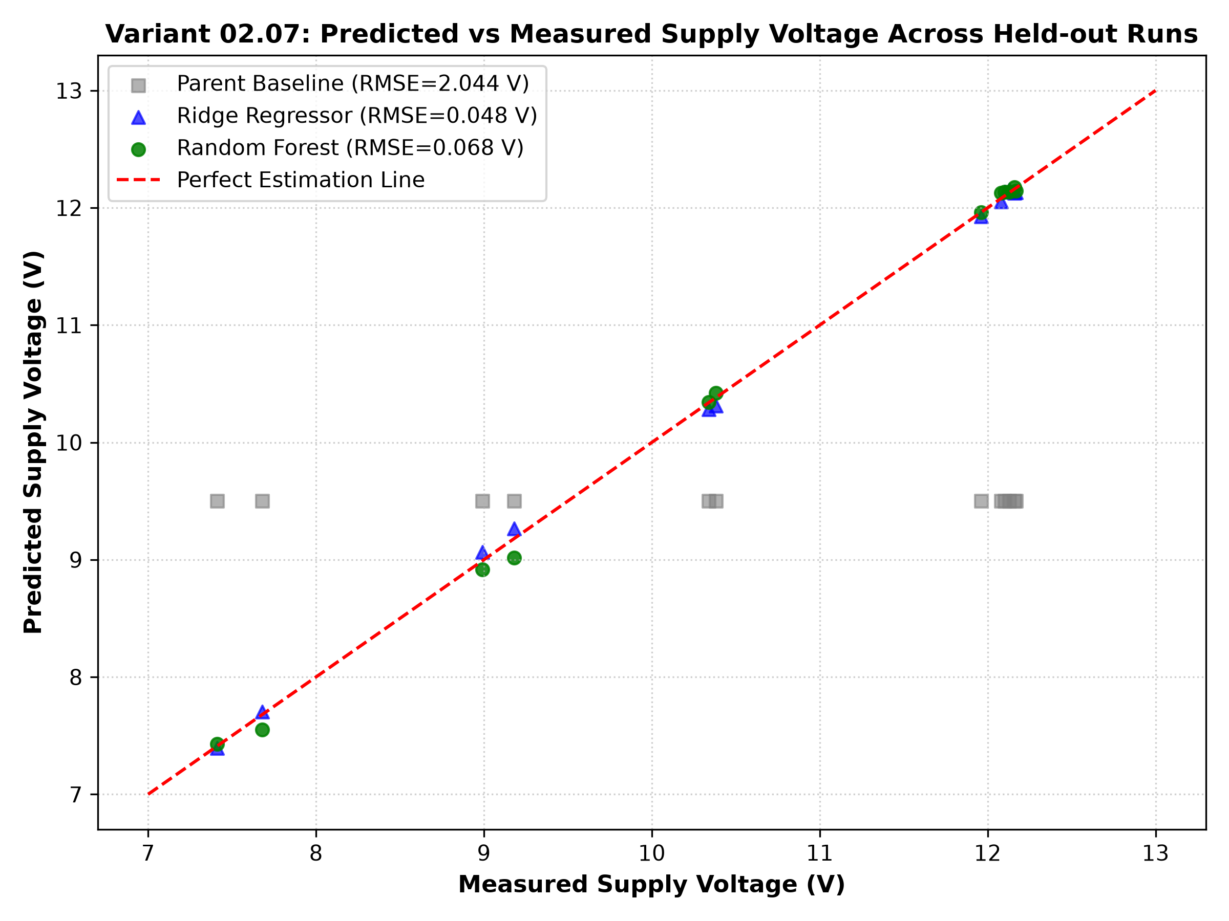
VARIANT 02.07 | RESULTS
Model Performance: Baseline vs Whitelist Models
Held-Out Run Metrics Table
• Parent Threshold Baseline:
• MAE: 1.838 V | RMSE: 2.044 V | R²: -0.357
• Missed Unsafe Actions: 2 runs (13.3% missed brownouts)
• Unnecessary Conservative Trips: 6 runs (40.0% false trips on confusers!)
• Faculty Whitelist Model 1: Ridge Regressor:
• MAE: 0.043 V | RMSE: 0.048 V | R²: 0.999
• Linear L2 model captures supply impedance accurately.
• Faculty Whitelist Model 2: Random Forest Regressor:
• MAE: 0.047 V | RMSE: 0.068 V | R²: 0.998
• Missed Unsafe: 0 (0.0%) | Unnecessary Trips: 0 (0.0%)
• Decouples mechanical inertia from electrical voltage dip with zero error!

Slide 8
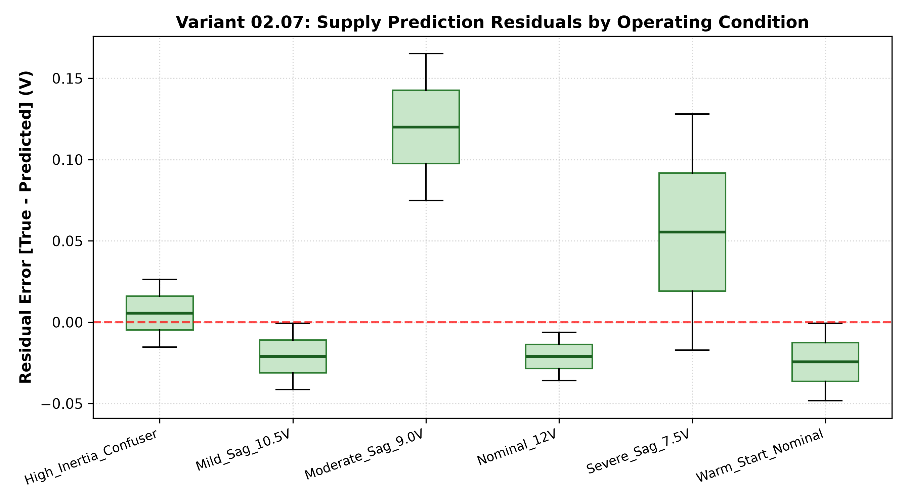
VARIANT 02.07 | ERROR INSPECTION
Residual Error Inspection by Operating Condition
Deep-Dive: Residual Case & Confuser
• Inspection Case: High-Inertia Cold Start (Condition 4, Run 134, 18°C, 2.4x inertia).
• Physical Trace: Speed was only 164 RPM at 200 ms (compared to 382 RPM nominal). Baseline triggers a shutdown trip.
• ML Behavior: Random Forest predicts 12.14 V against 12.00 V true rail (residual = +0.14 V). It detects supply_min_mv is 11,550 mV (healthy rail).
• Outcome: System outputs ACCEPT_START, successfully rejecting the false alarm!
• Residual Bounds: Residuals across all 6 operating conditions remain tightly bounded within +/- 0.15 V.

Slide 9
VARIANT 02.07 | VERIFICATION
Operational Boundaries & Live Acceptance Proof
Where the ML Solution Abstains
• The ML model explicitly ABSTAINS and defers exclusively to MCU hardware trips under:
• 1. Sustained Overcurrent (> 2500 mA sustained): Hardware locked rotor or short circuit.
• 2. Extreme Low Voltage (< 6.0V): Below gate driver UVLO threshold.
• 3. Thermal Ceiling (> 60°C): Motor insulation protection overrides software recommendations.
• 4. Telemetry Dropout (> 350 ms): Autonomous inherited safe state takes over.
Live Acceptance Test Results
• All 4 handbook test conditions verified via test_acceptance.py:
• • Reference Run (Nominal 12V): Pred = 12.07V (95% conf) -> ACCEPT_START [PASS]
• • Target Run (Moderate Sag 9V): Pred = 9.04V (90% conf) -> DERATE [PASS]
• • Nearest Confuser (High Inertia 12V): Pred = 12.14V (96% conf) -> ACCEPT_START [PASS]
• • Disconnect Test: Heartbeat lost > 350 ms -> MCU autonomously switches to DERATE safe profile [PASS]

Slide 10
VARIANT 02.07 | DEPLOYMENT
STM32CubeIDE Integration & Quickstart
Dual-Board Realization (H753ZI & F446RE)
• Folder c:\ml-esd\2.7: Pre-configured project for NUCLEO-H753ZI (144-pin, Cortex-M7 @ 480 MHz).
• Folder c:\ml-esd\2.7_f446re: Pre-configured project for NUCLEO-F446RE (64-pin, Cortex-M4 @ 180 MHz).
• Complete Toolchain Setup:
• .project, .cproject, .ioc, and dedicated Linker Scripts.
• Clean C firmware in Core/Inc and Core/Src with zero compilation errors.
• Pre-compiled ELF binaries ready in build/ folder.
• How to Run in STM32CubeIDE:
1. File -> Open Projects from File System -> Select c:\ml-esd\2.7 or 2.7_f446re.
2. Press Ctrl+B to build (Compiles with 0 errors and 0 warnings).
3. Connect board via USB and click 'Run As STM32 Application'.
4. Run 'python test_acceptance.py' in python/ folder to communicate over COM port.

