Slide 1

Plane Big Data
National Day of Civic Hacking
City of Baltimore
Vlad Korolev, Managing Member, dblfuzzer.com
Michael Behrens, CTO, R2AD, LLC
1-2 June 2013

Slide 2
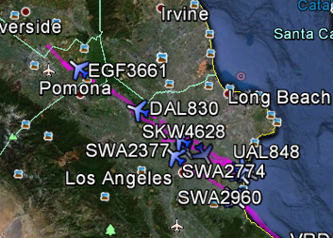
Why Plane Big Data
Solve problems
Impact due to weather related and other delays
Avoid mid-air collisions
Understand air corridor congestion, trends, patterns
Provide airline related statistics
One time, average flight duration, trends
Airline and Airport data is available from the Federal Aviation Administration (FAA)
Concepts of planes, travel, airports well understood by many.
Big Data processing is new and evolving.
Airplane traffic is a great use-case for helping folks to understand “How-To” do big data

Slide 3
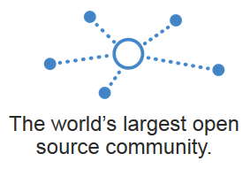
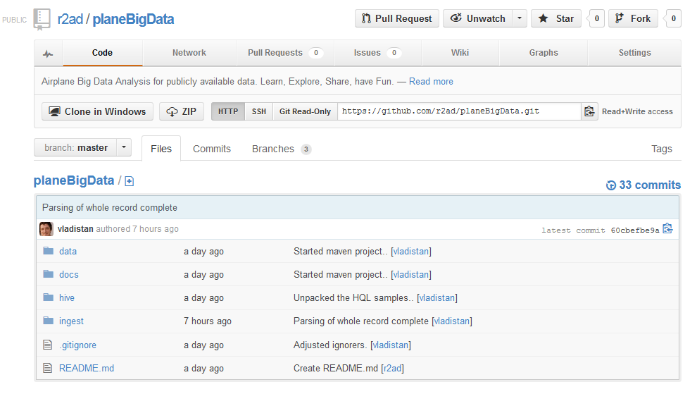
Created Open Source Repository
GitHub: PlaneBigData
https://github.com/r2ad/planeBigData
Store all code
Documentation
Algorithms
Map/Reduce
Briefings
Tutorials, etc.
Share All!!!
Project to grow over time
Use many different Cloud Computing technologies

Slide 4
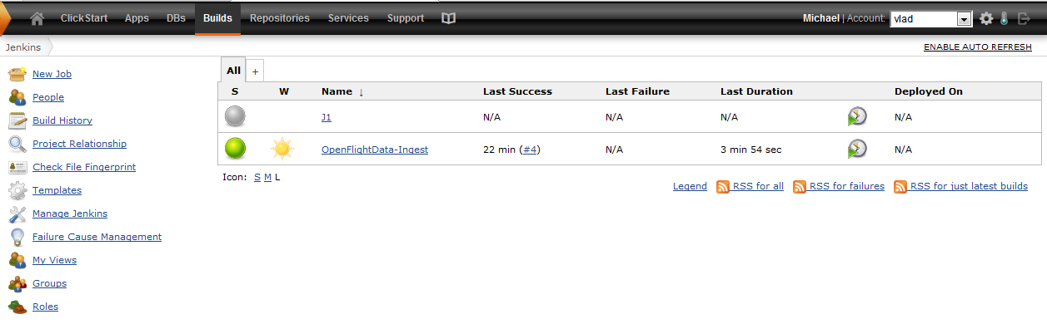
Created Initial Cloud Dev/Test
Setup Dev/Test environment
Supports rapid and automated deployment, build, test,
Jenkins via Cloud Bees

Slide 5
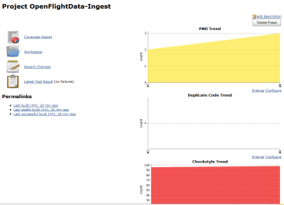
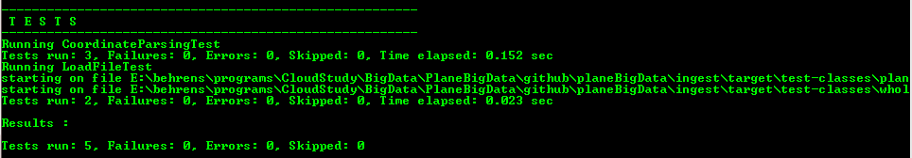
Plane Data Ingestion
Using Jenkins to poll data periodically and ingest it for Big Data processing
Checkout project using git
Git clone
cd PlaneBigData\github\planeBigData\ingest
mvn install
This will get the dependencies, and then will compile and run the test code which converts the flight data, making it ready for Big Data Analysis

Slide 6
Next Steps….
Continue Development Cycles
Ingestion, Analytics, Visualization/Reporting
Enlist support from FAA
Generate Map/Reduce code
Add in more data
Airport codes, maybe weather
Brief at Baltimore and DC area Meetups
Thanks for the great kickoff!

