Slide 1


MongoDB Intro
Baltimore MongoDB Meetup, 23 July 2013
http://www.meetup.com/Baltimore-MongoDB-Users-Group/
A basic overview
Michael Behrens, R2AD, LLC
Jose Rodriguez
Brief source:
https://github.com/r2ad/planeBigData
https://github.com/madaxx/mongoflight/
MongoDB Website:
http://www.mongodb.org/

Slide 2
Categories of Databases
These categories help us to understand the basic benefits and limitations of various offerings
Relational
Relational database management systems (RDBMSs) are set-theory-based systems implemented as two-dimensional tables with rows and columns.
Document
Stores documents based on a unique ID field. Documents can be JSON documents, XML, or anything.
Key Value
Pairs keys to values in much the same way that a map (or hash table) would in any popular programming language.
Columnar
Data from a given column (in the two-dimensional tabular sense) is stored together (column-oriented). Adding columns, for example is fast.
Graph
Consists of nodes and relationships between nodes. Excels at dealing with highly interconnected data.
Focus of this Brief
Notes:
As an common approach to the analysis, the team agreed that categorizing the databases helps to understand them and to compare them. These are the main categories which have been analyzed.

Slide 3
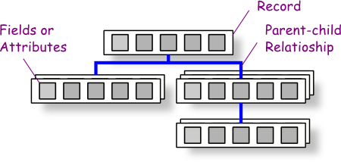
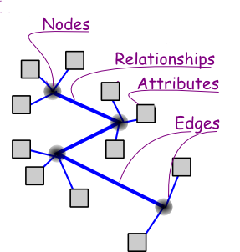
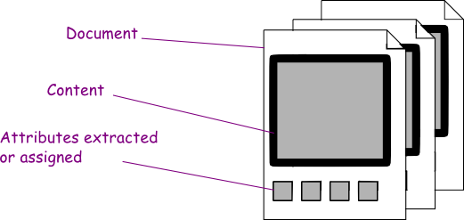
Depiction of Database Categories
Relational Databases
Graph Databases
Key Value
Document Databases
Value
Value
Value
Columnar Databases
Keys
Column
Family
Sharded (distributed)
Containers can have multiple documents references by the same key (see CDMI)
Key
Key
Key
Key
Key
Key
Key
Key
Value
Value
Value
Value
Value
Value
Value
Value
Simple KV
Images (w/Permission): http://www.cbsolution.net/ontarget/databases_relational_vs_object_vs
Notes:
These graphics help depict the different models underlying the different database categories.

Slide 4
MongoDB Overview
MongoDB (from "humongous") is a document oriented, scalable, open source NoSQL database supported by 10gen.
Highlights of MongoDB
JSON documents
Supports Ad Hoc Queries and M/R
Very Speedy, index capable
at the expense of data integrity in the event of a server crash
Scalable via replication of nodes
Geospatial support
Multiple Programming languages supported
Very popular with startups and other groups
Bundled in leading PaaS Distributions (OpenShift, CloudFoundry)
Terminology
Table,View -> Collection
Row -> Document
Join -> Embedded
Foreign Key -> Reference
Replica Set
Shard₁
Shard₂
Routers:
Mongos
Sharded
Replica Set
MongoDB Replica 1
MongoDB Replica 1
Mongos
Read Performance
MongoDB Replica 2
MongoDB Replica 2
Mongos
…
MongoDB Replica 3
MongoDB Replica 3
Sharded
Config State:
Config Server
Config Server
Write Performance
Config Server
Notes:
MongoDB is considered to be one of the fastest scalable JSON oriented document databases. It is well supported by the community and is part of open source PaaS offerings from VMware and RedHat. MongoDB’s indexes are flexible and provide efficiencies. A nice feature of MongoDB is its query support which uses a simple JSON document for the query. Setup for MongoDB is fairly straightforward as well. MongoDB also provides compatibility with the Map/Reduce paradigm via JavaScript on the servers. Replication is also supported across the LAN or WAN (mirrored replica sets).

Slide 5
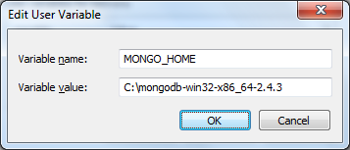
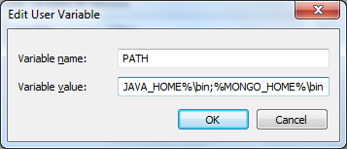
Setup/Install…Windows Example
Install and set environment path…
1)
2)
3)
Microsoft Windows [Version 6.1.7601]
Copyright (c) 2009 Microsoft Corporation. All rights reserved.
C:\>which mongod
C:\mongodb-win32-x86_64-2.4.3\bin/mongod.exe

Slide 6
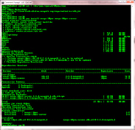
Setup/Install…Linux Example
First, setup Repo…then,
yum install mongo-10gen mongo-10gen-server
Then start the service
[root@r2adnet opt]# service mongod start
Starting mongod: about to fork child process, waiting until server is ready for connections.
forked process: 14396
all output going to: /var/log/mongo/mongod.log
child process started successfully, parent exiting
[ OK ]
[root@r2adnet opt]# which mongo
/usr/bin/mongo
Make it always start
chkconfig mongod on
Ref: http://docs.mongodb.org/manual/tutorial/install-mongodb-on-red-hat-centos-or-fedora-linux/

Slide 7
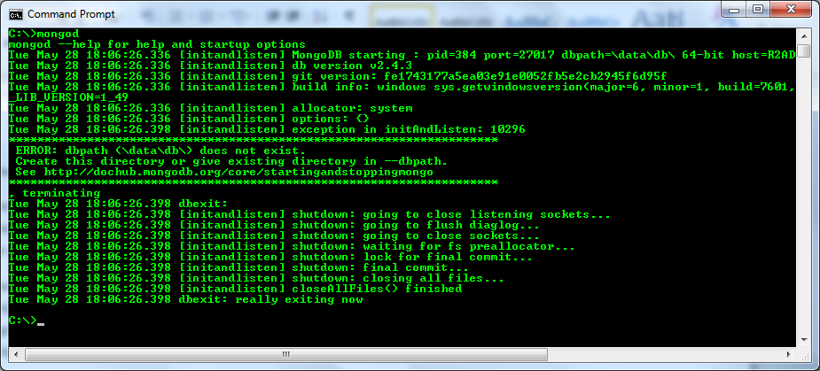
Starting the server, Windows
To run a single server database:
C:\> mkdir /data/db
C:\> mongod

Slide 8
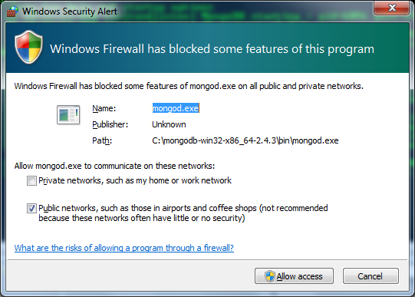
Be aware of ports…firewall & Security
By default:
mongod is waiting for connections on port 27017
web status page is waiting for connections on port 28017
decide
Note: Best to allow database access only to server(s) that needed it…..keep traffic inside as much as possible – good security practice. See: http://docs.mongodb.org/manual/core/security/

Slide 9
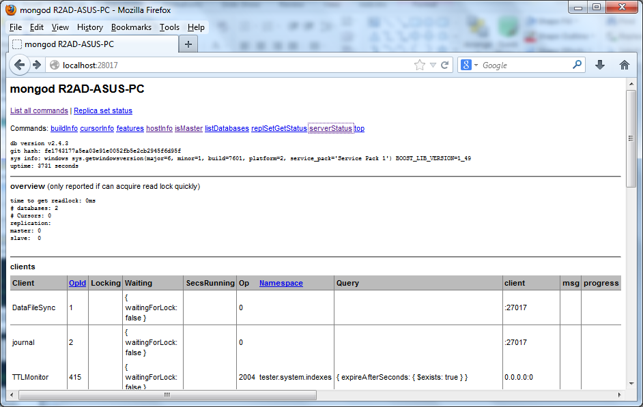
Web Status Console
REST is not enabled. use --rest to turn on. check that port 28017 is secured for the network too.

Slide 10
mongo – the shell
[root@r2adnet opt]# mongo
MongoDB shell version: 2.4.4
connecting to: test
Welcome to the MongoDB shell.
For interactive help, type "help".
For more comprehensive documentation, see
http://docs.mongodb.org/
Questions? Try the support group
http://groups.google.com/group/mongodb-user
>
> help
db.help() help on db methods
db.mycoll.help() help on collection methods
sh.help() sharding helpers
rs.help() replica set helpers
help admin administrative help
help connect connecting to a db help
….
mongo is an interactive JavaScript shell interface to MongoDB

Slide 11
Adding data manually
> db.plane.insert({
... "callsign" : "UAL653",
... "model" : "757-200",
... "manufacturer" : "Boeing",
... "lat" : "33.97",
... "lon" : "118.203611",
... "altituteFt" : "31000",
... "speedKt" : "480",
... "heading" : "121",
... "timestamp" : "11:29PM EDT",
... "PositionsCount" : "0",
... }
... )
>
> db.plane.find()
{ "_id" : ObjectId("51cb6ee9cb8ffebb1dbede9f"), "callsign" : "UAL653", "model" : "757-200", "manufacturer" : "Boeing", "lat" : "33.97", "lon" : "118.203611", "a
ltituteFt" : "31000", "speedKt" : "480", "heading" : "121", "timestamp" : "11:29PM EDT", "PositionsCount" : "0" }
>
Adding a JSON document….note that it automatically adds an object ID
Note also that I did not have to create a table or database ahead of time! The “plane” collection is created automatically
Test database is the default
The “use” command can change databases.

Slide 12
Adding data manually
Added some more records….how many do we have?
> db.plane.count()
3
The log file can be examined from the OS or from the web page.
[root@r2adnet flights]# cat /var/log/mongo/mongod.log
***** SERVER RESTARTED *****
Wed Jun 26 21:26:56.209 [initandlisten] MongoDB starting : pid=14396 port=27017 dbpath=/var/lib/mongo 64-bit host=r2adnet
Wed Jun 26 21:26:56.209 [initandlisten] db version v2.4.4
Wed Jun 26 21:26:56.209 [initandlisten] git version: 4ec1fb96702c9d4c57b1e06dd34eb73a16e407d2
Wed Jun 26 21:26:56.209 [initandlisten] build info: Linux ip-10-2-29-40 needed
Wed Jun 26 21:26:56.299 [FileAllocator] allocating new datafile /var/lib/mongo/local.ns, filling with zeroes...
Wed Jun 26 21:26:56.299 [FileAllocator] creating directory /var/lib/mongo/_tmp
Wed Jun 26 21:26:56.388 [FileAllocator] done allocating datafile /var/lib/mongo/local.ns, size: 16MB, took 0.051 secs
Wed Jun 26 21:26:56.389 [FileAllocator] allocating new datafile /var/lib/mongo/local.0, filling with zeroes...
Wed Jun 26 21:26:57.737 [FileAllocator] done allocating datafile /var/lib/mongo/local.0, size: 64MB, took 1.348 secs
Wed Jun 26 21:26:57.783 [initandlisten] command local.$cmd command: { create: "startup_log", size: 10485760, capped: true } ntoreturn:1 keyUpdates:0 reslen:37
1486ms
Wed Jun 26 21:26:57.784 [websvr] admin web console waiting for connections on port 28017
Wed Jun 26 21:26:58.212 [initandlisten] waiting for connections on port 27017
Wed Jun 26 21:31:16.455 [initandlisten] connection accepted from 127.0.0.1:55611 #1 (1 connection now open)

Slide 13
Quick search to see if data exists
[root@r2adnet flights]# mongo
MongoDB shell version: 2.4.4
connecting to: test
> db.plane.find()
{ "_id" : ObjectId("51cb6ee9cb8ffebb1dbede9f"), "callsign" : "UAL653", "model" : "757-200", "manufacturer" : "Boeing", "lat" : "33.97", "lon" : "118.203611", "a
ltituteFt" : "31000", "speedKt" : "480", "heading" : "121", "timestamp" : "11:29PM EDT", "PositionsCount" : "0" }
{ "_id" : ObjectId("51cb72d7cb8ffebb1dbedea0"), "callsign" : "DLH457", "model" : "747-8", "manufacturer" : "Boeing", "lat" : "33.9333", "lon" : "-118.4333", "al
tituteFt" : "15125", "speedKt" : "363", "heading" : "64", "timestamp" : "12:43 UTC", "PositionsCount" : "0" }
{ "_id" : ObjectId("51cb72f1cb8ffebb1dbedea1"), "callsign" : "DLH457", "model" : "747-8", "manufacturer" : "Boeing", "lat" : "33.7214", "lon" : "-118.5997", "al
tituteFt" : "181000", "speedKt" : "306", "heading" : "-71", "timestamp" : "6/26/2013 10:42:09 PM", "PositionsCount" : "0" }
>
tester@R2AD-ASUS-PC> db.Airport.find( { altitude: { $gt: 10, $lt: 15 }} )
{ "_id" : "SHYZBDPNO3W2E5ED41DC0LACQ02UJR0K", "altitude" : 11, "dst" : 0, "iatafaa" : "", "city" : "", "name" :
: "" }
{ "_id" : "5IJYRS3KAKAXVCQ03KEWVGMTJWOM3S4J", "altitude" : 12, "dst" : 0, "iatafaa" : "", "city" : "", "name" :
: "" }
{ "_id" : "BFJINH1BD3SDSMQOOMEOVGPMYSQDORZP", "altitude" : 13, "dst" : 0, "iatafaa" : "", "city" : "", "name" :
: "" }
{ "_id" : "BATDX2FCD0MLGRMB2TBEDTLPHHIJLQTF", "altitude" : 14, "dst" : 0, "iatafaa" : "", "city" : "", "name" :
: "" }

Slide 14
Find and Pretty
> db.plane.find({"speedKt":"480"})
{ "_id" : ObjectId("51cb6ee9cb8ffebb1dbede9f"), "callsign" : "UAL653", "model" : "757-200", "manufacturer" : "Boeing", "lat" : "33.97", "lon" : "118.203611", "a
ltituteFt" : "31000", "speedKt" : "480", "heading" : "121", "timestamp" : "11:29PM EDT", "PositionsCount" : "0" }
> db.plane.find({"speedKt":"480"}).pretty()
{
"_id" : ObjectId("51cb6ee9cb8ffebb1dbede9f"),
"callsign" : "UAL653",
"model" : "757-200",
"manufacturer" : "Boeing",
"lat" : "33.97",
"lon" : "118.203611",
"altituteFt" : "31000",
"speedKt" : "480",
"heading" : "121",
"timestamp" : "11:29PM EDT",
"PositionsCount" : "0"
}
>

Slide 15
Review…..on-line tutorial available
> show dbs
local 0.078125GB
mydb 0.203125GB
test 0.203125GB
> db
mydb
> show collections
system.indexes
testData
> db.testData.find()
{ "_id" : ObjectId("51ed9b855ad739bfd0f31088"), "name" : "mongo" }
{ "_id" : ObjectId("51ed9b875ad739bfd0f31089"), "x" : 3 }
>
>
This is the simple example from:
http://docs.mongodb.org/manual/tutorial/getting-started/

Slide 16
Collections…..
[root@r2adnet flights]# mongo
MongoDB shell version: 2.4.4
connecting to: test
> show collections
plane
system.indexes
> use bigdata
switched to db bigdata
> show collections
> use test
switched to db test
> show collections
plane
system.indexes
>

Slide 17
Custom Prompt
UNIX
Windows
[root@r2adnet flights]#
[root@r2adnet flights]# cat > ~/.mongorc.js
host = db.serverStatus().host;
prompt = function() {
return db+"@"+host+"> ";
}
[root@r2adnet flights]#
[root@r2adnet flights]# mongo
MongoDB shell version: 2.4.4
connecting to: test
test@r2adnet> use bigdata
switched to db bigdata
bigdata@r2adnet> exit
bye
C:\mongodb-win32-x86_64-2.4.3\bin>copy con .mongorc.js
host = db.serverStatus().host;
prompt = function() {
return db+"@"+host+"> ";
}
^Z
1 file(s) copied.
C:\mongodb-win32-x86_64-2.4.3\bin>mongo
MongoDB shell version: 2.4.3
connecting to: test
test@R2AD-ASUS-PC>
Assigning the variable prompt can override the default “>” prompt. Also, to make it permanent, put the commands in this file in your home directory: .mongorc
This file gets read in and processed each time the mongo shell starts.

Slide 18
Running a Script
[root@r2adnet flights]# cat > findone.js
db.plane.findOne()
[root@r2adnet flights]#
[root@r2adnet flights]# mongo < findone.js
MongoDB shell version: 2.4.4
connecting to: test
{
"_id" : ObjectId("51cb6ee9cb8ffebb1dbede9f"),
"callsign" : "UAL653",
"model" : "757-200",
"manufacturer" : "Boeing",
"lat" : "33.97",
"lon" : "118.203611",
"altituteFt" : "31000",
"speedKt" : "480",
"heading" : "121",
"timestamp" : "11:29PM EDT",
"PositionsCount" : "0"
}
bye
Note: The redirection character “<“ is needed on linux, not windows.

Slide 19
Lots more to learn!
This is just a quick intro….for our demo, we wanted to add a Web Front End…
Thought about using node.js along with restler, etc.
[root@r2adnet opt]# npm install restler
npm http GET https://registry.npmjs.org/restler
npm http 200 https://registry.npmjs.org/restler
npm http GET https://registry.npmjs.org/restler/-/restler-2.0.1.tgz
npm http 200 https://registry.npmjs.org/restler/-/restler-2.0.1.tgz
restler@2.0.1 node_modules/restler
[root@r2adnet opt]#
However, after talking with Jose….
Used Lift, a powerful/rapid web framework: http://liftweb.net/
and Crudify, which automatically adds CRUD (Create, read, update and delete) operations

Slide 20
Jose’s Simple Application
Jose started an simple interface for a MongoDB database using lift and crudify. He pushed a beta up to GIT:
https://github.com/madaxx/mongoflight/
To use it…install and configure the following:
SBT: https://github.com/sbt/sbt
support flexible and powerful build definitions
Java 7
Scala: http://www.scala-lang.org/downloads
Object oriented language which interoperates with Java

Slide 21
Jose’s Simple Application
Currently configured to use the local mongodb installation but can be set to use any. So start the mongod.
Then download the project and then type the following commands in the project directory:
SBT
update
reload
container:Start
If all goes well , open your browser to localhost:8080.
As you update it will create a database and a collection called airports. Changing the Object Model is easy. There are a few kinks for example the latlong mongotype is not fully working w/crudify.
BTW type container:stop to exit.

Slide 22
Starting…
D:\mongoflight-master>sbt
D:\mongoflight-master>set SCRIPT_DIR=D:\mongoflight-master\
D:\mongoflight-master>java -XX:+CMSClassUnloadingEnabled -XX:MaxPermSize=256m -Xmx1024M -Xss2M -jar "D:\mongoflight-master\\sbt-launch-0.12.1.jar"
Getting org.scala-sbt sbt 0.12.2 ...
downloading http://repo.typesafe.com/typesafe/ivy-releases/org.scala ...
[SUCCESSFUL ] org.scala-sbt#sbt;0.12.2!sbt.jar (733ms)
> update
[info] Updating {file:/D:/mongoflight-master/}default-5db528...
[info] Resolving org.scala-lang#scala-library;2.10.0 ...
> reload
[info] Loading project definition from D:\mongoflight-master\project
[info] Set current project to Mongotracks (in build file:/D:/mongoflight-master/)
> container:start
[info] Started SelectChannelConnector@0.0.0.0:8080
[success] Total time: 12 s, completed Jul 22, 2013 11:11:08 PM

Slide 23
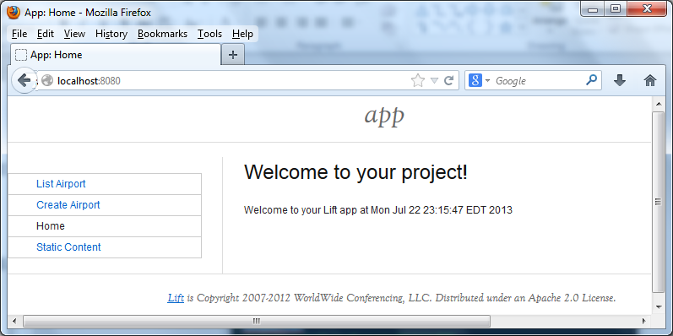
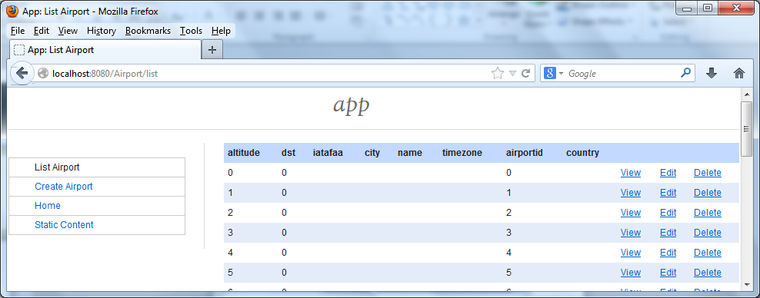
End Result…

Slide 24
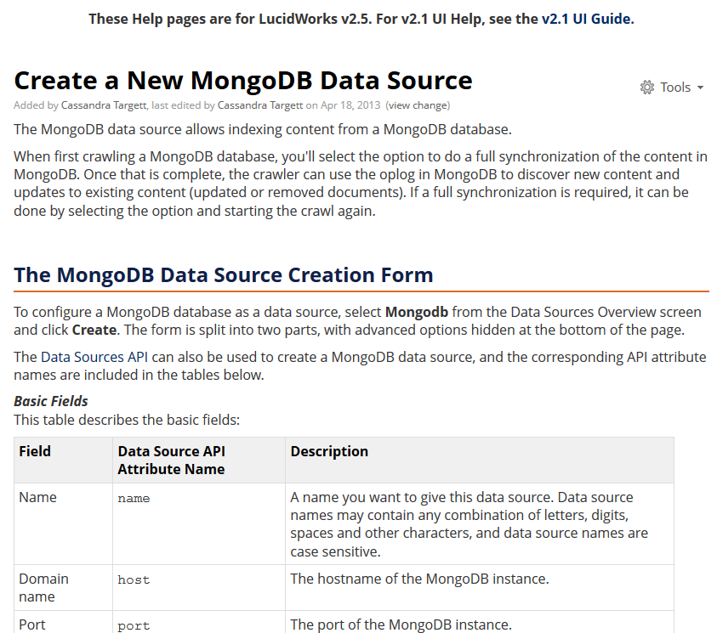
Next Goal: Adding search – an example
A good experiment would be to configure Lucene/Solr to search for content in Mongo.
Lucid-works has a nice page describing how to do this with their release.
http://docs.lucidworks.com/display/help/Create+a+New+MongoDB+Data+Source

Slide 25
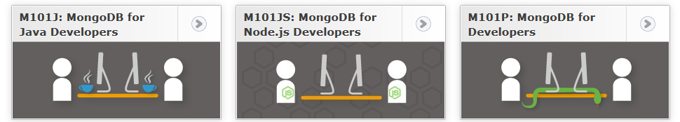
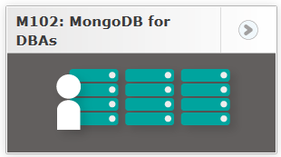
FYI: MongoDB Training
10gen offers training classes…check on-line
2 day developer
One-on-One
Also, they support free on-line course too:
https://education.10gen.com/

