Slide 1
Speech Validation System using MFCC and DTW in Python.
عبدالرحمن مصطفى موسى محمد رباح، احمد صبري علي، عبدالله عادل ابراهيم، عمرو محمد السيد
4th Year, Electronics and Communication Department, Faculty of Engineering, Cairo University
Giza, 12613, Egypt
Abdelrahman.Rabah00@eng-st.cu.edu.eg
ahmed.omer99@eng-st.cu.edu.eg
Abdullah.Fattah99@eng-st.cu.edu.eg
amr.hassan99@eng-st.cu.edu.eg

Slide 2
Introduction
In this project, it is desired to create a speech validation system in which it differentiate between 2 words in the same pair or if this word doesn’t belong to this pair. These words must follow a set of rules.
The system is implemented in Python.
The system is divided into different functions
This system works with Mel Frequency Cepstrum Coefficient (MFCC) method and Distance Time Warping (DTW) algorithm.

Slide 3
Methodology
Function’s Name | Function’s use
collectWords | It collect every user mat files and its respective name
featureScaling | It Standardize all values to reduce variance, so DTW is reduced
find_Group_Student | It returns the samples of the equivalent Student in this specified group
find_Pair_Word_Gender | It returns the desired Word along with the desired Gender in this specified Pair
dtw | Calculate the Distance Time Warping
calc_dtw | It returns 1D Vector between the Reference and the desired word from find_Pair_Word_Gender function
detect_outliers | It returns the indices of the outliers from the calc_dtw, these data are numerically distant from the rest of the data
remove_elements | It removes these indices from detect_outliers function
detect_th | It returns the threshold for these 1D vectors from calc_dtw after being cleaned by the 2 above functions.
Judgement | It judges if the word pronounced right or wrong.

Slide 4
MFCC
MFCC is a method of feature extraction of voice signals
Convert time domain signals into frequency domain signal by mimicking cochlea function using Mel filters, cochlea is part of the ear
MFCC is the most used method in various areas of voice processing field
The voice sample must be converted by Analog to Digital Converter
followed by Pre-Emphasis and Filtering. We must also watchout for the sampling rate to avoid aliasing
The Noise-gate is applied to the pre-emphasized sample to remove the noise

Slide 5
MFCC Cont’d
Zero Allignment
Multiplying each frame in the voice sample by hamming window
FFT is applied to each frame to transform the signal to frequency domain
MEL Filter banks
MEL filter and Discrete Cosine Transform is applied to return the signa to time domain

Slide 6
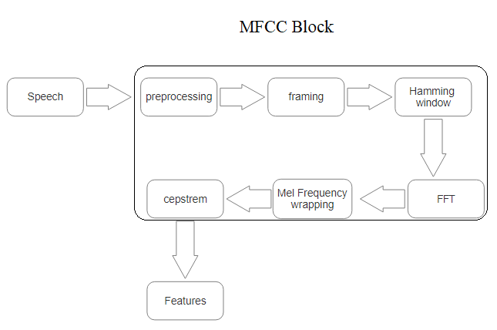
MFCC Cont’d

Slide 7
DTW
This algorithm is implemented to calculate least distance between features of words
finds the optimal alignment between two times series whether by shrinking or stretching the signal along it’s time axis
Euclidean computation is used to measure distance between features of input sample and the reference

Slide 8
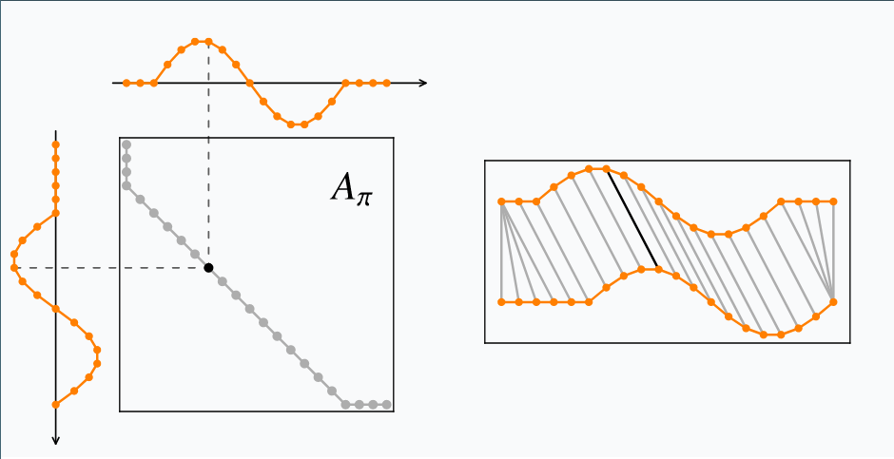
DTW Cont’d

Slide 9
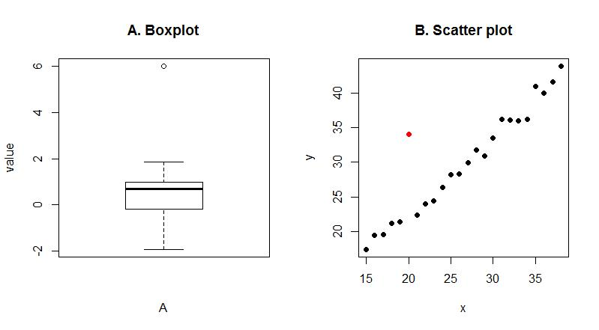
Outliers
Outliers are data which are numerically distant from the rest of the data.
It affects the mean of the data by reducing/increasing it.

Slide 10
Outliers Cont’d
Outliers need to be removed to fix the data
Calculating Threshold depends on the data, and outliers ruin this data so Outliers need to be removed
We can spot outliers by box plot or scatter plot

Slide 11
Threshold
We calculate a certain threshold to divide between words in the same pair and outside this pair
We get the mean of the two words in the same pair DTW vector and get the mean of both of them, so we got a point in between

Slide 12
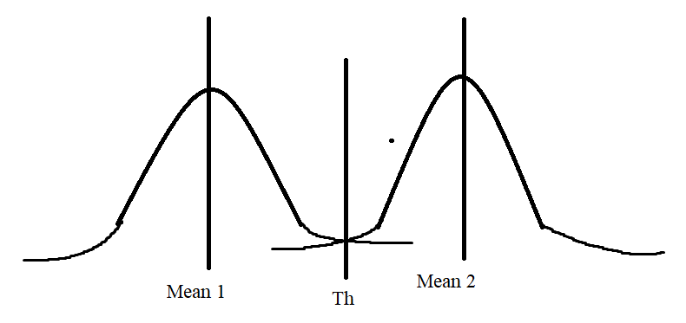
Threshold Cont’d

Slide 13
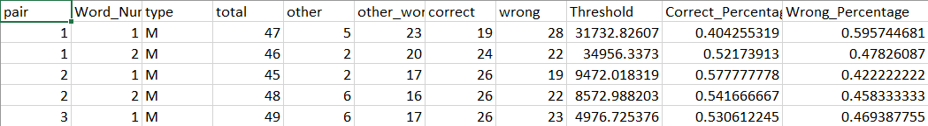
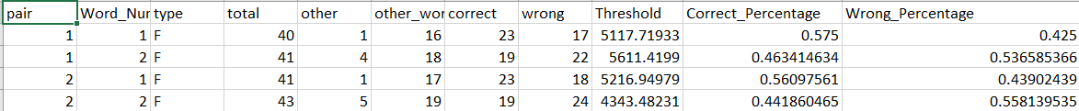
Data CSV

Slide 14
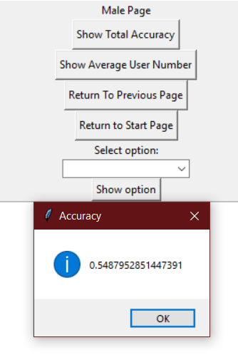
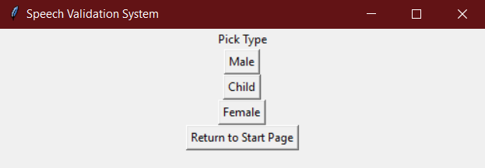
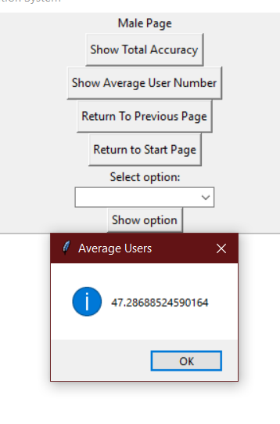
GUI

Slide 15
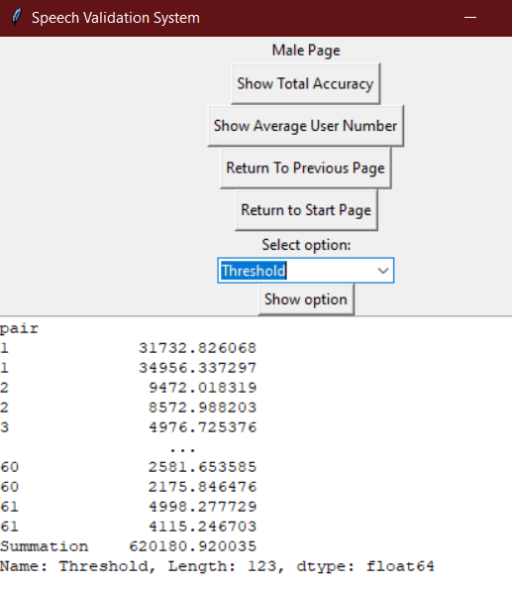
GUI Cont’d

Slide 16
Conclusion
We can increase accuracy by better recording technique.
Data overall accuracy is higher than 50% as with attached .csv files.

