Slide 1
Reactivity
Shiny App

Slide 2
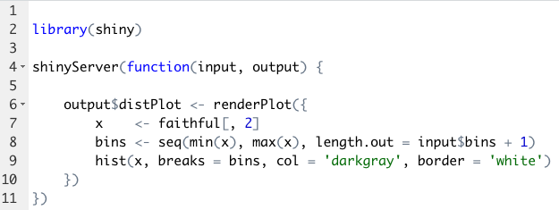
input$bins
output$dist

Slide 3
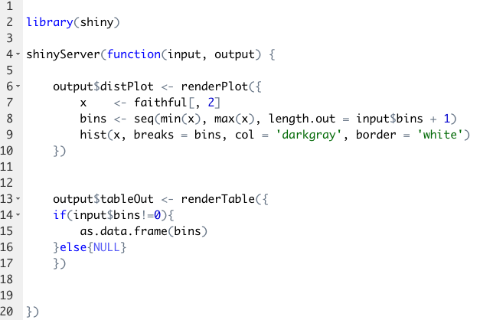
output$dist
input$bins
output$tableOut

Slide 4
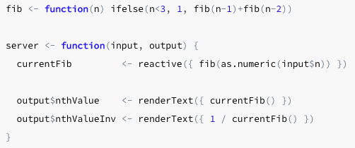

Slide 5

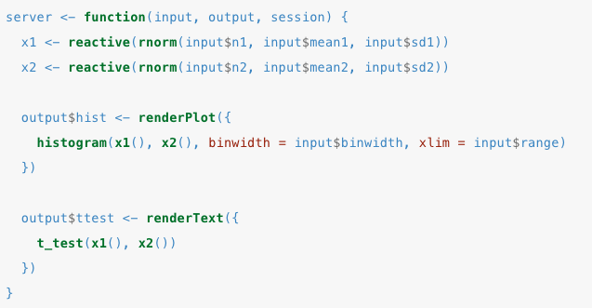

Slide 6
Input$n1
Input$mean1
ttest
x1
Input$sd1
Input$n2
Input$mean2
x2
Input$sd2
hist
..$bindwith
Input$range

Slide 7
Updating UI

Slide 8
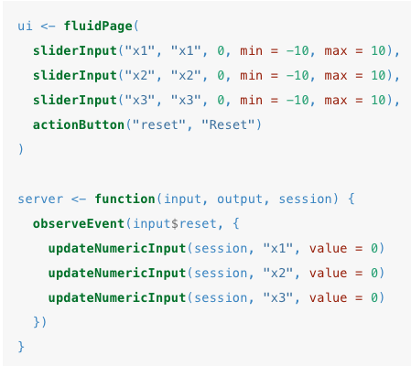
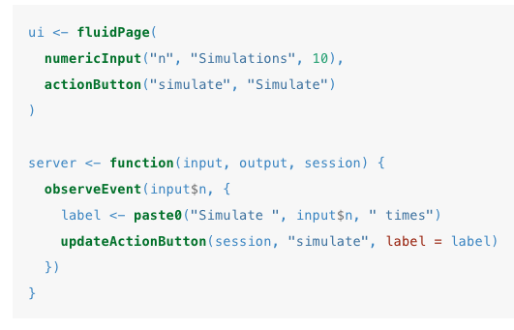

Slide 9
https://www.kaggle.com/kyanyoga/sample-sales-data

Slide 10
Territory
Territory()
Customer()
Customer
Ordernumber
Data

