Slide 1
Association Rule Mining
Apriori Algorithm

Slide 2
Why Apriori? (Motivation)
Goal: Efficiently find frequent itemsets in large transactional datasets.
Challenge: Number of possible itemsets grows exponentially with number of items.
If there are d items → possible itemsets = 2^d - 1
Example: 20 items → 1,048,575 possible itemsets.
Brute force approach (count support of every subset) is infeasible.
Key Insight (Apriori Principle):
If an itemset is frequent, then all of its subsets must also be frequent.

Slide 3
Transactional Data Model
Let
I = {i1, i2, ..., id} be the set of all items.
D = {T1, T2, ..., Tn} be the transaction database.
Each transaction Tk ⊆ I.
Example dataset:
T1: {Milk, Bread, Butter}
T2: {Bread, Diaper, Beer, Eggs}
T3: {Milk, Bread, Diaper, Beer}
T4: {Bread, Milk, Diaper, Beer}
T5: {Milk, Bread, Butter}
Let Minimum support threshold = 60%
Total Transactions count = 5
➔ minsup count = 0.6 * 5 = 3

Slide 4
Definitions: Itemsets & Support
k-itemset: itemset containing k items.
Example: {Milk, Bread} → 2-itemset
Support count:
supp(X) = |{Tk ∈ D : X ⊆ Tk}|
Support Threshold ( fraction )
support(X) = supp(X) / |D|
Example:
supp({Milk}) = 4 ( Support Count )
support({Milk}) = 4/5 = 0.8 (fraction or threshold)

Slide 5
Apriori Principle (Downward Closure)
Theorem: If itemset X is frequent, then every subset Y ⊂ X is also frequent.
If abc is frequent ➔ ab, ac, bc is frequent
Proof (contrapositive reasoning):
Assume subset Y is not frequent.
If supp(Y) < minsup
Since every occurrence of X implies occurrence of Y :
Then supp(X) ≤ supp(Y)
Thus supp(X) < minsup
⇒ X not frequent.
Hence Proved.

Slide 6
Apriori Algorithm: High-Level Idea
Apriori performs Level-wise breadth-first search over itemset lattice
C_{k} = candidate k-itemsets ( pre pruning )
L_{k} = frequent k-itemsets ( post pruning )
C_{k} = L_{k-1} ⋈ L_{k-1} (Generate C_{k} by self joining L_{k-1} )
Overall Approach :
C_{k} ➔ L_{k} ➔ C_{k+1} ➔ L_{k+1} ➔ C_{k+2} ➔ L_{k+2} ➔ ........
Process
1. Find frequenct 1-itemsets ➔ L1
2. Generate candidate 2-itemsets ➔ C2
3. Prune using Apriori Algorithm
4. Count supports → get L2
5. Repeat until no candidates remain

Slide 7
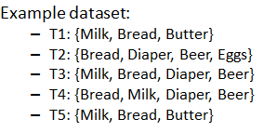
Step 1. Frequent 1‑Itemsets (L1)
Counts:
Milk 4
Bread 5
Butter 2
Diaper 3
Beer 3
Eggs 1
minsup = 3
L1 = {Milk, Bread, Diaper, Beer}

Slide 8
Step 2. Candidate Generation (C2)
L1 = {Milk, Bread, Diaper, Beer}
Self Join L1 :
{Milk,Bread}
{Milk,Diaper}
{Milk,Beer}
{Bread,Diaper}
{Bread,Beer}
{Diaper,Beer}
Self Join Step ➔ C_{k} = L_{k-1} ⋈ L_{k-1}

Slide 9
Step 3. Support Counting for C2
Counts:
Milk,Bread 4
Milk,Diaper 2
Milk,Beer 2
Bread,Diaper 3
Bread,Beer 3
Diaper,Beer 3
minsup = 3
L2 = {Milk,Bread; Bread,Diaper; Bread,Beer; Diaper,Beer}

Slide 10
Step 4. Candidate Generation for 3‑Itemsets
L2 : {Milk,Bread; Bread,Diaper; Bread,Beer; Diaper,Beer}
Self Join L2 to get C3
Milk,Bread; Bread,Diaper = Milk Bread Diaper = 2
Milk,Bread; Bread,Beer = Milk Bread Beer = 2
Milk,Bread; Diaper,Beer=Milk Bread Diaper Beer = 2
Bread,Diaper; Bread,Beer = Bread Diaper Beer = 3
Bread,Diaper; Diaper,Beer = Bread Diaper Beer = 3
Bread,Beer; Diaper,Beer = Bread Diaper Beer = 3
L3 = {Bread,Diaper,Beer}

Slide 11
Attempt C4
L3 = {Bread,Diaper,Beer}
|L3| = 1 , hence No further joins possible.
Algorithm terminates
Final Frequent itemsets:
L1: {Milk, Bread, Diaper, Beer}
L2: {Milk,Bread; Bread,Diaper; Bread,Beer; Diaper,Beer}
L3:{Bread,Diaper,Beer}

Slide 12
Industrial Challenges & Real-World Friction
The "Candidate Explosion": If a dataset has 10^4 frequent 1-itemsets, the algorithm must generate over 10^7 candidate 2-itemsets.
Repeated Database Scans: Apriori requires mutiple scans of the database for a frequent k-itemset. In large-scale industries like retail (e.g., Walmart, Target), this becomes an I/O bottleneck.
High-Dimensional Sparsity: In e-commerce, most customers only buy a tiny fraction of total products. This "sparsity" makes it difficult for the algorithm to find strong rules without setting the support threshold extremely low, which then leads to memory issues.
Memory Intensive: Storing massive candidate hashes can crash systems with limited RAM when processing millions of transactions.

Slide 13

The Mathematical Triple
While support and confidence are fundamental, "Lift" and "Conviction" provide deeper insights into rule significance.
Lift (Correlation): Measures how much more likely item B is purchased when A is purchased, compared to its random occurrence.
Formula:
Interpretation:
> 1 Positive correlation (items "pull" each other).
= 1 Independence (no association).
< 1 Negative correlation (items "repel" each other).
The "Anti-Monotonicity" Principle: If an itemset is infrequent, all of its supersets are guaranteed to be infrequent. This mathematical property allows the algorithm to prune vast search spaces early.

Slide 14
The Problem with Confidence
Confidence can be misleading because it ignores how popular the "consequent" (the item being predicted) is in general. If almost everyone buys an item (like Milk), any rule leading to Milk will have high confidence, even if the items are actually negatively correlated
Imagine a dataset of 10 customer transactions at a grocery store:
6 people buy Bread ( Support = 0.6)
8 people buy Milk ( Support = 0.8)
4 people buyboth Bread & Milk ( Support = 0.4)
Let's evaluate the rule: If a customer buys Bread, they will also buy Milk (Bread -> Milk).

Slide 15
Confidence ( B -> M )
Probability of buying milk, given they bought bread
Conf = Support( B ∪ M ) / Support(B) = .4/.6 = 66.7%
Interpretation : In your store 66.7% bread buyers also pick up milk. Great!!!
Lift ( Correlation )
Compares confidence of to the base probability of buying Milk
Lift = Confidence(B -> M)/Support(M) = .667/.8 = .83
Interpretation: < 1 indicating a negative correlation

Slide 16
Aha Moment!!!
Even though the confidence of B -> M is high (66.7%), it is actually lower than the average probability of buying Milk in the store (80%).
In this specific data, buying Bread actually makes a customer less likely to buy Milk than a random shopper
80% of the customers who come to store buys milk
But when someone buys bread his probability of buying milk drops from 80% to 66.7%

Slide 17
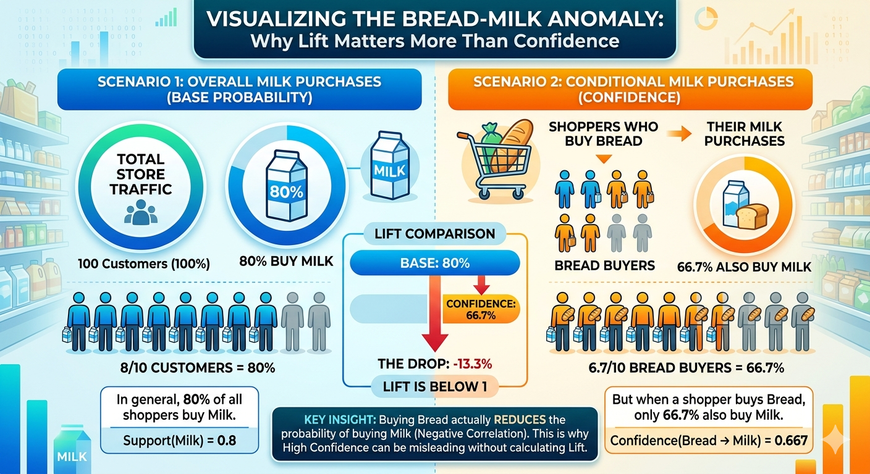

Slide 18
Apriori Pseudocode
L1 = frequent 1-itemsets
k=2
while Lk-1 ≠ ∅:
Ck = apriori_gen(Lk-1)
count supports
Lk = minsup candidates
k++
return ⋃ Lk

Slide 19
apriori_gen
Steps
Join: C_{k} = L_{k-1} ⋈ L_{k-1}
Prune: Remove c ∈ C_{k} if any (k−1)-subset of c ∉ L_{k−1}
Mathematically

