Slide 1
Model Evaluation
Quantifying our Hypothesis

Slide 2
How to evaluate a Model
Need some Metric
Metric will need some data to compute on
Where do we get the data on which metric needs to be computed
The only data we have is Trainign Data
So we have to somehow use the Training Data to arrive at a metric

Slide 3
training data partitioning

Slide 4
Training and Testing Data
Training data:
Used to learn model parameters.
Testing data:
Used to evaluate performance.
Typical split:
Training → 70–80%
Testing → 20–30%

Slide 5
Why Separate Training and Testing?
If the same data is used for both training and testing:
Model may memorize training data.
Separate testing ensures:
True evaluation
Reliable performance estimate
Better generalization.

Slide 6
Data Partitioning
Data split into:
Training set
Testing set
Typical split:
70% training
30% testing
Training learns model parameters
Testing evaluates generalization

Slide 7
Data Split Example
Dataset size = 1000 records
Training = 700
Testing = 300
Model trained on training set
Performance measured on unseen test set

Slide 8
Holdout Method
What we just learnt is called Holdout Method
Dataset divided into:
Training set
Test set
Procedure:
Train model on training data
Evaluate on test data

Slide 9
Limitations of Holdout
Results depend on random split
High variance in performance estimates
Better methods needed for stability

Slide 10
k-Fold Cross Validation
Dataset divided into k folds
For each fold:
Train on k−1 folds
Test on remaining fold
Final error = average of all folds

Slide 11
Example: 5-Fold Cross Validation
Dataset: 100 samples
Each fold = 20
F1,F2,F3,F4,F5
Training = 80
Testing = 20
Average error across 5 runs
Run1 : Test:F1, Train:F2..F4
Run2 : Test:F2, Train: F1, F3..F5
Run3 : Test:F3, Train: F1,F2, F4..F5
Run4: Test:F4, Train: F1..F3, F5
Run5: Test:F5, Train: F1..F4

Slide 12
Final production model
After cross-validation has helped you:
Choose the best algorithm
Tune hyperparameters (via grid search / random search + CV)
Compare different modeling approaches
Estimate realistic performance
You throw away those k temporary models.
Then you train one final model using:
The exact same modeling procedure that performed best in cross-validation
All available training data (no hold-out folds anymore)
This final model has seen more data than any of the individual CV models → it usually generalizes slightly better and is the one you deploy to production.

Slide 13
generalization, overfitting and underfitting

Slide 14
Goal of Supervised Learning
Let's use the example of someone preparing for JEE
The Syllabus: The entire universe of Physics, Chemistry, and Math problems (the true function).
The Coaching Material (Training Data): A set of practice problems and previous years' papers.
Here the goal isn't to just solve the problems in his coaching material. It's to grasp the concepts so well that he can solve any new problem on exam day. How he studies determines his success.

Slide 15
Overfitting
The Hardworking Rote learner
Someone who doesnt bother understanding concepts and memorizes all Q&As in the coaching Material.
He scores 100% on Coaching material Questions
Fares very poorly on JEE exam ( unseen data also referred as Test Data )
Model has memorized the data and has made itself overtly complex to overfit training data to capture even the accidental mistakes (aka noise) made in Coaching Material.

Slide 16
Underfitting
The Lazy Skip Learner
Someone who skims through chapters, tries to understand the basic equations ( F = ma, GMM/r^2 etc. ) and does few simple problems
He fares badly on Coaching Material Questions
He fares even worse on JEE ( Test Data )
Model is overtly simple (e.g. linear or constant) to capture the pattern. It neither fits training data nor test data

Slide 17
Good Fit/Generalization
Smart Learner
Someone who first understands concepts and then tries to apply concepts to solve the problems
Fares decent on Practice Problem. Makes few errors, but can apply concept to solve problems. His training error is low
Since he applies concepts and doesnt memorize, does ok on unseen problems with few testing errors
This is the sweet spot.

Slide 18
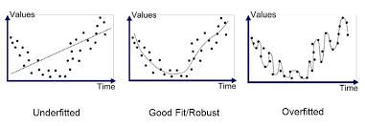

Slide 19
Concept of Generalization
Generalization means performing well on unseen data.
Good model:
Low training error
Low testing error
Goal: learn patterns, not memorize examples.

Slide 20
Example : Chai wala Prediction
You want to predict the number of cups of chai sold based on the temperature in degrees Celsius (x).
True Trend: As temperature rises, chai sales slowly decrease (prefers cold drinks), but sales are never zero.
Our Data (Training Set):
We collect data for 5 days.
Day | Tmp (°C) | Cups Sold | Notes
Day 1 | 15 | 100
Day 2 | 16 | 98
Day 3 | 15.5 | 101 | Wedding party, Noise
Day 4 | 25 | 70
Day 5 | 26 | 68

Slide 21
Underfitting: A horizontal line predicting 85 cups for every temperature.
Problem: Ignores the temperature trend entirely. High error everywhere.
Overfitting: A highly complex squiggle that passes through Day 1, Day 2, and Day 3 perfectly, creating a huge spike at 15.5°C because of the "wedding noise."
Problem: It thinks 15.5°C is a special day for chai, but next time it's 15.5°C, there may not be a wedding. It will be wildly wrong.
Good Generalization: A smooth, gently sloping line that starts at ~100 cups at 15°C and ends at ~60 cups at 30°C. It ignores the "wedding spike" as noise.

Slide 22
Analyzing the fitting-ness
Symptom | Training Accuracy | Validation Accuracy | Generalization Gap | Diagnosis | Prescription
Underfitting | Low | Low | Small Gap | High Bias (Model too simple) | Add parameters, add features, reduce λ.
Overfitting | High | Low | Large Gap | High Variance Memorizing | Get more data, increase λ, simplify model.
Just Right | High | High | Small Gap | Good Generalization | Deploy the model!

Slide 23
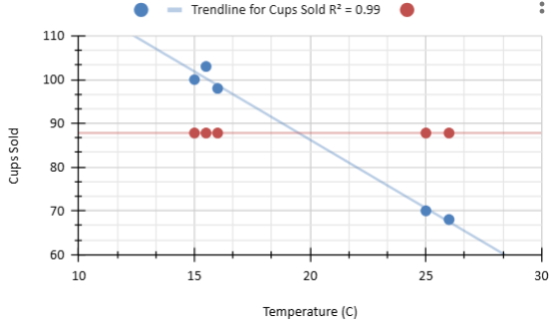
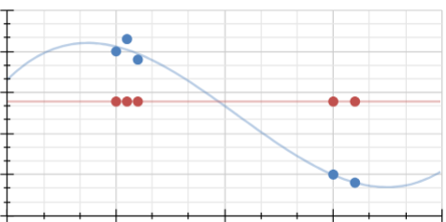
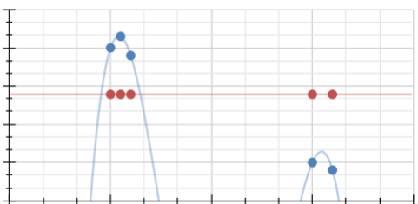
Models with increasing complexity
Linear model
Polynomial(degree 2)
Polynomial(degree 3)

Slide 24
Diagnose & Fix Underfitting
Start with a Simple Model
Detection ➔ Math signature of underfitting
High Training Error
Is the model failing to learn even the training data?
If yes Increase Model Complexity
Fix 1. Add more model parameters
Example: Go from a Linear Model y = wx + b (2 parameters) to a Polynomial Model y = w1x + w2x² + b (3 parameters). More parameters mean more flexibility to fit curves.

Slide 25
Tunable Parameters in ML
Model
Output
Input
Feature Engineering

Slide 26
Increase Model Complexity
Fix 2: Feature Engineering (The Kernel Trick)
Increase Feature Dimensionality
Transform the input space to make the pattern easier to find.
Math: If your data isn't linearly separable, project it into a higher dimension.
Example: Adding a feature x1² or x1*x2, the interaction terms can turn a non-linear problem in 2D into a linear one in 3D.

Slide 27
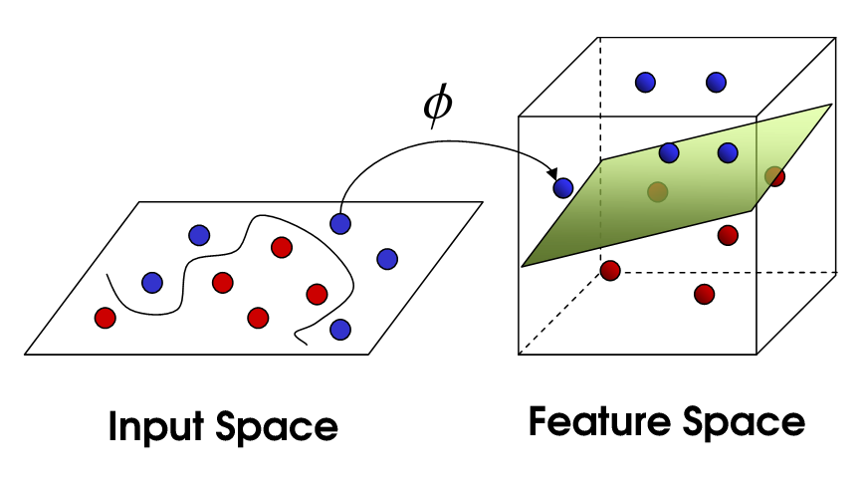

Slide 28
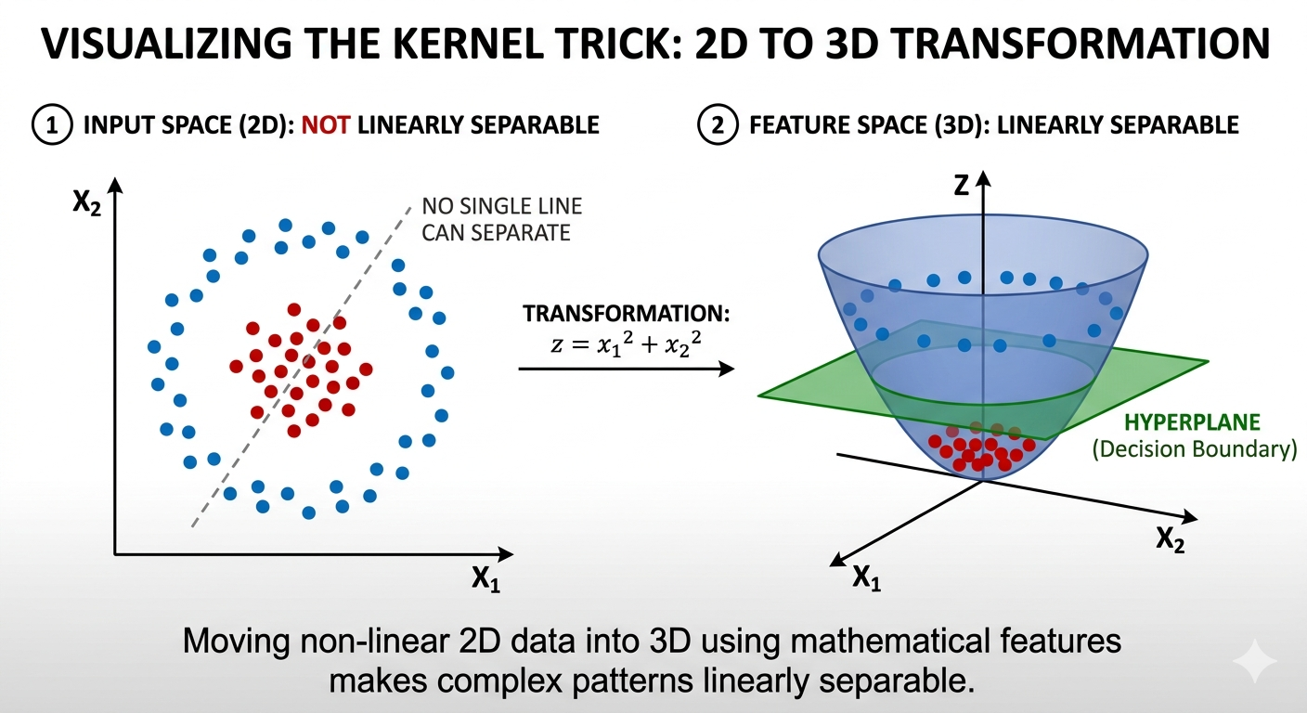

Slide 29
Physical Intuition ( Why does it work )
You are trading mathematical complexity for geometrical Complexity
Untie a messy knot
Simply use your fingers (1D)
Put it on a Table ( 2D )
Hang it over strings (3D)
Stretching the distance
In the 2D image, the red and blue dots are "on top of each other" from the perspective of a straight line. By adding a new feature like z = x1^2 + x2^2 you are essentially reorganizing the data based on a specific characteristic
This transformation "pushes" the blue dots up and keeps the red dots down.
Because they are now at different "heights," the gap between them becomes massive and easy to find.

Slide 30
Turning Curves ( x^2) into Flat ( z) Surfaces
When you explicitly include those higher-order terms as their own dimensions (like the Z axis), you've already done the "curvy" work.
The model doesn't have to "bend" the decision boundary anymore because the data itself has been "unbent" into a different space.
The "Shadow" Analogy
The 3D Decision Boundary is a simple, flat sheet of glass (a linear hyperplane) cutting through the bowl.
The 2D Decision Boundary is just the shadow of where that glass hits the bowl.
Even though the "shadow" on the ground looks like a complex circle, the actual "cut" in the 3D space was perfectly flat and simple.

Slide 31
Increase Model Complexity
Fix 3: Train for More Epochs / Increase Model Capacity
You might have just stopped training too early. Let the optimizer run longer.
Fix 4: Reduce (or Remove) Regularization
Will Discuss Regularization in detail l later
Goal : To bring down the Training Error

Slide 32
Diagnose & Fix Overfitting
Detection ➔ Math signature of Overfitting
High Testing Error ( High error on unseen data)
High gap between Training & Testing error
Generalize the model
Fix 1: Reduce Model Complexity
Explicitly cut down the number of parameters.
Examples: Reduce the degree of a polynomial (go from x^10 down to x^3), reduce the depth of a tree, or reduce the number of layers in a neural network.

Slide 33
Model Generalization
Fix 2: Increase Training Data (The Gold Standard)
A model overfits when it has enough capacity to memorize the noise. If you give it more data, it becomes statistically harder to memorize everything; it is forced to generalize.
Math: As the number of samples N increases, the model's variance decreases. The law of large numbers helps smooth out the noise.
Fix 3: Early Stopping
Monitor the Validation Loss during training. The moment the Validation Loss stops decreasing and starts increasing (the inflection point), stop training.
Math: This prevents the model from continuing to minimize Training Loss (which leads to overfitting) after it has already maximized its performance on unseen data.
Fix 4: Increase Regularization
Will Discuss regularization

Slide 34
Regularization
Overfitting happens when a model becomes too complex and starts memorizing noise instead of learning the true pattern. This often results in extremely large model weights (coefficients) .
The Core Idea of Regularization:
We want to discourage the model from learning overly complex patterns.
We do this by adding a penalty term to the loss function. This penalty grows with the size of the model's coefficients.
How to add penalty ? ➔ Loss ∝ Model-Complexity

Slide 35
How to do it Mathematically
Lets start with a standard loss function, Mean Squared Error (MSE) for regression:
Original Loss = MSE = (1/n) * Σ (yᵢ - ŷᵢ)²
Now, we add a penalty term that depends on the model’s weights (w₁, w₂, …, wₚ).
More the model weights/complexity → More the penalty
Lets use L2 Regularization Penalty = λ * Σ wⱼ²
Σ wⱼ² is the sum of squares of all coefficients ( aka model complexity)
λ = 0: No regularization (back to original loss).
λ small: Mild penalty, slightly smoother model.
λ large: Strong penalty, forces coefficients to be very small → much simpler model (can lead to underfitting if too large).
New Loss = MSE + λ * Σ wⱼ²

Slide 36
Chai Wala Example
Day | Temperature (x) | Chai Cups Sold (y)
1 | 15°C | 100
2 | 20°C | 85
3 | 25°C | 70
4 | 30°C | 55
We suspect a quadratic relationship might fit well, but to illustrate overfitting, let's try fitting a cubic polynomial
ŷ = w₀ + w₁x + w₂x² + w₃x³

Slide 37
Fitting the Model – With and Without Regularization
Model A (No Regularization λ = 0): Minimizes only MSE. It will pass through all 4 points exactly.
Model B (With Regularization λ = 0.1): Minimizes MSE + 0.1*(w₁² + w₂² + w₃²).
Resulting Coefficients (approximate, for illustration):
Coefficient | Without Reg. (λ=0) | With Reg. (λ=0.1)
w₁ (x term) | +150 | +12
w₂ (x² term) | -12 | -2
w₃ (x³ term) | +0.3 | +0.02

Slide 38
Comparing with/without Reg.
Without regularization: The coefficients are large in magnitude, causing the curve to wiggle dramatically between points.
With regularization: The coefficients are shrunk towards zero. The model still fits the data reasonably well, but the curve is much smoother.

Slide 39
Key Takeaways
Supervised learning learns mapping from inputs to outputs.
Key goals:
Good generalization
Low prediction error
Robust modeling.

Slide 40
Metrics and evaluation

Slide 41
Confusion Matrix
Evaluation structure:
Actual Positive / Negative vs
Predicted Positive / Negative
Metrics derived:
TP = True Positive
TN = True Negative
FP = False Positive
FN = False Negative

Slide 42
Accuracy Metric
Accuracy = (TP + TN) / (TP + TN + FP + FN)
Example:
TP=40 TN=50 FP=5 FN=5
Accuracy = 90%

Slide 43
Precision and Recall
Precision = TP / (TP + FP)
correctness of positive predictions
Recall = TP / (TP + FN)
ability to detect positives
Web Search Context ( Google/Bing/Amazon)
Precision ➔ Correctness of stuff shown ( might miss few )
Recall ➔ Ability to dig out real information ( with impurities as well )

