Slide 1
Foundations of DM

Slide 2
BDA and DM
Feature | Big Data Analysis | Data Mining
Primary Focus | The overall infrastructure and "big picture" of data. | Finding specific patterns and relationships.
Data Size | Specifically deals with massive, high-velocity datasets. | Can be used on both large and small datasets.
Goal | To derive strategic insights and business value. | To discover unknown patterns and predict trends.
Tools | Hadoop, Spark, NoSQL, Cloud Warehousing. | Excel, Python (Scikit-Learn), Weka,Heritrix,
Scope | Broad (includes storage, security, and cleaning). | Narrow (focused on the extraction of knowledge).
Nature | An ongoing architectural process. | An algorithmic, discovery-based task.⁸

Slide 3
Why Study Data Mining?
Massive volumes of data generated daily
Raw data has no value without analysis
Data Mining converts data into knowledge
Used for decision-making in all industries

Slide 4
Real-World Data Explosion
E-commerce: millions of transactions per day
Banking: ATM and card swipe data
Education: attendance and assessment data
Manual analysis is impossible at this scale

Slide 5
Data Mining
It is the process of using techniques to extract knowledge from large amounts of data.
Methodologies: Data mining encompasses both predictive methods (to forecast outcomes) and descriptive methods (to characterize properties of the data).
Evaluation: A key component is using techniques to quantify the accuracy or quality of the predictions or descriptions made.

Slide 6
What is Data Mining?
Definition: Data mining is the set of techniques used to extract knowledge from large amounts of data.
Discovery of useful patterns from large datasets
Patterns are non-trivial and previously unknown
Focuses on actionable insights
Supports strategic decision-making
Primary Goal:
To move beyond simple data storage and retrieval to find meaningful patterns and information.
It transforms raw, voluminous data into actionable insights and patterns.
Context:
It serves as a foundational process for advanced analytics in various fields

Slide 7
What is Data Mining? ( contd. )
It is The process of discovering interesting patterns and knowledge from massive amounts of data.
The Evolution: Data Collection → Data Storage → Data Mining (The Intelligence Layer).
The Goal: Turning raw data into actionable insights
"Customers who buy bread also buy butter"

Slide 8
The Data Deluge: We are Drowning in Data..
The Data Explosion
"Over 90% of the world's data was created in the last two years."
Daily data generation: X petabytes from social media, sensors, transactions, etc.
"Data is the new oil." But crude oil is useless unless refined into fuel, plastic, chemicals.
How do we transform this data into valuable insights and knowledge?

Slide 9
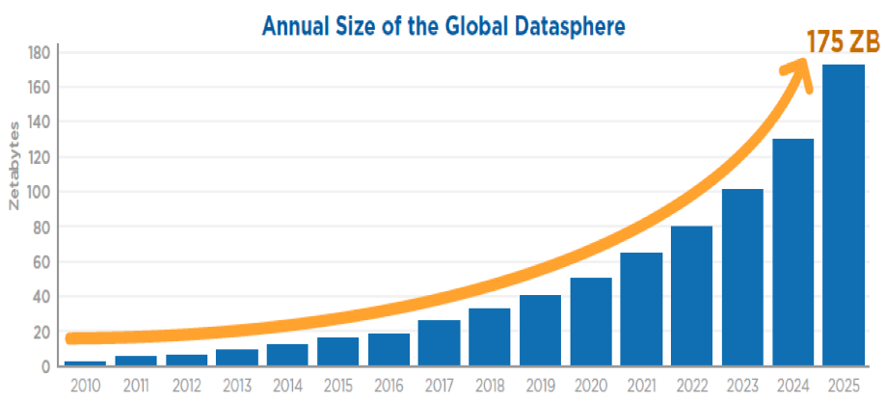
A steep exponential curve rising from left (past) to right (present/future) X-axis: Time (Years) Y-axis: Data Volume (TB → PB → EB → ZB)

Slide 10
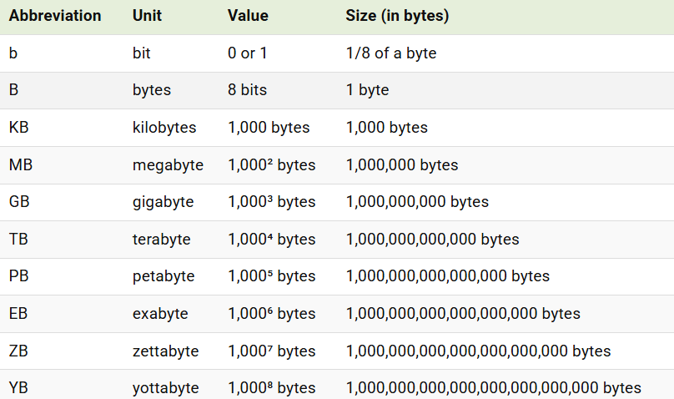

Slide 11
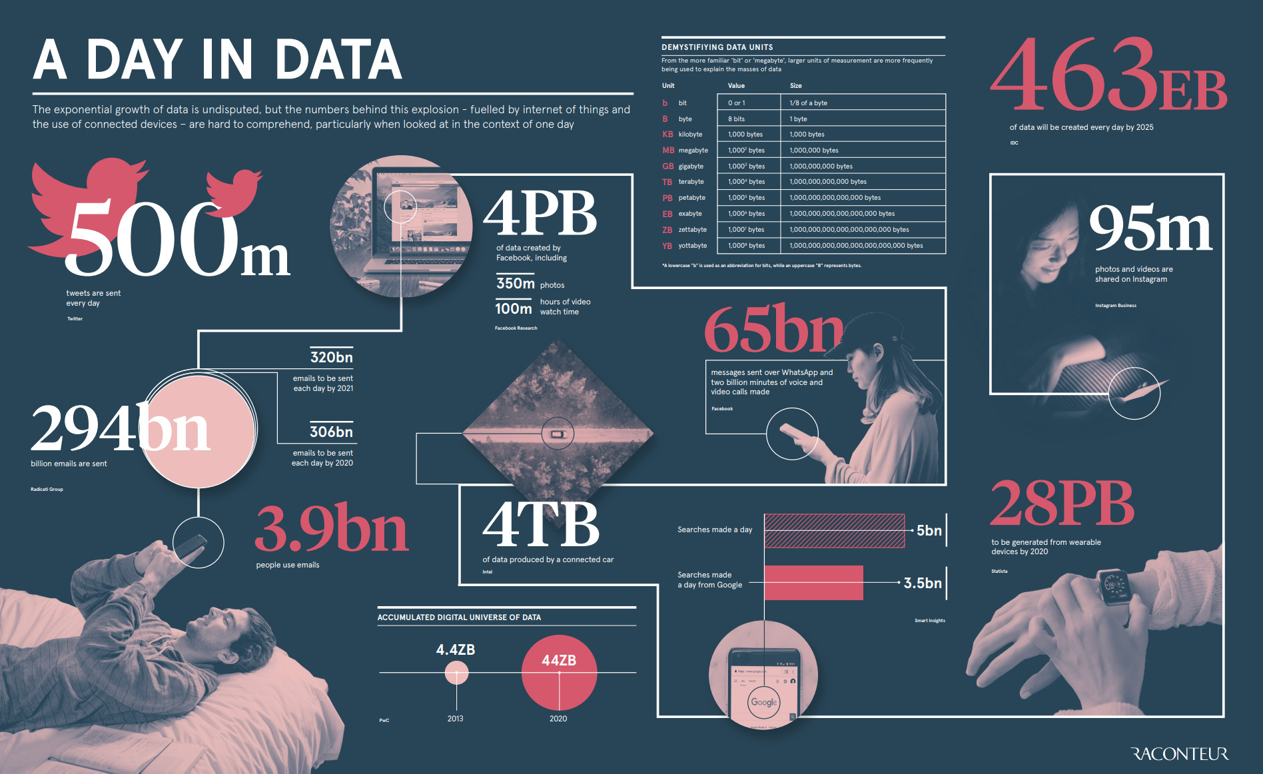
2019 report

Slide 12
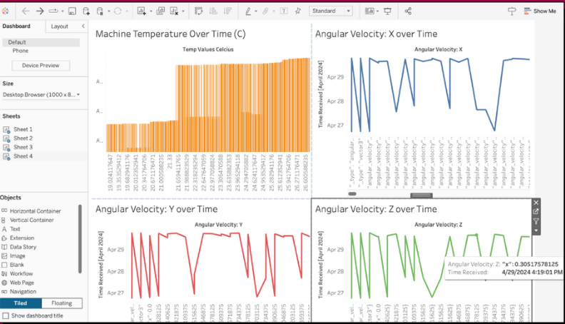
Data inside companies
Notes:
Drip irrigation system

Slide 13
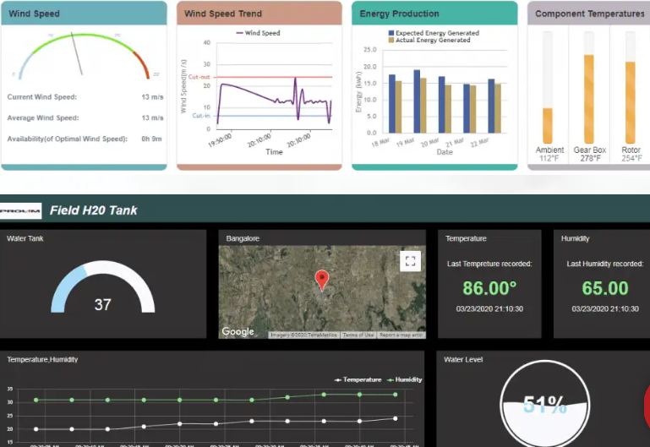
Notes:
Considering an example of data collected from the sensors connected to the windmill of a windfarm, sensors are connected to various components of the windmill to calculate the wind speed, energy produced and temperature of different components of the windmill.

Slide 14
Simple Example of Data Mining
Supermarket transaction data
Database query: list all milk buyers
Data Mining: milk buyers also buy bread
Pattern helps product placement strategy

Slide 15
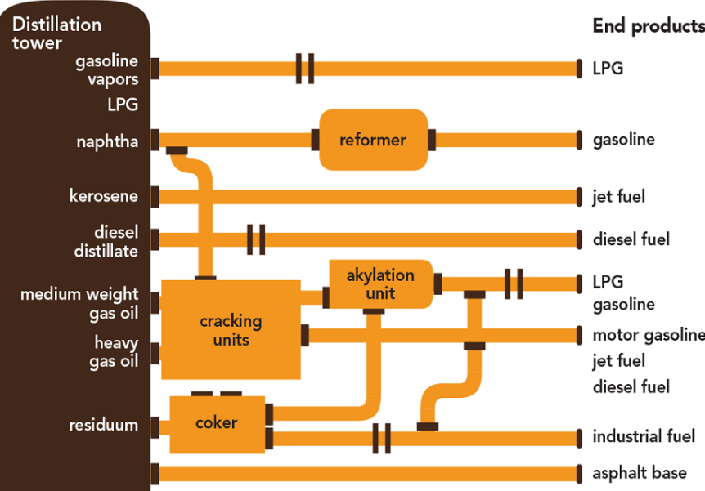
Data is the new Oil
Data Mining is the refinery
End Products : Google Analytics Dashboard

Slide 16
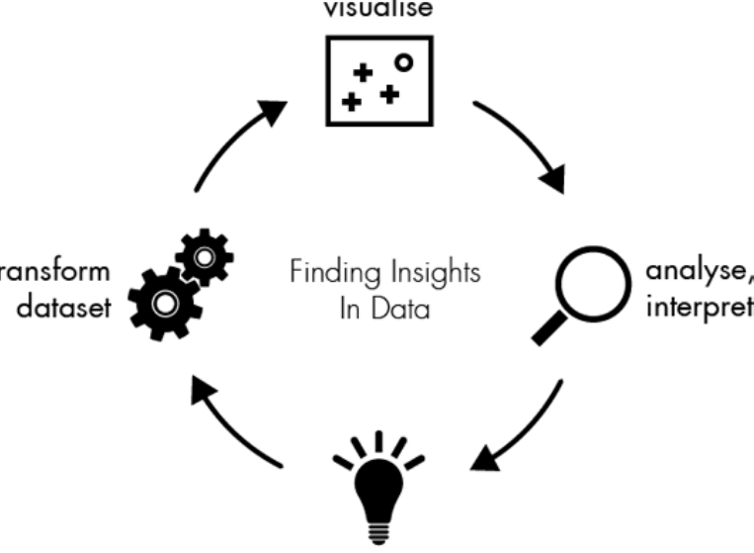

Slide 17
...But Starving for Knowledge
The Gap Between Data and Wisdom
Data-Information-Knowledge-Wisdom (DIKW) Pyramid.
Data: Raw, unprocessed facts (e.g., "42", "F", "Purchase").
Information: Processed, organized data with context (e.g., "Customer ID 42, Female, purchased a laptop on Date D").
Knowledge: Patterns, rules derived from information (e.g., "Female customers in age group 20-30 frequently buy laptops and accessory X within 2 weeks").
Wisdom: Using knowledge to make strategic decisions.
Data Mining operates primarily at the Knowledge layer.

Slide 18
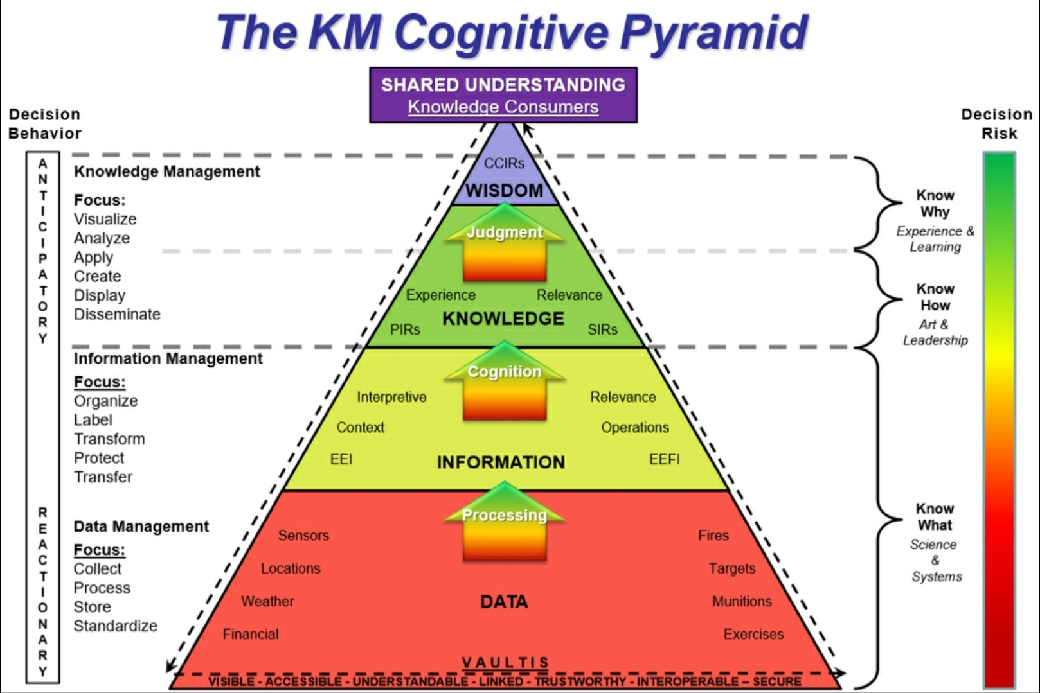

Slide 19
What is Data Mining? A First Definition
Extracting Gold from the Mine
Formal Definition
"Data mining is the process of discovering interesting patterns and knowledge from large amounts of data. The data sources can include databases, data warehouses, the web, other information repositories, or data that are streamed into the system dynamically."
Key Verbs: Discover, Extract, Identify, Analyze.
Key Nouns: Patterns, Knowledge, Relationships, Trends.

Slide 20
What Data Mining is NOT
Clarifying Common Misconceptions
It is NOT simple query/reporting (SELECT * FROM sales WHERE year=2023). That's information retrieval.
It is NOT just statistical analysis (though it uses stats heavily). It's more about automated discovery.
It is NOT about working with small, curated datasets. Scale is inherent.
It is NOT magic. It's a rigorous, iterative process of hypothesis (model) and testing.

Slide 21
The Big Picture: Knowledge Discovery in Databases (KDD)
Data Mining is One Step in a Larger Process called KDD
KDD is the non-trivial process of identifying valid, novel, potentially useful, and ultimately understandable patterns in data.
Emphasize: Data Mining is the core analytical step, but it's preceded and followed by critical stages.
Raw Data/Selection -> Preprocessing -> Data Mining -> Postprocessing -> Knowledge.

Slide 22
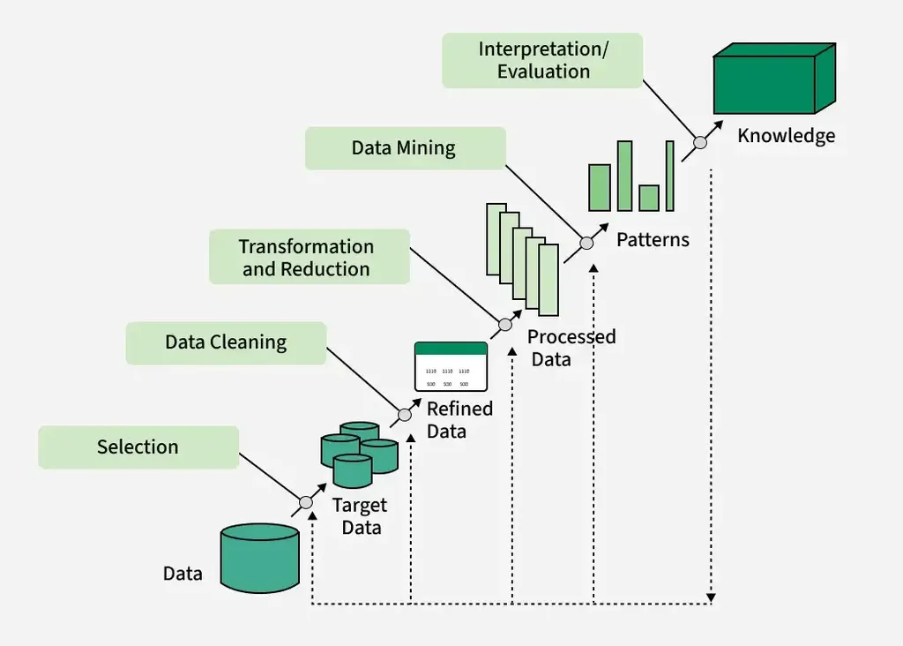
What is KDD

Slide 23
5 step Model
Data Selection
Data Cleaning and Preprocessing
Data Transformation and Reduction
Data Mining
Evaluation and Interpretation of Results

Slide 24
5 Step Model
Selection:
Identifying and creating a target dataset from existing databases.
Cleaning & Preprocessing:
Cleaning the data to remove noise, outliers, and handle missing fields.
Transformation & Reduction:
Converting data into forms appropriate for mining, such as normalization or dimension reduction.
Data Mining:
Applying intelligent algorithms to extract patterns (e.g., classification, clustering).
Interpretation/Evaluation:
Analyzing the extracted patterns to determine their validity and translating them into usable knowledge.

Slide 25
7 Step Model
Selection:
Retrieving data relevant to the analysis task from the integrated source.
Cleaning:
Removing noise and inconsistent data.
Integration:
Combining multiple data sources (like databases or files) into a single repository.
Transformation:
Transforming data into formats suitable for mining (e.g., aggregation).
Data Mining:
The central step where patterns are discovered.
Pattern Evaluation:
Identifying the truly interesting patterns representing knowledge based on given measures.
Knowledge Presentation:
Using visualization and knowledge representation techniques to present the mined data to users.

Slide 26
Acronyms
5-Step Model
Selection, Preprocessing, Transformation, Data Mining, Evaluation
S-P-T-D-E: "Smart People Think Data's Easy"
7-Step Model
Cleaning, Integration, Selection, Transformation, Mining, Evaluation, Presentation
C-I-S-T-M-E-P: "Can Intelligent Students Truly Master Every Pattern?"

Slide 27
Key Differences
Granularity: The 7-step model explicitly separates Cleaning and Integration, which are often grouped under "Preprocessing" in the 5-step model. Additionally it adds Presentation
Focus: The 5-step model is a broader conceptual workflow, while the 7-step model (often called the Data Mining Process) is more specific about the technical pipeline required to reach the mining stage.

Slide 28
Deep Dive: The KDD Process
The Journey from Raw Data
Data Selection: Identifying and retrieving relevant data from various sources (DBs, warehouses, logs). What data do we need for our goal?
Data Cleaning & Preprocessing (The "80% Job"): This is where we spend most of our time. Cleaning, integration, transformation.

Slide 29
KDD Process contd.
The Heart of the Matter
Data Integration: Combining multiple data sources (like databases or files) into a single repository.
Data Transformation: Converting data into forms suitable for mining (normalization, aggregation, feature construction).
Data Mining (The "Algorithms" Step): Applying intelligent methods to extract patterns. Classification, Clustering, Association Rule Mining, etc.

Slide 30
KDD Contd.
From Patterns to Actionable Knowledge
Pattern Evaluation/Interpretation: Identifying truly interesting patterns representing knowledge.
Criteria: Validity, Novelty, Usefulness, Understandability.
Knowledge Presentation: Visualizing and reporting the discovered knowledge using techniques like decision trees, rules, graphs.
Crucial Point: The process is highly iterative.

Slide 31
Database vs data mining

Slide 32
Storage Vs Discovery
Database (The "Digital Library"):
Focus: Optimized for CRUD operations (Create, Read, Update, Delete) and maintaining data integrity.
Architecture: Uses a rigid Schema (tables, columns, keys) to ensure that every piece of data has a specific home.
Role: Acts as the "source of truth." If you need to know your bank balance or a student's GPA, you go to the database.
Data Mining (The "Private Investigator"):
Focus: Extracts non-trivial, implicit, and previously unknown information from those same databases.
Mechanism: Uses mathematical algorithms (clustering, classification, regression) to "dig" through the noise.
Role: Identifies the "why" and "what next." It doesn't care about the single record; it cares about the trend across a million records.

Slide 33
Known Questions vs. Unknown Relationships
Databases: Querying the Known
Interaction: Driven by SQL (Structured Query Language).
Nature: Confirmative. You know what you are looking for (e.g., "List all customers who spent > $500 in 2025").
Precision: Results are binary and exact. A record either matches the criteria or it doesn't.
Data Mining: Discovering the Unknown
Interaction: Driven by Machine Learning and Statistical Models.
Nature: Exploratory. You don't know the question yet (e.g., "Group customers based on similar buying behaviors I haven't noticed").
Probability: Results are often probabilistic. It finds Associations (X ➔ Y ) with a calculated Confidence and Support.

Slide 34
Data Mining vs Databases
The Difference in a Nutshell:
Database: "What was our highest-selling product last month?"
Data Mining: "Why do people who buy video games also tend to buy energy drinks on Friday nights?“
The Symbiosis :
You cannot have Data Mining without a Database. The Database provides the raw material (data), and Data Mining provides the refinery (insights). Together, they turn data into a competitive advantage.

Slide 35
Relationship with a Larger Framework
Data Mining is actually a single step within a larger framework called Knowledge Discovery in Databases (KDD).
Feature | Database Management (DBMS) | Data Mining (KDD)
Primary Task | Data Integration & Persistence | Pattern Discovery & Prediction
Data State | Operational/Transactional | Historical/Aggregated
Output | Reports, Records, Lists | Rules, Clusters, Models
Philosophy | "Tell me what happened." | "Tell me what it means."

Slide 36
The KDD Pipeline
Selection: Identifying relevant data from the DBMS.
Preprocessing: Cleaning "noise" and handling missing values.
Transformation: Normalizing data into a format suitable for algorithms.
Data Mining: The "Core"—applying algorithms to find patterns.
Evaluation: Interpreting the patterns to see if they are actually useful.

Slide 37
Real-World "Magic" — Relatable Examples
To make these concepts stick, let’s look at how platforms like Netflix, Spotify, and Amazon use both systems simultaneously.
The Database Side (The Foundation):
Stores your username, password, and subscription tier.
Keeps a "Watch History" table (e.g., "User 101 watched Stranger Things at 8 PM").
Goal: Efficiency and Security.
The Data Mining Side (The Intelligence):
Collaborative Filtering: Analyzes millions of watch histories to find users similar to you.
Association Rules: If users who liked Interstellar also liked Inception, the system recommends the latter to you.
Goal: Predictive Engagement.

Slide 38
Summary Table — Side-by-Side Comparison
Attribute | Databases (DBMS) | Data Mining
Objective | To store and retrieve facts. | To discover knowledge and trends.
Usage | Day-to-day business operations. | Long-term strategic planning.
Query Type | Well-defined (SQL). | Vague or exploratory (Algorithms).
Data Quality | Must be 100% accurate. | Can handle "noisy" or incomplete data.
Math Involved | Simple arithmetic (Sum, Avg). | Complex stats (Probability, R^2 values).

Slide 39
Data Mining vs Statistics vs ML

Slide 40
Data Mining vs Statistics vs ML
Statistics summarizes and infers
Machine Learning focuses on prediction, clustering
Data Mining integrates stats, ML, and databases
Goal: discovery + interpretation + Knowledge

Slide 41
Bridging the Gap: Where Statistics, ML, and Data Mining Meet
While these fields overlap, they originated from different academic lineages. Understanding their "ancestry" helps clarify their unique strengths.
Statistics (The Root): Mathematics-based. It focuses on the validity of the data and the mathematical proof behind a trend.
Machine Learning (The Intelligence): Computer Science-based. It focuses on efficiency and the ability of an algorithm to improve without manual coding.
Data Mining (The Process): Information Systems-based. It focuses on scalability—finding "gold" in massive, messy mountains of data.
Key Philosophy:
Statistics is about "Why?" (Inference)
Machine Learning is about "What's next?" (Prediction)
Data Mining is about "What's in there?" (Discovery)

Slide 42
Data Mining : Digging for Diamonds
Data Mining is the computational process of discovering patterns in large data sets involving methods at the intersection of ML, statistics, and database systems.
The KDD Process (Knowledge Discovery in Databases): It involves data cleaning, integration, selection, transformation, mining, and finally, interpretation.
Scalability is King: While a statistician might work on a spreadsheet, a data miner works on a distributed server (like Hadoop or Spark) containing petabytes of data.
Pattern Recognition: Finding "Association Rules"—e.g., "People who buy diapers at 7 PM also tend to buy beer."
Integration Recap:
Databases: Provide the storage and indexing.
Statistics: Provide the "noise" vs. "signal" filtering.
ML: Provides the algorithms to automate the search.

