Slide 1
Descriptive Data Summarization

Slide 2
Why Descriptive Statistics in Data Mining?
The First Step in KDD Process:
Before mining patterns, we must understand our data
Descriptive statistics provide a quantitative summary
Helps identify data quality issues early
Guides selection of appropriate mining algorithms
Basis for data cleaning and preprocessing decisions
Analogy: "You wouldn't start digging for treasure without first surveying the land"

Slide 3
Types of Data - Quick Review
Numerical (Quantitative) Data:
Interval: Temperature in °C, Calendar dates
Ratio: Height, Weight, Income (has true zero)
Categorical (Qualitative) Data:
Nominal: Gender, Color, ZIP Code (no ordering)
Ordinal: Education level, Customer satisfaction (ordered categories)

Slide 4
Measures of Central Tendency - Overview
The "Center" of Data:
Single values that describe the middle or typical value
Different measures tell different stories
Choice depends on data type and distribution shape
Three Primary Measures:
Mean (Arithmetic Average)
Median (Middle Value)
Mode (Most Frequent Value)

Slide 5
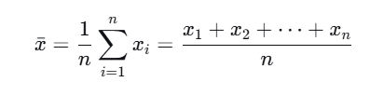
Mean (Arithmetic Average)
Formula
Properties
Uses all data points
Sensitive to extreme values (outliers)
Only meaningful for numerical data
Example:
Customer ages: 23, 27, 25, 28, 26
(23+27+25+28+26)/5=129/5=25.8

Slide 6

Weighted Mean
When observations have different importance:
Data Mining Application
Customer value analysis (weight by purchase amount)
Sensor data aggregation (weight by reliability score)
Survey data analysis (weight by respondent representativeness)
Example: Course grades with different weights:
Exam 1 (30%, score 85), Exam 2 (30%, score 90), Project (40%, score 95)
0.3×85+0.3×90+0.4×95 = 102.5

Slide 7
Median
Definition: The middle value when data is sorted
Calculation:
Sort data in ascending order
If n is odd: Median = middle value
If n is even: Median = average of two middle values
Properties:
Robust to outliers (resistant measure)
Better for skewed distributions
Can be used with ordinal data
Not sensitive to exact values, only positions
Example 1 : 12, 15, 17, 21, 24 → Median = 17 Example 2 : 12, 15, 17, 21, 24, 30 → Median = (17+21)/2 = 19

Slide 8
Mode
Definition: The most frequently occurring value(s)
Types:
Unimodal: One mode
Bimodal: Two modes
Multimodal: Multiple modes
No mode: All values equally frequent
Properties:
Can be used with all data types (nominal, ordinal, numerical)
May not exist or may not be unique
Not affected by extreme values
Useful for categorical data analysis

Slide 9
Examples of Mode
Product colors sold :
Red, Red, Blue, Green, Red, Blue, Red
Mode = Red (appears 4 times)
Bimodal example (two modes):
Data: {2, 2, 2, 3, 4, 4, 5, 5, 5}
Modes = 2 and 5 (both appear 3 times; useful when a dataset has two equally common peaks)
Most frequent shoe size sold by a retailer in a week:
Data: {8, 9, 8.5, 9, 10, 9, 11, 9.5, 9, 8}
Mode = 9 (helps the retailer know which size to stock the most)

Slide 10
Examples of Mode
Popular majors at a university:
Data: {Psychology, Nursing, Mathematics, Biology, Psychology, Child Development, Media Production, Psychology}
Mode = Psychology (the most popular choice, even though it's not a number)
Most common hair color in a classroom:
Data: {Brown, Blonde, Black, Red, Brown, Black, Blonde, Brown, Black, Blonde, Brown}
Mode = Brown (identifies the characteristic that appears most often)
Most preferred ice cream flavor in a survey:
Data: {Vanilla, Chocolate, Strawberry, Vanilla, Chocolate, Vanilla, Strawberry, Vanilla, Chocolate, Chocolate}
Mode = Chocolate (shows the most popular flavor)

Slide 11
Symmetric Distribution: Mean ≈ Median ≈ Mode
Right-Skewed (Positive Skew): Mean > Median > Mode
Left-Skewed (Negative Skew): Mean < Median < Mode
Which to use?
Symmetric, no outliers: Mean
Skewed or with outliers: Median
Categorical data: Mode
Best practice: Report all three when possible

Slide 12
Symmetric Distribution
In these cases, data is balanced. The average value is also the most common and sits right in the middle.
Heights of adult women: Most women cluster around a central average height, with roughly equal numbers being taller or shorter.
Standardised test scores: Exams like the SAT are often designed to produce a bell curve where the majority score in the middle range.
Rolling a fair die: If you roll a die thousands of times, each number (1–6) appears with roughly equal frequency, creating a flat, symmetric Uniform Distribution.

Slide 13
Right-Skewed / Positive Skew
Here, a few "extreme" high values pull the mean upward, even though most data points are lower.
Household income: Most people earn a modest salary (the Mode), but a few billionaires (outliers) drag the Mean Income much higher than what the typical person earns.
House prices in a city: Most homes might cost $300k, but a few $10-million mansions pull the average price up, making the mean higher than the median.
Years of education: Most people complete high school or college, but a small number of people with multiple PhDs or extensive post-grad work create a tail to the right.

Slide 14
Left-Skewed / Negative Skew
In this scenario, a few very low values pull the mean downward, while the majority of data clusters at the high end.
Age at retirement: Most people retire in their 60s (the Mode), but a few people who retire in their 30s or 40s pull the Mean Retirement Age down.
Easy exam scores: If a test is very easy, most students will score 90–100%, but a few students who fail will drag the class average (mean) below the most common score.
Gestational age of births: Most babies are born at full term (around 38–40 weeks), but premature births (the "tail" on the left) pull the average pregnancy length down.

Slide 15
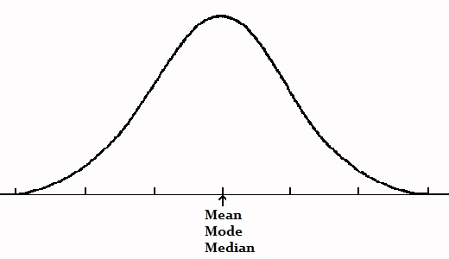

Slide 16
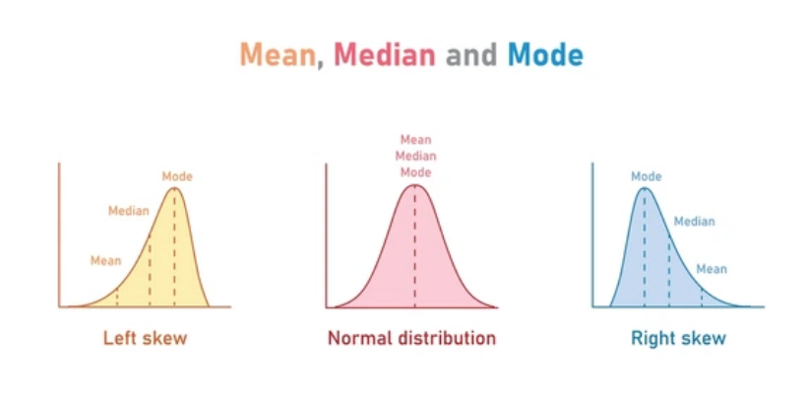

Slide 17
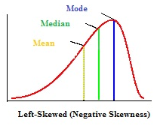

Slide 18
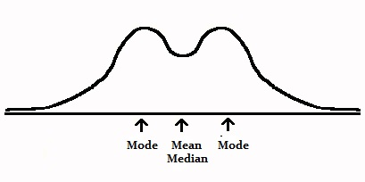

Slide 19
dispersion

Slide 20
Measures of Dispersion - Introduction
Why dispersion matters:
Central tendency alone is misleading
Two datasets can have same mean but different spreads
Risk assessment in business applications
Quality control in manufacturing
Key Measures:
Range
Variance
Standard Deviation
Interquartile Range (IQR)

Slide 21
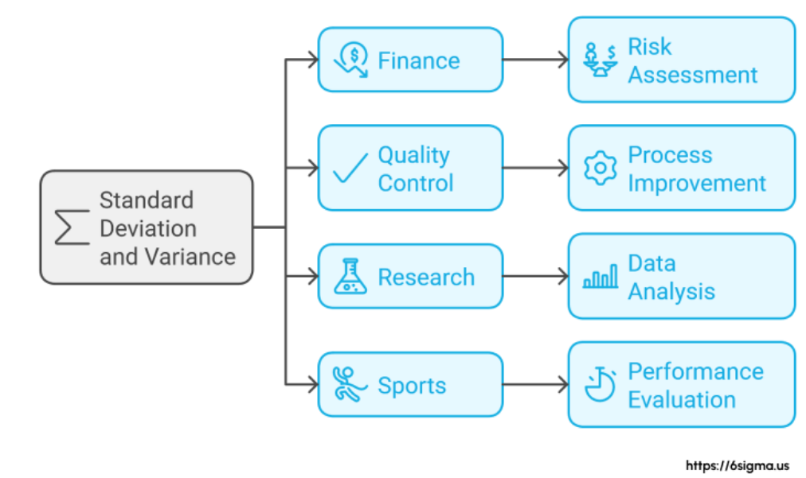

Slide 22
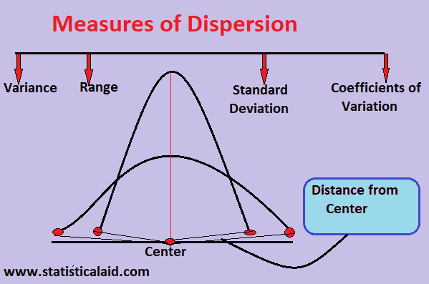

Slide 23
Range and Quartiles
Range
Range=Maximum−Minimum
Simple but sensitive to outliers
Quartiles: Divide sorted data into four equal parts
Q1 (First Quartile): 25th percentile
Q2 (Second Quartile): Median (50th percentile)
Q3 (Third Quartile): 75th percentile
Interquartile Range (IQR):
IQR=Q3−Q1
Range of middle 50% of data
Robust to outliers

Slide 24
Example 1: Standard Sequential Data
For the Set 1 to 10
Sorted Data = {1 2 3 4 5 6 7 8 9 10 11 .... 20}
Step 1 : Find Q2 ( Median : 50th percentile)
(10 + 11)/2 == 10.5
Step 2 : Find Q1 ( Median of first lower half )
(5 + 6)/2 == 5.5
Step 3 : Find Q3 ( Median of upper half)
(15 + 16)/2 == 15.5
Step 4. Calculate IQR : Q3 – Q1 = 15.5-10.5 = 5

Slide 25
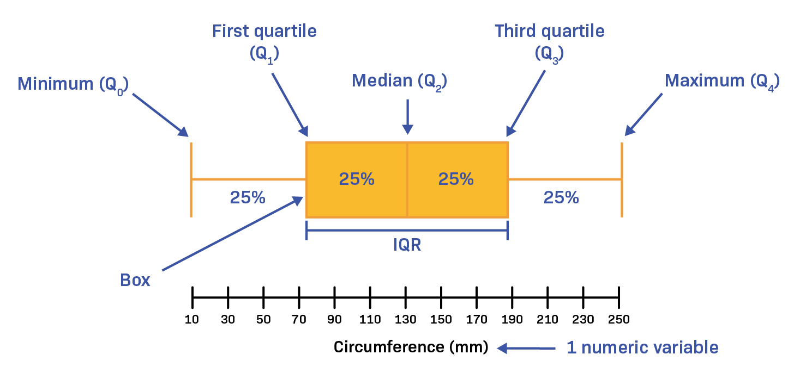
Copyright : labxchange.org

Slide 26
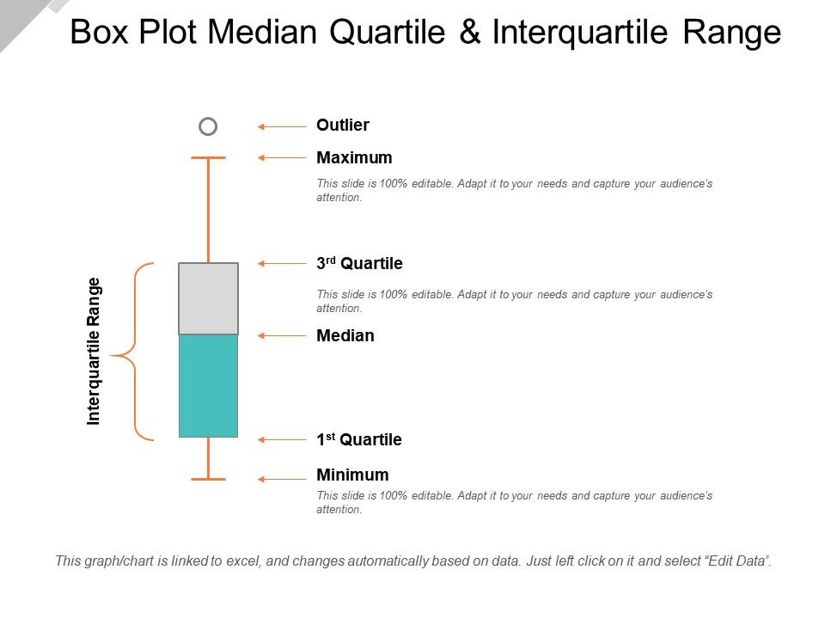
Copyright : slideteam.net

Slide 27
variance

Slide 28
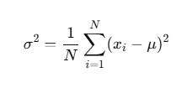

Variance
Measures average squared deviation from mean
Population Variance
Sample Variance

Slide 29
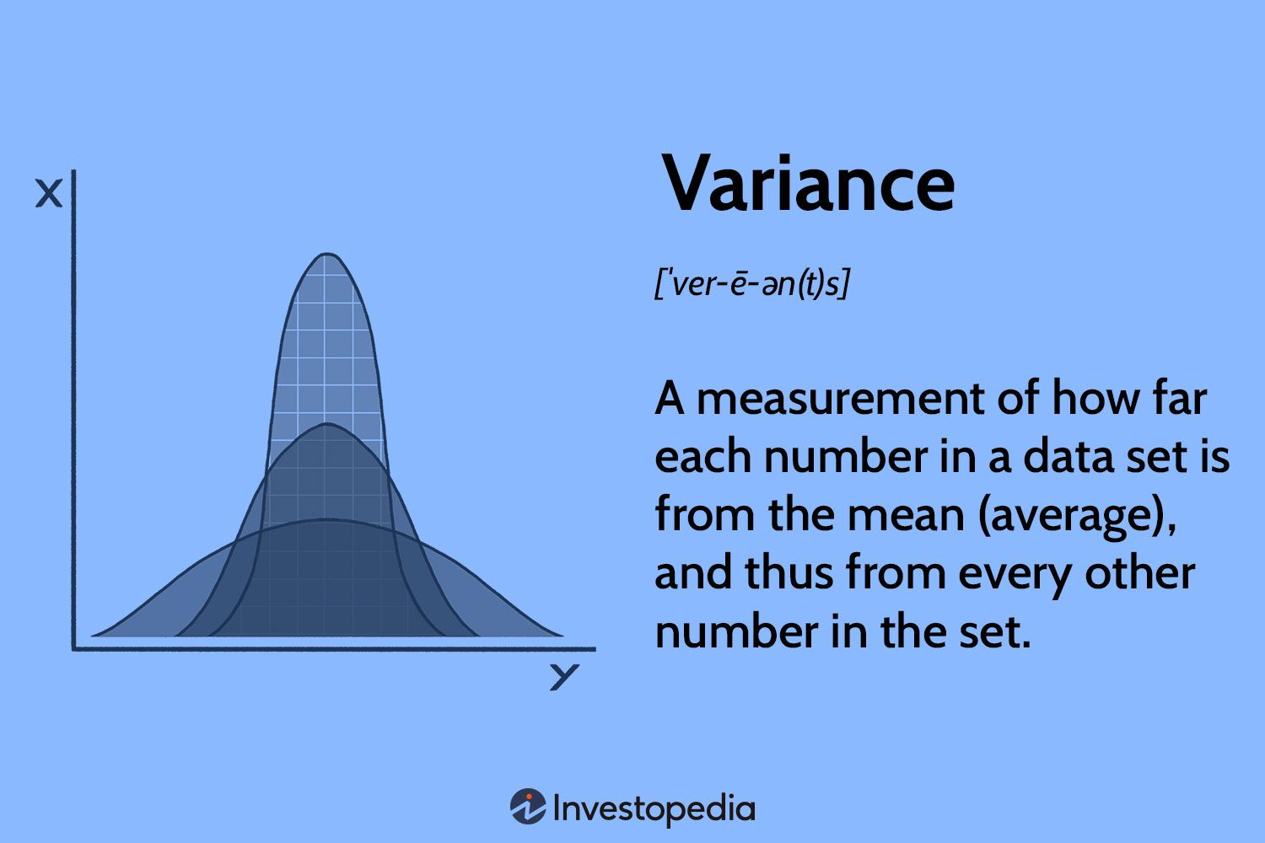

Slide 30
Bessel’s Correction
Why n-1 for sample? (Bessel's correction)
Corrects bias in estimation of population variance
Accounts for degrees of freedom
Population variance (no correction)
If you have data for the entire population, the variance is defined as:
Why divide by N?
Because:
You know the true mean
You are measuring actual spread, not estimating anything
No bias is introduced
So no correction is needed.

Slide 31
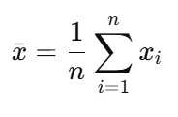
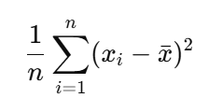
Sample variance
In practice, we usually have only a sample, not the full population.
Estimated mean
Lets see the issue with estimated variance
⚠️ This is biased — it underestimates the true population variance.

Slide 32
Why Underestimation
Key idea: The sample mean is “too close” to the data
The sample mean xˉ is computed from the same data
It is chosen specifically to minimize squared deviations
This makes the data points appear artificially closer to the mean
Result: The squared deviations are systematically smaller than they would be around the true mean mu
Why Smaller and not bigger

Slide 33
heart of Bessel’s correction
Once you compute the sample mean:
Only n−1 values are free to vary
The last value is forced to satisfy the mean
Example: If n=5 and you know 4 deviations from the mean, the 5th is fully determined.
➡So you really have n−1 independent pieces of information

Slide 34
Bessel’s Correction ( the Fix )
To correct the bias, we divide by n-1 instead of n
This is Bessel’s correction.
What it does
Inflates the variance slightly
Exactly compensates for the bias introduced by estimating the mean
Makes s^2 an unbiased estimator of σ^2

Slide 35
Bessel’s correction compensates for the loss of one degree of freedom caused by estimating the mean from the sample, preventing systematic underestimation of variance.

Slide 36
Explain with Example
Toy numerical example
Data
x = { 2, 4, 6 }
Assume this is a sample from a population
Sample Mean = 2+4+6/3 = 4
Assume Population mean = 5

Slide 37
Pupolation Style Varianve
μ=5
Point | Deviation | Squared
2 | −3 | 9
4 | −1 | 1
6 | +1 | 1
Variance = 11/3 = 3.67

Slide 38
Sample Mean
Sample Mean = 4
Naive Sample Variance = 8/3 = 2.67
Point | Deviation | Squared
2 | −2 | 4
4 | 0 | 0
6 | +2 | 4

Slide 39
Constraint
Deviations must sum to zero
Once two deviations are chosen, the third is forced
Example:
(−2) + 0 + 2=0
1 Equation ➔ 1 less degree of freedom
Only 2 independent directions of movement exist.
Bessel’s Correction fixes the geometry
S^2 = 8/(3-1) = 4 ( closer to 3.67 )

Slide 40
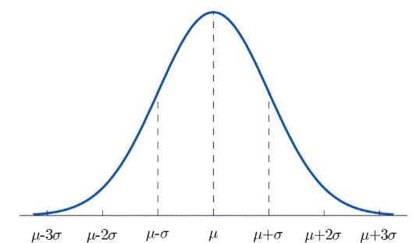
Standard Deviation
Square root of variance:
s=SqRoot(s^2)
​Properties:
In original units of measurement
Measures "typical" deviation from mean

Slide 41
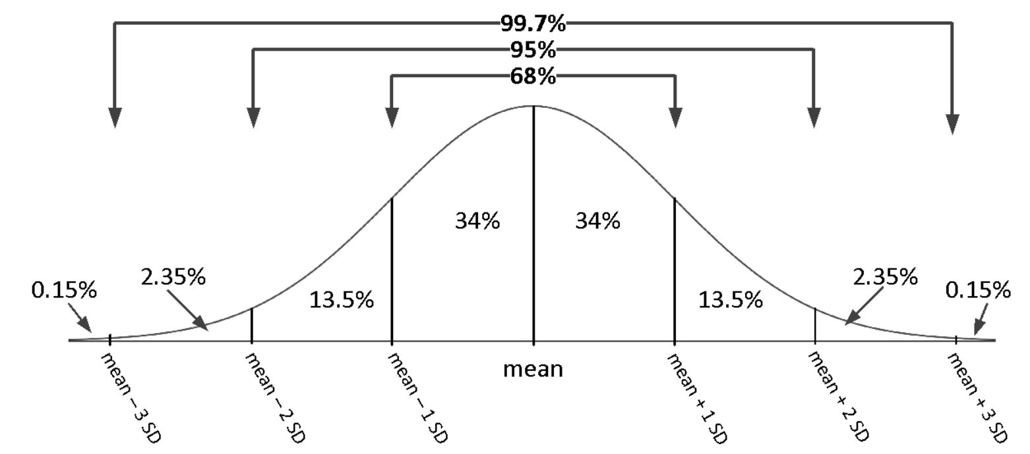
For normal distribution:
~68% within ±1 SD
~95% within ±2 SD
~99.7% within ±3 SD

Slide 42
Questions
Suppose we have a normal distribution with a mean of 10 and standard deviation of 2.
What is the percentage of the population that has a value between 8 and 12?
What is the percentage of the population that has a value below 12?
What is the percentage of the population with values between 6 and 12?

Slide 43

Coefficient of Variation (CV)
Relative measure of dispersion:
Purpose: Compare variability across different datasets
Unitless measure
Useful when means are different
Example:
Dataset A: xˉ=100, s=10 → CV = 10%
Dataset B: xˉ=200, s=20 → CV = 10%
Both have same relative variability despite different scales

Slide 44
Five-Number Summary
Compact description of distribution:
Minimum
First Quartile (Q1)
Median (Q2)
Third Quartile (Q3)
Maximum
Example : Min=12, Q1=17, Median=27, Q3=40, Max=50
Provides information about:
Center (median)
Spread (range, IQR)
Shape (symmetry, skewness)

Slide 45
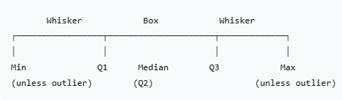
Introduction to Boxplots (Box-and-Whisker Plots)
Visual representation of five-number summary:
Components:
Box: From Q1 to Q3 (contains middle 50%)
Line inside box: Median
Whiskers: Extend to min/max within 1.5×IQR
Outliers: Plotted individually as points

Slide 46
Constructing a Boxplot - Step by Step
Data:
12, 15, 17, 21, 24, 30, 35, 40, 45, 50
Step 1: Calculate five-number summary
Min=12, Q1=17, Median=27, Q3=40, Max=50
Step 2: Calculate IQR
IQR = Q3 - Q1 = 40 - 17 = 23
Step 3: Determine whisker limits
Lower limit = Q1 - 1.5×IQR = 17 - 34.5 = -17.5
Upper limit = Q3 + 1.5×IQR = 40 + 34.5 = 74.5
Step 4: Identify outliers
No values below -17.5 or above 74.5 → No outliers
Step 5:
Draw boxplot with whiskers to min and max

Slide 47
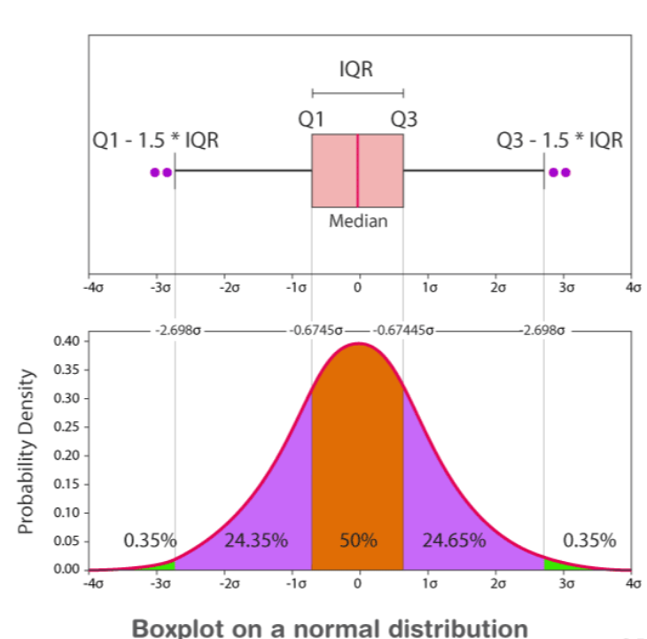
https://loppsided.blog/posts/2021-06-18-boxplots-and-p-values/

Slide 48
Interpreting Boxplots
Shape Identification:
Symmetric: Median centered in box, whiskers similar length
Right-skewed: Median closer to Q1, right whisker longer
Left-skewed: Median closer to Q3, left whisker longer
Spread Assessment:
Tall box = high variability in middle 50%
Long whiskers = extreme values far from center
Short box/whiskers = data concentrated
Outlier Detection:
Points beyond whiskers are potential outliers
Indicates extreme values that may need investigation

Slide 49
Histograms - Construction
Step 1: Determine number of bins (k)
Common rules:
Square-root: k=⌈sqrt of n⌉
Sturges' formula: k=⌈log⁡2n+1⌉
Rice rule: k=⌈2 sq cube of n⌉
Step 2: Calculate bin width
Bin width=Range/k=(Max−Min)/k​
Step 3:
Create bins and count frequencies
Step 4:
Draw rectangles with height = frequency

Slide 50
Example
Data: Customer ages (n=20)
22, 23, 24, 25, 25, 26, 27, 28, 29, 30, 31, 32, 33, 34, 35, 36, 38, 40, 45, 50
Step 1: Range = 50 - 22 = 28
Step 2: Using k=5 bins, width = 28/5 = 5.6 ≈ 6
Step 3: Bins: 22-27, 28-33, 34-39, 40-45, 46-51
Step 4: Frequencies: 7, 6, 4, 2, 1
Interpretation: Right-skewed distribution, most customers 22-33 years old

Slide 51
Histogram vs. Boxplot
Aspect | Histogram | Boxplot
Shows | Distribution shape | Summary statistics
Details | Frequency distribution | Five-number summary
Outliers | Not explicitly marked | Explicitly shown
Comparison | Harder for multiple datasets | Easy side-by-side comparison
Best for | Understanding distribution shape | Identifying center, spread, outliers
Recommendation: Use both for comprehensive data understanding

Slide 52
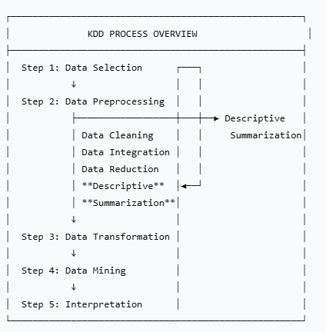
KDD Context
Descriptive statistics is the FIRST analytical step in data preprocessing, providing the foundation for all subsequent mining activities.

Slide 53
Why Start with Descriptive Statistics?
Data Quality Assessment
Identify missing values through counts and summaries
Detect outliers through boxplots and extreme values
Spot data entry errors via impossible values (e.g., age=200)
Understanding Data Distribution
Shape (normal, skewed, bimodal) guides algorithm selection
Scale and range inform normalization needs
Identifying categorical vs. numerical patterns
Feature Engineering Foundation
Which features have sufficient variation to be useful?
Identifying redundant features (low variance)
Guiding transformation decisions (log, square root, etc.)
Algorithm Selection Guidance
Normal distribution: Many parametric methods work well
Skewed distribution: May need transformation or non-parametric methods
Outliers present: Need robust algorithms

Slide 54
Data Mining Applications
Customer Segmentation:
Mean/median income for different segments
Variance in purchase amounts
Age distribution histograms
Quality Control:
Boxplots of manufacturing measurements
Identifying outlier batches
Fraud Detection:
Unusual transaction amounts (outliers)
Comparing distributions of legitimate vs fraudulent transactions
Market Basket Analysis:
Mode of frequently bought items together
Distribution of transaction sizes

Slide 55
Summary - Key Takeaways
Central tendency tells us about the "typical" value
Mean for symmetric data, median for skewed data, mode for categorical
Dispersion measures tell us about variability
Variance/standard deviation for parametric analysis
IQR for robust, non-parametric analysis
Visualizations complement numerical summaries
Boxplots show distribution summary and outliers
Histograms reveal distribution shape
Context matters - choose statistics appropriate for your data mining task

