Slide 1


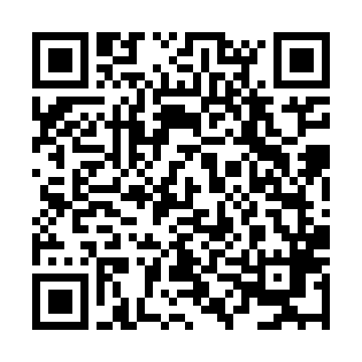
Academic Reading & Writing Workspace
Hi! I'm Dr. Arturo Rodríguez
"He creado esta plataforma con mucho cariño para apoyarte en tu camino hacia la excelencia académica...“
0000-0002-7017-9443
TEMPLATE
Platform: https://academic-reading-writing.vercel.app/ This platform supports academic reading and writing development through structured modules and tools.

