Slide 1
Intro to Web Dev: Node.js 101
The basics of developing applications (w/ a backend!) using Node.js

Slide 2
What to expect today?
Brief introduction to Node.js
What is it? What’s so special about it?
Motivation: What can be accomplished with Node.js?
Hands-on: Developing an application with Node.js
Express
MongoDB & Mongoose (Backend)
Handlebars (Rendering into a frontend)

Slide 3
Prologue: JavaScript Origins
JavaScript was originally developed to build web applications for browsers.
Browsers serves as runtime environments for JavaScript
B R O W S E R
JS Engine
JS Code
Machine Code

Slide 4



JS Engine
Different browsers have different engines, which is why sometimes JS code behaves differently in some browsers.
Chakra
V8
SpiderMonkey

Slide 5
What is Node.js?
+ Open-source JavaScript runtime environment that enables JavaScript to be executed outside a browser
+ Created by Ryan Dahl in 2009.
+ Has been constantly evolving until then, even as we speak!

Slide 6
What is Node.js?
Cross-platform runtime environment
Programs are written in Javascript, which are then run on the Node.js runtime environment
Comes with a big (!!!) library of Javascript modules
Useful for High scalability in application deployment and data-intensive realtime applications

Slide 7
Take Note:
JavaScript | Node.js
+ Scripting language used by web browsers + Can operate in any browser using the default browser’s operating environment + Used for adding interactivity to web application interfaces, such as validation, cookie processing, etc. | + Runtime environment or JavaScript interpreter + Contains a large number of libraries used in JavaScript for general-purpose programming + Allows the utilization of JavaScript beyond the browser’s means, such as constructing shell scripts or implementing backend modules.

Slide 8
Clearing up misconceptions about Node.js
Node.js is NOT a backend framework
Node.js is a JavaScript runtime environment with a large number of libraries…it just so happens that some libraries, or frameworks, are catered towards backend functionalities!
Therefore, Node.js can ALSO be used for the frontend!

Slide 9



Node.js backend frameworks
Express.js
Koa.js
socket.io

Slide 10
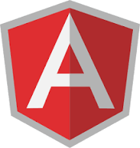


Node.js frontend frameworks
Angular
React
Vue.js

Slide 11
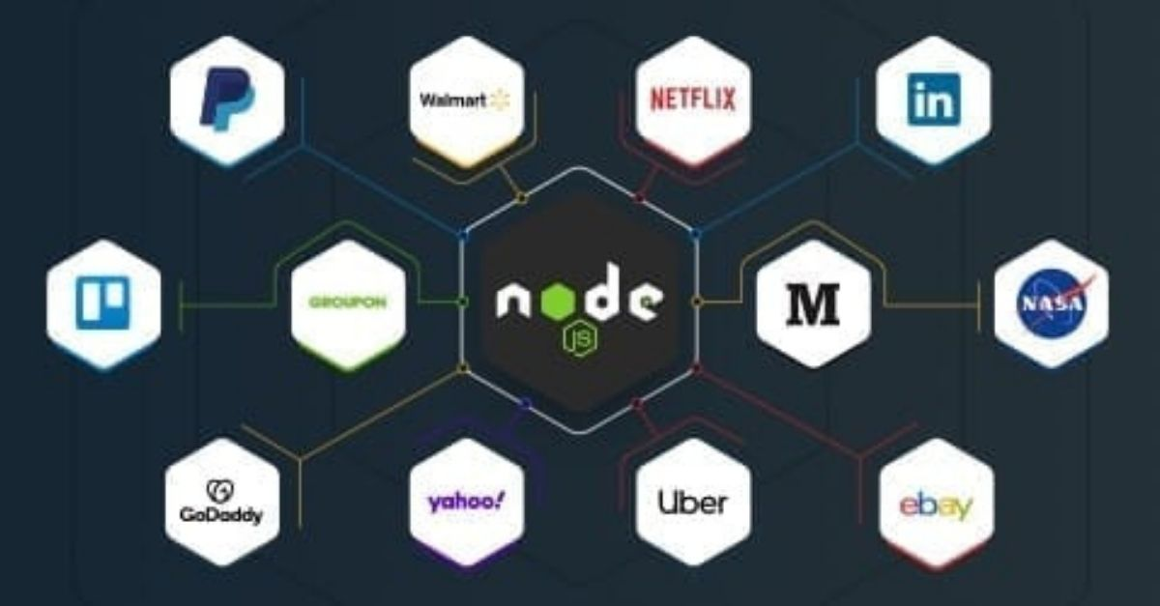
Companies that use Node.js!

Slide 12
Let’s Code!
Getting started with Node.js
Your first application in Node.js
Creating your “first server” in Node.js
Responses from the Node.js server
Backend CRUD using MongoDB and mongoose
Rendering to the front-end using Handlebars

Slide 13
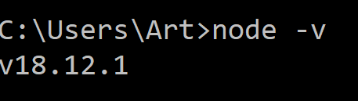
Your first application in Node.js
We’ll want to make sure that you have Node.js properly installed.
First, open your command prompt and type “node –v” to indicate the version that you have installed.

Slide 14
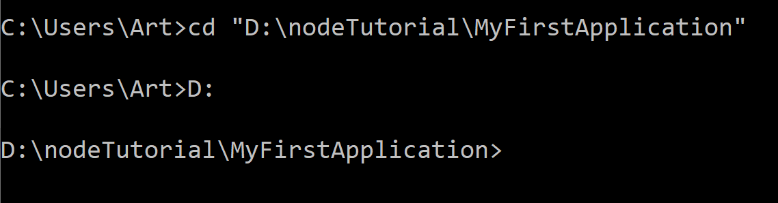
Your first application in Node.js
Navigate to your project folder, and make sure you set the directory in the command line to point to your project folder

Slide 15
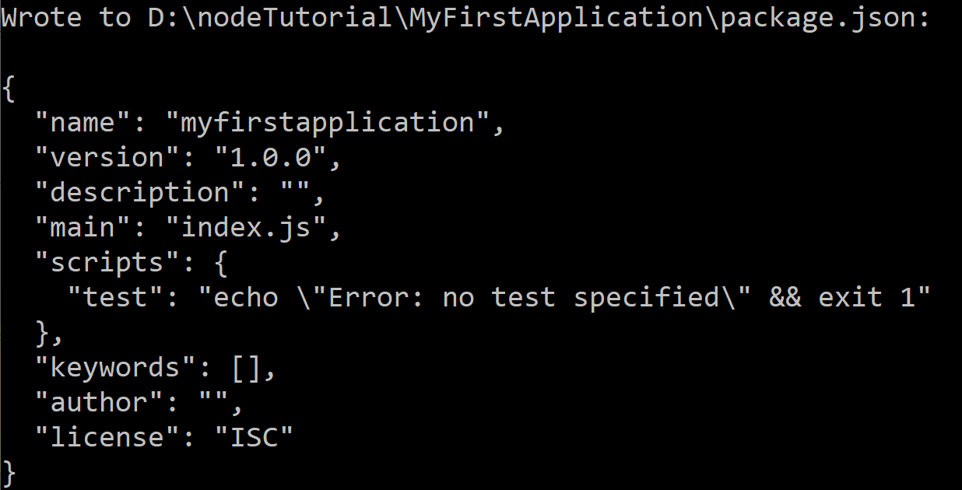
Your first application in Node.js
Run the following command: “npm init –y”

Slide 16
Your first application in Node.js
npm init -y
npm is the Node package manager for all modules built for/using Node
init is the command to initialize a Node-based project and creates a package.json file
“-y” basically is just to answer “yes” by default to all questions regarding your project creation.

Slide 17
Your first application in Node.js
Any framework / libraries that you will use will have to be installed with the npm command
We will use express.js module in today’s tutorial, and as a result, in your first Node.js application.
As a result, we’ll have to install express.js using the npm command.
Syntax: npm install <library/framework>

Slide 18
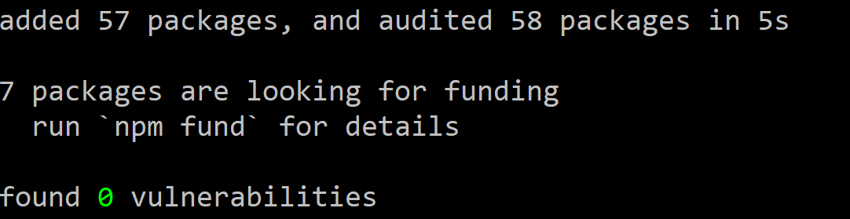
Your first application in Node.js
Run the following command: “npm install express”
A folder called “node_modules” should appear in your project directory. This folder contains all files related to the express.js framework we installed.

Slide 19
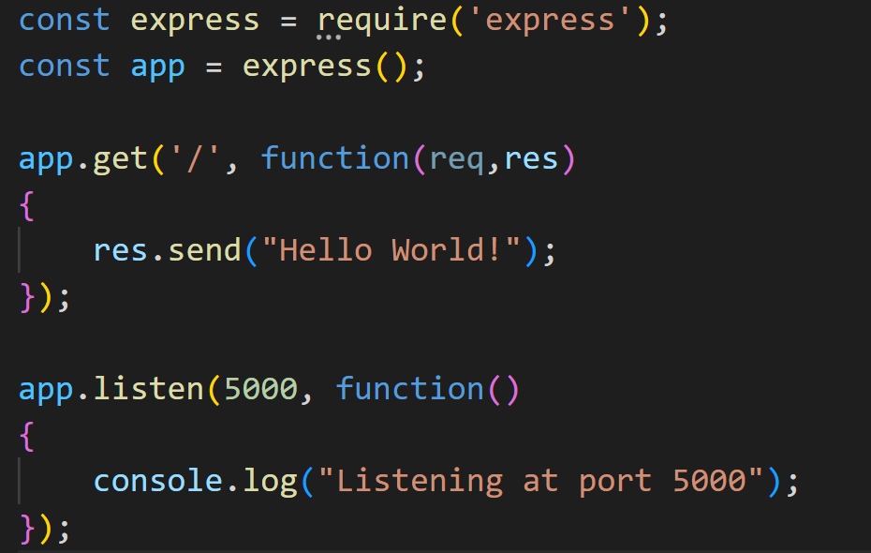
Your first application in Node.js
index.js

Slide 20
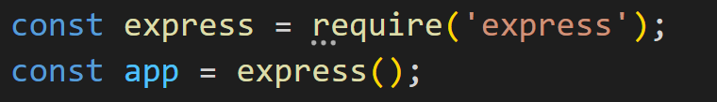
const express = require(‘express’)
The require method is used to import a module to your node.js code.
In the example above, the highlighted text is the name of the module we want to import.

Slide 21
Routing in Express
Route definition follows this structure:
app.METHOD(path, callback)
app - instance of express
METHOD - the HTTP request method, in lowercase
path - a path on the server
callback - function to be executed when the path is matched (accessed)

Slide 22
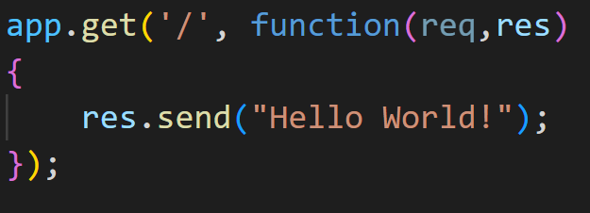
app.get(path, callback)
Routes HTTP GET requests to the specified path with the specified callback function
path - a path on the server
callback - function to be executed when the path is matched (accessed)

Slide 23
There is also the POST method, which we will tackle very lightly later.
app.get(path, callback)
Routes HTTP GET requests to the specified path with the specified callback function
path - a path on the server
callback - function to be executed when the path is matched (accessed)

Slide 24
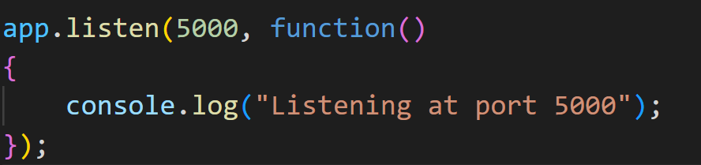
app.listen([port], [host], [callback])
Binds the application to a specific port and hosts it in the machine
port - the port to bind the server
host - the IP address to bind the server
callback - function to be executed when the server has been bounded

Slide 25
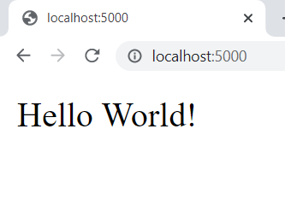
Your first application in Node.js
Now in your command prompt, type the command “node index.js”

Slide 26
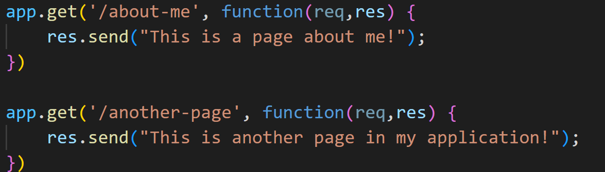
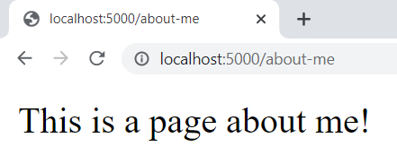
Try this: Add more routes!

Slide 27
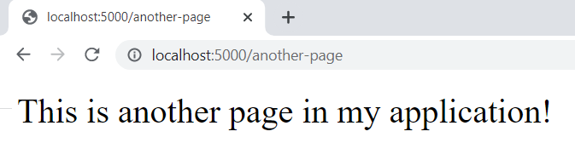
Try this: Add more routes!

Slide 28
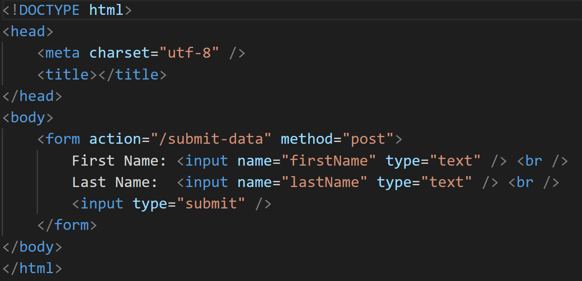
Responding with an HTML page
Index.html

Slide 29
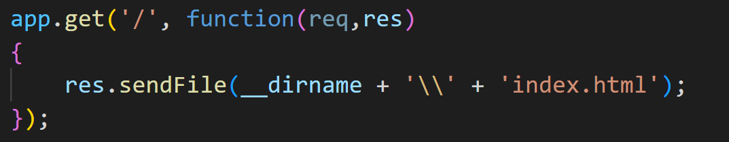
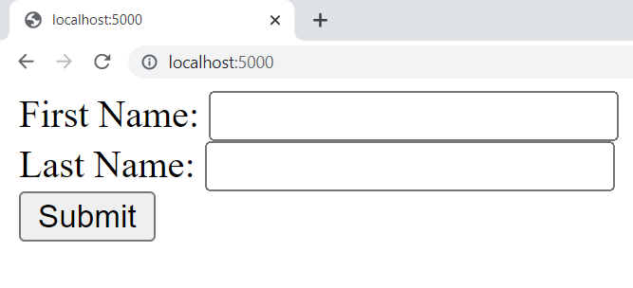
Responding with an HTML page

Slide 30
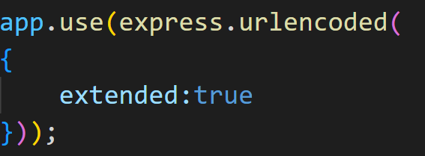
Processing Request Information
Indicates we are using the urlencoded middleware, which enables processing information in the request body (ex: Strings in forms)

Slide 31
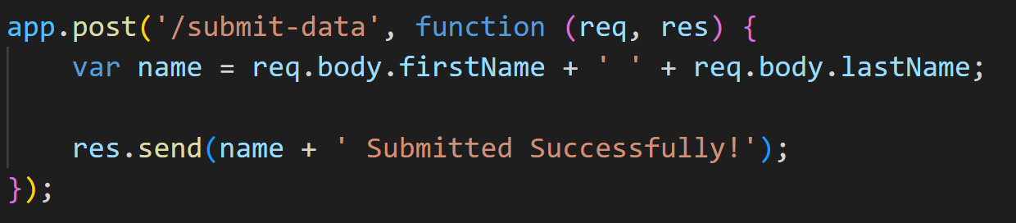
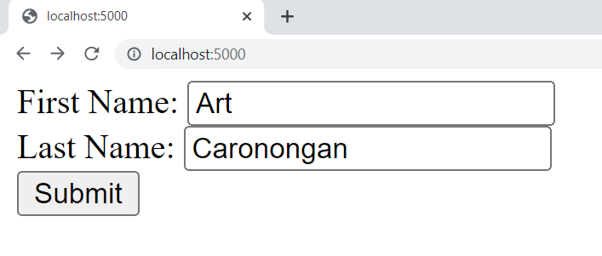
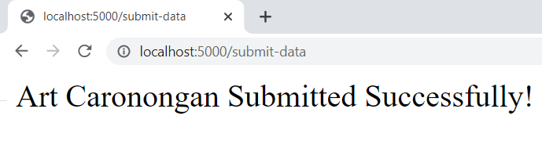
Processing Request Information

Slide 32
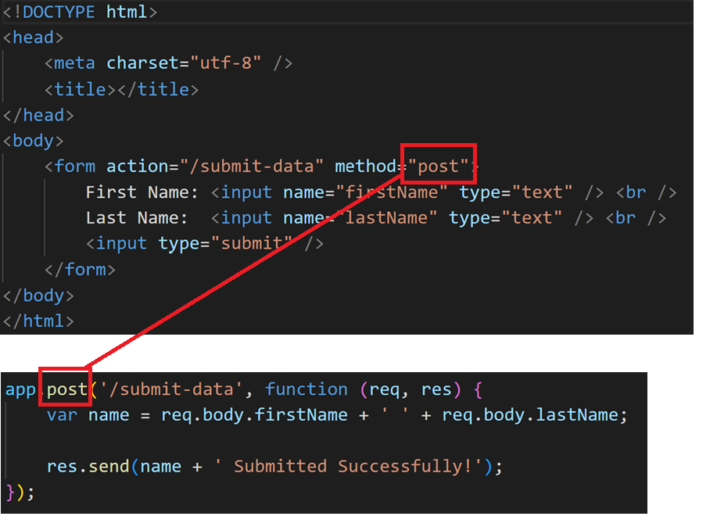

Slide 33
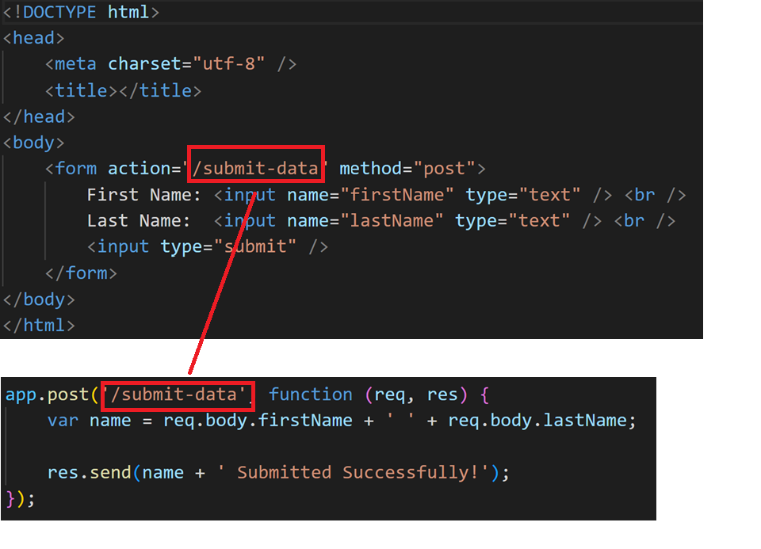

Slide 34
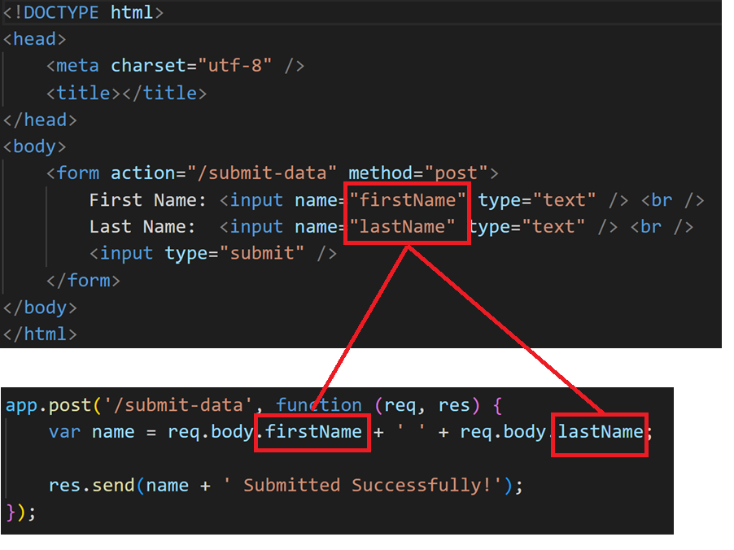

Slide 35
Checkpoint
What is Node.js
Initializing a project using npm init
Installing the express framework using the Node Package Manager (npm)
Executing a .js file using the node command
Deploying a local server into the localhost via an assigned port
Processing a Form Submission via express middleware

Slide 36
Back-end development
This time, we should be familiar with the basic syntax of Node.js and how it works
We can now try installing a back-end module using Node.js
We will be using MongoDB for this one

Slide 37
MongoDB
MongoDB Atlas
Cloud database that you can use for deploying your projects (albeit, limited 512mb space)
MongoDB Compass
Provides a graphical user interface to manage your collections. Can be used for local server development

Slide 38
MongoDB
For today’s session, we will get into the very basics of MongoDB and use MongoDB Compass

Slide 39
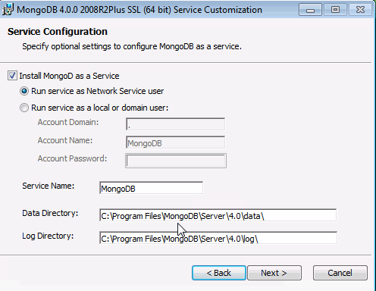
Installation is very simple. Just let the installation wizard take care of things
When presented with the following settings, you may just leave it as default

Slide 40
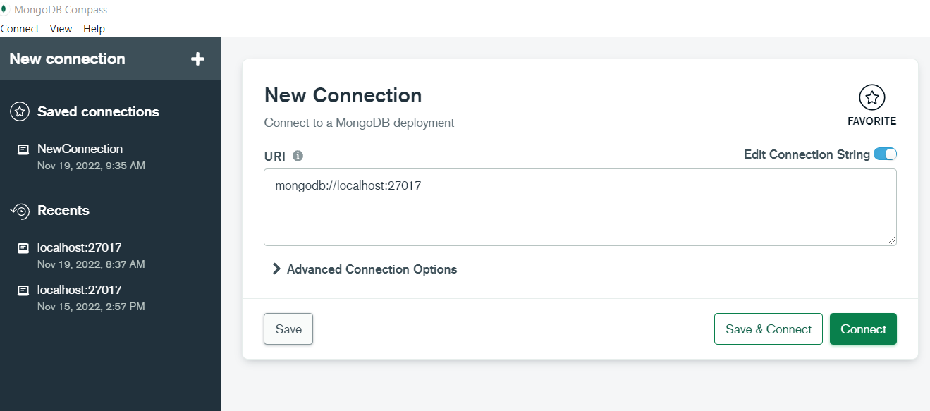
MongoDB Compass
Take note of the URI connection string. We will use it later.

Slide 41
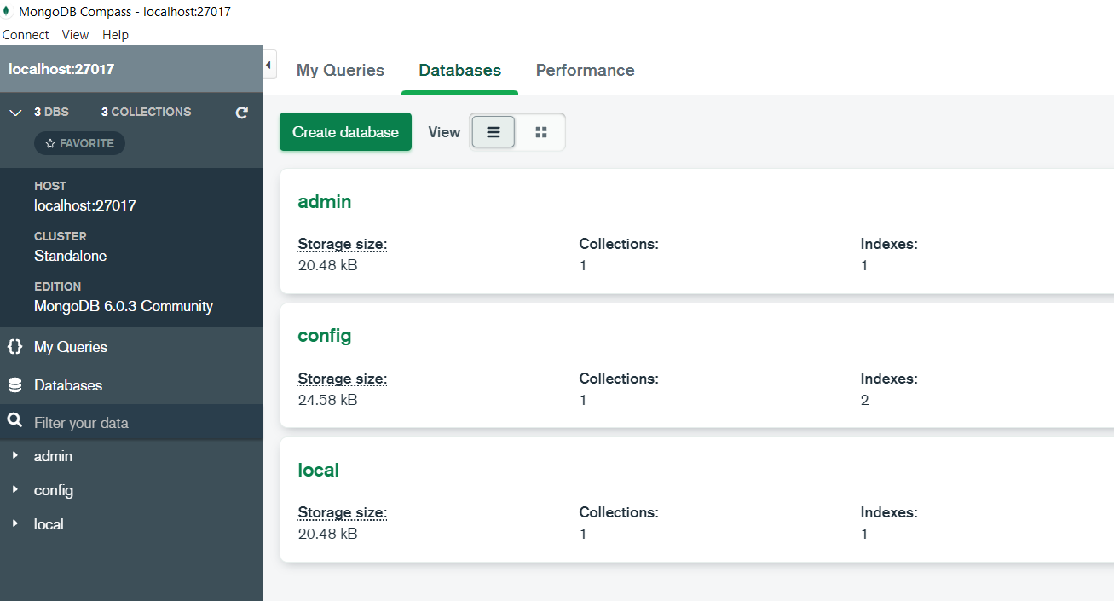
MongoDB Compass

Slide 42
mongoose for MongoDB
Object Data Modeling (ODM) library for MongoDB and Node.js
Manages relationships between data
Provides schema validation
Translate objects in code to MongoDB document representation

Slide 43
mongoose for MongoDB
…in short
mongoose makes it easier to use MongoDB for Node.js projects ☺

Slide 44
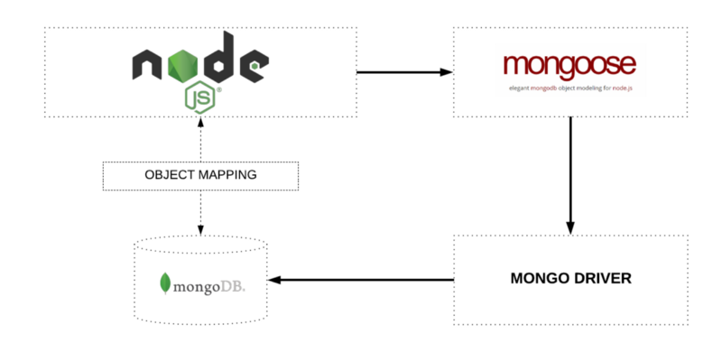
mongoose for MongoDB

Slide 45
Backend: TODO
Install MongoDB driver and library into our project
Install mongoose into our project to make using MongoDB easier
Create an application that allows us to insert values into MongoDB

Slide 46
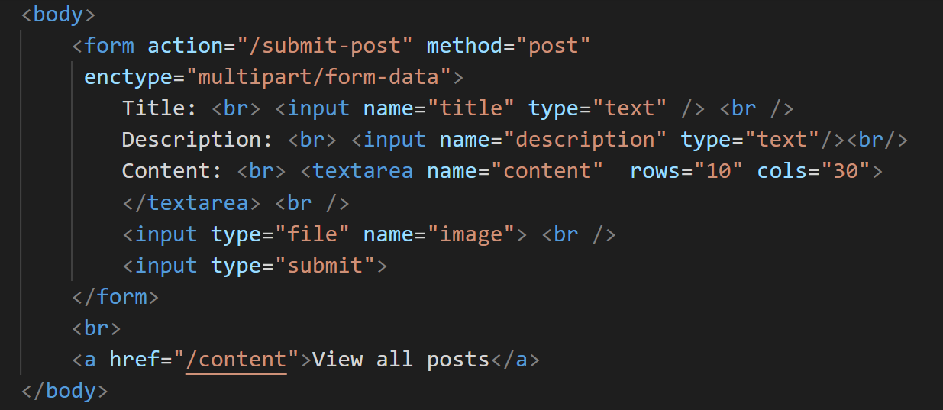
Sample Back-end Application
index.html

Slide 47
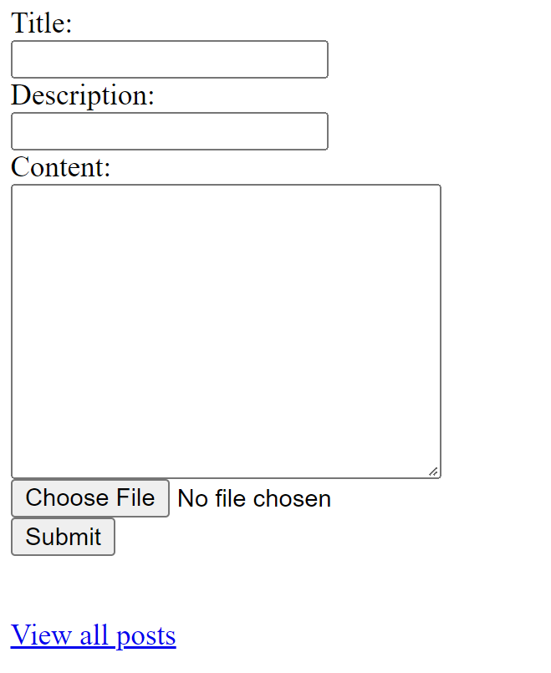
Sample Back-end Application
index.html

Slide 48
Sample Back-end Application
Now let’s add MongoDB and mongoose
Add MongoDB: “npm install mongodb”
Add mongoose: “npm install mongoose”
We will also do file uploads for this!
Add Express’ fileupload scheme:
“npm install express-fileupload”
You might get a few warnings. That’s okay and you may ignore them for now. (If you get any)

Slide 49
Sample Back-end Application
The first thing required to use mongoose is to create what is called a schema
For good practice and navigation, create a directory in your project named “database/models”
Inside this folder, we will place our schema model

Slide 50
mongoose schema
Although MongoDB is schema-less, mongoose ‘schema’ defines the document structure to be enforced (for validation!).
It includes the structure, default values and validators.
const userSchema = new mongoose.Schema({
name: {
first: String,
last: { type: String, trim: true }
},
age: { type: Number, min: 0 }
});

Slide 51
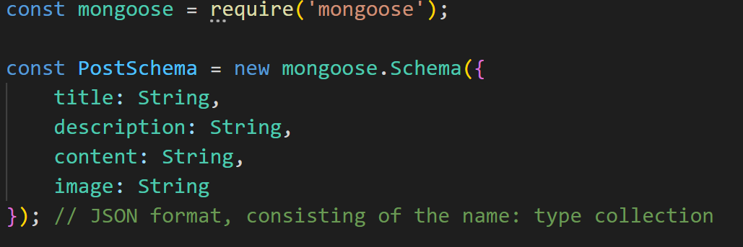
mongoose schema
Our post schema

Slide 52
mongoose model
A mongoose ‘model’ is a constructor that takes the defined schema and lets you create instances of a document.
Rough equivalent of collections in MongoDB terms.
Ex:
const User = mongoose.model('user', userSchema);

Slide 53
mongoose schema
Our post model
Each document entry will be called inside the collection “Post” + ‘s’, with each entry being represented with the PostSchema scheme

Slide 54
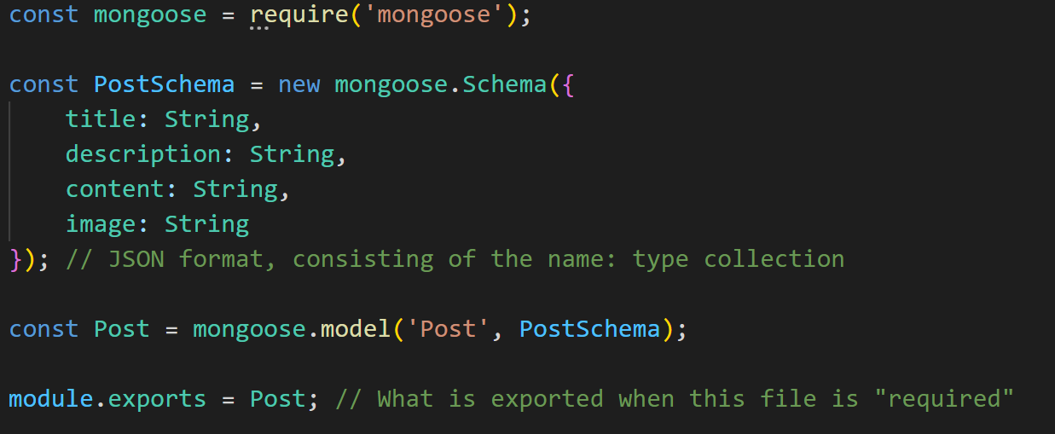
mongoose schema
database/models/Post.js

Slide 55
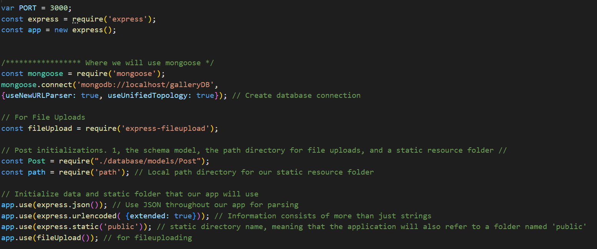
Setting up your project
index.js

Slide 56
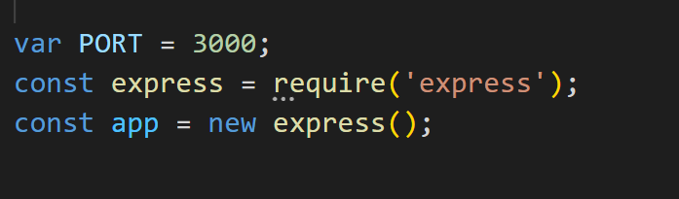
Setting up your project
Recall: Setting up express. The PORT is a variable that will store the port assigned to our application’s local server

Slide 57
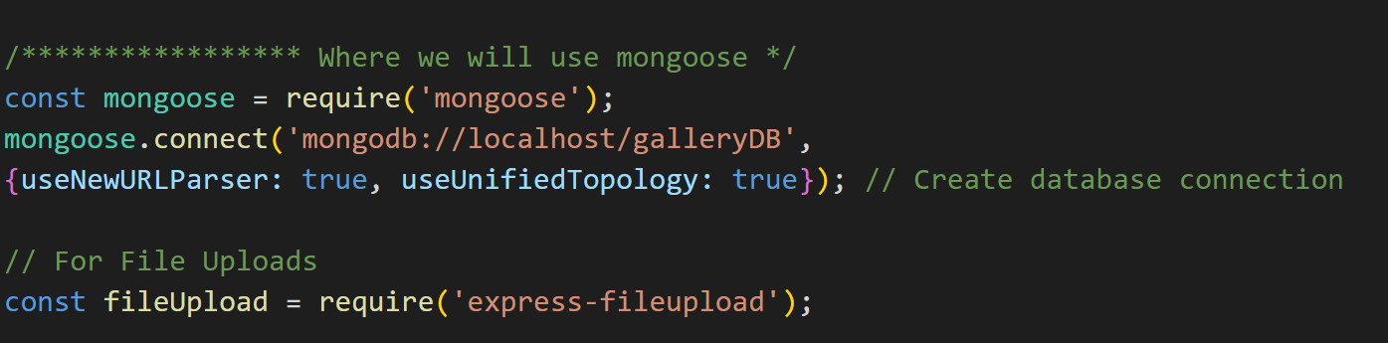
Setting up your project
Setting up mongoose and file upload

Slide 58
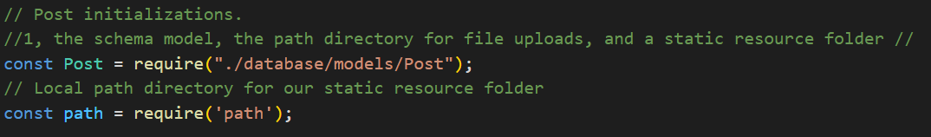
Setting up your project
Configuring the use of our schema model

Slide 59
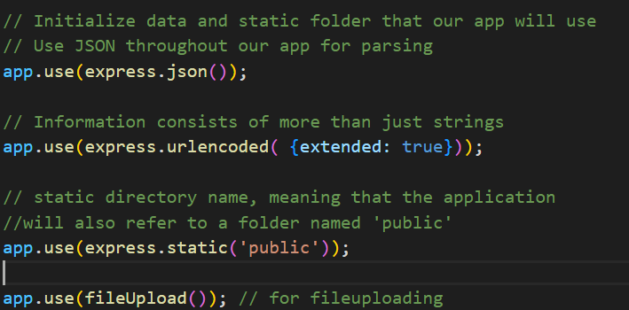
Setting up your project
Configuring fileupload and data parsing modules

Slide 60
Setting up your project
Indicates that our resources will be stored in a folder called “public”
Inside your project, create a directory named “public/images”

Slide 61
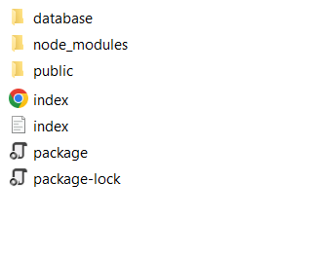
Setting up your project
Your project’s contents

Slide 62
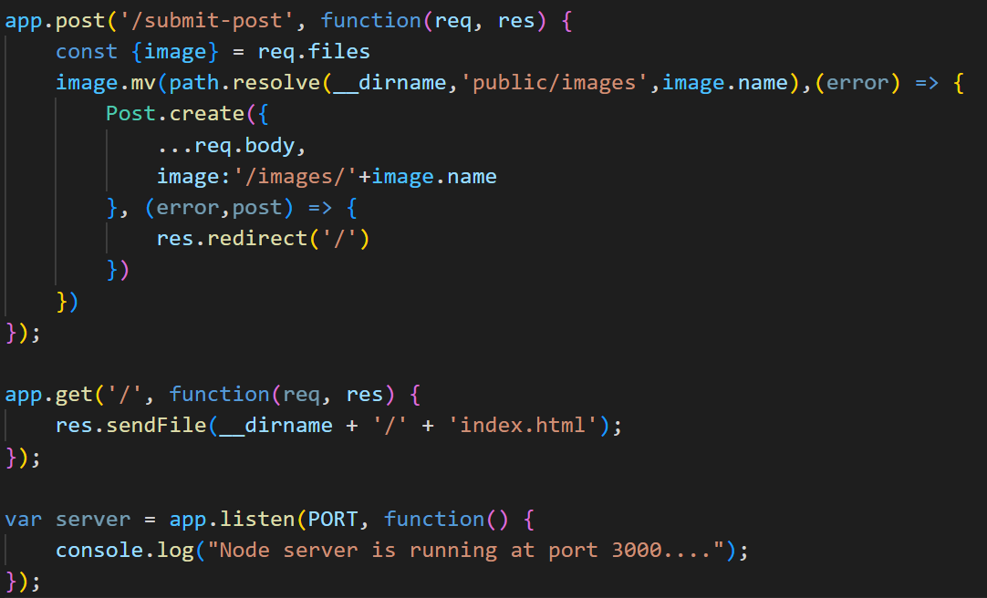
Code the backend!

Slide 63
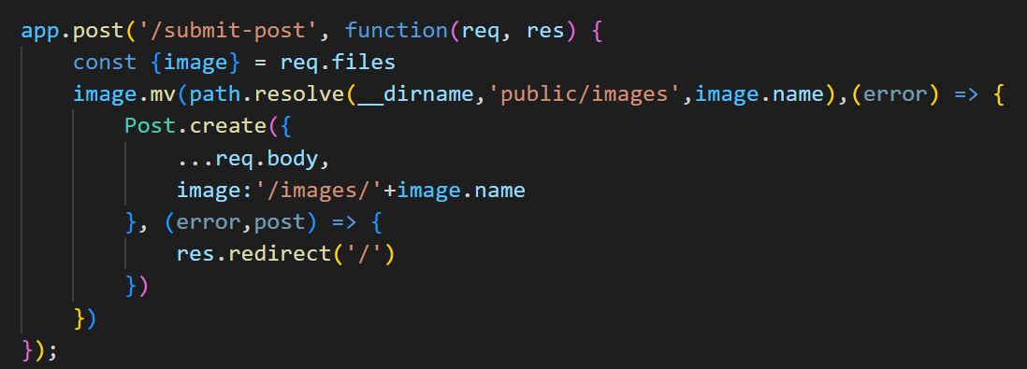
Code the backend!
Here, we are creating the command that enables us to add a new document using the mongoose schema model

Slide 64
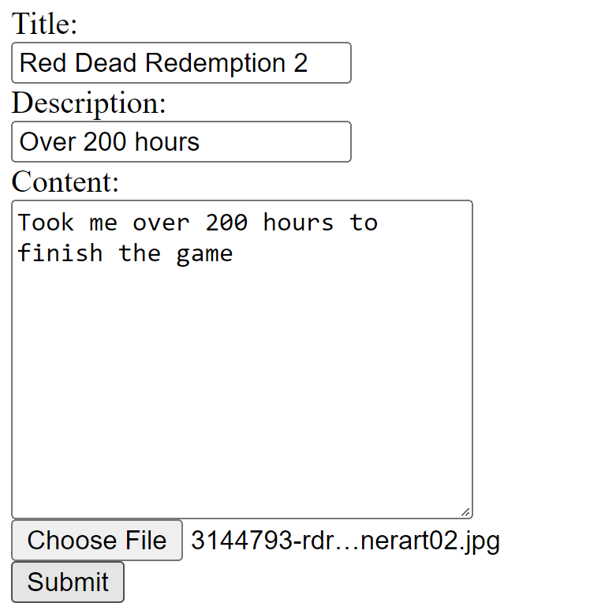
Code the backend!

Slide 65
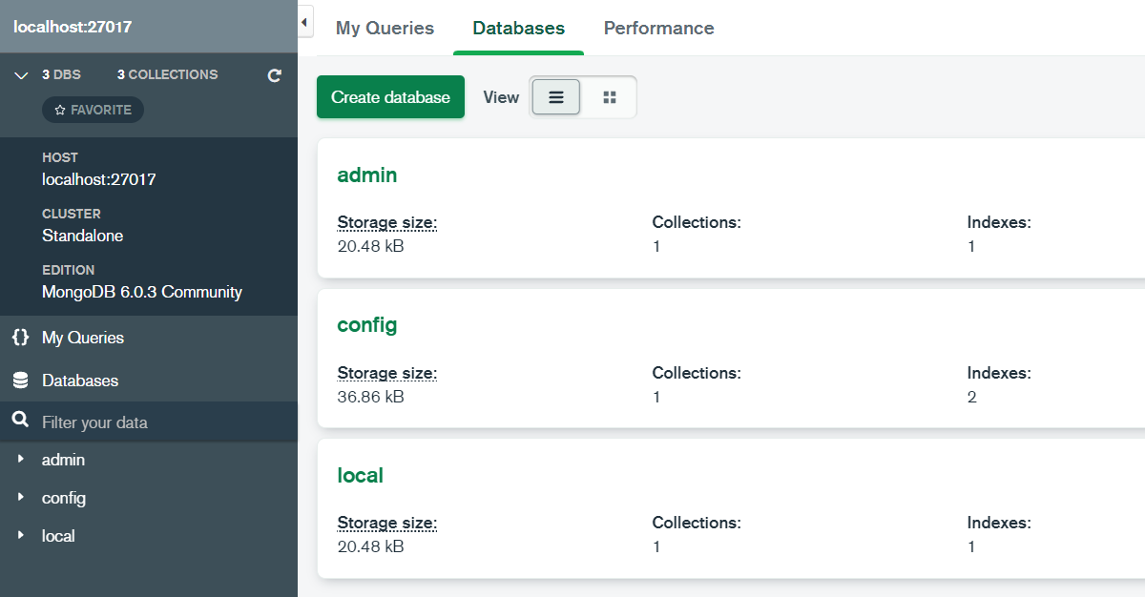
Code the backend!
Before

Slide 66
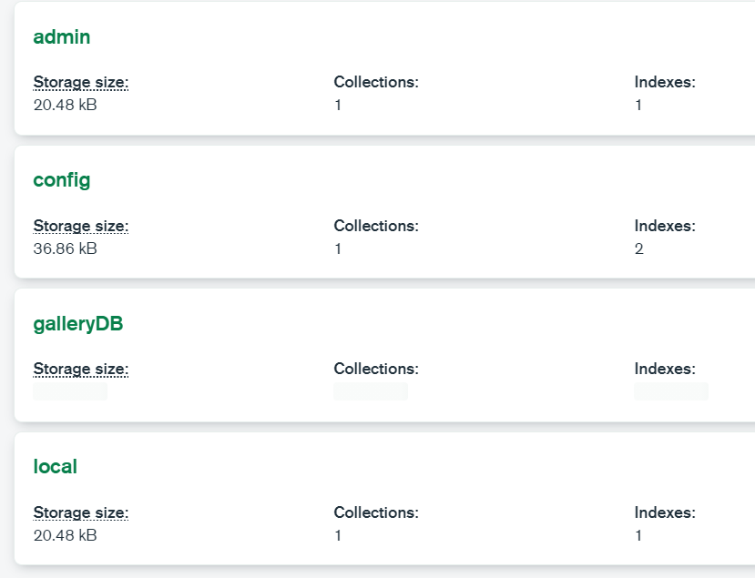
Code the backend!
After

Slide 67
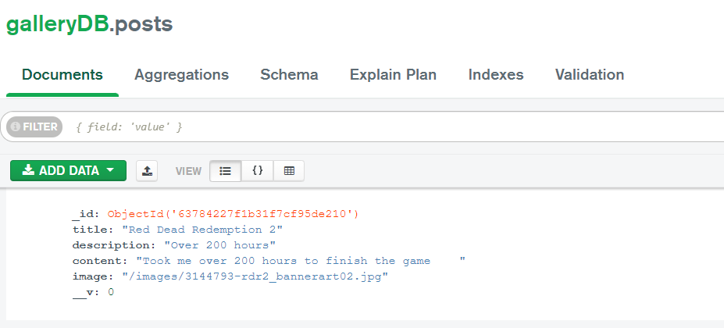
Code the backend!
After

Slide 68
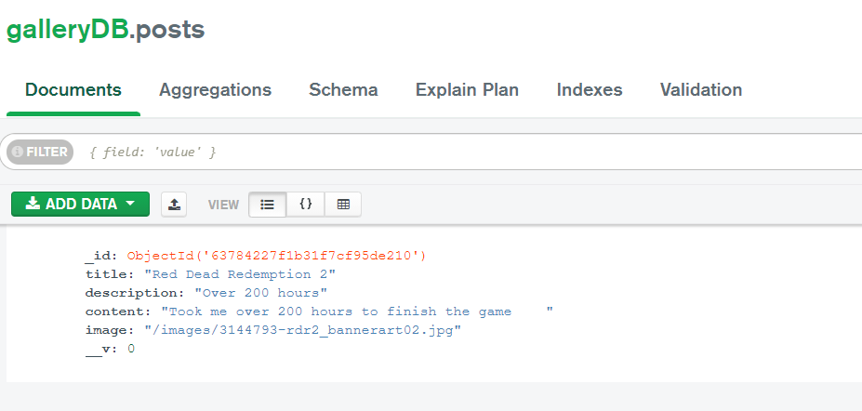
Code the backend!

Slide 69
Code the backend!

Slide 70
ECONNREFUSED error
Simply change
to

Slide 71
Checkpoint
Connect to MongoDB
Use mongoose to create a document entry in our MongoDB collections
Install into our Node.js project for use via the Node Package Manager (npm)
Process form input and file uploads via express as a JSON (JavaScript Object Notation) file
Insert into MongoDB using mongoose

Slide 72
Rendering from the backend to the front end
There are many ways on how you can render information from the backend into the front end
Normally, this approach requires you to make use of a view-engine
For today’s tutorial (and due to time constraints), we will use the most basic handlebars

Slide 73
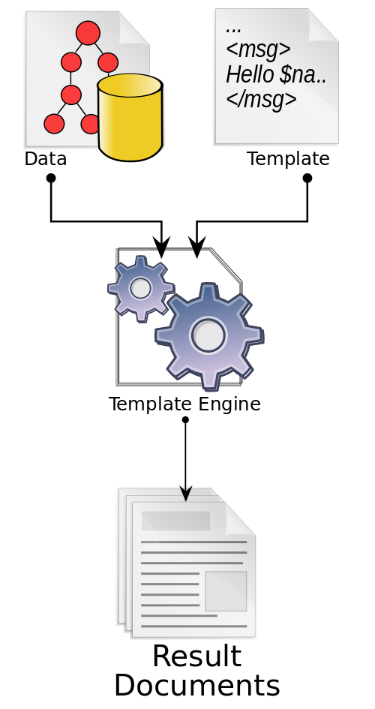
Template Engine - Recall
How it works
Connects to the data model
Process the code specified in the source template
Directs the output to a specific pipeline, text file, or stream
Some template engines: mustache.js, EJS, PUB, handlebars, ...

Slide 74
In Short…
Handlebars are an example of a Template Engine or a view-engine
Allows us to render sections in our page indicated with the {{}} syntax depending on the parameters / values passed to the engine

Slide 75
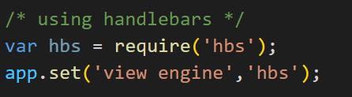
Rendering from the backend to the front end
Install hbs
“npm install hbs”
Add the following to the top of your project

Slide 76
Rendering from the backend to the front end
It is possible to change the default configuration of handlebars (e.g. Filename extension) but for today’s purposes, we will use the default configurations only

Slide 77
Rendering from the backend to the front end
Create a folder called “views”
Place a file named “content.hbs” inside. This will be our handlebar.

Slide 78
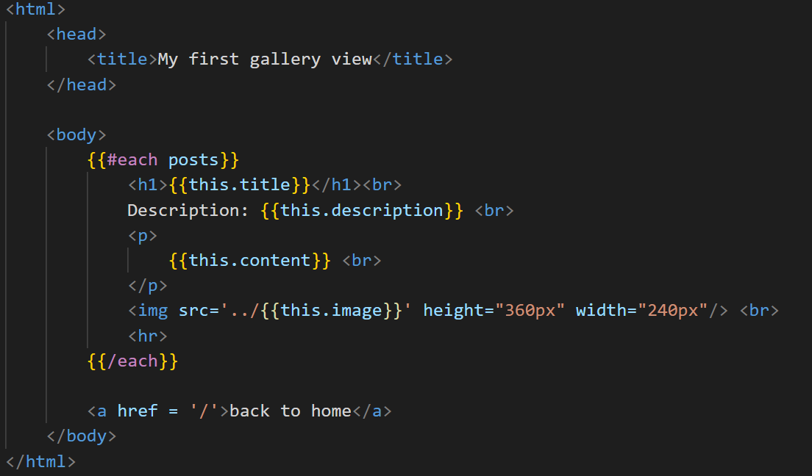
Rendering from the backend to the front end
content.hbs

Slide 79
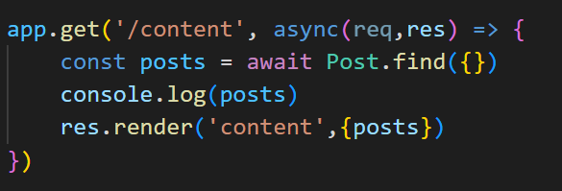
Rendering from the backend to the front end
Index.js

Slide 80
Rendering from the backend to the front end
The mongoDB “query” is placed in between the {}.
Since we are entering a blank query, it will simply return all entries into our collection
You may refer to the mongoDB documentation for different queries that exist and that may be used.

Slide 81
Rendering from the backend to the front end
Where we render into our “content.hbs” while passing the collections to be rendered into posts.

Slide 82
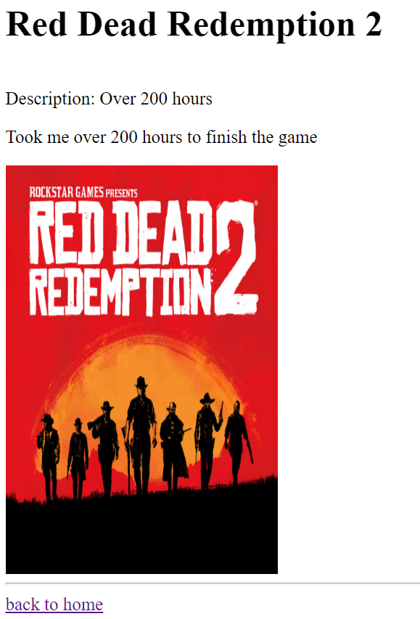
Rendering from the backend to the front end

Slide 83
Checkpoint
Obtaining values from the backend using MongoDB Query built-in through the mongoose scheme model
Rendering values through handlebars by passing obtained documents from query as parameters
Replace {{this.<attribute>}} with values obtained from document fields

Slide 84
TODO:
Explore using nodemon
Makes having the need to restart your application using node command each time irrelevant
Explore using other front end frameworks
Angular / React / Vue
Improve the UI of your application
Explore other MongoDB queries

Slide 85
Summary
Node.js is not just a back-end framework, but a platform for executing JavaScript files beyond a browser
We can, however, use several back-end modules to aid in developing back-end applications for our projects
We made use of the REST API in Express.js for rendering responses and processing requests
MongoDB was used as the back-end through the mongoose module
We rendered into the front-end information received from the back-end using Handlebars

Slide 86
Intro to Web Dev: Node.js 101
The basics of developing applications (w/ a backend!) using Node.js

