Slide 1

SmartClaim AI: Intelligent Vehicle Damage
Detection & Insurance Claim Estimator
Group members with Student_Id
Sunny Gupta : 23104136
Pranav Ghodke : 23104115
Aditya Chavan : 23104090
Under the guidance of Ms. Snehal Mali
Notes:
Introduce the team and the project: SmartClaim AI turns one photo of a damaged car into an itemised repair estimate and insurance claim settlement.

Slide 2
Contents
Introduction
Problem Statement
Objectives
Scope
Literature Survey
Proposed System
Methodology & Algorithms
Datasets
Results
Implementation & Demo
Project Timeline
Conclusion & Future Scope
References
Notes:
Walk through the agenda.

Slide 3
1. Introduction
SmartClaim AI is an AI-powered system that turns a single photograph of a damaged car, together with a few vehicle and policy details, into an instant, itemised repair estimate and insurance claim settlement.
Detects where the damage is and how severe it is
Finds the damaged car parts and the type of damage
Prices each part: parts, labour, paint and GST
Applies IRDAI depreciation and deductible rules
Shows what the insurer pays and what you pay
1 photo
input
3 AI models
YOLO
~2 s
per estimate
Notes:
After an accident the owner wants to know the repair cost and how much insurance pays. Today that needs a surveyor visit. SmartClaim AI gives a first estimate from one photo in about 2 seconds.

Slide 4
2. Problem Statement
Slow: the claim amount is unknown until a surveyor inspects the car.
Inconsistent: two surveyors can value the same damage differently.
Opaque: customers rarely understand depreciation and deductibles.
Claim data can't price damage: on a public claims dataset a model predicting repair cost from damage severity scored R² = −0.14 (worse than guessing the average).
Problem statement: Design a system that takes a photo of a damaged car and basic vehicle and policy details, identifies the damaged parts and the type of damage, and produces an itemised, explainable repair estimate and claim settlement consistent with Indian motor-insurance rules.
Notes:
Explain the four pain points, then read the problem statement. Mention that the public claims dataset could not predict repair cost (R squared -0.14), so we price at part level.

Slide 5
3. Objectives
To build and compare deep-learning models that classify damage location (front/rear) and severity (normal, breakage, crushed).
To segment which car part is damaged and what type of damage it has.
To attribute each damage region to the car part it lies on.
To design a transparent pricing engine using part prices, car segment, labour rates, paint and GST.
To apply IRDAI rules: depreciation, deductibles, zero-dep cover and total loss.
To deliver the complete pipeline as an easy-to-use web application.
Notes:
All six objectives are implemented and demonstrated in the web app.

Slide 6
4. Scope
Can be used to assess damage to hatchback, sedan, SUV and luxury cars from one front or rear photo.
Can be used to classify damage into 6 classes: front / rear × breakage, crushed, normal.
Can be used to identify 21 car parts such as bumpers, bonnet, doors, fenders, lamps and glass.
Can be used to detect 8 damage types: dent, scratch, broken part, missing part, crack and more.
Can be used to generate an itemised repair estimate from 23 priced parts with city-tier labour rates.
Can be used to compute the settlement as per IRDAI depreciation, deductibles, zero-dep and total loss.
Can be used through a web application to get an instant first estimate.
Can be extended with multi-photo assessment, live prices, fraud screening and a mobile app.
Notes:
What the system can be used for.

Slide 7
5. Literature Survey
Paper (year) | Key idea | Use in SmartClaim AI
Patil et al., Car damage classification (2017) | CNN + transfer learning on ~1,500 images | Pretrained backbones, augmentation
He et al., ResNet (2016) | Residual connections, deep nets | ResNet50 baseline: 73.9%
Tan & Le, EfficientNet (2019) | Compound model scaling | EfficientNet-B0 baseline: 60.7%
Redmon et al., YOLO (2016) | Single-stage real-time detection | All 3 models are YOLO
He et al., Mask R-CNN (2017) | Per-object pixel masks | Masks for damage-to-part overlap
Wang et al., CarDD (2023) | Car damage segmentation dataset | Damage types and benchmark
Gap: existing work stops at detecting damage; none turns it into a priced, itemised repair plan with Indian insurance rules.
Notes:
Key papers and what we took from each. Gap: none of them prices the repair or applies Indian insurance rules.

Slide 8
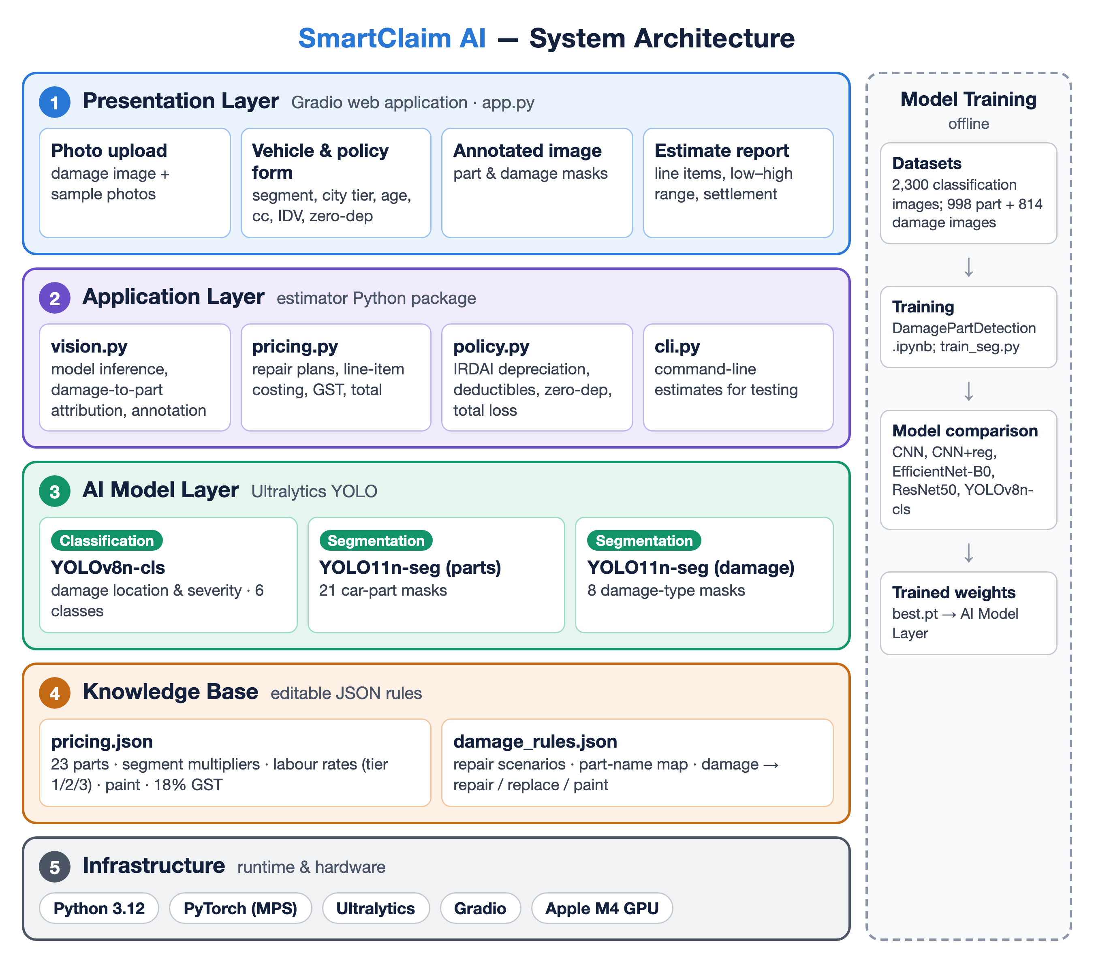
6. Proposed System: Architecture
Notes:
Four layers. Vision models produce evidence; the rule engine turns evidence into rupees, so each can be changed without touching the other.

Slide 9
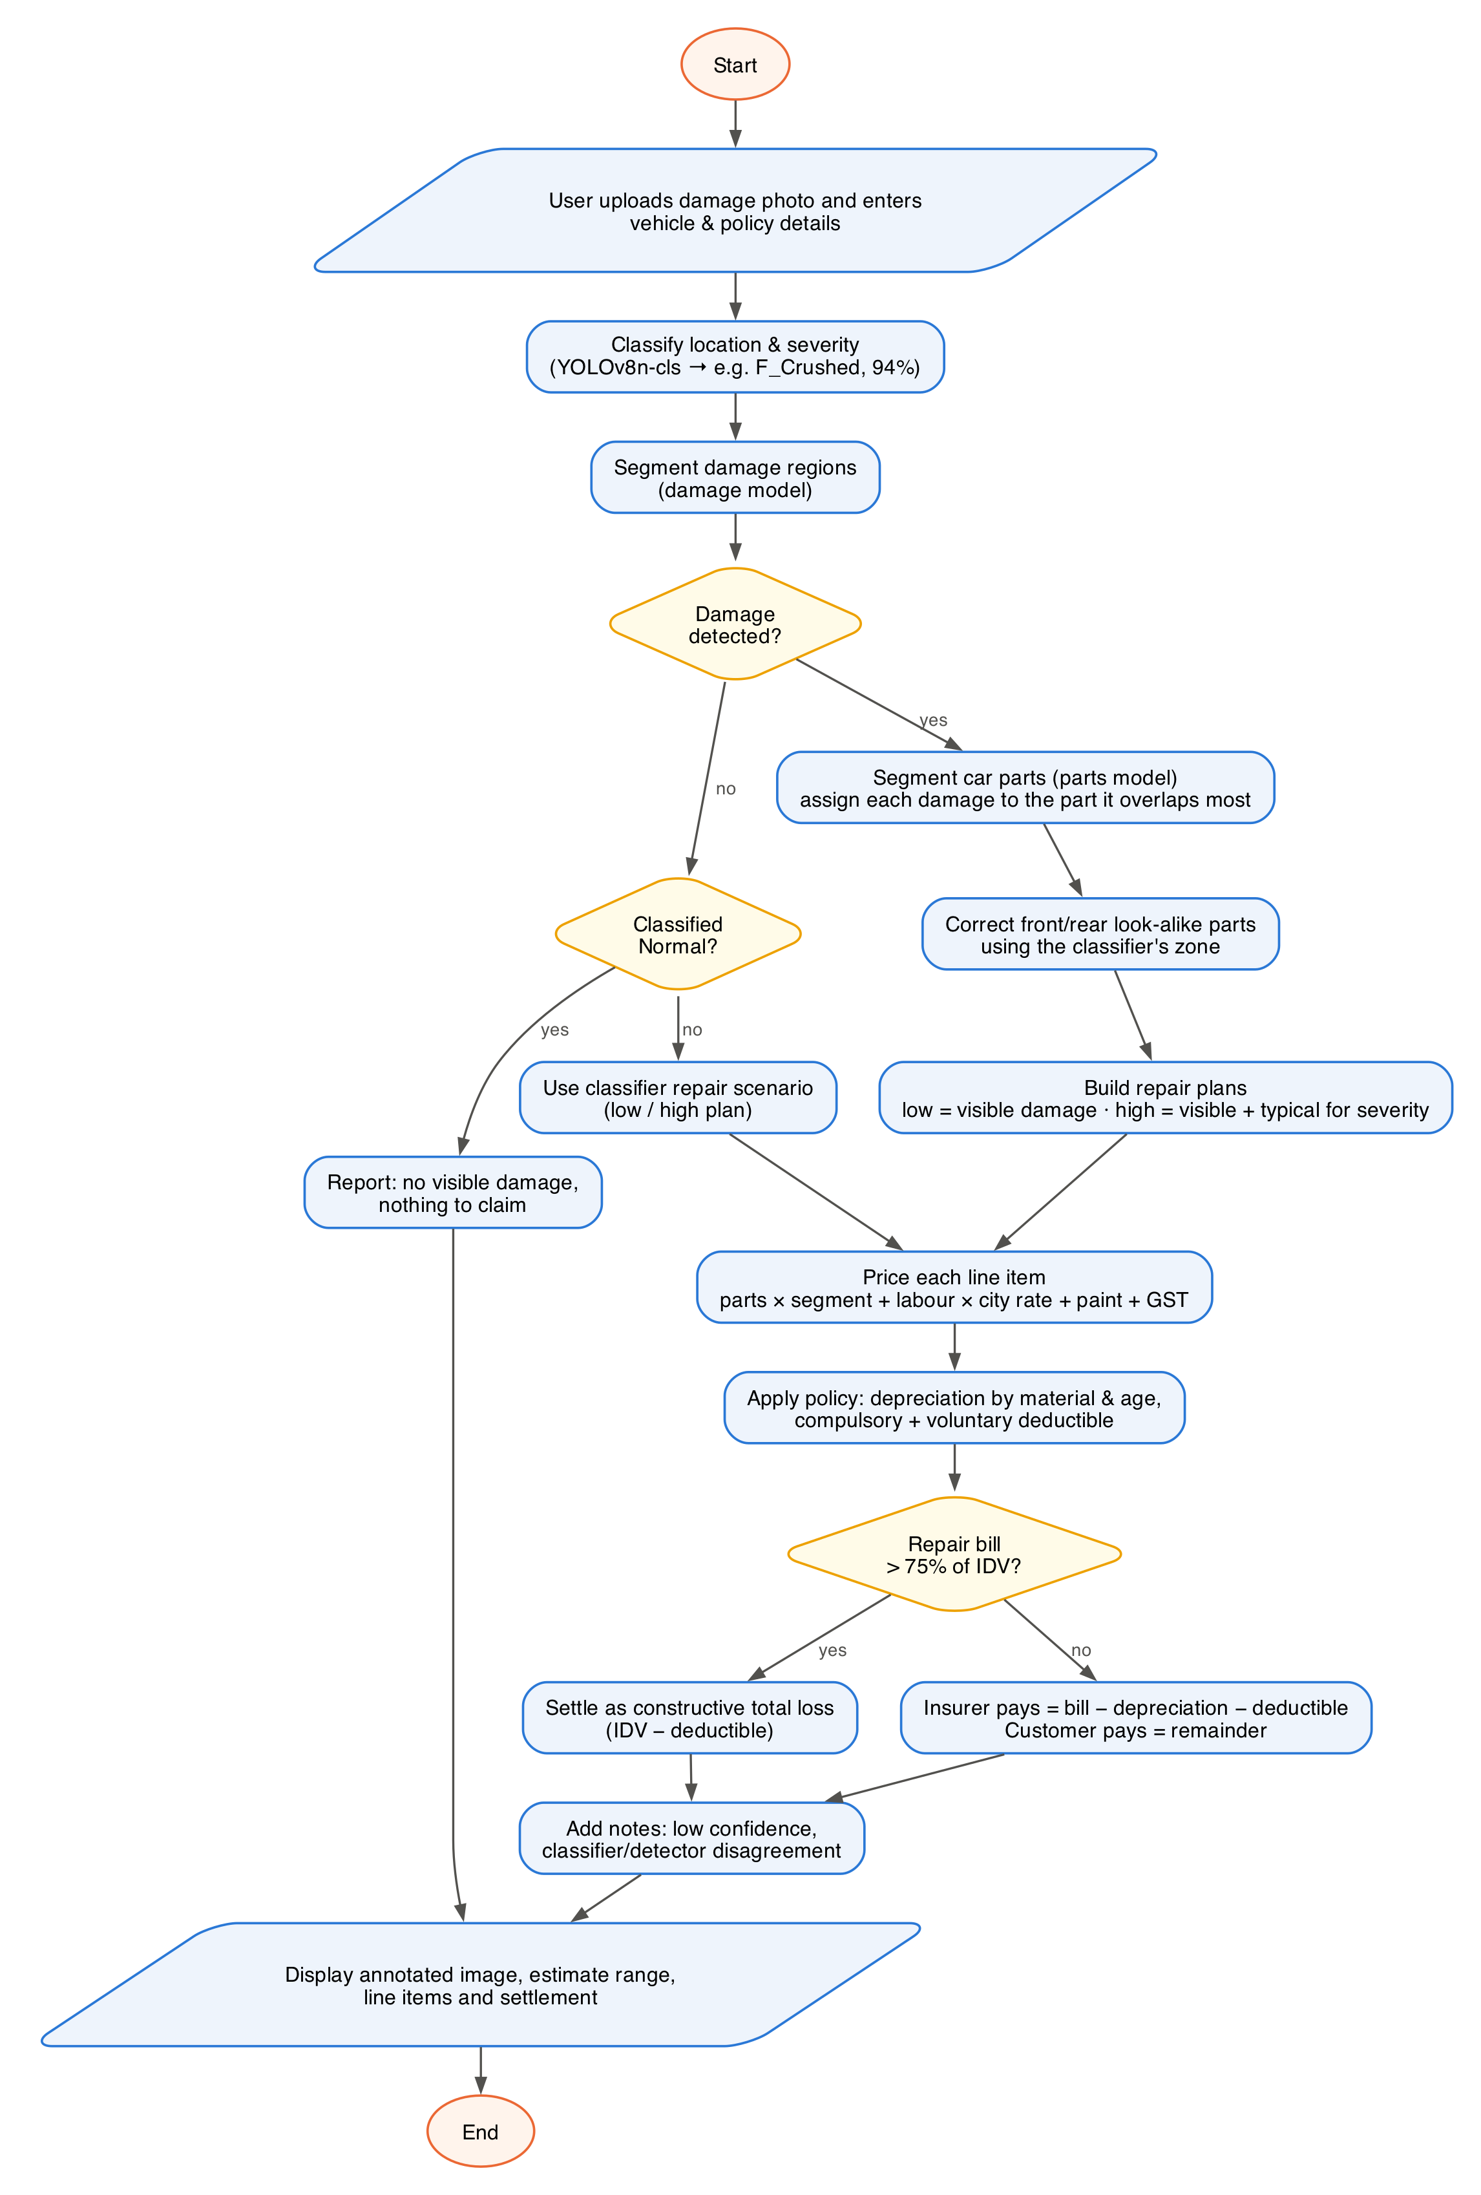
7. Workflow
Upload photo + vehicle & policy details
Classify location & severity
Segment parts and damage
Attribute damage to parts
Build low & high repair plans
Price: parts, labour, paint, GST
Apply depreciation, deductible, total-loss check
Show annotated photo & settlement
Notes:
Trace one request from upload to settlement. Two decisions: did the damage model find anything, and is the bill above 75% of IDV (total loss).

Slide 10
8. Models & Algorithms
Stage | Model / Algorithm | Output
Location & severity | YOLOv8n-cls (CNN, transfer learning, softmax) | 6 classes + confidence
Car parts | YOLO11n-seg instance segmentation | 21 part masks
Damage types | YOLO11n-seg instance segmentation | 8 damage masks
Attribution | Mask overlap |D ∩ P| / |D| ≥ 0.2 | Damage → part
Pricing | Rule engine (JSON price tables) | Itemised repair bill
Settlement | IRDAI depreciation + deductible rules | Insurer / customer share
Compared for classification: custom CNN, CNN + regularisation, EfficientNet-B0, ResNet50 and YOLOv8n-cls, all on the same 2,300-image dataset.
Notes:
Explain each stage. Classifier = CNN with transfer learning and softmax. Segmentation = YOLO11 instance segmentation. Pricing is deliberately rule-based so every rupee is explainable.

Slide 11
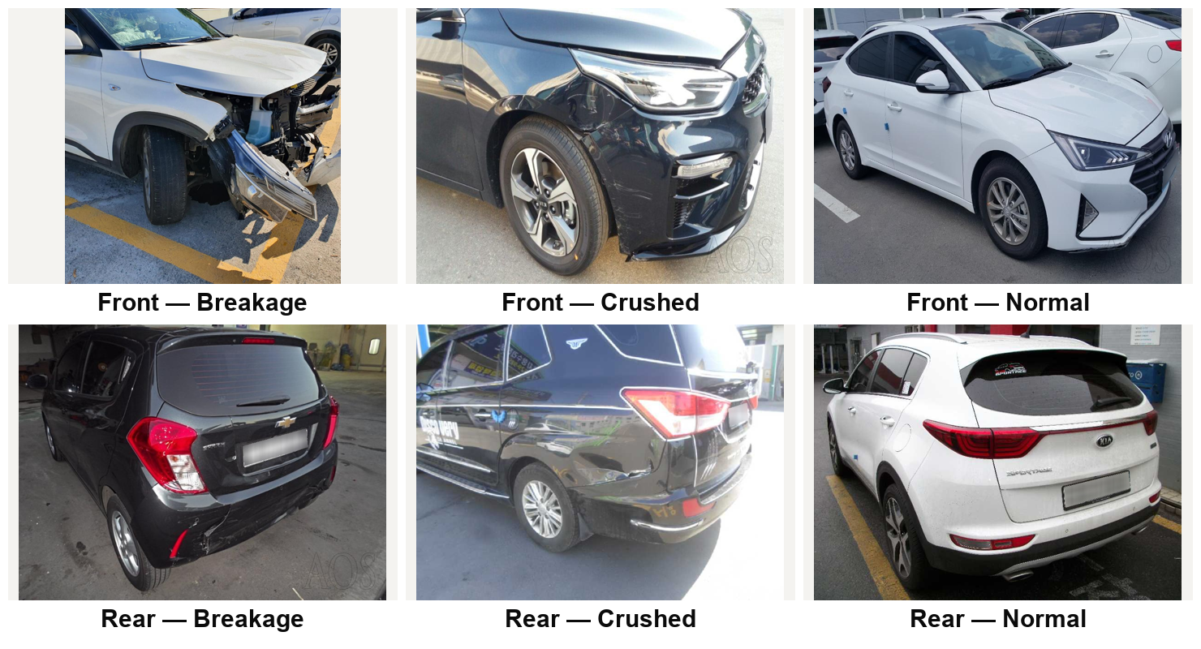
9. Datasets
Dataset | Size | Used for
Car damage (front/rear × severity) | 2,300 images, 6 classes | Classifier
Car parts & damages polygons (MIT) | 998 + 814 images | Part & damage segmentation
Auto insurance claims (Kaggle) | 1,000 claims, 40 fields | Analysis: R² = −0.14
Notes:
Three datasets. The claims dataset was analysed and showed tabular claims cannot price visible damage.

Slide 12
10. Results: Classification
80.35%
YOLOv8n-cls accuracy
0.80
weighted F1-score
3.2 min
training on M4 GPU
Best classes: front breakage F1 0.89, front normal 0.87; hardest: rear crushed 0.65.
575 held-out validation images; transfer learning from ImageNet.
Notes:
YOLOv8n-cls wins: 80.35% on 575 held-out images, 31.7 points above the custom CNN and 6.4 above ResNet50, trained in 3.2 minutes on the M4 GPU.

Slide 13
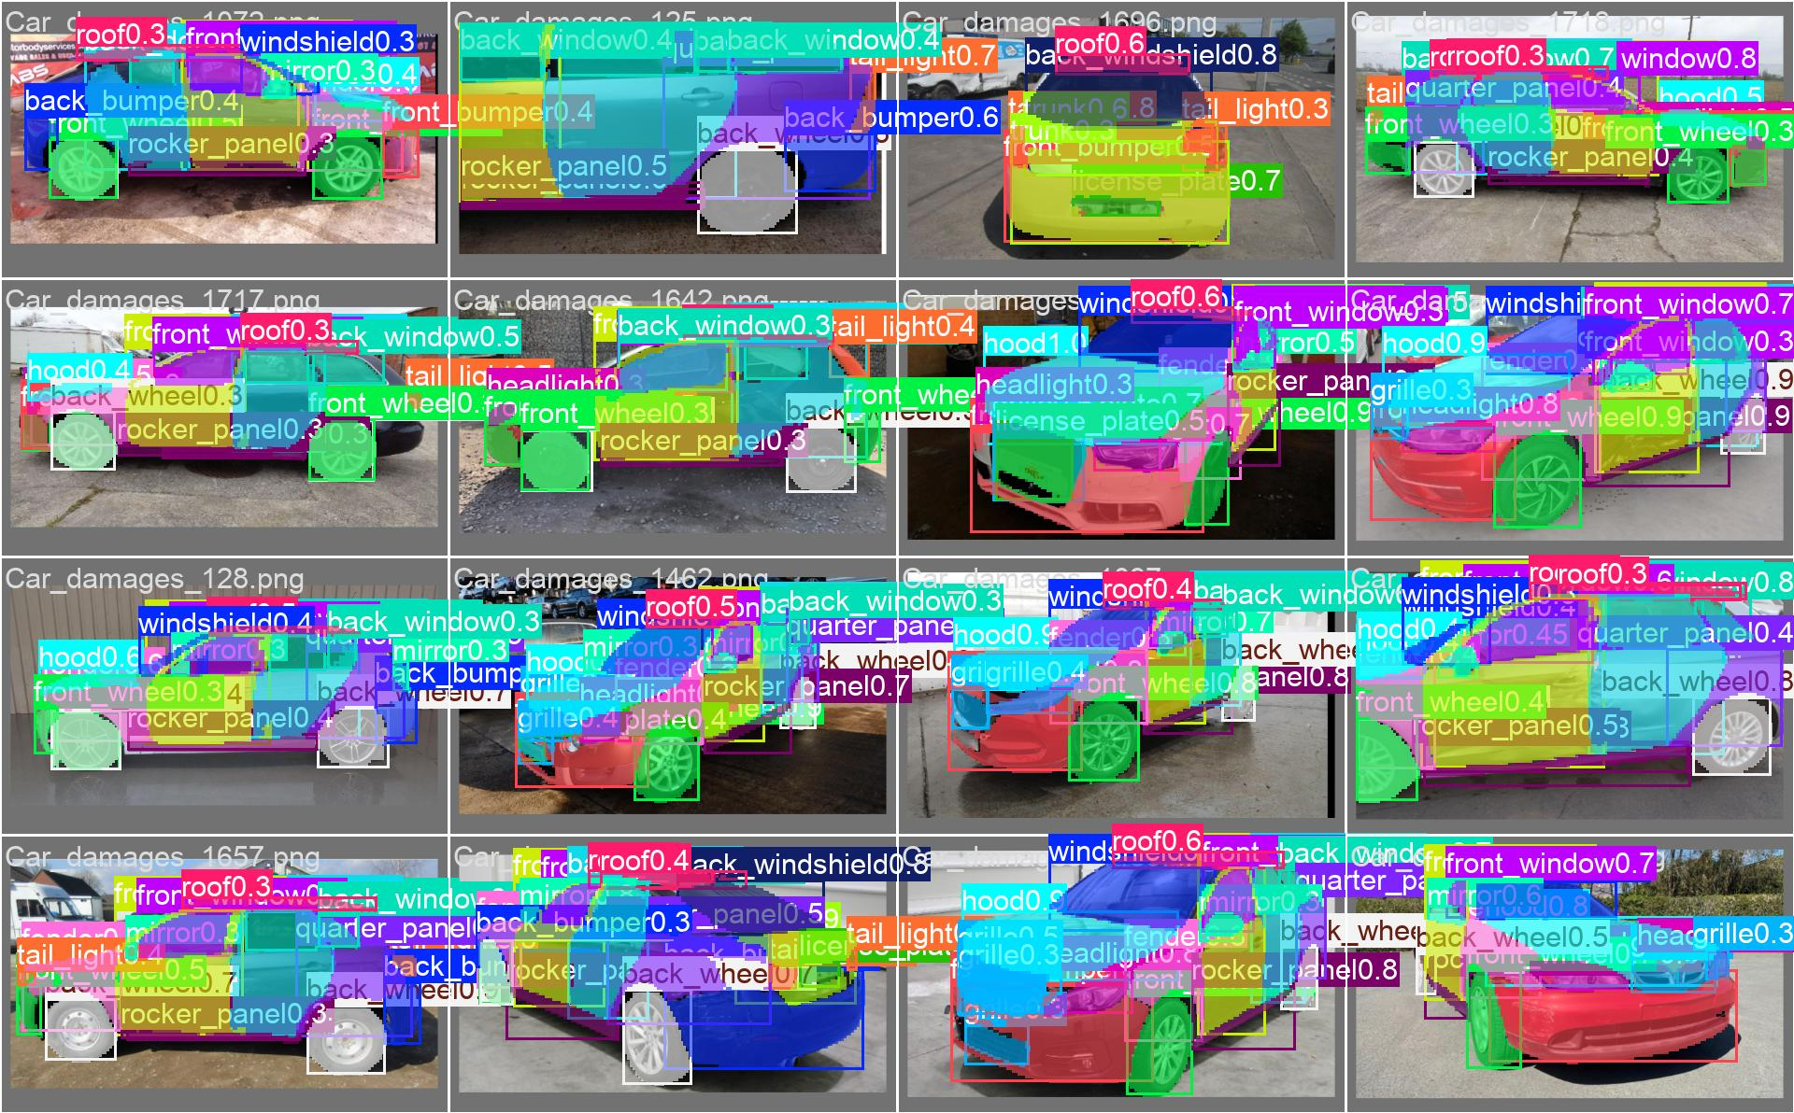
11. Results: Segmentation
Metric | Parts | Damage
Classes | 21 | 8
Mask mAP@50 | 0.81 | 0.15
Box mAP@50 | 0.83 | –
Precision | 0.81 | 0.41
Recall | 0.75 | 0.18
Car-part predictions on validation images
Damage model is strongest on the costly types: crack 0.44, missing part 0.35, broken part 0.25.
Thin damage (scratch, paint chip) is hard on 814 images; the severity classifier's high estimate covers what the damage model misses.
End-to-end time: ~1.9 s per photo.
Notes:
Parts model is strong (mask mAP50 0.81). Damage model is 0.15 overall because the dataset is small and scratches are thin, but it is best on the costly classes: crack, missing part, broken part.

Slide 14
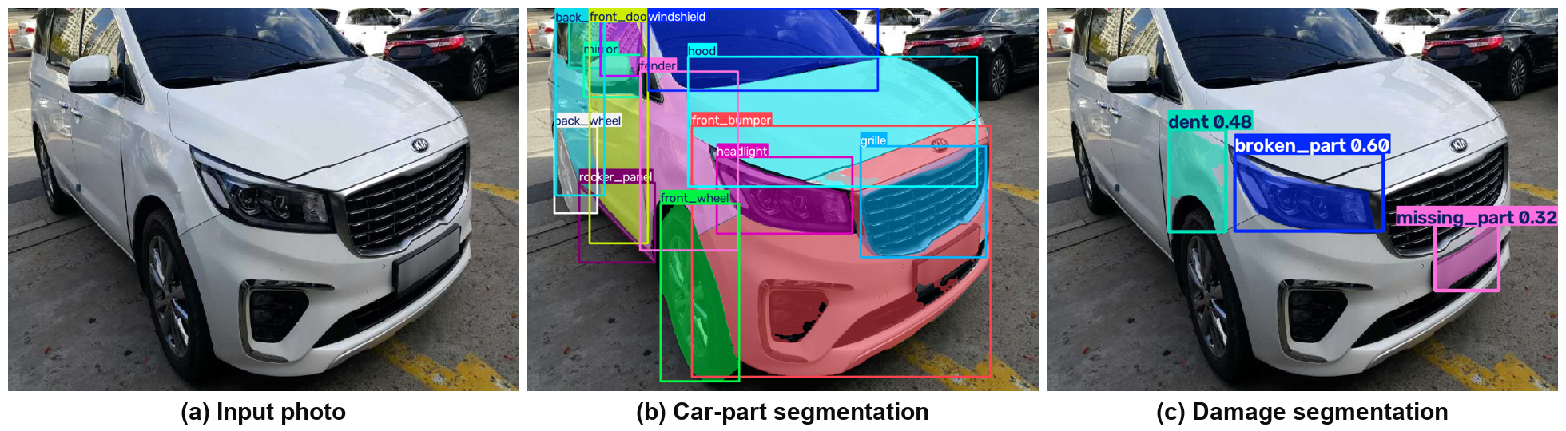
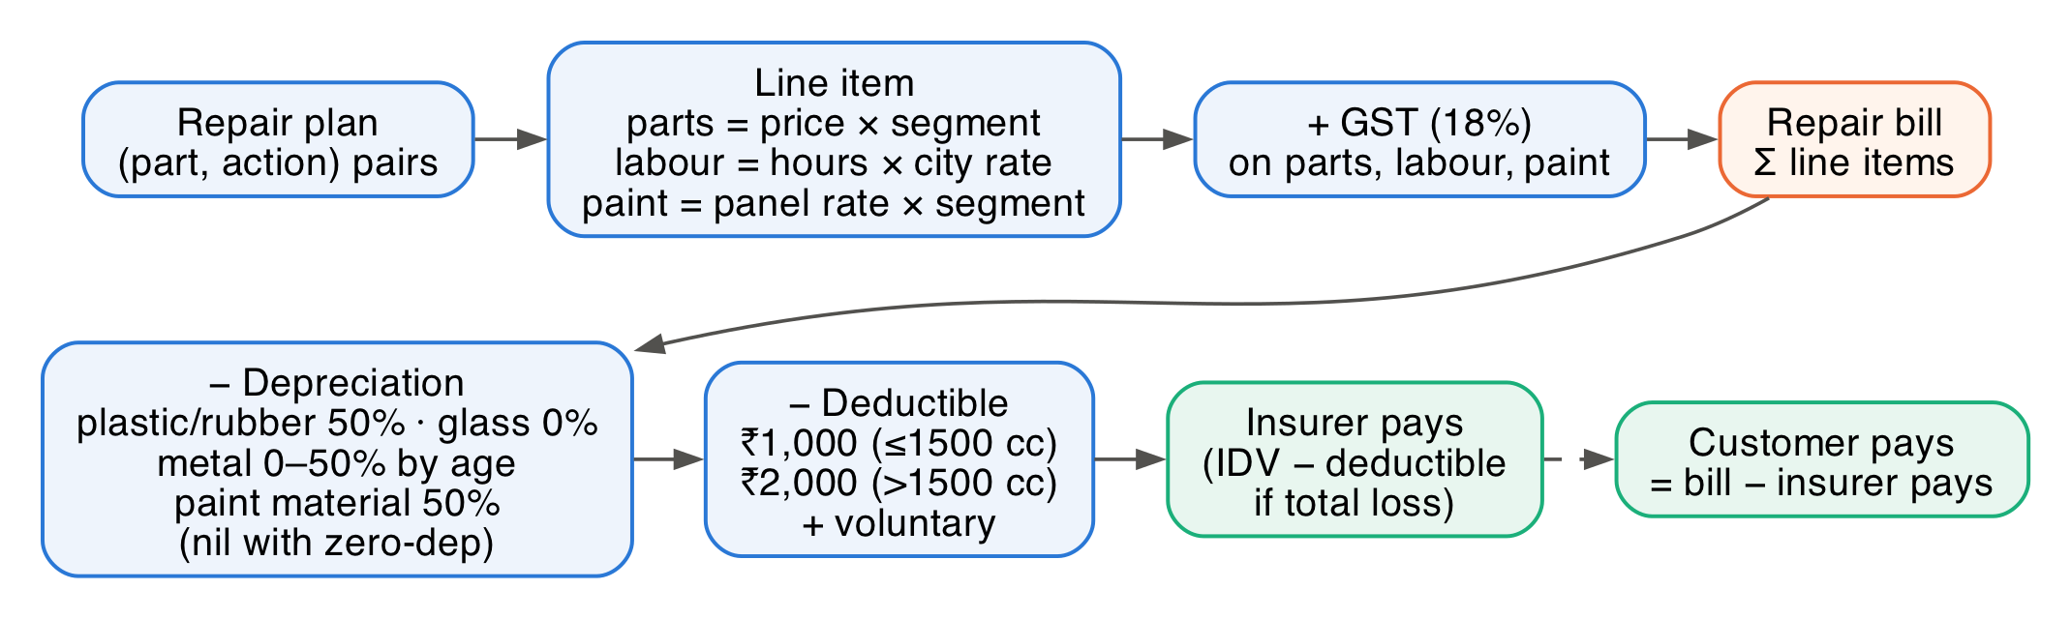
12. Damage-to-Part Attribution & Claim
Damage masks matched to part masks by overlap
Insurer pays = repair bill − depreciation − deductible (total loss if bill > 75% of IDV)
Notes:
Each damage mask goes to the part it overlaps most (at least 20%). Then the claim calculation: bill minus depreciation minus deductible.

Slide 15
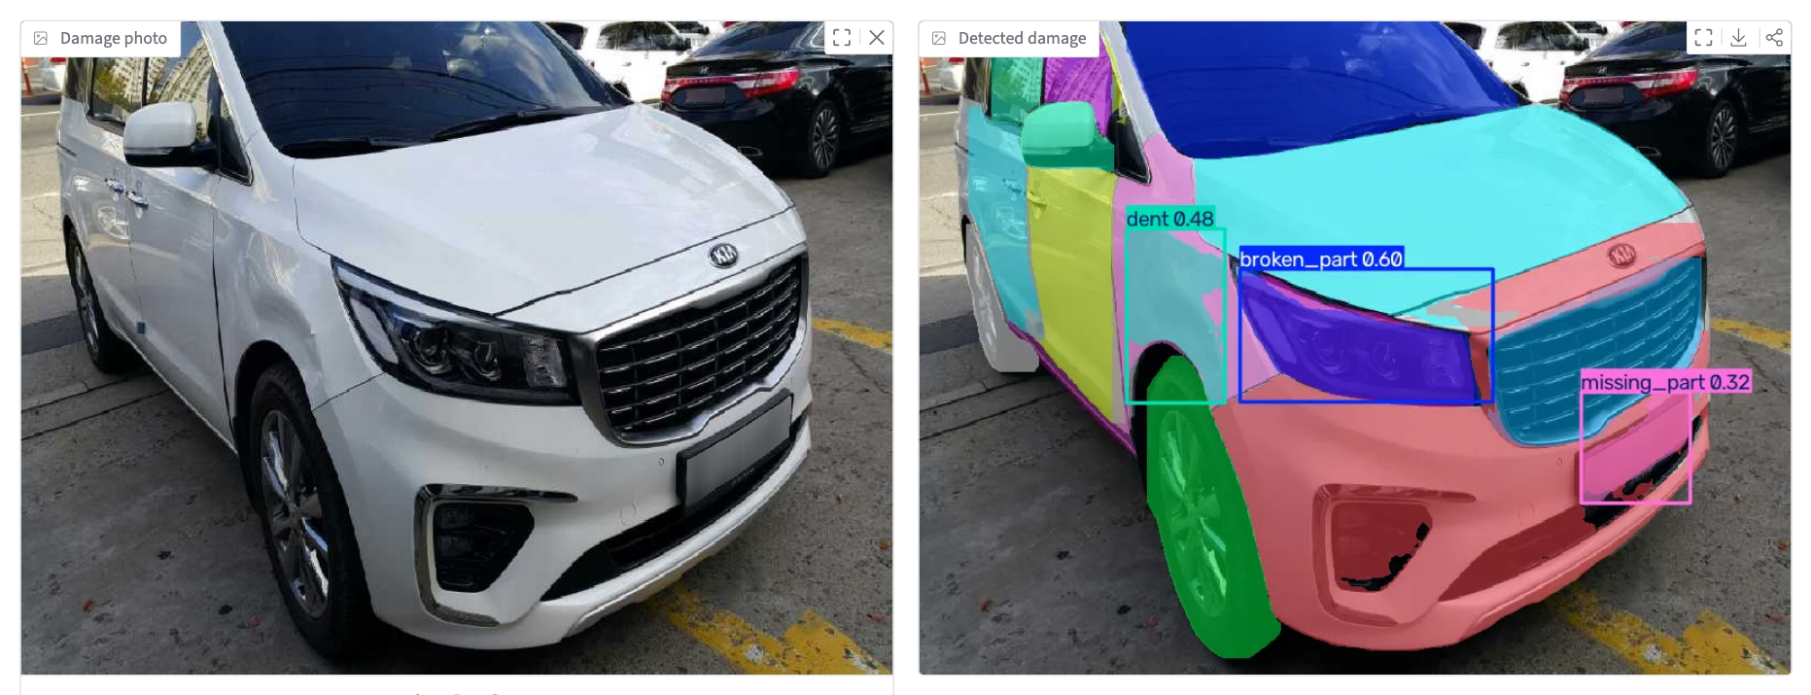
13. Implementation: Web App
Input: photo, car segment, city tier, vehicle age, engine cc, IDV, zero-dep, voluntary deductible
Output: annotated photo, damage table, low–high repair estimate, insurer and customer share
Stack: Python, PyTorch (MPS), Ultralytics YOLO, Gradio; 32 automated tests passing
Notes:
Live demo: run the app (cd car-estimator; ../.venv/bin/python app.py) and upload a sample photo.

Slide 16
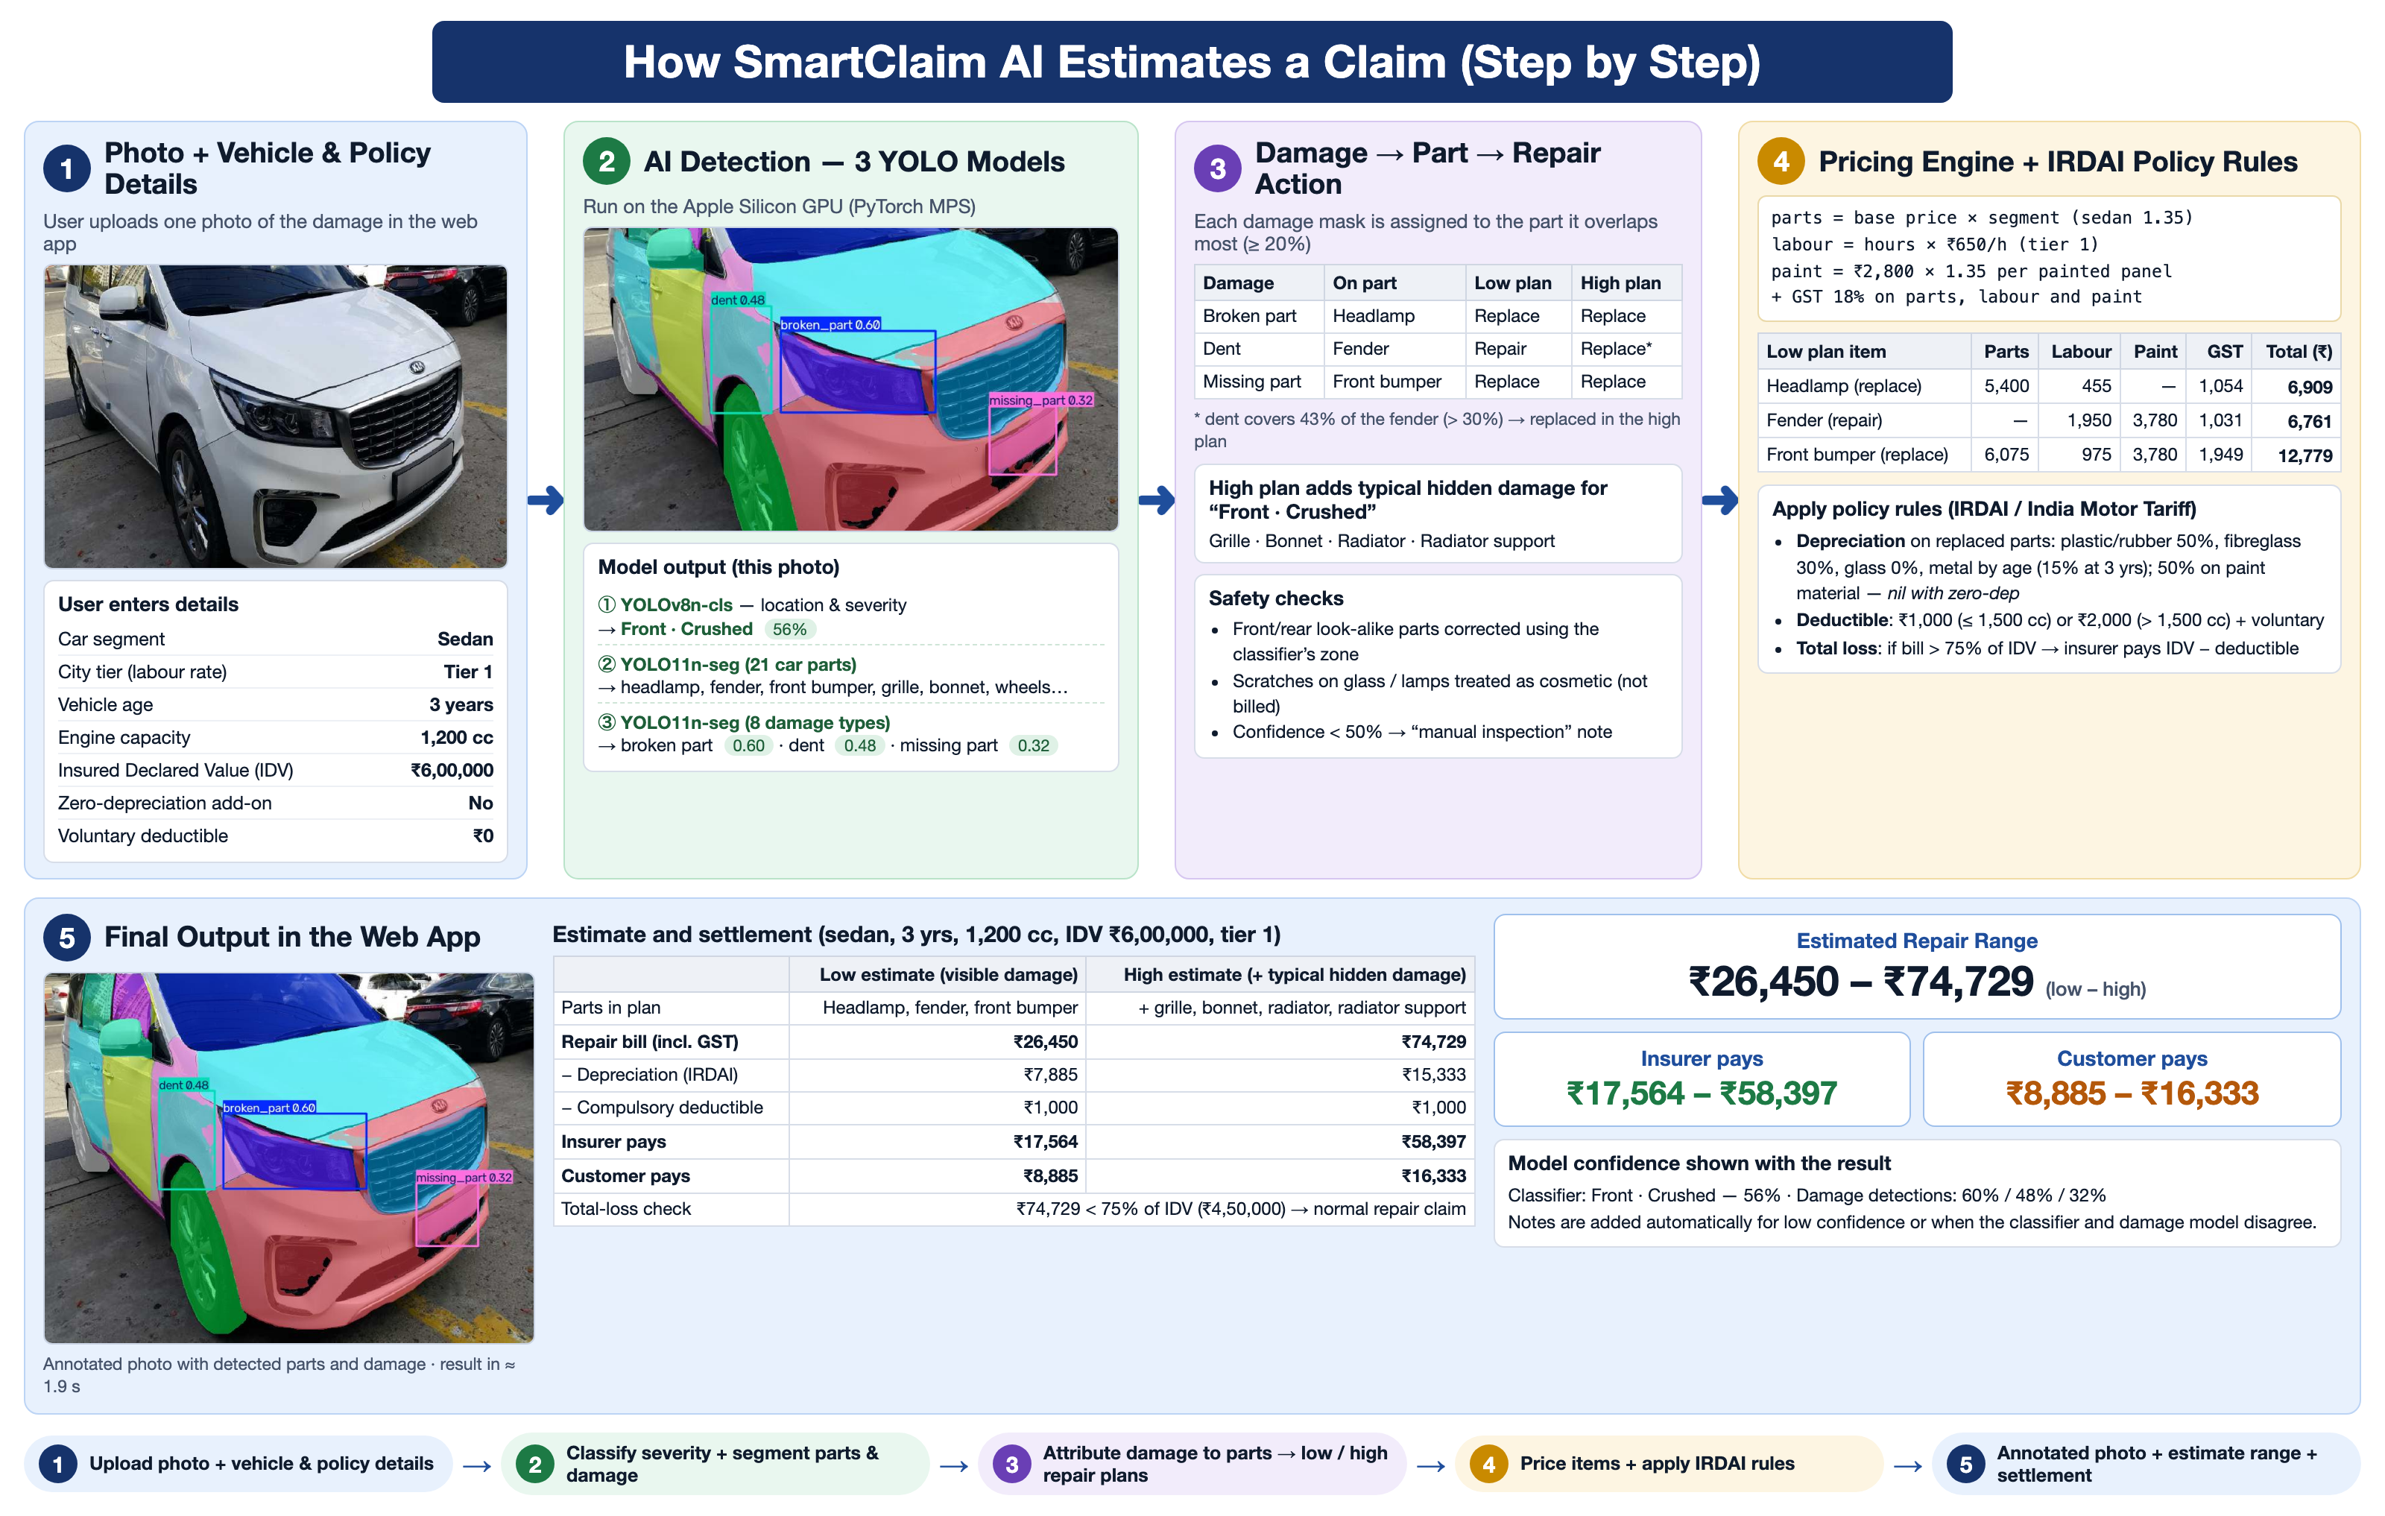
14. Worked Example
Notes:
Real held-out sedan photo: front crushed 56%. Broken headlamp, dented fender, missing bumper section. Low 26,450 / high 74,729 rupees; insurer pays 17,564 to 58,397.

Slide 17
15. Project Timeline
Phase | W1 | W2 | W3 | W4 | W5 | W6 | W7 | W8 | W9 | W10 | W11 | W12 | W13
1. Problem identification & literature survey
2. Dataset collection & preprocessing
3. Classifier training & comparison
4. Part & damage segmentation models
5. Attribution & pricing engine
6. IRDAI policy rules & testing
7. Web application
8. Report & presentation
Notes:
Phase-wise plan across 13 weeks.

Slide 18
16. Conclusion
Built a complete pipeline from one photo to a claim settlement in about 2 seconds.
Compared 5 classifiers; YOLOv8n-cls reached 80.35% accuracy.
Car-part segmentation with mask mAP@50 of 0.81 across 21 parts.
Damage is attributed to named parts, so every estimate is itemised and explainable.
Implemented IRDAI depreciation, deductibles, zero-dep and total-loss rules.
Showed that historical claim amounts cannot price visible damage, which justified part-level pricing.
Notes:
Summarise what was achieved.

Slide 19
17. Future Scope
Train on larger damage datasets for more epochs to improve scratch and dent detection.
Combine multiple photos of the same car and cover side damage.
Live part prices per make and model, and city-specific labour rates.
Fraud screening of edited or re-used photos.
Mobile app with guided photo capture and insurer integration.
Notes:
Next steps to improve the system.

Slide 20
References
K. Patil, M. Kulkarni, A. Sriraman, S. Karande, “Deep learning based car damage classification,” IEEE ICMLA, 2017.
K. He, X. Zhang, S. Ren, J. Sun, “Deep residual learning for image recognition,” IEEE CVPR, 2016.
M. Tan, Q. V. Le, “EfficientNet: Rethinking model scaling for CNNs,” ICML, 2019.
J. Redmon, S. Divvala, R. Girshick, A. Farhadi, “You only look once: Unified, real-time object detection,” IEEE CVPR, 2016.
K. He, G. Gkioxari, P. Dollár, R. Girshick, “Mask R-CNN,” IEEE ICCV, 2017.
X. Wang, W. Li, Z. Wu, “CarDD: A new dataset for vision-based car damage detection,” IEEE T-ITS, 2023.
U. Waqas, N. Akram et al., “Vehicle damage classification and fraudulent image detection including Moiré effect using deep learning,” IEEE CCECE, 2020.
G. Jocher, J. Qiu, A. Chaurasia, Ultralytics YOLO, 2023. github.com/ultralytics/ultralytics
IRDAI, India Motor Tariff: depreciation, deductibles and total loss. irdai.gov.in

Slide 21
Thank You...!!

