Slide 1

HR Email Automation
Product Demo

Slide 2

PROBLEM
Candidates not being informed of their status in the hiring process
Not knowing If the application has been received
Competitors informing candidates of their status in the hiring process leads to more confidence with the competitor
A Candidate applying for multiple positions will not know their status with AKP

Slide 3

SOLUTION
Centralized Hub for HR department to monitor and send emails to candidates

Slide 4




PRODUCT
Send multiple emails at once
Personalize emails with templates
Search for candidates by name
Features
Interactive UI

Slide 5
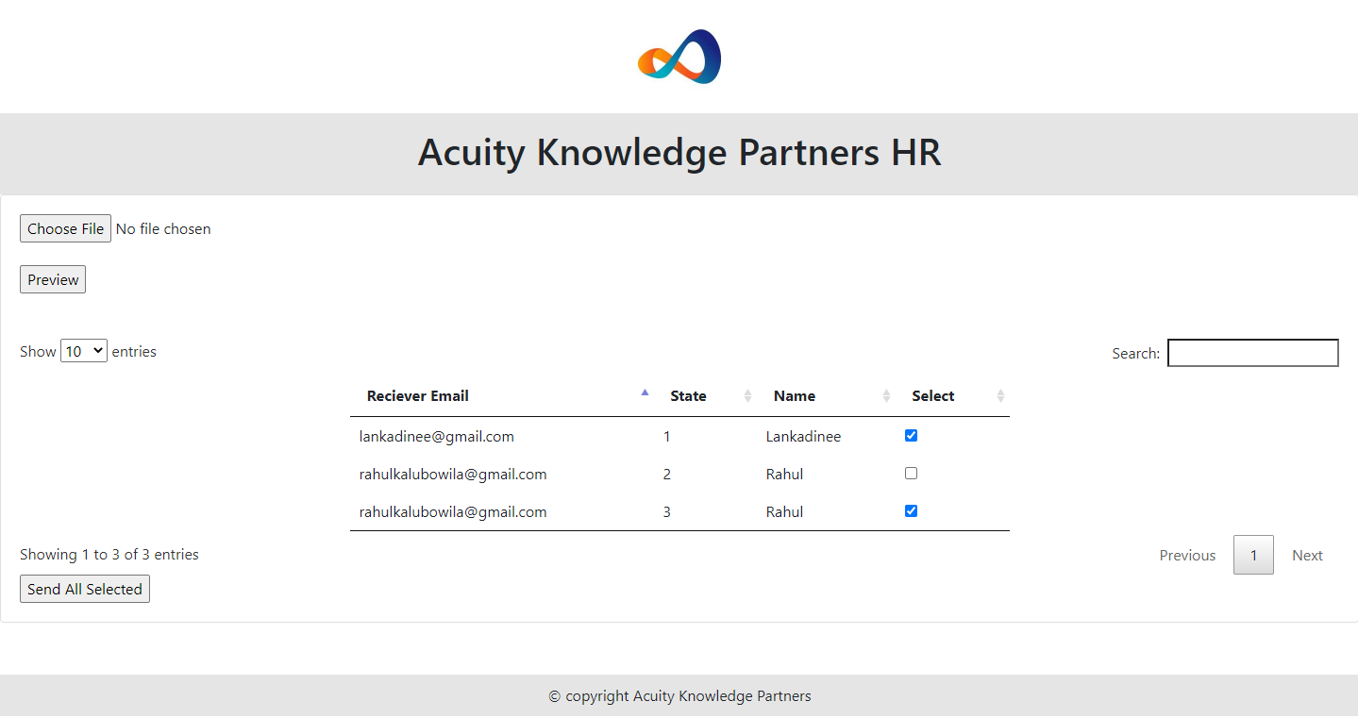
PRODUCT DEMO
https://akpemailapp.herokuapp.com/

Slide 6
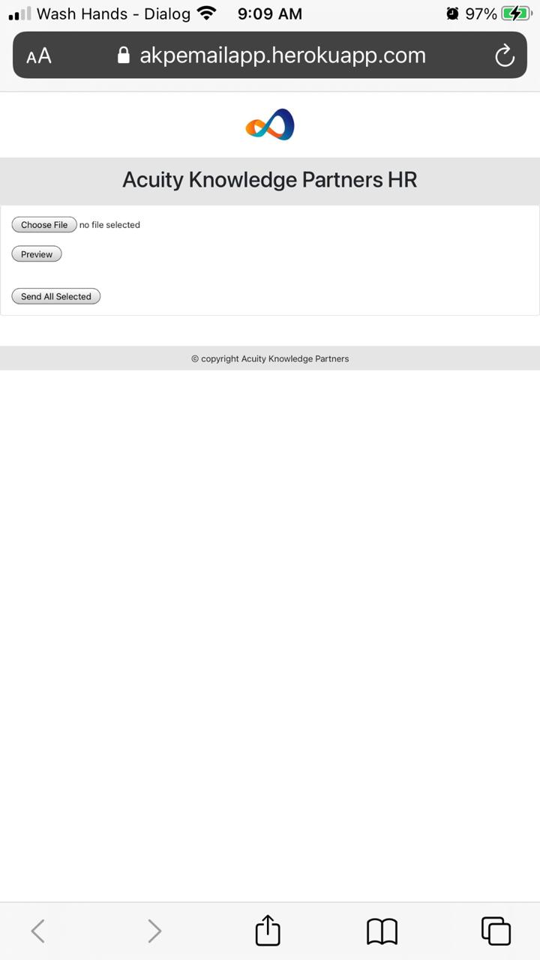
MOBILE READY
Responsive UI

Slide 7
THANK YOU!
Phone:
Email:
Website:
www.acuitykp.com

