Slide 1

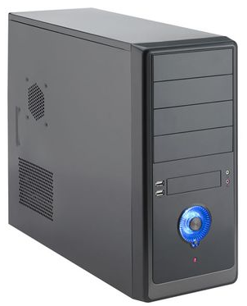
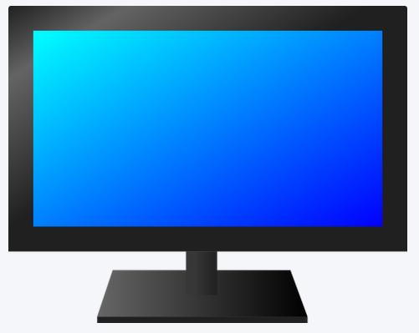
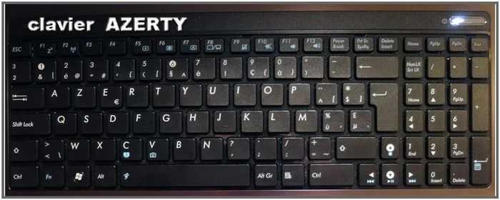
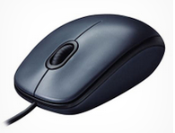
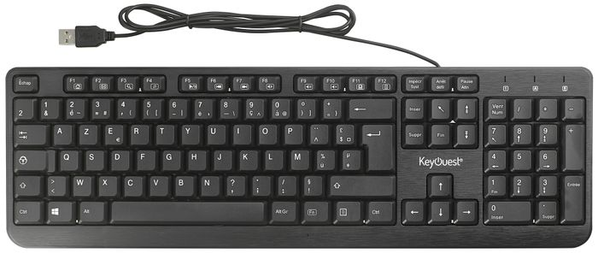
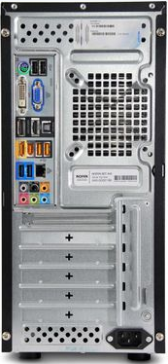
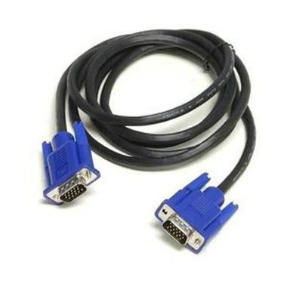
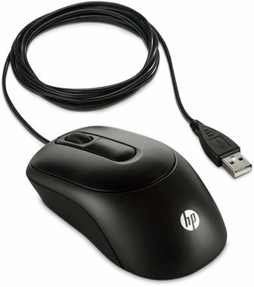
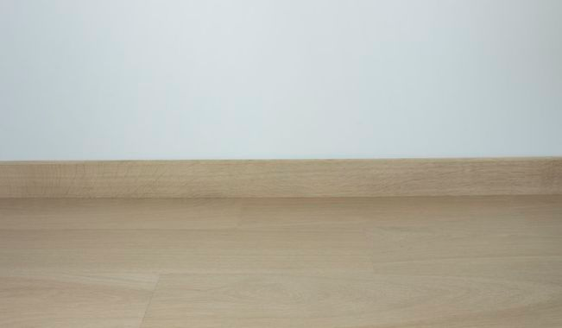
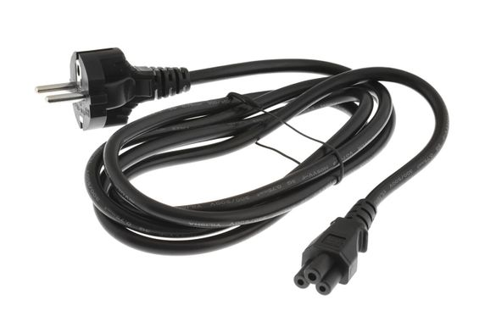
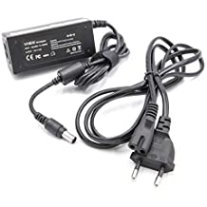
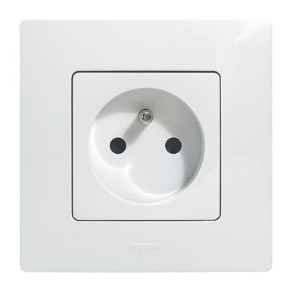


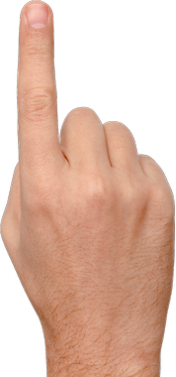
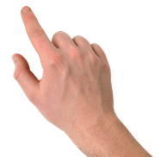

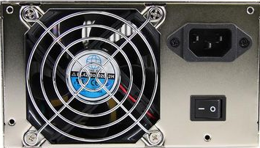
The computer : components, cables and boot
A computer is usually made up by :
- a large rectangular block, called the central (processing) unit, which contains most of the computer's elements,
- a screen,
- a keyboard with keys for letters, numbers and other characters,
- a mouse with two buttons and a central (scroll) wheel.
In order for them to communicate, the keyboard, the mouse and the screen are connected to the central unit by cables.
- the end of the keyboard cable and the end of the mouse cable go into one of the holes at the back of the central unit,
- the screen cable is connected on one side to the screen and on the other to the back of the central unit.
For these devices to work, they need to be supplied with electricity.
- The central unit and the screen must be connected to the electrical network by electrical power cables which on one side have a socket which plugs into the current and on the other a tip which is inserted in the back of the device.
- the keyboard and the mouse do not need connection with the electrical network. The cable that connects it to the central unit also acts as a power supply.
Warning: As with any appliance plugged into the electrical network, improper use may result in electric shock.
To start a computer, it is required to turn on certain elements that compose it.
In general, it is enough to turn on the screen and the central unit.
- First turn on the screen.
On the front there is often a button to press.
- Then you have to start the central unit by pressing a button at the front of the central unit. But sometimes you have to first press a button located at the back of the central unit and marked I O
usually located near the power supply.
2nd step (optional)
Press on I of the button I O located at the back of the central unit.
3rd step
Press the startup button of the central unit.
1st Step
Press the on-screen startup button.

Slide 2
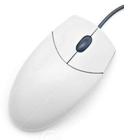

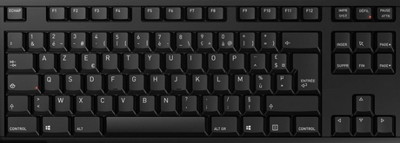



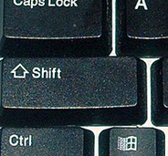

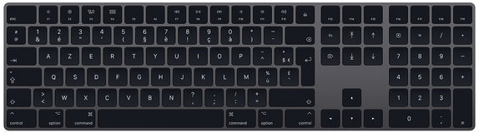
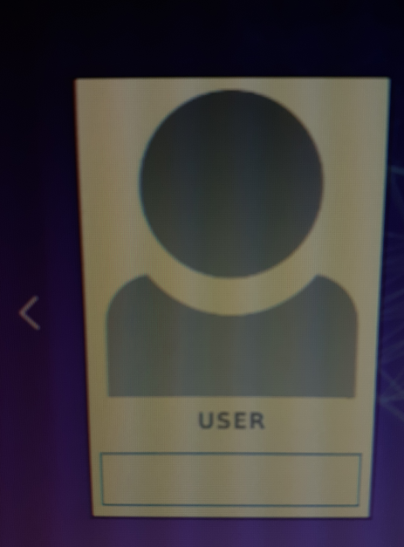
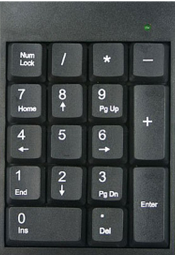
Use of mouse and keyboard
When we start a computer, we have first to enter a password on the first screen that is displayed. To enter this password, you have to use the mouse and the keyboard.
The mouse allows to move a small cursor
(an arrow or a hand) on the screen. To move the mouse makes the cursor move in the same direction.
On the mouse there are two buttons. We press the left button (we call this action "to click") to tell the computer that we want to do an action at the place where the cursor is (for example, to enter text ).
Moving the mouse to the right ...
Click on the left button of the mouse...
…to indicate an action at the cursor location.
… makes the cursor move to the right too.
The right mouse button and the wheel between the two buttons have other functions which will be described later.
For left-handers, it is possible to reverse the use of the two mouse buttons. See the "Applications" sheet to do this.
The keyboard allows you to enter text that will be displayed on the screen.
This text will of course consist of letters, but may also contain numbers, operation signs (e.g. "+" or "="), punctuation marks (e.g. "?" or ";" ), but also more unusual signs (e.g. "#" or "&"). All these digits, letters or signs are called input characters.
To enter a letter, simply press the corresponding key on the keyboard, and the letter is displayed on the screen.
1
Press the key « H » ...
… and an « h » is displayed in the input area on the screen.
1
1
2
h
But the displayed letter is a lowercase letter. If you want to display a capital letter, you must first press the key (or « Shift ») with a finger of the left hand, keep your finger pressed on the key, and press with a finger of the right hand on the letter that you want to display in uppercase.
Press the key (or « Shift ») with a finger of the left hand and keep it pressed ...
1
… and then press the "H" key with a finger of the right hand ...
1
2
1
3
H
… and a capital « H » will be displayed in the input area on the screen
The numbers are shown on the row of keys above the letter keys. To display a number, you must do the same manipulation as for capital letters. (key + key of the number to be displayed).
Press the key (or « Shift ») with a finger of the left hand and keep it pressed ...
1
… and then press the « 2 » key with a finger of the right hand ...
1
2
1
… and a « 2 »
will be displayed in the input area on the screen.
3
2
Entering the password in LUbuntu
The password entry area is located under the computer user name.
It often happens that to the right of a computer keyboard there is a numeric keypad. On this pad we find the figures as well as the signs of current operations ( +, -, *, /).
If necessary, use the mouse to move the cursor to the very beginning of the password entry zone and click on the left mouse button.
Very often, when starting the computer, these numbers cannot be entered. You have to press the key on the top left of the keypad (labeled "Num lock" or "Ver num") to activate them.
Then enter the password, using the keyboard, in this area.
And finally press the key
(or « Enter »).
If you have entered a wrong character, you can go back by pressing the key or delete it by pressing the key marked « suppr » (suppress) or « del » (delete).

