Slide 1

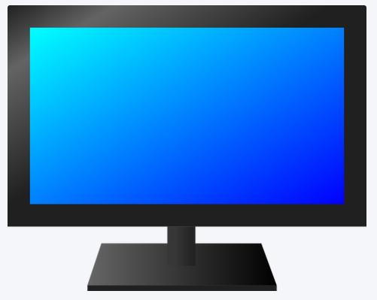
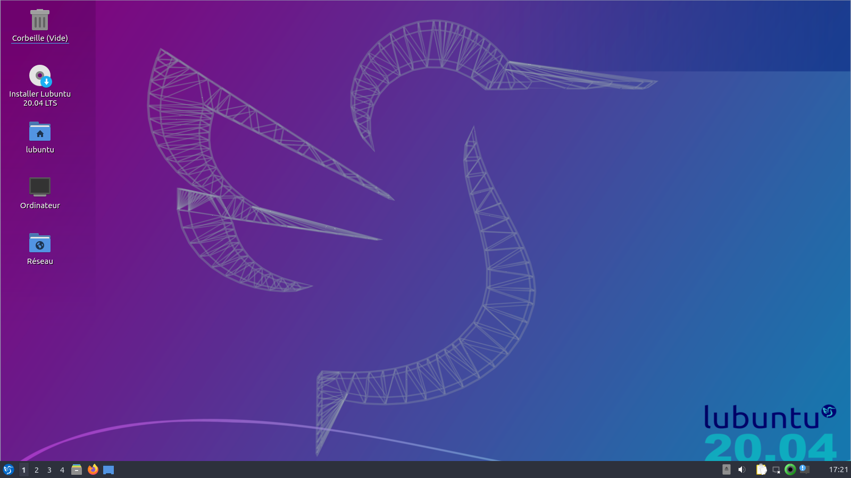

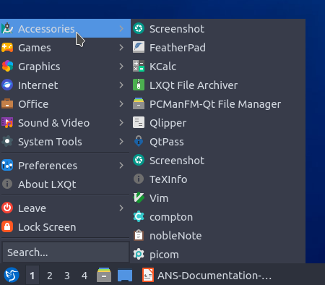

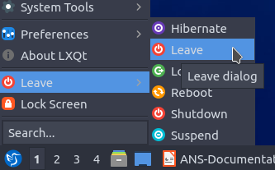
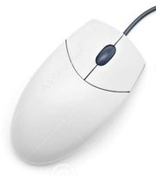
The Lubuntu desk
After entering the password, you arrive on a screen called the desk. Initially, the center of this desk is almost empty. On the other hand, there are elements on a bar at the bottom of the desktop, left side and right side.
On the far right of the bottom bar, the time is displayed. If clicked, a calendar displays the month and day. Click again to clear the calendar.
On the far left of the bottom bar, a blue dot represents a hummingbird.
When you click on this dot, a list is displayed above. Each row of the list consists of a small image and some text. Small images are called icons.
If you slide the mouse cursor over one of these lines, another list is displayed to the right of the line on which the cursor is.
Each line of this new list corresponds to an application. An application is a tool that will allow you to do something: create texts, create drawings, chat with other people, send messages, listen to music, etc.
By moving the cursor over one of the lines of this second list and clicking on it, you open the corresponding application, i.e. you can start using this tool.
Among the lines that appear, there is a particular one, the one marked "Shutdown" and preceded by an icon . When hovering over it, a sub-list shows several options. By clicking on the "Shut down" line, itself preceded by an icon , the computer is turned off.
Note: There is another way to shut down the computer; it is to press 5 seconds on the button of the computer (the one we pressed to start it) but it is strongly advised to privilege the method indicated above to turn off the computer, the method of 5 seconds being reserved in case of the computer being completely blocked.
Next to the hummingbird icon, there are 4 numbers ranging from 1 to 4.
Each number indicates a desk. It's like having 4 different desks to work on. To switch from one desktop to another, just click on it.
Note: You can also use the mouse wheel to switch between desktops. You have to bring the cursor to one of the numbers and roll the wheel.
The beginning of a document is displayed on the screen but we cannot see the end...
Start of text
a
b
Continuation of the text
Début du texte
a
b
Suite du texte
c
… We roll the wheel towards ourselves ...
Between the two mouse buttons, there is a small wheel that can be turned in one direction or the other, usually with the middle finger.
… On fait rouler la molette vers soit ...
Entre les deux boutons de la souris, il y a une petite roue que l’on peut faire tourner dans un sens ou dans l’autre, généralement avec le majeur (doigt du milieu).
b
Continuation of the text
c
End of text
… and the document slides down. We can then see the end of the written text.
And vice versa, you can go up in the document by rolling the wheel in the opposite direction.
b
Suite du texte
c
d
Fin du texte
…et le document glisse vers le bas. On peut alors voir la fin du texte inscrit.
A l’inverse, on peut remonter dans le document en faisant rouler la molette dans l’autre sens.
This small wheel allows you to move the object on the screen on which you are working, for example a document.

Slide 2

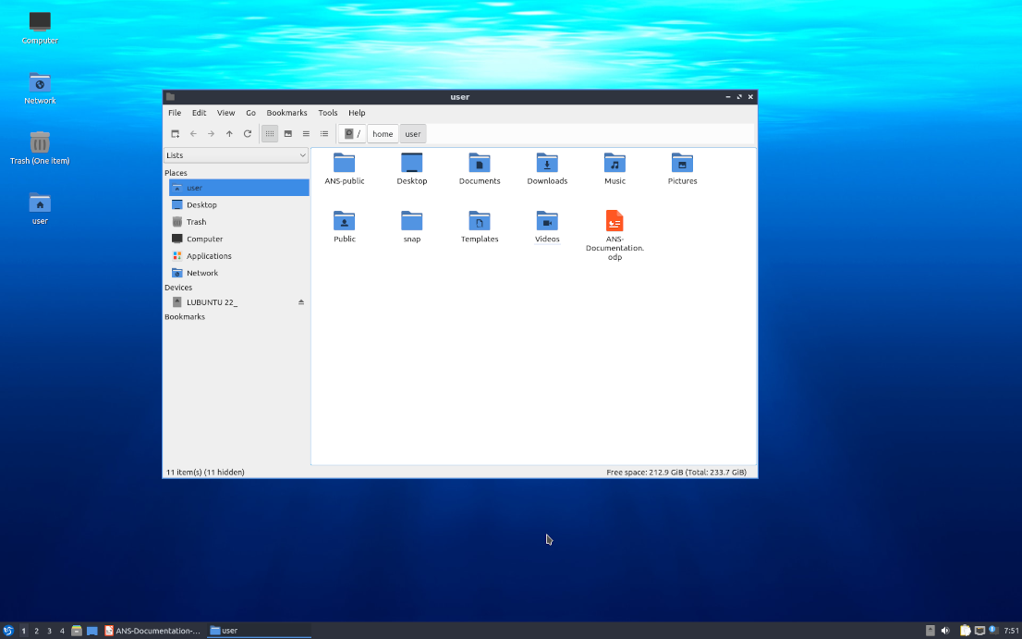



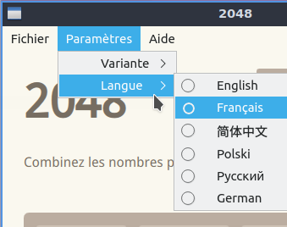
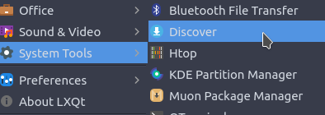
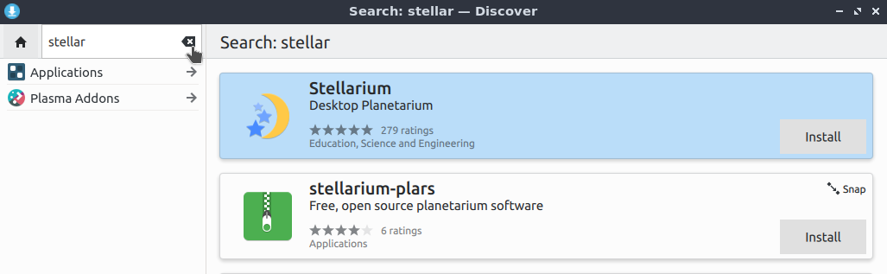
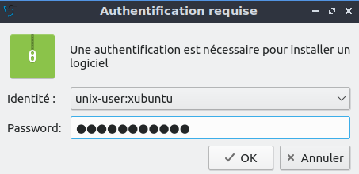
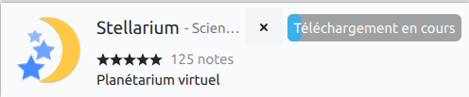
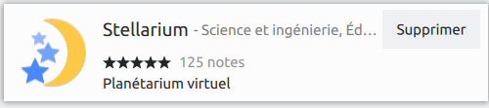
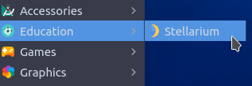



Applications
A computer is used for different things: creating texts, creating drawings, chatting with other people, sending messages, listening to music, etc. For each of these things we want to do, we use a particular tool that we call an application. Once the application is open, as indicated in the previous paragraph, you can work with this tool.
Each application has its particularities which will be explained in the following paragraphs. On the other hand, certain characteristics are found in all applications and are explained in this paragraph.
When an application opens, it appears in the middle of the desktop, in a window.
At the top right of the window, there are three signs.
When we press the sign , the application will be closed.
When we press the sign , the window then occupies the entire screen. A new click on the same sign returns the window to its previous size.
Finally, if we click on the sign , the window disappears, but the application is not closed. It is still active but we no longer see it.
Each time you open an application, a reference to this application is added to the bar at the bottom of the screen. To display the window again, click on this reference.
For most applications, the available actions are grouped together in menus whose headings are displayed in a bar located at the top of the window.
If you click on one of these menus, a series of lines is displayed. You can move the mouse over this series of lines and select one by clicking on it. The action corresponding to this line is then executed.
It is also possible that the line does not indicate an action but a submenu. This sub-menu in turn indicating a series of possible actions.
{
In addition to those installed on the computer, it is possible to install additional applications which are stored in the software store (the application store).
For this we use a particular application whose function is to install or remove applications from the computer. On LUbuntu, this application is called Discover. You can find it in the "System Tools" menu.
Once the application has been launched, you can enter in the area at the top left, located before the arrow , the name of an application that you know or a given theme. For example, you can enter "stars" to display apps that relate to stars.
To install an application on the computer, press the "Install" button to the right of the application. A window will then appear in which you must enter the password that allowed you to access the desktop and click on the "OK" button. Then, the application is downloaded, that is to say that it will be retrieved somewhere on the internet to be installed on the computer.
Once the app is loaded, the "Install" button is replaced with a "Remove" button that you can press to remove the app from the computer.
Once installed, the application is integrated into the menus and submenus and can be relaunched like any other previously installed application.
To reverse mouse buttons for left handed, choose in the main menu, then and finally . .
In the window that appears, left click on the mouse,
then on the small square on the last line at the bottom of the window. The square turns blue.
The "Apply" button will appear. Left click on it.
From this moment, the use of the two buttons is reversed.

Slide 3
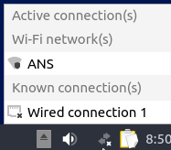
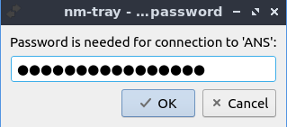
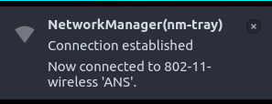
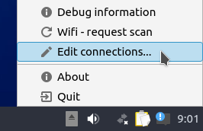
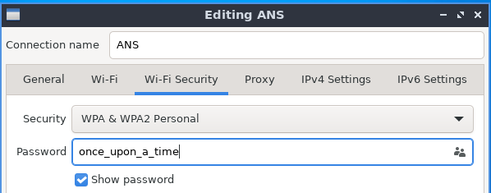

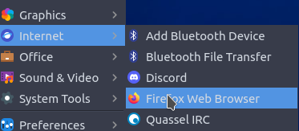
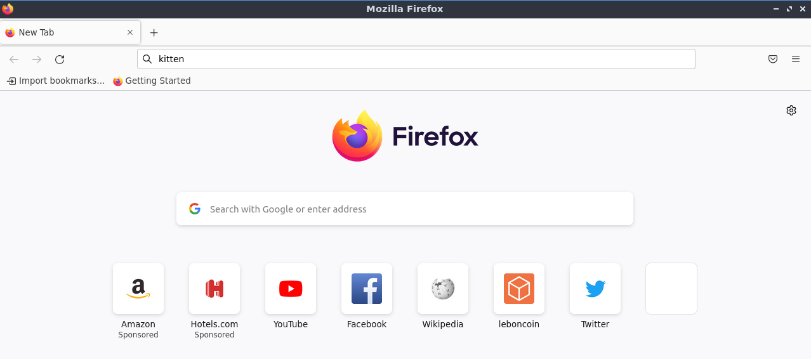

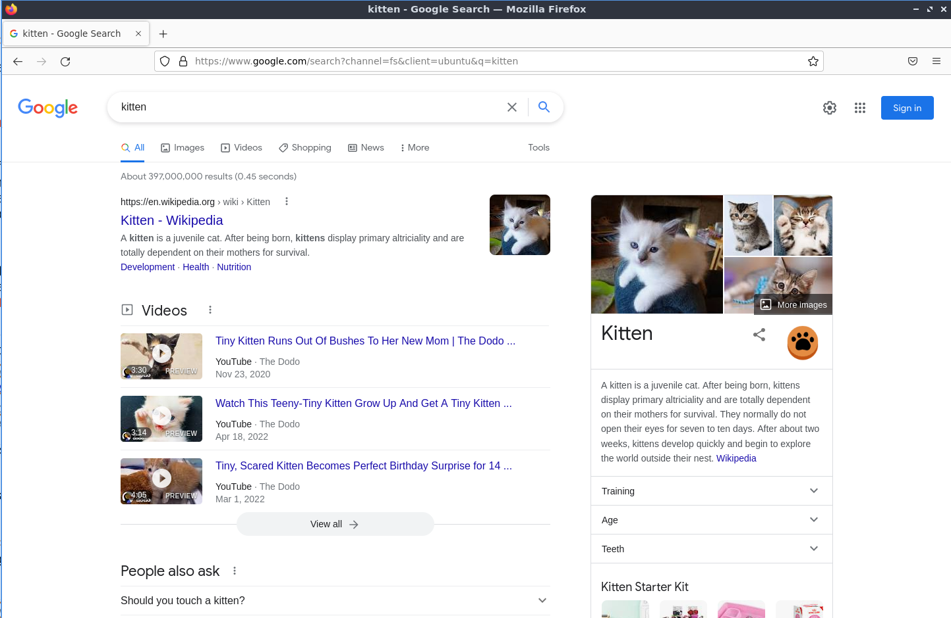
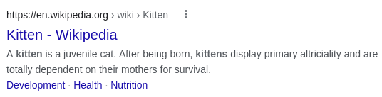

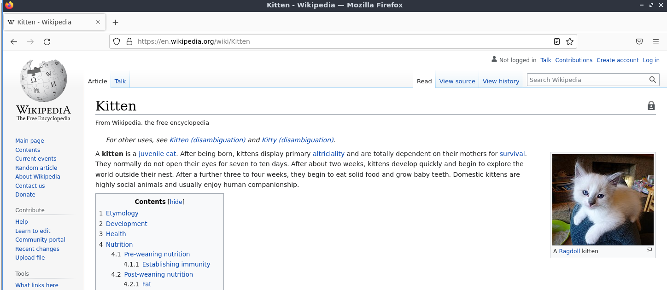

Internet
The Internet is a network that connects computers around the world. When you connect your computer to this network, you can consult information on all topics (languages, DIY or cooking etc.).
To connect to the internet, you must start by clicking on the icon at the bottom right of the screen. A list appears above this icon. In this list, you must find your internet box by its identifier and click on it.
An input box appears with the name of your box. You must then enter the password provided with your box in the area provided for this purpose and click on the "OK" button.
At the top of the screen, a window tells you that the connection is established.
If the connection is not made, click on the icon , but this time with the right button.
Left click on "Edit Connections"
Double click on your box in the displayed list
In the window that appears, click on the "Wifi-Security" menu and on the small square at the bottom to "Show password".
The entered password is displayed and can then be corrected.
Press the "Save" button and the connection should be established.
To consult information on the Internet, you must launch an application called a browser. The default browser on Lubuntu is Firefox.
Firefox is in the apps list, specifically in the "Internet" sublist.
Click on the corresponding line to open Firefox.
Information on the internet is gathered as web pages. Firefox can display these pages.
To find the page that interests us, the easiest way is to use a search engine. The best known search engine is Google.
In Firefox, an input field is preceded by a .
Type in this field a topic that interests you (for example: "kitten") and press the "Enter" key on the keyboard. Input is also possible in the field above.
The screen fills with a lot of information.
This information is grouped by tiles. Each tile groups information about a given web page:
- an internet address, i.e. the place where the page will be found on the internet,
- A succinct (more or less accurate) explanation of what can be found on this page.
{
{
It is possible to see other tiles by scrolling the mouse wheel down.
It is also possible to see even more tiles by clicking on one of the numbers displayed below at the very bottom of the search page.
Clicking on an internet address (or website name) takes you to the corresponding internet page.
By using the mouse wheel, you can view the full content of this page.
.
When we move the mouse cursor on the page, we can notice that it sometimes changes (for example becomes ). This indicates the possible access to another web page by clicking on the mouse. And you can go from one web page to another one. This is called browsing the internet.

Slide 4






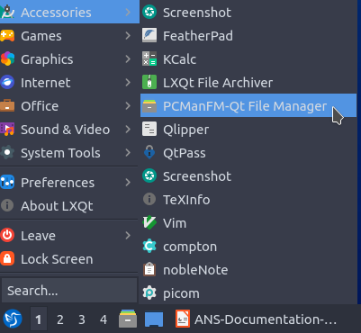
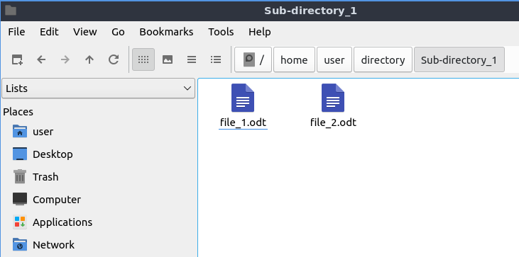
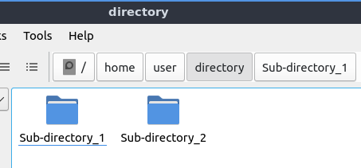
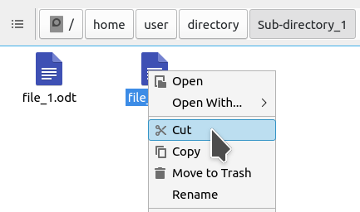
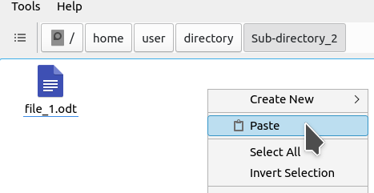
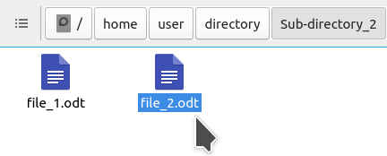
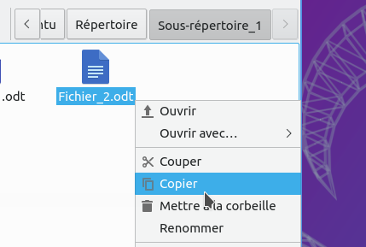
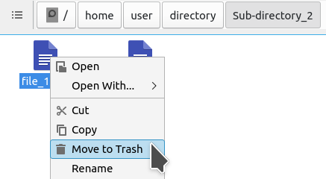
Files and directories
As you work with applications, you save your information to files.
To find your files, you must put them away. To do this, you can group them into directories. A directory can contain files or other directories, creating a directory hierarchy.
Subfolder 1
Subfolder 2
File1.odt
File2.odt
File3.odt
To find your way through all the directories and files that you will have to manage, you will use an application called File Manager. Under LUbuntu, the file manager is "PCMan", which you will find in the "Accessories" menu.
It is also possible to access this application by clicking on the icon at the bottom of the screen.
Below the menu line is indicated the directory in consultation and the hierarchy on which it depends (here: the directory "Sub-directory_1" is in the directory "directory" itself in the directory "user" which is itself in the "home" directory).
In this example, clicking on the directory called "Directory" displays its contents.
The gray background indicates that this directory is being consulted.
Below this directory hierarchy, we can see the contents of the directory in consultation (here: "Subdirectory_1 contains "File_1.odt" and File_2.odt ).
To see the contents of a directory, just click on it.
To change a directory file, place the cursor on the file and click on the right button.
A pop-up menu appears. Hover over "Cut" and left-click.
Then select in PC-Man the directory in which you want to move the file.
Then right-click to display the context menu. Hover over "Paste" and left click.
1
2
This manipulation to move a file is called a cut / paste.
Similarly, it is possible to make a copy of a file in another directory by choosing "Copy" in the first step. This other manipulation is called a copy / paste.
The file is moved to the target directory.
3
1
To delete a file, place the cursor on the file and click on the right button. Hover over "Move to Trash" and left-click. The file is deleted (trashed).
All the operations presented in this page for files (moving, copying, deleting) can be applied in the same way to directories.

