Slide 1

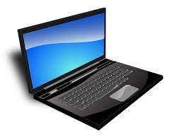
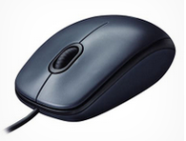
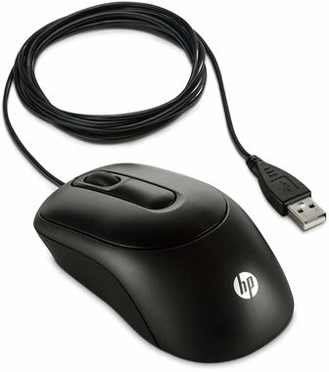
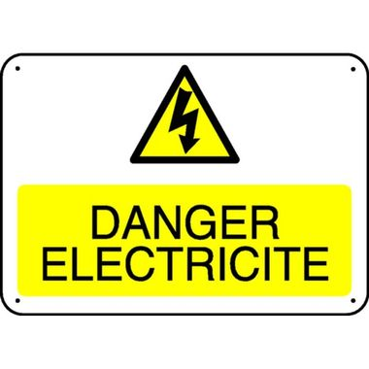
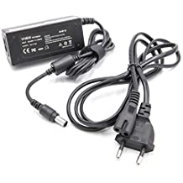
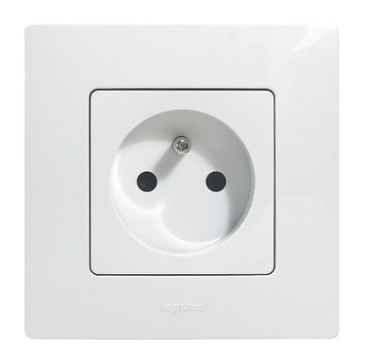
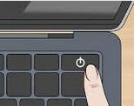

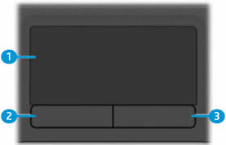
The laptop : components, cables and boot
A laptop is usually made up by :
- a screen,
- a keyboard with keys for letters, numbers and other characters,
- it may be accompanied by a mouse with two buttons and a central (scroll) wheel.
If present, in order to communicate, he mouse is connected to the laptop by a cable.
- the end of the mouse cable go into one of the holes at the side of the laptop.
For these laptop to work, they need to be supplied with electricity.
Sometimes, the transfomer is separeted from the cable.
Therefore there are 2 cables :
A tip of the first cable must be inserted in the laptop and the other end of the cable must be inserted in the transformer ;
The end of the second cable must be inserted in the transformer and, at the other end of the cable, the plug must be inserted in the power outlet.
- The laptop must be connected to the electrical network by electrical power cable and transfomer given with laptop.
The cable have on one side a socket which plugs into the current and on the other a tip which is inserted in the side of the device.
The transfomer is between the two sides of the cable.
Beware serious danger :
The power supply of a laptop with a transformer wich is not the one originaly supplied can permanently damage the laptop, or even blow up its battery.
The main advantage of a laptop is to be electrically charged before use. It can be disconnected and transported everywhere. Be carefull, the use time out of electric supply is limited.
- the mouse don't need to be connected to power supply. The cable linking to laptop powers the mouse.
Caution : like all devices connected to the power grid, a misuse can cause electric shock
To start a computer, it is required to turn it on.
In general, just press the button
located at the top of the keyboard.
As the particularity of a laptop particularity is to be autonomous, it has a touchpad that makes optional the use of the mouse.
1.The touchpad allows to move on the screen as it would be with the mouse
2. The left button (or the left down corner) of the touchpad works like the left button of the mouse.
3. The right button (or the right down corner) of the touchpad works like the left button of the mouse.
- The touchpad is before the keyboard.

Slide 2

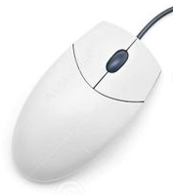
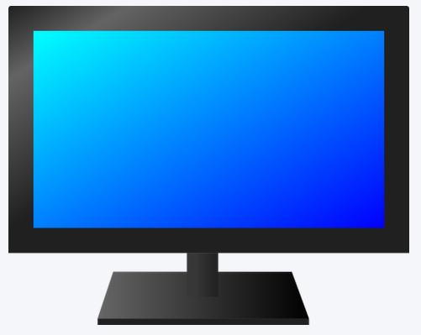

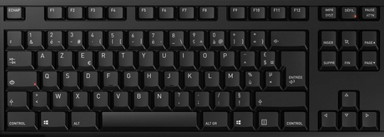



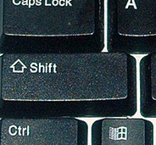

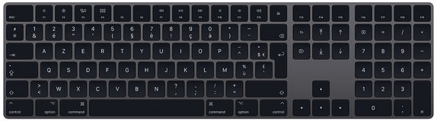
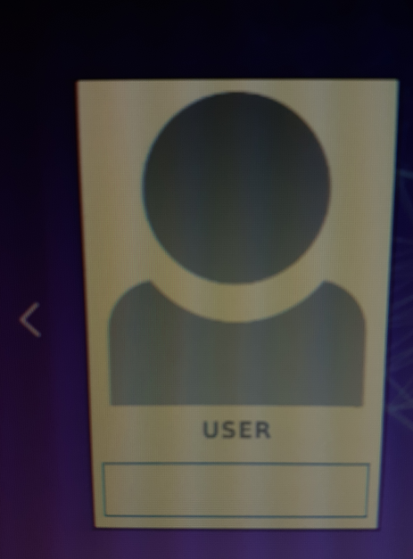
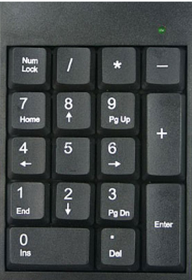
Use of mouse and keyboard
When we start a computer, we have first to enter a password on the first screen that is displayed. To enter this password, you have to use the mouse and the keyboard.
The mouse allows to move a small cursor
(an arrow or a hand) on the screen. To move the mouse makes the cursor move in the same direction.
On the mouse there are two buttons. We press the left button (we call this action "to click") to tell the computer that we want to do an action at the place where the cursor is (for example, to enter text ).
Moving the mouse to the right ...
Click on the left button of the mouse...
…to indicate an action at the cursor location.
… makes the cursor move to the right too.
The right mouse button and the wheel between the two buttons have other functions which will be described later.
For left-handers, it is possible to reverse the use of the two mouse buttons. See the "Applications" sheet to do this.
The keyboard allows you to enter text that will be displayed on the screen.
This text will of course consist of letters, but may also contain numbers, operation signs (e.g. "+" or "="), punctuation marks (e.g. "?" or ";" ), but also more unusual signs (e.g. "#" or "&"). All these digits, letters or signs are called input characters.
To enter a letter, simply press the corresponding key on the keyboard, and the letter is displayed on the screen.
1
Press the key « H » ...
… and an « h » is displayed in the input area on the screen.
1
1
2
h
But the displayed letter is a lowercase letter. If you want to display a capital letter, you must first press the key (or « Shift ») with a finger of the left hand, keep your finger pressed on the key, and press with a finger of the right hand on the letter that you want to display in uppercase.
Press the key (or « Shift ») with a finger of the left hand and keep it pressed ...
1
… and then press the "H" key with a finger of the right hand ...
1
2
1
3
H
… and a capital « H » will be displayed in the input area on the screen
The numbers are shown on the row of keys above the letter keys. To display a number, you must do the same manipulation as for capital letters. (key + key of the number to be displayed).
Press the key (or « Shift ») with a finger of the left hand and keep it pressed ...
1
… and then press the « 2 » key with a finger of the right hand ...
1
2
1
… and a « 2 »
will be displayed in the input area on the screen.
3
2
Entering the password in LUbuntu
The password entry area is located under the computer user name.
It often happens that to the right of a computer keyboard there is a numeric keypad. On this pad we find the figures as well as the signs of current operations ( +, -, *, /).
If necessary, use the mouse to move the cursor to the very beginning of the password entry zone and click on the left mouse button.
Very often, when starting the computer, these numbers cannot be entered. You have to press the key on the top left of the keypad (labeled "Num lock" or "Ver num") to activate them.
Then enter the password, using the keyboard, in this area.
And finally press the key
(or « Enter »).
If you have entered a wrong character, you can go back by pressing the key or delete it by pressing the key marked « suppr » (suppress) or « del » (delete).

