Slide 1

AFL – how to win
A data driven analysis of winning factors in matches
James Hooi

Slide 2
SPORT IS ABOUT WINNING
Choosing personnel and tactics in sport used to be more art than science. In some sports, it arguably still is. Nowadays, the rich commercial returns of succeeding in sport through TV rights deals, sponsorships and merchandising is too much to leave to chance – teams need to maximise their chances of “making their own luck”.
The story of Moneyball and the Oakland A’s signalled the beginnings of a data-driven revolution in sport
Elite sport is about winning and commercial success
This analysis sets out to find a link between AFL player performance and team results
Commercial success often follows on-field success
Data analysis is giving teams the competitive edge in elite competition
(explains)
Player metrics
Some formula
Team results

Slide 3
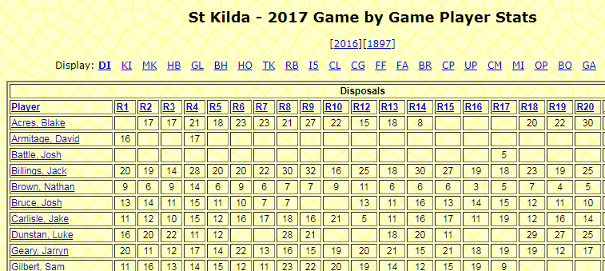

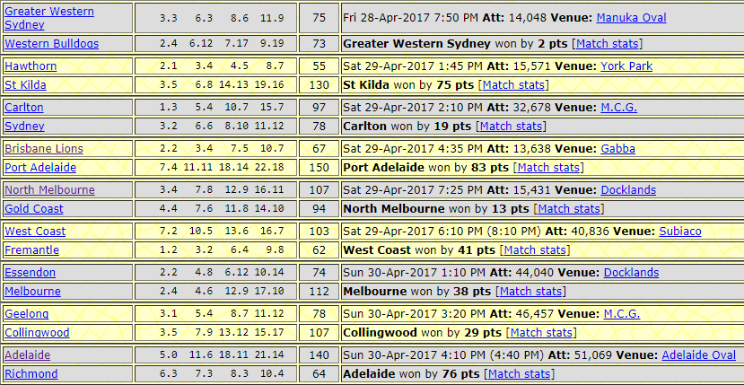



Analysis approach
The analysis uses free data from afltables.com and comprises:
Gathering player metric and team results data, creating team-wise totals for each match
EXPLORATORY ANALYSIS
Performing exploratory visualisation to look for relationships in the raw data
Creating indices to measure team vs opponent, performing visual and statistical analysis
INDEX STATISTICAL ANALYSIS
Creating additional proportion measures and clustering data for modelling
MACHINE LEARNING
Creating Decision Tree models, testing predictive accuracy non-clustered and clustered
Creating Logistic Regression models, testing predictive accuracy non-clustered and clustered
Documenting findings, opportunities for further analysis and wrap up
CONCLUSIONS

Slide 4
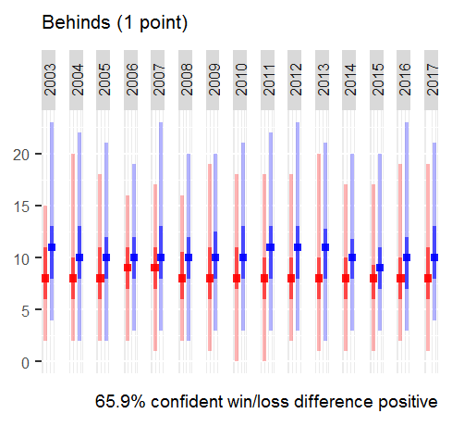
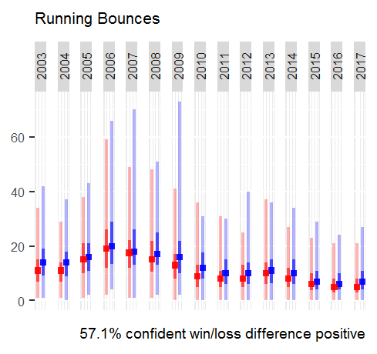
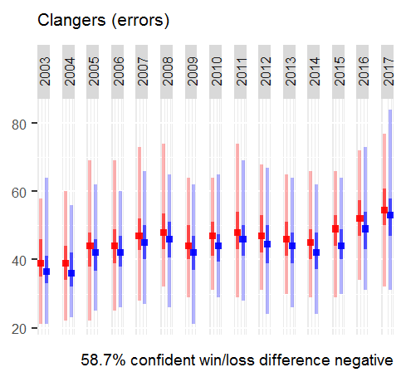
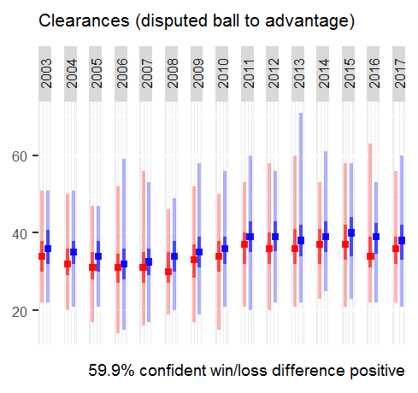
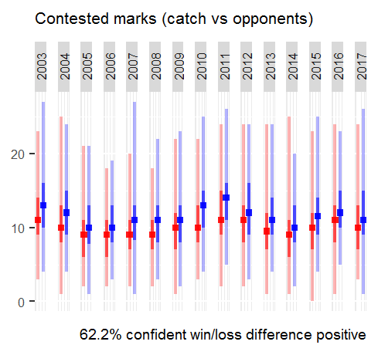
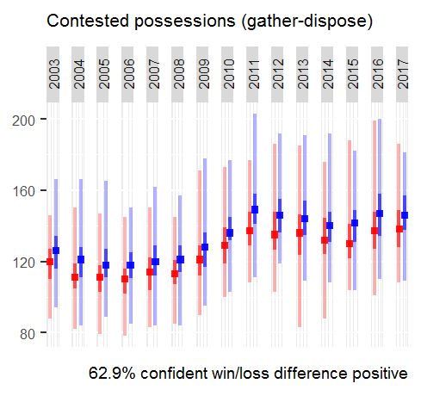
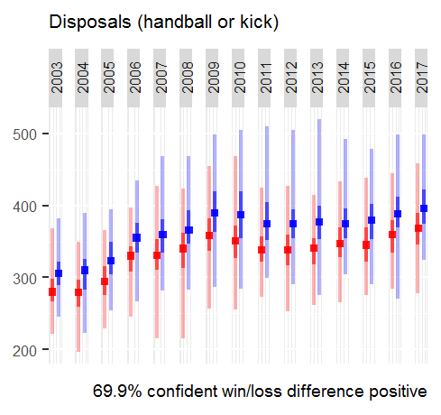
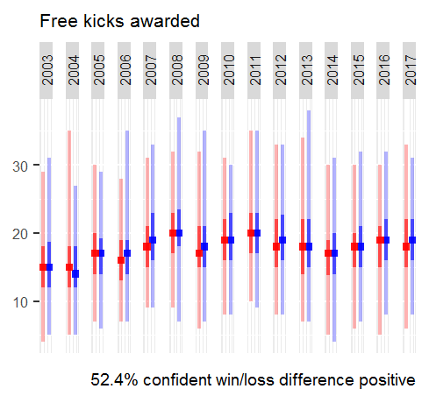
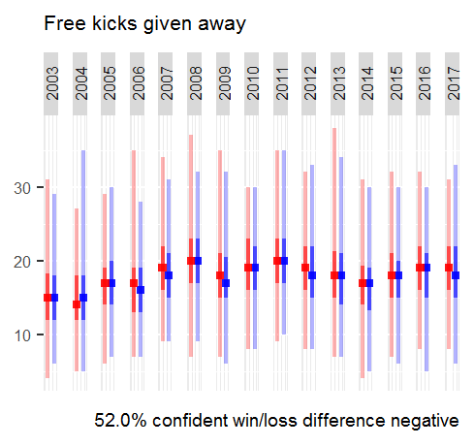
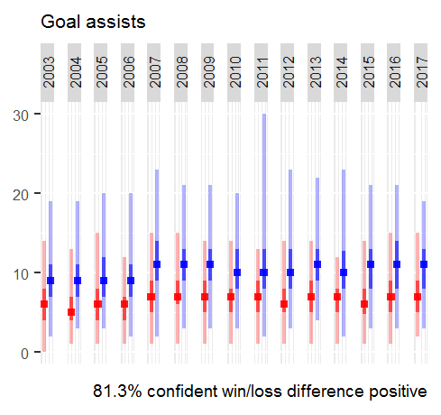
Exploratory analysis – 1 of 2
Data visualisation provides a simple and digestible method to get an overview of the data.
Below are plots showing team totals of player metrics in wins vs losses
Illustrated by year for last 15 years
Annotated with statistical confidence interval of win / loss difference being positive – test of whether metric is significant to winning

Slide 5
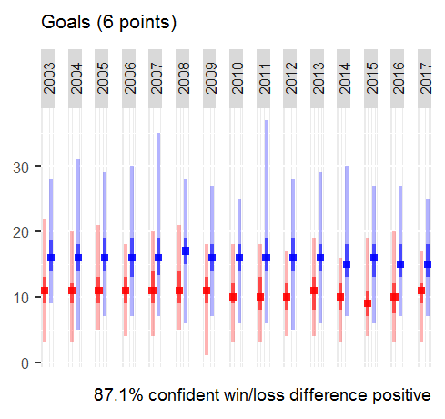
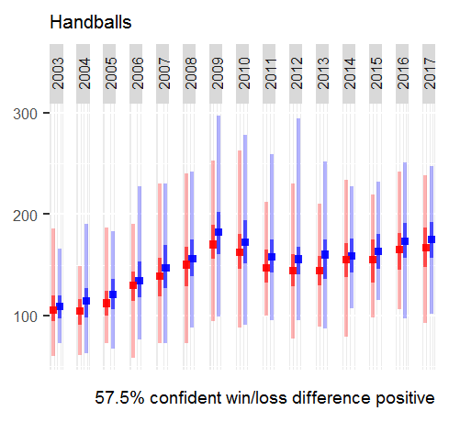
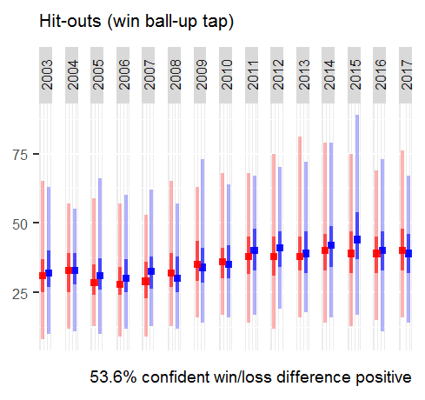
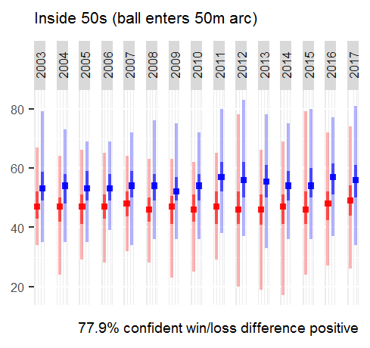
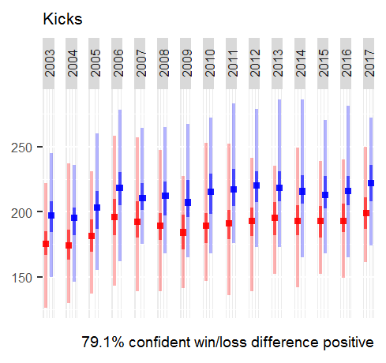
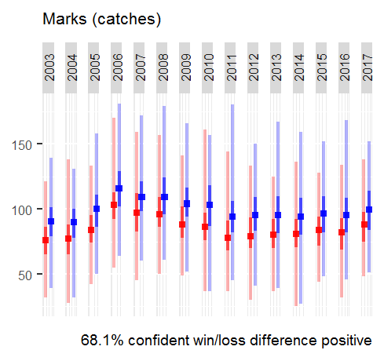
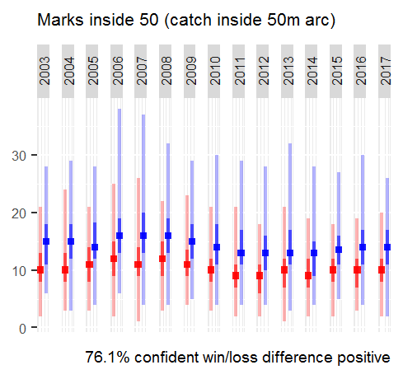
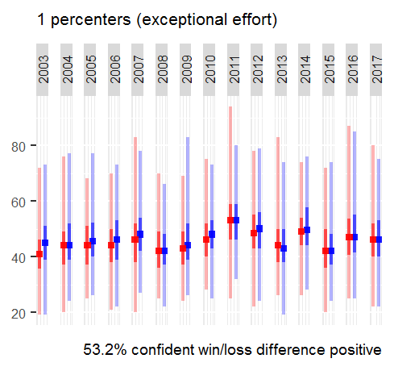
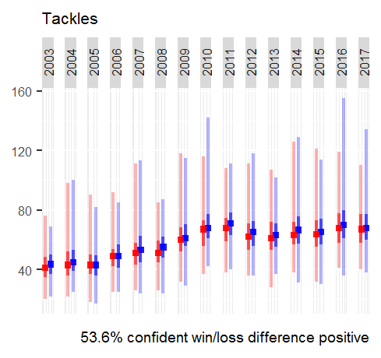
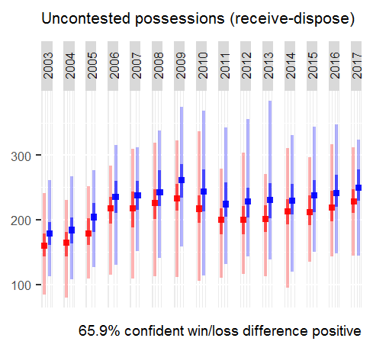
Exploratory analysis – 2 of 2
While some relationships are evident, they aren’t useful
The raw data tells us to score, by possessing the ball, from winning it in contests (obvious)
Deeper analysis may uncover more useful insights

Slide 6
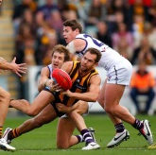
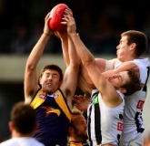


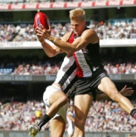
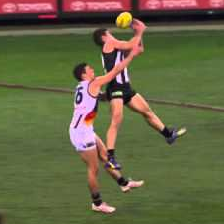
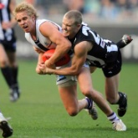

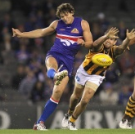
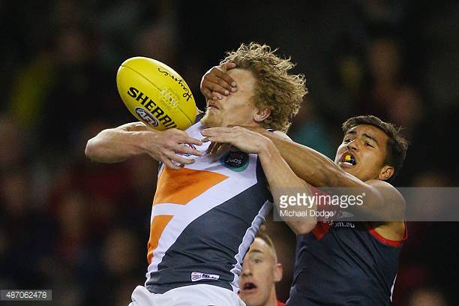
INDEX STATISTICAL analysis – 1 of 5
In sports analytics, it’s critical to remember the game is adversarial – opponents will also influence the result.
Players are not in total control of their performance outcomes due to opponents’ actions
Indices can be used to compare a team versus its opponent in key outcome measures (log used to standardise results)
Win contested ground ball
idx_win_ground_ball = log
contested possessions opposition contested possessions
Win contested aerial ball
idx_win_aerial_ball = log
contested marks opposition contested marks
Assisted goal
idx_goal_assist = log
goal assists/goals opposition goal assists/opp goals
Maintain possession
idx_mark_kick = log
marks/kicks opposition marks/opp kicks
Accurate 50m entry
idx_50m_entry = log
marks inside 50/inside 50s opposition marks i50/opp i50s
Less clangers
idx_less_clangers = log
opposition clangers clangers
Tackling
idx_tackle = log
tackles opposition tackles
Clear ball to advantage
idx_clear_ball = log
clearances opposition clearanced
One percenters
idx_one_pct = log
one percenters opposition one percenters
Give away less frees
idx_less_frees = log
opposition frees against frees against

Slide 7
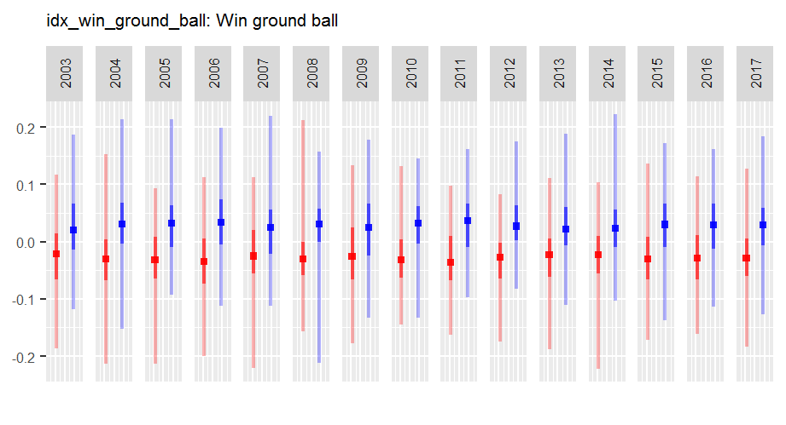
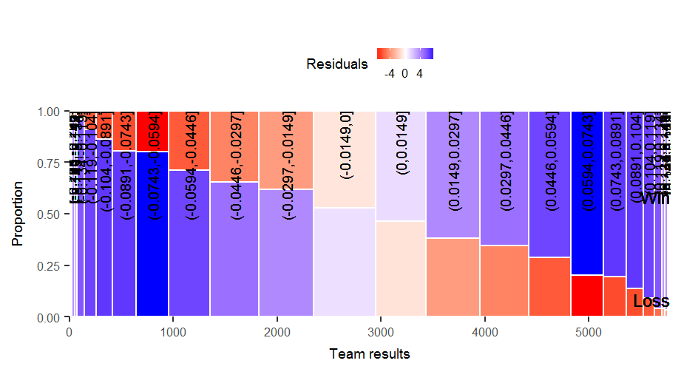
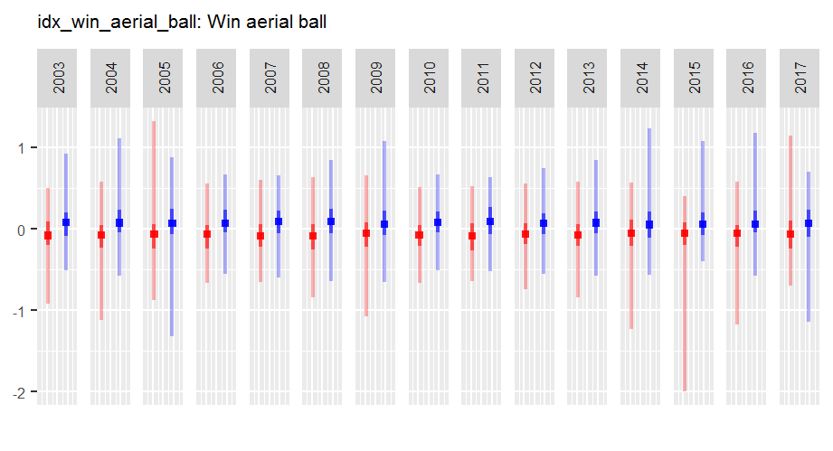
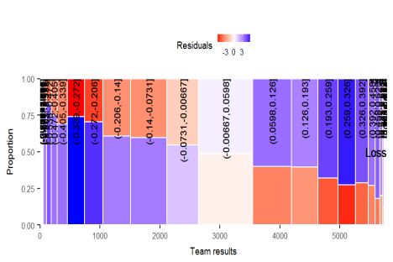
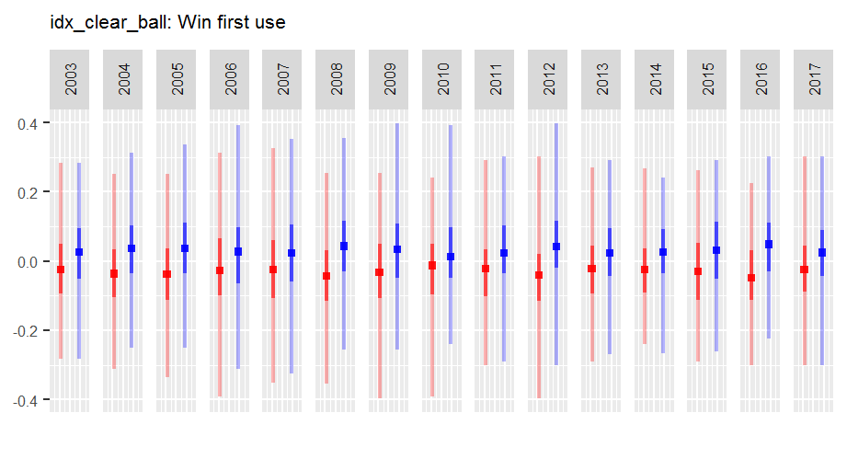
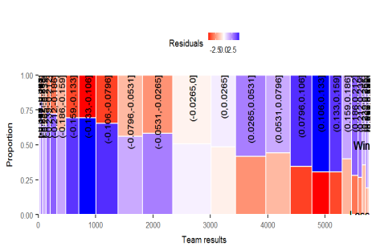
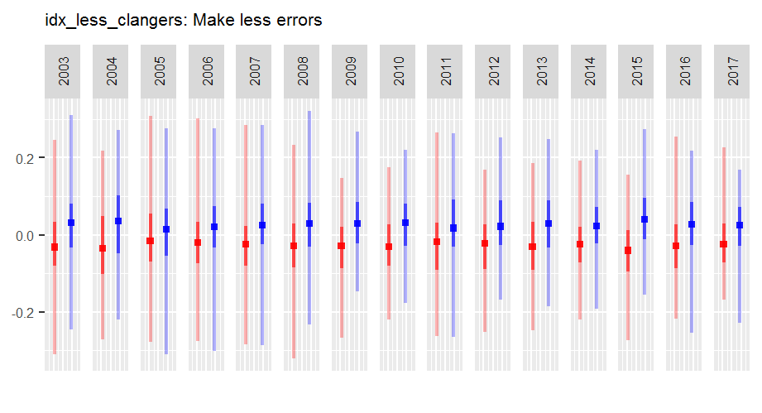
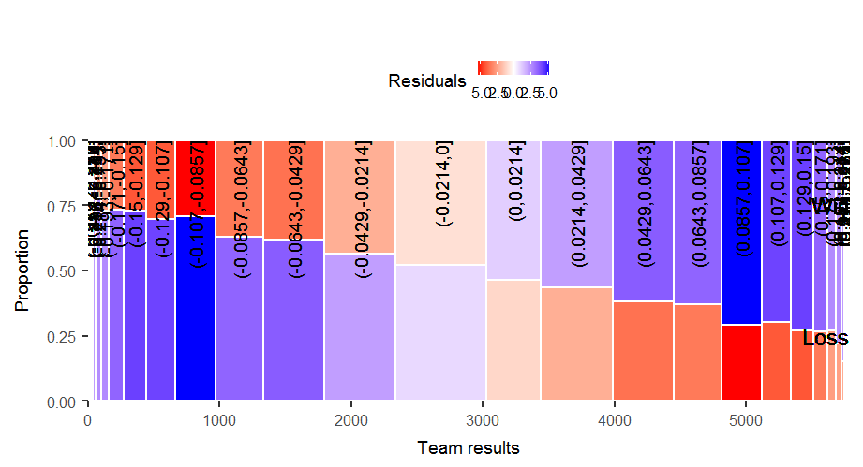
INDEX STATISTICAL analysis – 2 of 5
Below are plots showing team indices in wins vs losses
Next to the line plots are mosaics coloured by Chi-squared residuals: blue for over-represented, red for under-represented
Stronger slopes and shades indicate a more significant relationship to wins

Slide 8
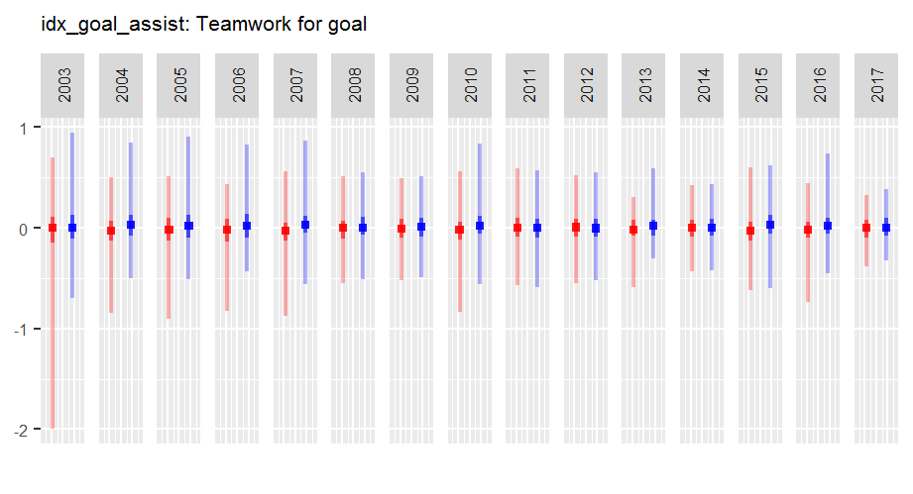
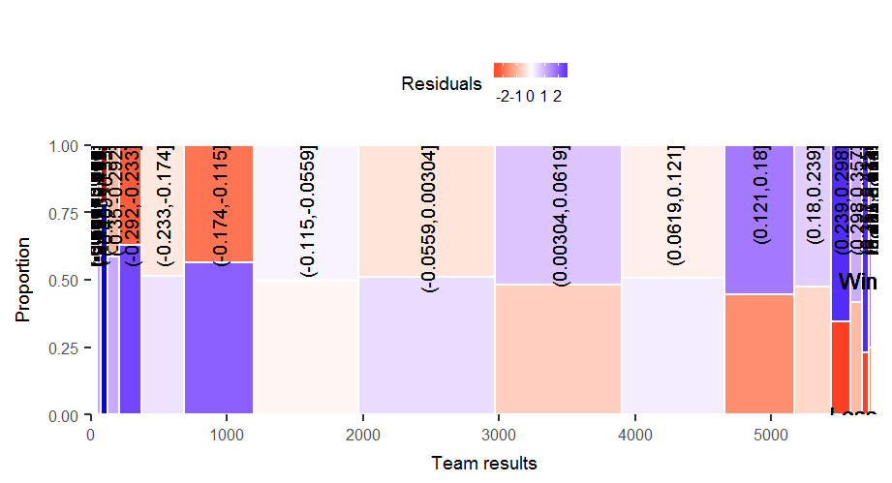
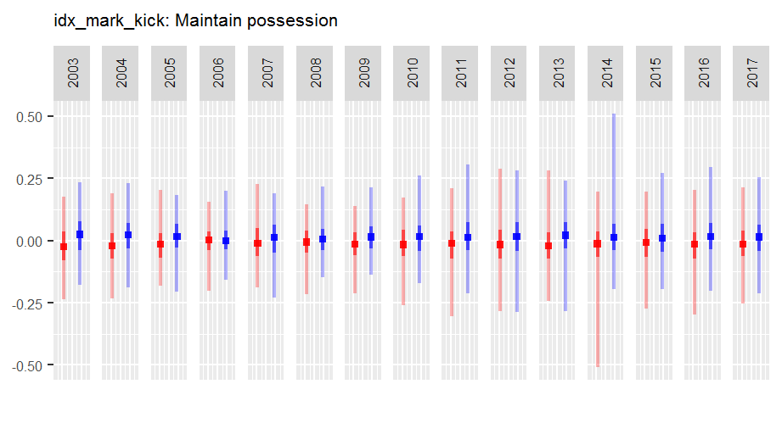
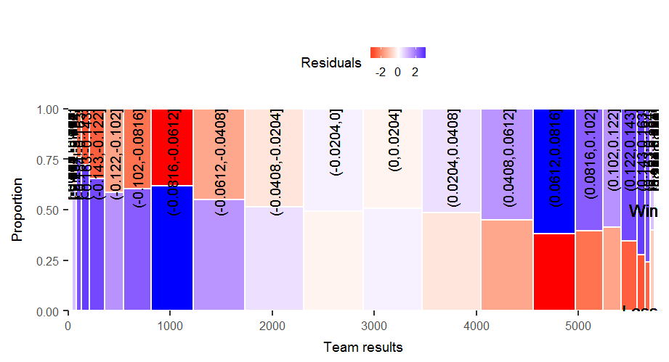
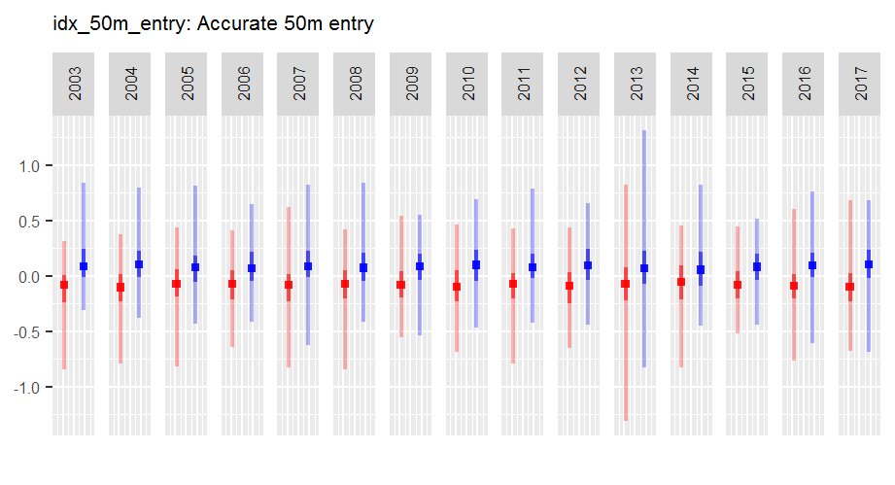
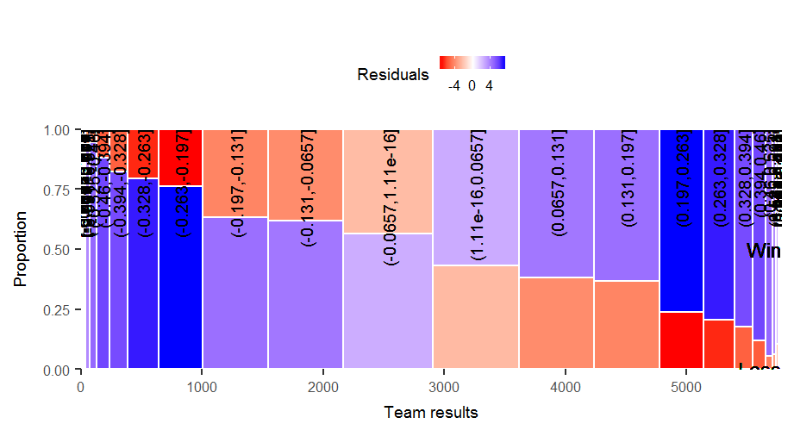
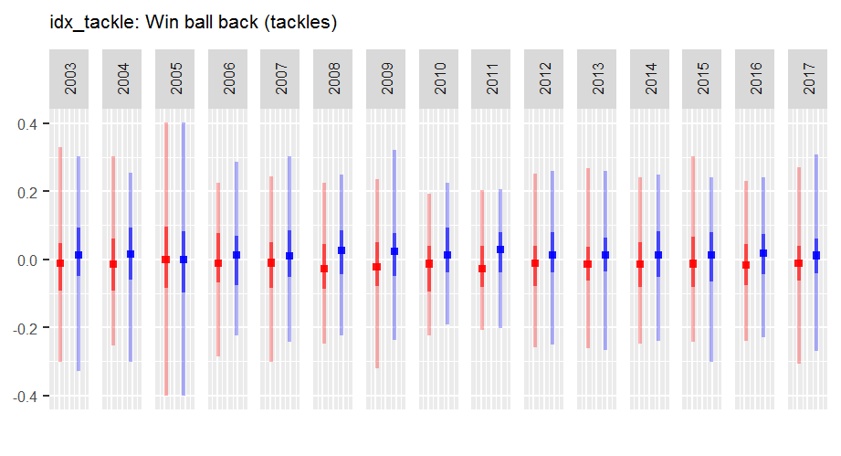
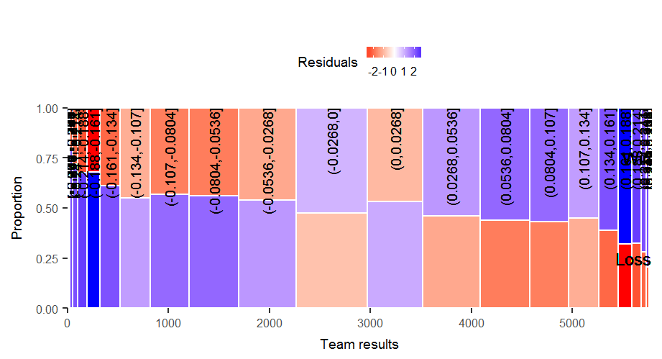
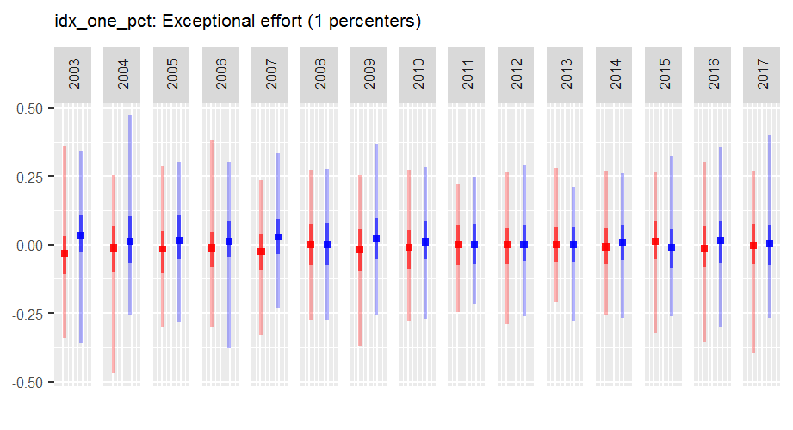
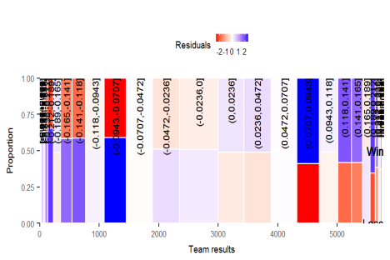
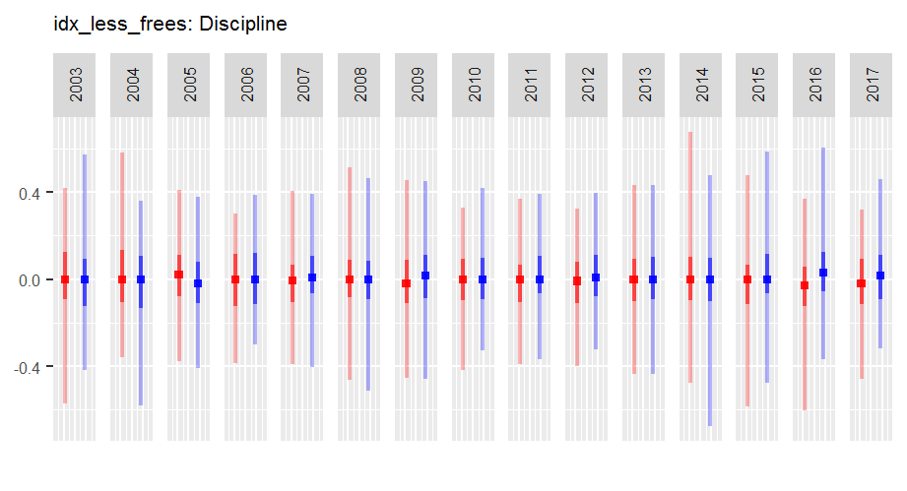
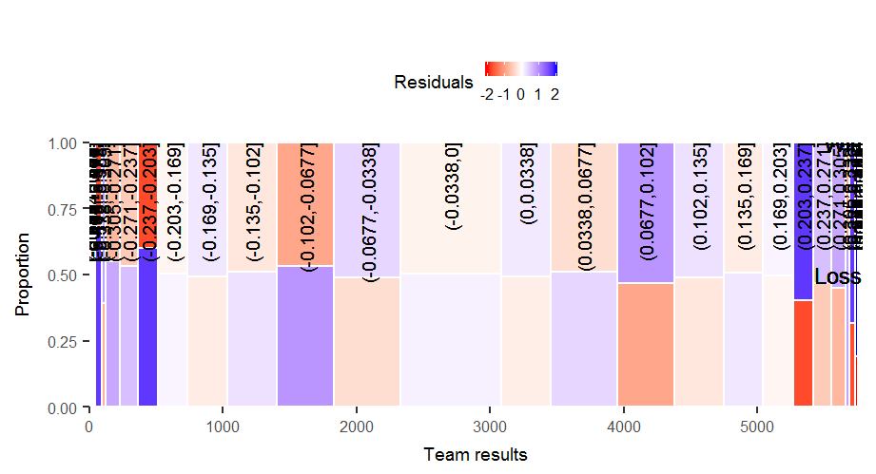
INDEX STATISTICAL analysis – 3 of 5

Slide 9
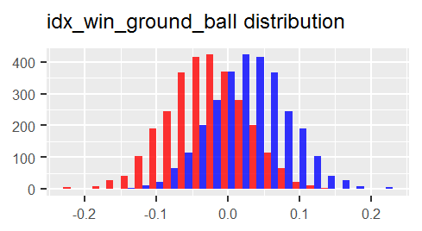









INDEX STATISTICAL analysis – 4 of 5
Distribution histograms of index values by win vs loss help confirm observations from index and mosaic plots
The more distinctly the win curve (blue) differs from the loss curve (red), the more confidently we can visually confirm the relationship of index to wins

Slide 10
INDEX STATISTICAL analysis – 5 of 5
Quantifying the results statistically with a significance test helps give them more meaning.
The null hypothesis is an index has no bearing on a win or loss result, so the true mean of the index is zero
If sport is random, a team should win 50% of the time
The calculated z-score from the population mean and standard deviation corresponds to probability of a win if the team scores higher on the index than its opponent
Index | Z-score | Significance test result interpretation
idx_win_ground_ball | 0.52 | The team leading this index wins approximately 70% of the time (Strong influence)
idx_win_aerial_ball | 0.33 | The team leading this index wins approximately 63% of the time (Fair influence)
idx_clear_ball | 0.27 | The team leading this index wins approximately 61% of the time (Fair influence)
idx_less_clangers | 0.30 | The team leading this index wins approximately 62% of the time (Fair influence)
idx_goal_assist | 0.12 | The team leading this index wins approximately 55% of the time (Weak influence)
idx_mark_kick | 0.19 | The team leading this index wins approximately 58% of the time (Weak influence)
idx_50m_entry | 0.45 | The team leading this index wins approximately 67% of the time (Fair influence)
idx_tackle | 0.16 | The team leading this index wins approximately 56% of the time (Weak influence)
idx_one_pct | 0.10 | The team leading this index wins approximately 54% of the time (Weak influence)
idx_less_frees | 0.06 | The team leading this index wins approximately 52% of the time (Weak influence)

Slide 11

Machine learning – 1 of 5
The exploratory and statistical analyses show relationships between indices derived from player metrics and team results. The next step is to model these relationships seeking to predict match results from player performance, and more importantly interpreting the models to gain insights. When modelling, the data used to “train” the model must be quarantined from the data used to “test” the model’s accuracy.
Calculated proportion of top ten players belonging to each team for key stats
Created six data clusters, thought of as ladder position (H / M / L) and game plan (fast / slow)
Tested for variable impact on each other (multicollinearity), which affects model validity
E.g. Of players with top ten most inside 50 entries, team A had six (60%)
Top ten expanded for ties, e.g. if players ranked 10 and 11 for a stat were the same, the proportion was of the top 11
Future analyses could explore different cluster stratification
Correlations below indicate some care in modelling is needed
Ball movement
Fast
Slow
High
Med
Ladder finish
Low

Slide 12
Machine learning – 2 of 5
Before detailing the models, a quick point about how the models will be measured:
Data up to 2016 used to train the model and 2017 matches used to test it
Realistically, 2017 player performance data would not be available so true predictive accuracy will be tested
This is the usual set up for testing predictive accuracy of machine learning models
The models will aim to classify whether a win was achieved or not, therefore accuracy is measured by how many wins and non-wins were correctly predicted
2017 player performance data will itself be predicted by taking the players’ 2016 match averages
These averages will be used to aggregate team totals and indices, then the models applied to predict the match result
The models will again be measured on classification accuracy
Training the model: 2003 – 2016 matches
Player performance data
Team results
Testing the model: 2017 matches
Measures how well the player performance metrics explain the match result
Testing the model: 2017 matches
Measures how well the models actually predict match results when 2017 metrics are redacted
Player performance data
Team results
2016 average player performance data
Team results

Slide 13



Machine learning – 3 of 5
A Decision Tree model iterates through each index to “split” by the most deterministic variable at each point. The tree below is “tuned” to balance over-fitting the model to the training data, predictive accuracy, and interpretability.
Each split checks if a condition is met
Each “leaf” at the bottom shows the predicted match result and how many losses vs wins were in the training data
The Decision Tree explained results well in testing (316 of 414 matches classified correctly, 2017 player performance available)
However, prediction was less accurate (267 of 414 matches classified correctly, 2017 player performance estimated)
LHS for Yes
RHS for No
0 for predicted loss, 1 for predicted win
LHS: number of actual losses in leaf RHS: number of actual wins in leaf
Using one model per cluster, prediction marginally improved
Cluster | Games | Classification accuracy | AUC
1 | 11 | 100% | 1.00
2 | 17 | 65% | 0.50
3 | 43 | 67% | 0.65
4 | 133 | 65% | 0.65
5 | 146 | 64% | 0.63
6 | 64 | 66% | 0.66
Weighted avg accuracy 65%
Weighted avg AUC 0.65
Classification accuracy = proportion of correct predictions against total matches. The benchmark to beat is flipping a coin (50% accuracy).
AUC = Area Under the Curve, a measure of how often a win is predicted for an actual win versus a win is predicted for an actual loss. The benchmark to beat is random (AUC = 0.50).

Slide 14




Machine learning – 4 of 5
A Logistic Regression model seeks a linear relationship between indices and winning. The model below ignores non-significant indices to improve predictive accuracy, and checks for multicollinearity to avoid over-fitting.
Each variable has a coefficient (“estimate” below) which is a measure of influence on winning
The Logistic Regression model explained results well in testing (316 of 414 matches classified correctly, 2017 player performance available) – same accuracy as Decision Tree but better AUC
Prediction was less accurate (259 of 414 matches classified correctly, 2017 player performance estimated) – less accurate than Decision Tree but better AUC
Note: estimate units are non-standardised so cannot be interpreted verbatim (see next page for variable significance)
Using one model per cluster, prediction was unchanged*
Cluster | Games | Classification accuracy | AUC
1 | 11 | 91% | 0.94
2 | 17 | 65% | 0.76
3 | 43 | 70% | 0.60
4 | 133 | 60% | 0.62
5 | 146 | 60% | 0.57
6 | 64 | 69% | 0.75
Very small p values indicate the variable is significant to prediction of win/loss result
Weighted avg accuracy 63%
Weighted avg AUC 0.63
Classification accuracy = proportion of correct predictions against total matches. The benchmark to beat is flipping a coin (50% accuracy).
AUC = Area Under the Curve, a measure of how often a win is predicted for an actual win versus a win is predicted for an actual loss. The benchmark to beat is random (AUC = 0.50).
Note: * Further tuning is available by choosing threshold value (currently probability > 50%)

Slide 15
Machine learning – 5 of 5
The relative significance of variables in the Logistic Regression model can be tested by leaving the variable out of the model and measuring the amount of AUC “lost”; i.e. the AUC lift the variable provided.
idx_50m_entry and idx_win_ground_ball both lift AUC strongly
idx_less_clangers and Inside_50s show some AUC lift
idx_less_frees had a negligible impact to AUC, while idx_win_aerial_ball actually dropped AUC, probably due to multicollinearity with inside 50 measures
Variable | AUC lift | Interpretation
idx_50m_entry | +0.04 | Marking more 50m entries than opponents is very important
idx_win_ground_ball | +0.03 | Winning more contested ground ball than opponents is very important
idx_less_clangers | +0.01 | Making less unforced errors than opponents is somewhat important
Inside_50s | +0.01 | Having a high proportion of top ten players who get the ball inside 50m is somewhat important
idx_less_frees | ±0.00 | Giving away less free kicks than opponents is not really important at all
idx_win_aerial_ball | –0.01 | We ignore this finding due to moderate correlation between idx_win_aerial_ball and idx_50m_entry
The most significant variables in the Logistic Regression model align with those in the Decision Tree – this is expected and confirms their relative importance in this analysis

Slide 16
conclusions – 1 of 2
This analysis has been an insightful proof-of-concept to the value of data to AFL. Beyond the usual sports focus areas of fan engagement, direct marketing and ticket sales, it shows that player performance data can be used as a predictor to match results and more importantly to define what factors are vital to winning.
The analysis confirmed conventional wisdom about how to win AFL matches
Player performance data is a surprisingly strong predictor of match outcomes
Further predictive accuracy could be found… but probably isn’t valuable
Clustering showed promise as a way of boosting accuracy
Trying different numbers of clusters might find improvement, as could setting individual threshold probability values for each Logistic Regression model
A more robust method of predicting player metrics for the predicted season (than prior season averages) is probably needed
However, finding the n^{th} degree of accuracy in prediction may not be valuable – the results must be interpretable to be useful to the football department (coach or talent manager)
Coaches and talent managers should focus on finding players who are excellent at winning contested ground balls
They should also seek accuracy in entering the forward 50m arc
It helps to have more inside 50m contributors generally
This is surprising due to the adversarial nature of sport where one would expect there are many ways to win
Decision Trees and Logistic Regression models were both reasonable prediction methods, including when 2017 player data was redacted

Slide 17
conclusions – 2 of 2
Where to from here?
There are almost unlimited opportunities to expand this analysis to keep seeking deeper insights and greater competitive advantage.
Combining multiple, proprietary data sources could lead to huge tactical gains
Going back to sports analytics roots: Moneyball version 2
This approach can be applied to any sport with rich data
This analysis only used free data – much more detail is in Champion Data
Combining this with player GPS data could lead to invaluable insights into play-by-play outcomes
What if we could go from understanding we need to win the contested ball, to knowing how to win it with the right running patterns and team plans?
An understanding of how players can successfully combine to create winning plays could lead to the next revolution in Moneyball
The relative value of players in the draft and trade period probably has more to do with a team’s specific needs than taking the best midfielders and big forwards on offer
Are we sure we’ve taken the lessons of Moneyball in AFL?
The use of data analysis in short-form cricket (T20) is already defining competitive advantage
It is evident that teams have specific plans by game phase, by match-up and by player

