Slide 1
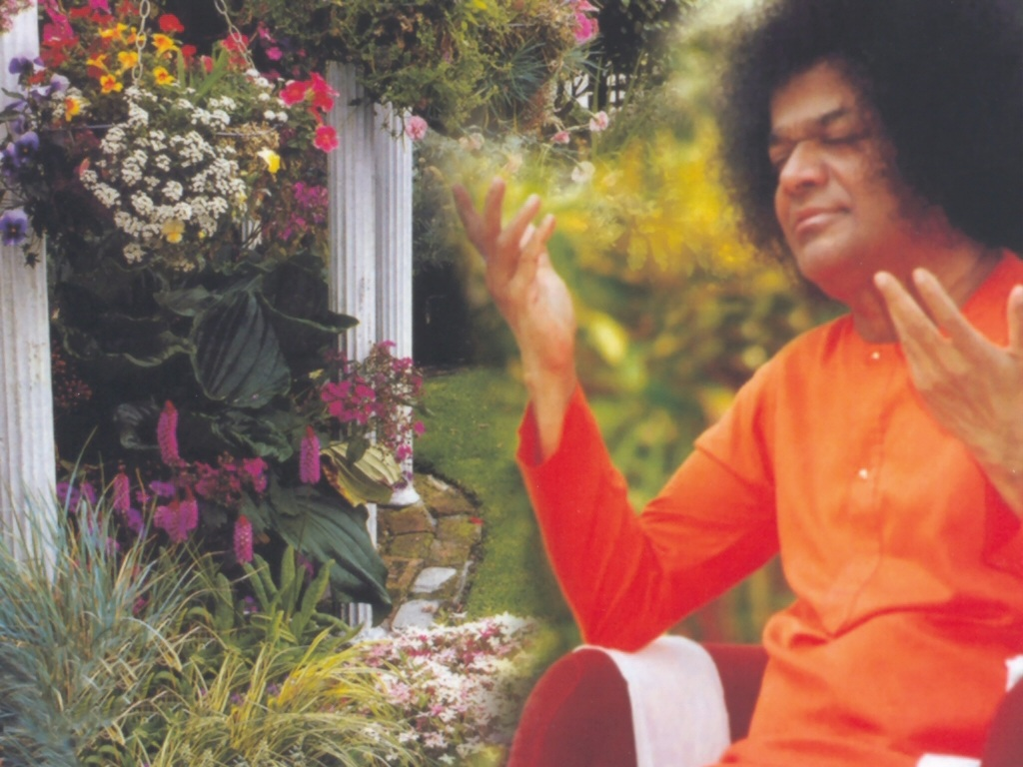
Central London Sai Center October 23, 2016

Slide 2
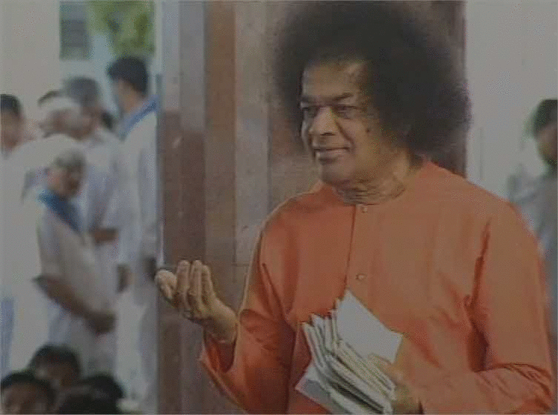
Ganapathi Prarthana
oṃ gaṇānā”m tvā gaṇapa’tigṃ havāmahe kaviṃ ka’vīnām upamaśra’vastavam | jyeṣṭharājaṃ brahma’ṇāṃ brahmaṇaspata ā na’ḥ śṛṇvannūtibhi’ssīda sāda’nam || �
Continued

Slide 3
Ganapathi Prarthana
praṇo’ devī sara’svatī | vāje’bhir vājinīvatī | dhīnāma’vitrya’vatu || gaṇeśāya’ namaḥ | sarasvatyai namaḥ | śrī gurubhyo namaḥ |
Continued

Slide 4
Ganapathi Prarthana
hariḥ oṃ || oṃ śāntiḥ śāntiḥ śāntiḥ ||�
Rudram - 1st Anuvaka

Slide 5
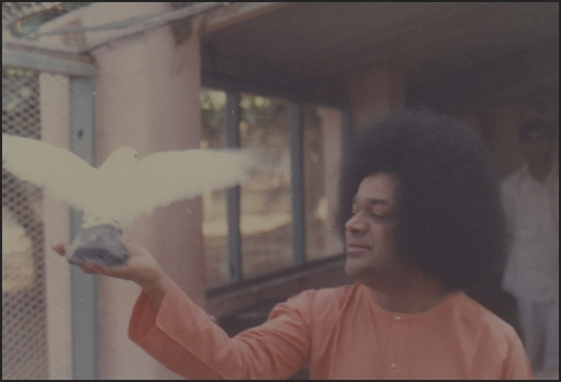
Rudram - 1st Anuvaka
Om Namo Bhagavate̍ Rudrā̱ya Om Nama̍ste Rudra Ma̱nyava̍ U̱tota̱ Iṣa̍ve̱ Namaḥ̍ Namas̍te Astu̱ Dhanvan̍e Bā̱hubhyā̍mu̱ta Te̱ Namaḥ̍ Yā Ta̱ Iṣu̍ḥ Śi̱vata̍mā Śi̱vaṁ Baḇhūva̍ Te̱ Dhanuḥ̍
Continued

Slide 6
Rudram - 1st Anuvaka
Śi̱vā Śa̍ra̱vyā̍ Yā Tava̱ Tayā̍ No Rudra Mṛḍaya Yā Te̍ Rudra Śi̱vā Ta̱nūragho̱rā
Kshamaa Prarthana

Slide 7
Kshamaa Prarthana
Yadakșarapadabhrașțam mātrāheīnam tu yad bhavet| tatsarvam kșamyatām̀ deva nārāyaņa namostute Visargabindumātrāņi padapādākșarāņi ca| nyūnāni cātiriktāni kșamasva sāiiśvara|
Continued

Slide 8
Kshamaa Prarthana
aparādha sahasrāņi kriyante’harniśam mayā| dāso’yamiti mām matvā kșamasva sāyīśvara| anyathā śaraņam nāsti tvameva śaraņam mama. tasmāt kāruņya bhāvena rakșa rakșa sāyīśvara|
Continued

Slide 9
Kshamaa Prarthana
harih om tatst śrī sāīśvarārpaņamastu| oṃ śāntiḥ śāntiḥ śāntiḥ ||
Continued

Slide 10
Kshamaa Prarthana

