Slide 1
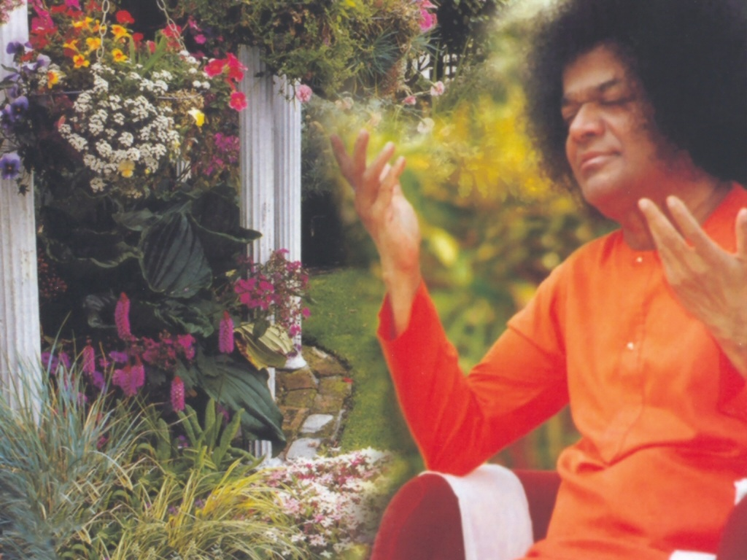
Central London \n Sai CenterSeptember 27, 2016

Slide 2
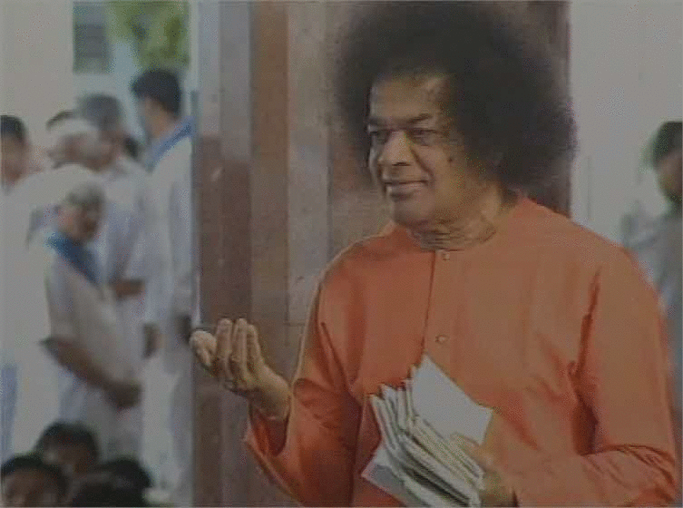
Aajanubahum Aravindha Nethram
Aajanubahum Aravindha Nethram Athmabhi Ramam Manasa Smarami (2) Bhoolokha Vaikunta Parthi Nivasam Prabhu Sai Ramam Manasa Smarami (2)
A

