Slide 1
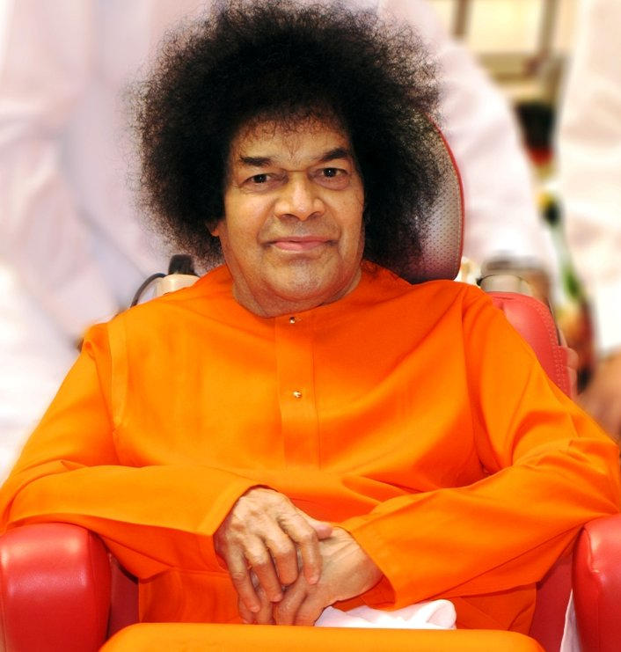
Central London Sai Center August 21, 2016

Slide 2
Aajanubahum Aravindha Nethram
Aajanubahum Aravindha Nethram Athmabhi Ramam Manasa Smarami (2) Bhoolokha Vaikunta Parthi Nivasam Prabhu Sai Ramam Manasa Smarami (2)
A
Sai Center

Slide 3
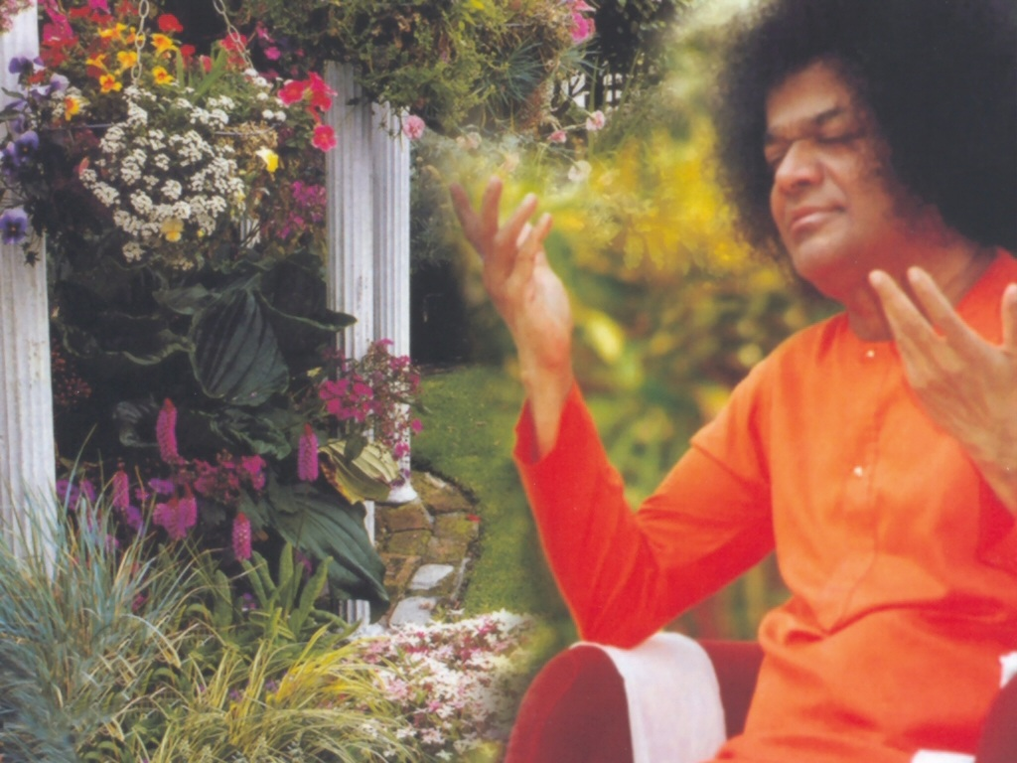

Slide 5
Aao Aao Sai Pyare
Aao Aao Sai Pyare Kirtan Karü Maï Sai Thumhare Aao Aao Sai Pyare Thum Ho Mere Nayanö Ke Tare Darshan Do Jivan Ke Sahare (2)
B
Aao Pyare Nayan Hamare Sai Hamare Aao
C

Slide 6
Aao Pyare Nayan Hamare Sai Hamare Aao
Aao Pyare Nayan Hamare Sai Hamare Aao Thum Bin Koi Nahi Rakhvale Thum Bin Kaun Sahare (Baba) (2) Aao Sai Pyare Sai Hamare Aao (3)
C
Aarti
Dd

Slide 7
Aarti
Om Jai Jagadish Hare Swami Sathya Sai Hare Bhaktajana Samrakshaka Bhaktajana Samrakshak Parthimaheshwara Om Jai Jagadish Hare Shashivadana Shreekara Sarva Pranapathe Swami Sarva Pranapathe Aashrita Kalpalatheeka Aashrita Kalpalatheeka Aapathbaandhava Om Jai Jagadish Hare
Dd
Continued

Slide 8
Aarti
Mata Pita Guru Daivamu Mariyanthayu Neeve Swami Mariyanthayu Neeve Nadabrahma Jagannatha Nadabrahma Jagannatha Nagendrashayana Om Jai Jagadish Hare Omkara Rupa Om Jai Shiva Sai Mahadeva Sathya Sai Mahadeva Mangala Aarti Anduko Mangala Aarti Anduko
Dd
Continued

Slide 9
Aarti
Mandaragiridhari Om Jai Jagadish Hare Narayana Narayana Om Sathya Narayana Narayana Narayana Om Narayana Narayana Om Sathya Narayana Narayana Om Sathya Om Jai Satguru Deva
Dd
Vibhuti Mantra
E

Slide 10
Vibhuti Mantra
Paramam Pavithram Baba Vibhuthim Paramam Vichitram Leela Vibhuthim Paramartha Ishtartha Moksha Pradhanam Baba Vibhuthim Idam Asrayami Sacred Holy and Supreme is Baba's Vibhuthi Pouring Forth in brilliant stream, this play of Vibhuthi So auspicious is its might, it grants liberation Baba's Vibhuthi, its power protects me
E

