Slide 1
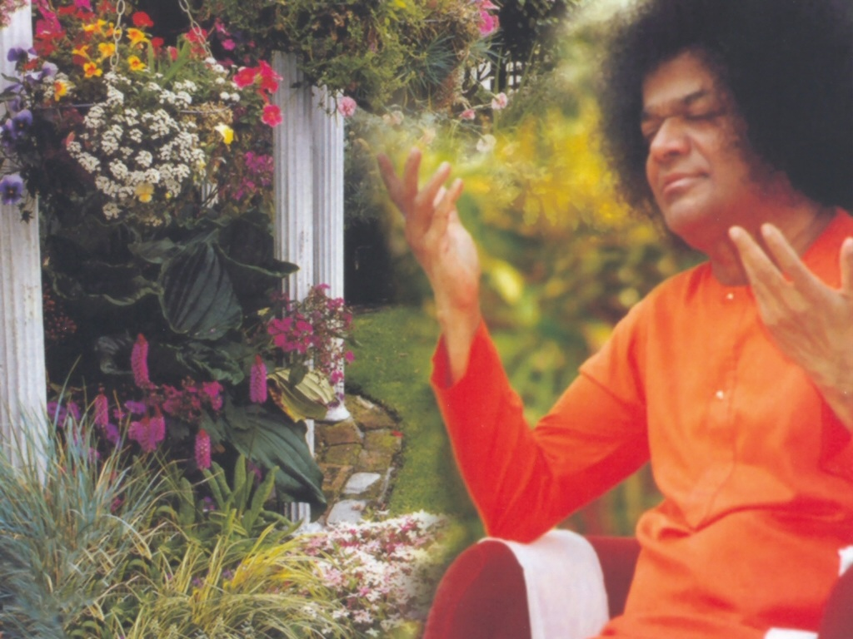
Central London Sai Center October 09, 2016

Slide 11
Harey Rama Harey Rama Rama Rama Harey Harey

Slide 12
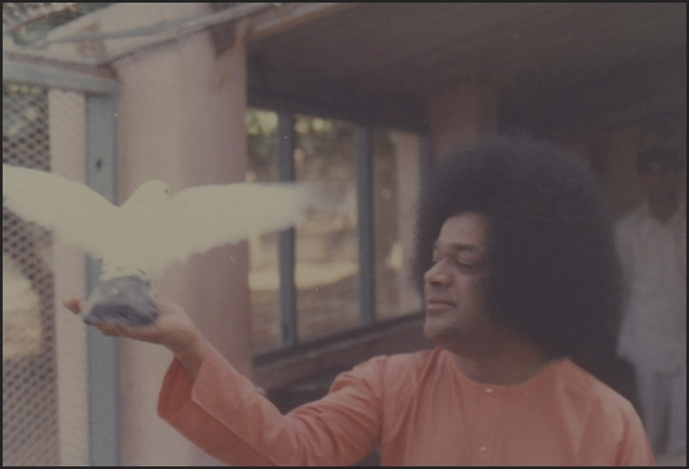
Harey Rama Harey Rama Rama Rama Harey Harey
Harey Rama Harey Rama Rama Rama Harey Harey Harey Krishna Harey Krishna Krishna Krishna Harey Harey Satsangathwey Nithsangathwam Nithsangathwey Nirmohathwam Nirmohatwey Nischala Thatwam Nischala Thatwey Jeevan Mukti

