Slide 1
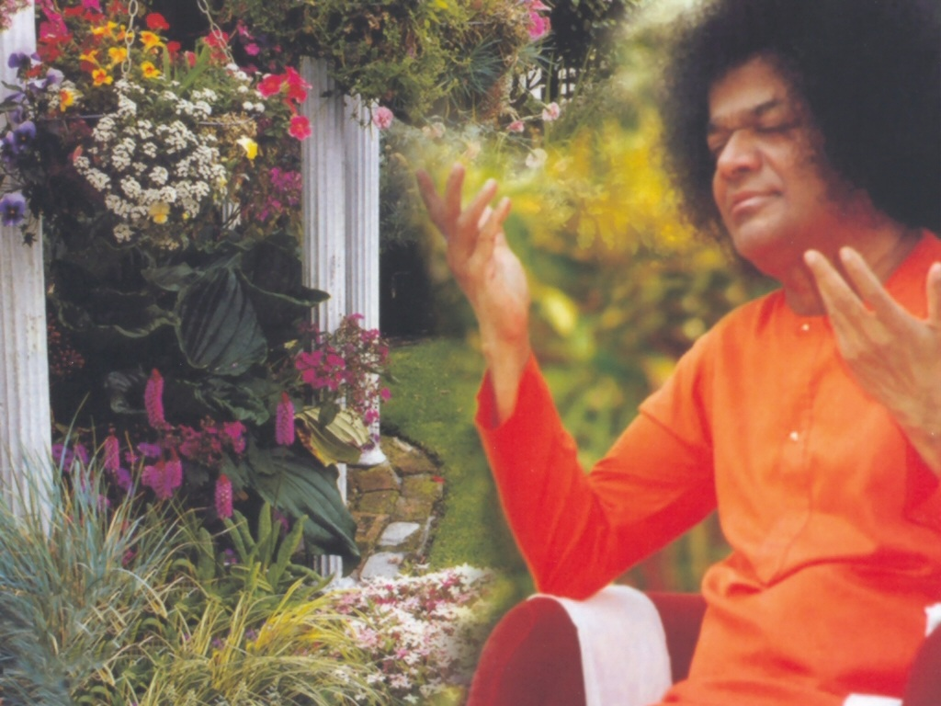
Central London Sai Center October 23, 2016

Slide 2
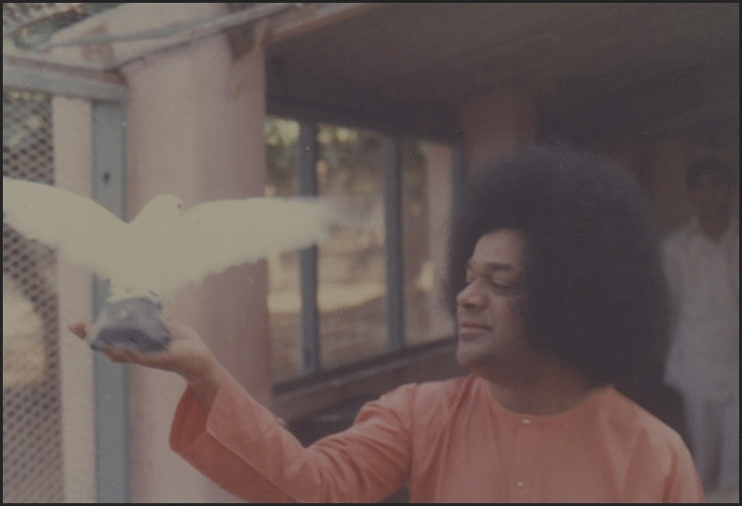
Bolo Rey Hari Naam
Bolo Rey Hari Naam Bolo Rey Shiva Naam |Bolo Rey...| Bhaktha Janon Ke Baba Naam Sai Naam Sai Baba Naam |Bhaktha Janon| Parthi Pureeshwara Sai Ram
Ganapathi Prarthana

Slide 3
Ganapathi Prarthana
oṃ gaṇānā”m tvā gaṇapa’tigṃ havāmahe kaviṃ ka’vīnām upamaśra’vastavam | jyeṣṭharājaṃ brahma’ṇāṃ brahmaṇaspata ā na’ḥ śṛṇvannūtibhi’ssīda sāda’nam ||
Continued

Slide 4
Ganapathi Prarthana
praṇo’ devī sara’svatī | vāje’bhir vājinīvatī | dhīnāma’vitrya’vatu || gaṇeśāya’ namaḥ | sarasvatyai namaḥ | śrī gurubhyo namaḥ |
Continued

Slide 5
Ganapathi Prarthana
hariḥ oṃ || oṃ śāntiḥ śāntiḥ śāntiḥ ||

