Slide 1
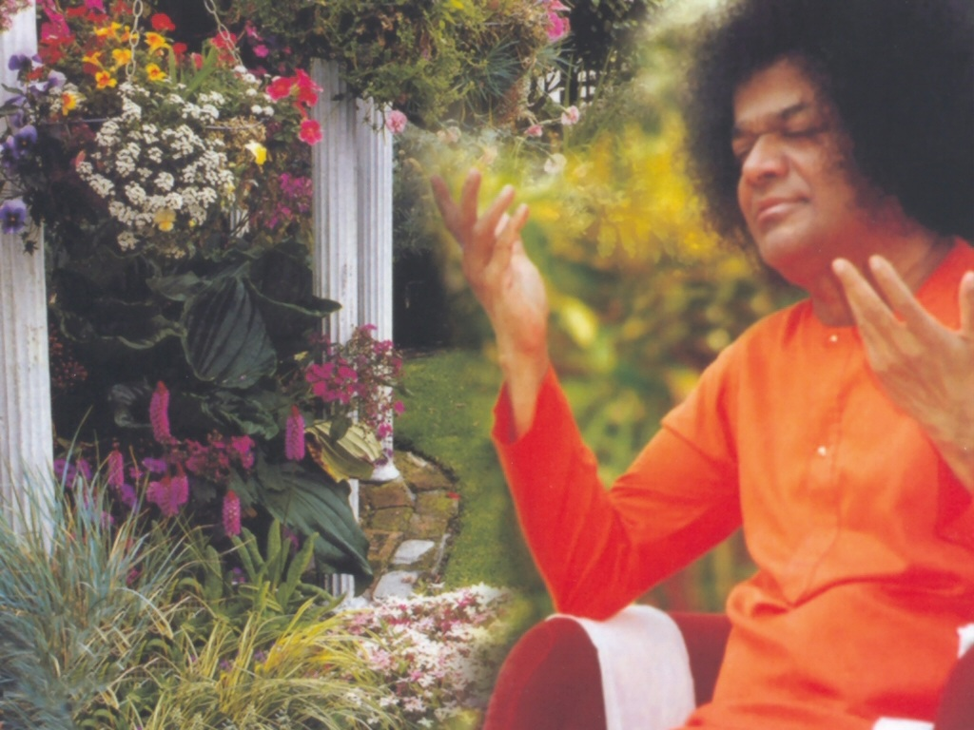
Central London Sai Center October 24, 2016

Slide 2
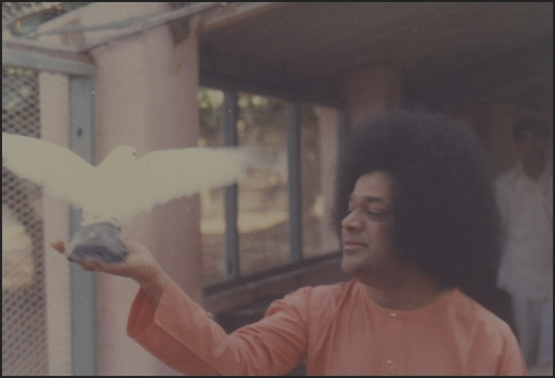
Ganapathi Prarthana
oṃ gaṇānā”m tvā gaṇapa’tigṃ havāmahe kaviṃ ka’vīnām upamaśra’vastavam | jyeṣṭharājaṃ brahma’ṇāṃ brahmaṇaspata ā na’ḥ śṛṇvannūtibhi’ssīda sāda’nam || praṇo’ devī sara’svatī | vāje’bhir vājinīvatī | dhīnāma’vitrya’vatu ||
Continued

Slide 3
Ganapathi Prarthana
gaṇeśāya’ namaḥ | sarasvatyai namaḥ | śrī gurubhyo namaḥ | hariḥ oṃ || oṃ śāntiḥ śāntiḥ śāntiḥ ||
Rudram - 1st Anuvaka

Slide 4
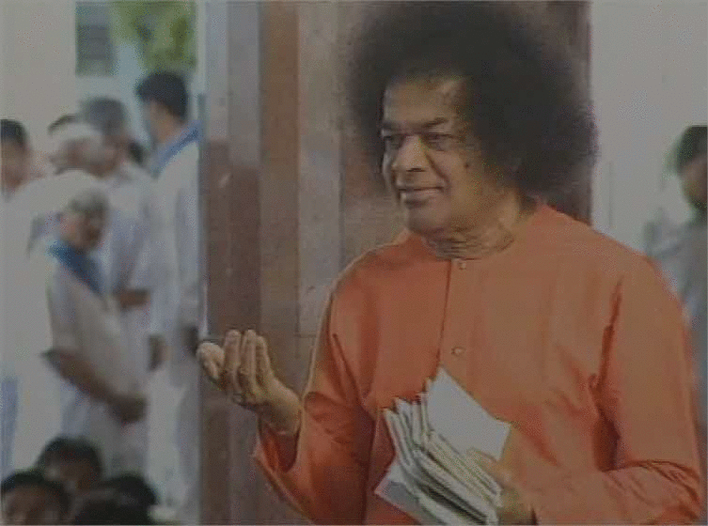
Rudram - 1st Anuvaka
Om Namo Bhagavate̍ Rudrā̱ya Om Nama̍ste Rudra Ma̱nyava̍ U̱tota̱ Iṣa̍ve̱ Namaḥ̍ Namas̍te Astu̱ Dhanvan̍e Bā̱hubhyā̍mu̱ta Te̱ Namaḥ̍ Yā Ta̱ Iṣu̍ḥ Śi̱vata̍mā Śi̱vaṁ Baḇhūva̍ Te̱ Dhanuḥ̍ Śi̱vā Śa̍ra̱vyā̍ Yā Tava̱ Tayā̍ No Rudra Mṛḍaya Yā Te̍ Rudra Śi̱vā Ta̱nūragho̱rā'pā̍pakāśinī Tayā̍ Nasta̱nuvā̱ Śanta̍mayā̱ Giri̍śaṁtā̱bhicā̍kaśīhi
Continued

Slide 5
Rudram - 1st Anuvaka
Yāmiṣuṁ̍ Giriśaṁta̱ Haste̱ Bibhaṟṣyasta̍ve Śi̱vāṁ Gi̍ritra̱ Tāṁ Kur̍u̱ Mā Higṁ̍sī̱ḥ Puru̍ṣaṁ̱ Jagat̍ Śi̱vena̱ Vaca̍sā Tvā̱ Giri̱śācchā̍vadāmasi Yathā̍ Na̱ḥ Sarvam̱ijjagad̍ayaḵṣmagṁ Sum̱anā̱ Asat̍ Adhya̍vocadadhiva̱ktā Pra̍tham̱o Daivyo̍ Bhiṣ̱ak Ahīg̍sca̱ Sarvā̎ñja̱mbhaya̱ntsarvā̎śca Yātudhā̱nya̍ḥ
Continued

Slide 6
Rudram - 1st Anuvaka
A̱sau Yastam̱ro A̍ru̱ṇa U̱ta Ba̱bhruḥ Su̍ma̱ṅgalaḥ̍ Ye Ce̱māgṁ Ru̱drā Aḇhito̍ Diḵṣu Śri̱tāḥ Sa̍hasra̱śo'vaiṣ̍ā̱gṁ̱ Heḍa̍ İ̄mahe A̱sau Yo̍'vas̱ Arpa̍ti̱ Nīla̍grīvo̱ Viloh̍itaḥ Uṯainaṁ ̍ Gop̱ā Adṛśa̱nnadṛś̍annudahā̱rya̍h U̱tainaṁ̱ Viśvā̍ Bhū̱tāni̱ Sa Dṛ̱ṣṭo Mṛ̍ḍayāti Naḥ Namo̍ Astu̱ Nīlag̍rīvāya Sahasrā̱kṣāya̍ Mī̱ḍhuṣe̎
Continued

Slide 7
Rudram - 1st Anuvaka
Atho̱ Ye A̍sya̱ Satvā̍no'̱ Haṁ Tebhyo̍'kara̱nnamaḥ̍ Pramuñ̍ca̱ Dhanvan̍as̱tvamu̱bhayoṟārtni̍ Yo̱rjyām Yāśca̍ Te̱ Hasta̱ İṣa̍vaḥ̱ Parā̱ Tā Bha̍gavo Vapa A̱va̱tatya̱ Dhanu̱stvagṁ Sahas̍rākṣa̱ Śateṣ̍udhe Ni̱śīrya̍ Śaḻyānāṁ̱ Mukhā̍ Śi̱vo Na̍ḥ Sum̱anā̍ Bhava Vijyaṁ̱ Dhanuḥ̍ Kapa̱rdino̱ Viśa̍lyo̱ Bāṇa̍vāgṁ U̱ta Ane̍śanna̱syeṣa̍va Āḇhura̍sya Niṣaṁ̱gathiḥ̍
Continued

Slide 8
Rudram - 1st Anuvaka
Yā Te̍ He̱tirmī̍ḍhuṣṭama̱ Haste̍ Baḇhūva̍ Te̱ Dhanuḥ̍ Tayā̱'smān Vi̱śvata̱stvama̍yaḵṣmayā̱ Pari̍bbhuja Namas̍te As̱tvāyud̍hā̱yānā̍tatāya Dhṛ̱ṣṇave̎ U̱bhābhyā̍muṯa Te̱ Namo̍ Bā̱hubhyām̱ ̱ Tava̱ Dhanva̍ne
Continued

Slide 9
Rudram - 1st Anuvaka
Pari̍ Te̱ Dhanvan̍o Heṯiras̱mānvṛṇ̍aktu Vi̱śvata̍ḥ Atho̱ Ya İṣ̍u̱dhistavā̱re A̱smannidheh̍i̱ Tam Nama̍ste Astu Bhagavan Viśveśva̱rāya̍ Mahāde̱vāya̍ Tryamba̱kāya̍ Tripurānta̱kāya̍ Trikāgnikā̱lāya̍ Kālāgniru̱drāya̍ Nīlaka̱ṇṭhāya̍ Mṛtyuñja̱yāya̍ Sarveśva̱rāya̍ Sadāśi̱vāya̍ Śrīmanmahāde̱vāya̱ Nama̍ḥ
Kshamaa Prarthana

Slide 10
Kshamaa Prarthana
Yadakșarapadabhrașțam mātrāheīnam tu yad bhavet| tatsarvam kșamyatām̀ deva nārāyaņa namostute Visargabindumātrāņi padapādākșarāņi ca| nyūnāni cātiriktāni kșamasva sāiiśvara| aparādha sahasrāņi kriyante’harniśam mayā|
Continued

Slide 11
Kshamaa Prarthana
dāso’yamiti mām matvā kșamasva sāyīśvara| anyathā śaraņam nāsti tvameva śaraņam mama. tasmāt kāruņya bhāvena rakșa rakșa sāyīśvara| harih om tatst śrī sāīśvarārpaņamastu| oṃ śāntiḥ śāntiḥ śāntiḥ ||

