Slide 1
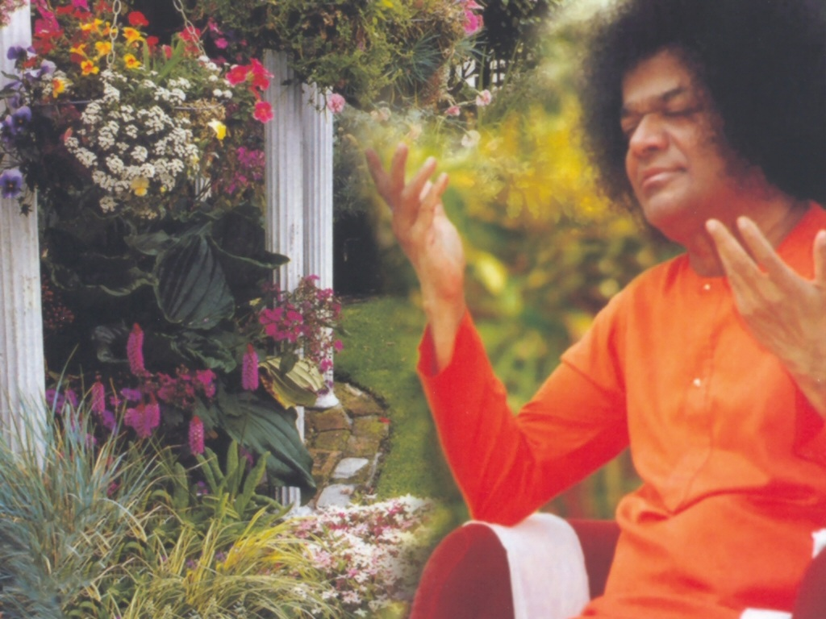
Central London Sai Center October 22, 2016

Slide 2
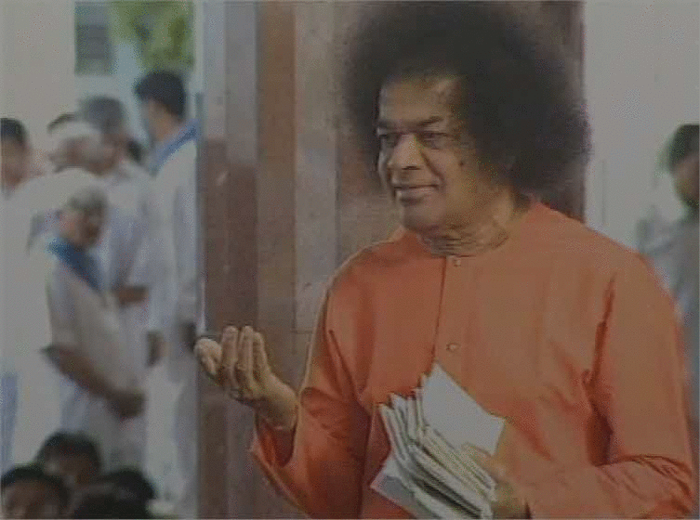
Aao Aao Antaryami
Aao Aao Antaryami Adi Narayana Sai Narayana |Aao Aao...| Hrudaya Vihari Hey Giridhari Hey Giridhari Hey Giridhari Hari Hari Sri Hari Sai Murari

