Slide 1
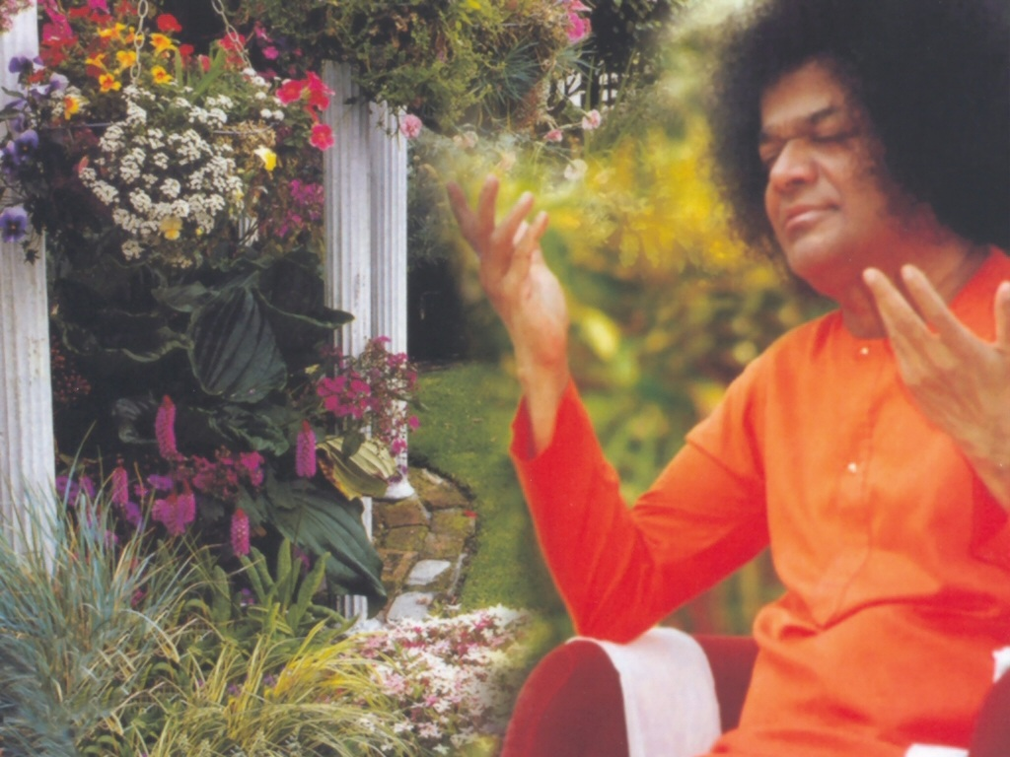
Central London Sai Centre November 05, 2016

