Slide 1
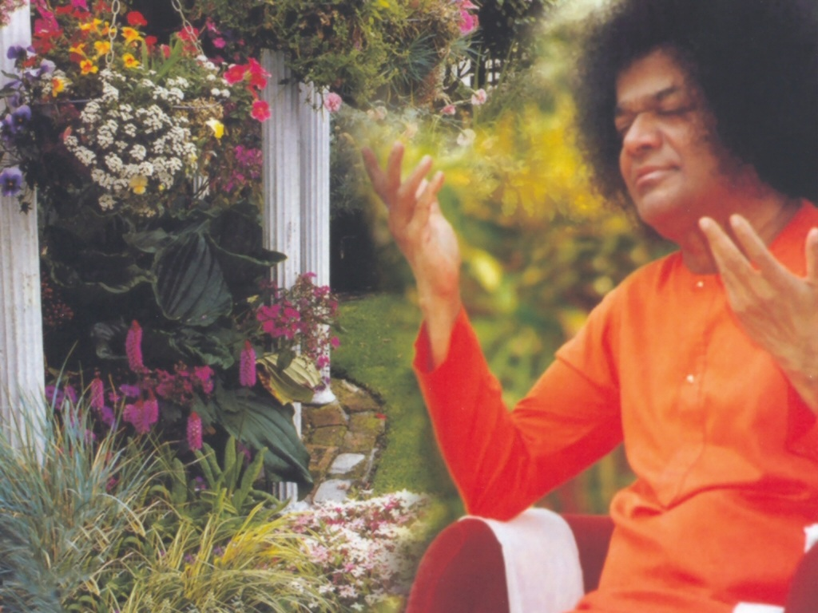
Central London Sai Center October 23, 2016

Slide 2
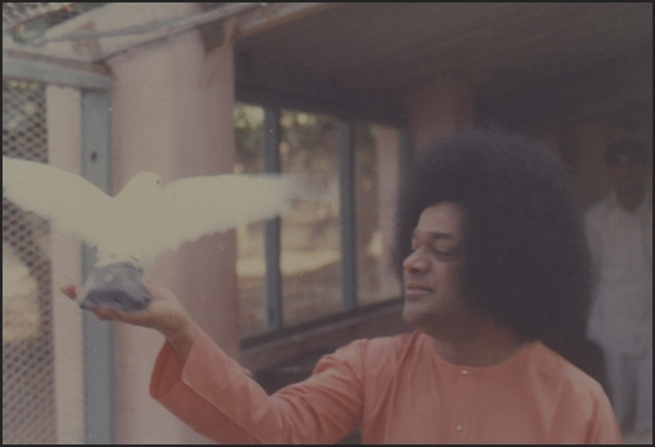
Adi Poojita Gajanana
Adi Poojita Gajanana Mangala Kari Maha Ganadhipa |Adi Poojita...| Ambika Tanaya Gajanana Amba Bhavani Shiva Shambho Kumara Jaya Jaya Jaya Hey Gajanana
Aao Pyaarey Nayana Hamarey Sai Hamarey Aao

Slide 3
Aao Pyaarey Nayana Hamarey Sai Hamarey Aao
Aao Pyaarey Nayana Hamarey Sai Hamarey Aao Tum Bin Koi Nahin Rakhwaley Tum Bin Kaun Saharey (Baba) Tum Bin Kaun Saharey Aao Sai Pyaarey Sai Hamarey Aao (3)

