Slide 1
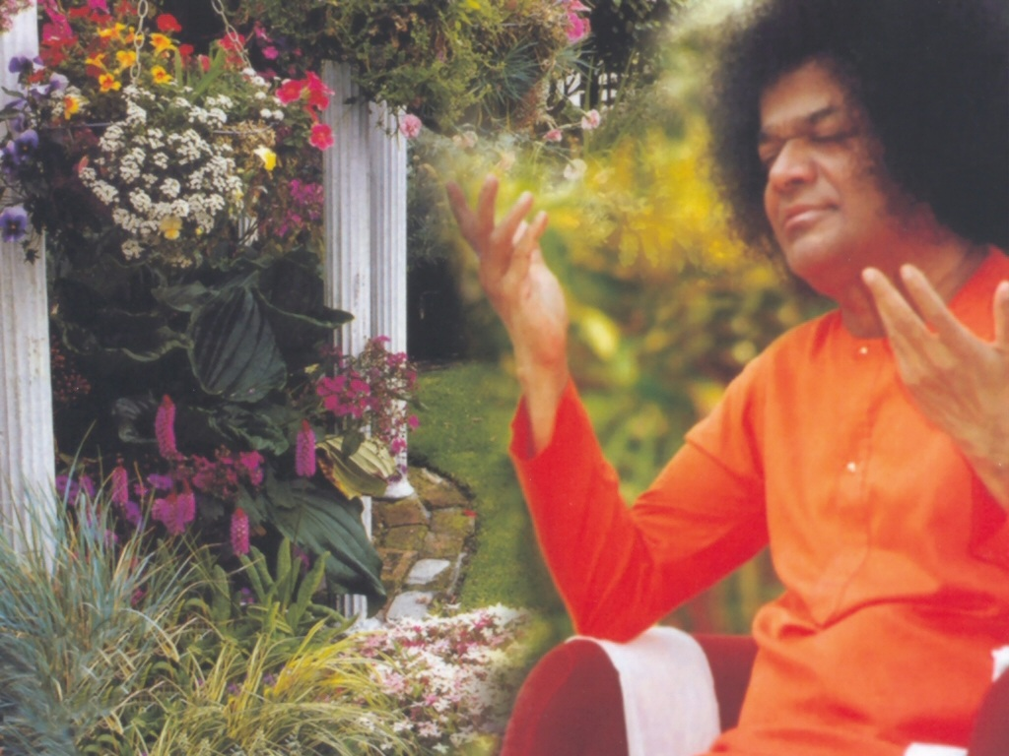
Central London Sai Center October 15, 2016

Slide 2
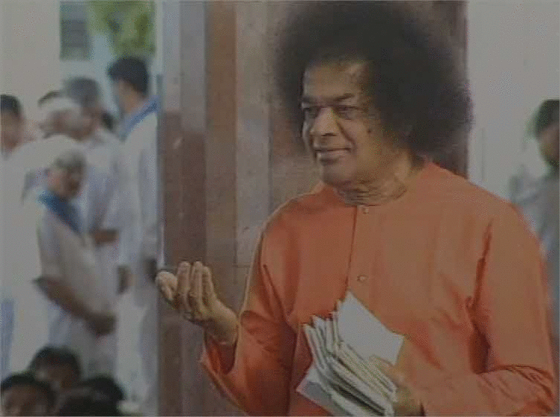
Aao Aao Aao Aao
Aao Aao Aao Aao Aao Sundara Nanda Gopal Navaneetha Chora Manasa Vihara
Continued

Slide 3
Aao Aao Aao Aao
Darshana Do Nandalala (2) Mujhey Darshana Do Nandalala

