Slide 1
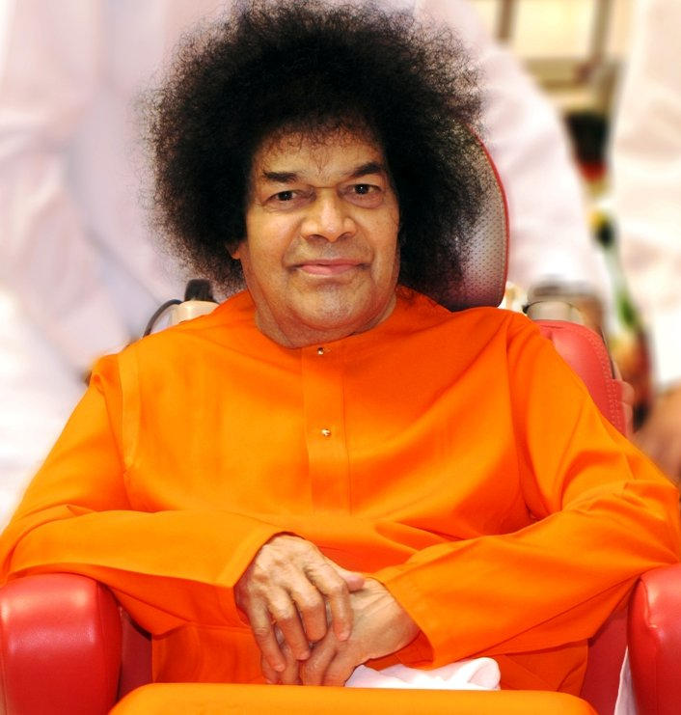
Central London Sai Center August 21, 2016

Slide 2
Vibhuti Mantra
Paramam Pavithram Baba Vibhuthim Paramam Vichitram Leela Vibhuthim Paramartha Ishtartha Moksha Pradhanam Baba Vibhuthim Idam Asrayami Sacred Holy and Supreme is Baba's Vibhuthi Pouring Forth in brilliant stream, this play of Vibhuthi So auspicious is its might, it grants liberation Baba's Vibhuthi, its power protects me
A

