Slide 1
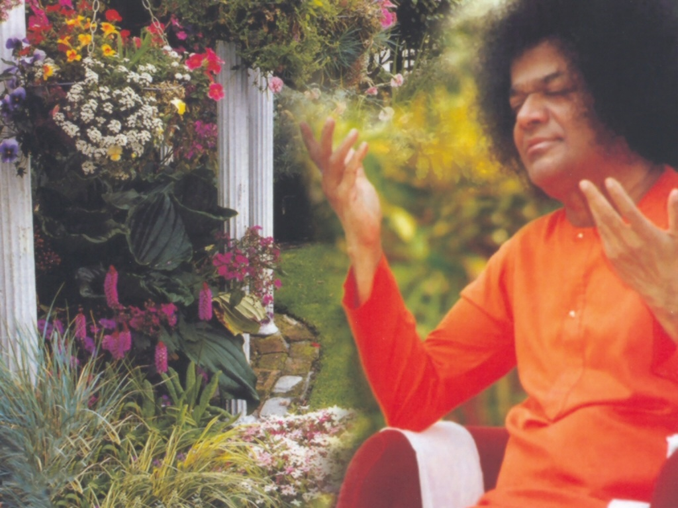
Central London Sai Center September 11, 2016

Slide 2
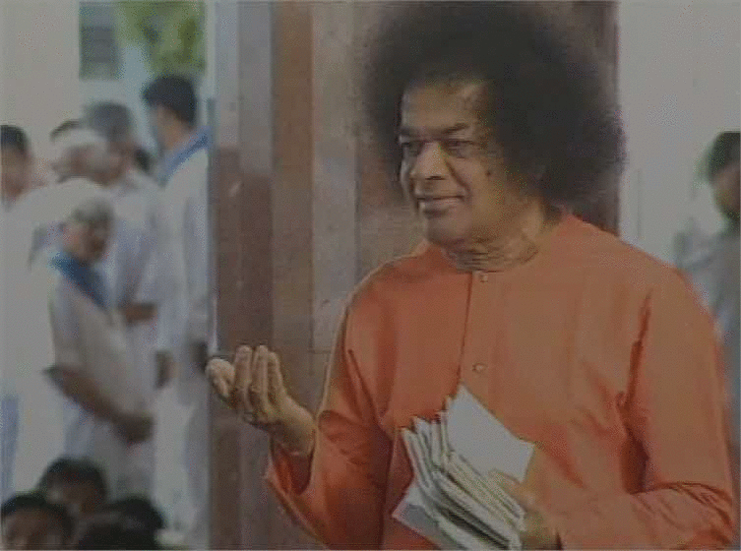
Akhanda Jyothi Jalao Sai Man Mandir Me
Akhanda Jyothi Jalao Sai Man Mandir Me Akhanda Jyothi Jalao (2) Koti Surya Sama Theja Swaroopa Sai Thum Ho Divya Swaroopa Akhanda Jyothi Jalao (2) Divya Jyothi Gnana Jyothi Prema Jyothi Jalao
V

Slide 4
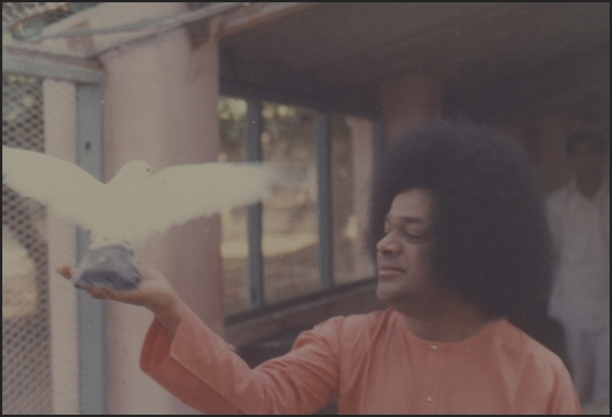
Madhurashtakam
Adharam Madhuram Vadanam Madhuram Nayanam Madhuram Hasitam Madhuram | Hrdayam Madhuram Gamanam Madhuram Madhura-Adhipater-Akhilam Madhuram ||2||
B
Continued

Slide 5
Madhurashtakam
Vacanam Madhuram Caritam Madhuram Vasanam Madhuram Valitam Madhuram | Calitam Madhuram Bhramitam Madhuram Madhura-Adhipater-Akhilam Madhuram ||2||
B
Continued

Slide 6
Madhurashtakam
Vennur-Madhuro Rennur-Madhurah Paannir-Madhurah Paadau Madhurau | Nrtyam Madhuram Sakhyam Madhuram Madhura-Adhipater-Akhilam Madhuram ||1||
B
Continued

Slide 7
Madhurashtakam
Giitam Madhuram Piitam Madhuram Bhuktam Madhuram Suptam Madhuram | Ruupam Madhuram Tilakam Madhuram Madhura-Adhipater-Akhilam Madhuram ||2||
B
Continued

Slide 8
Madhurashtakam
Karannam Madhuram Tarannam Madhuram Harannam Madhuram Smarannam Madhuram | Vamitam Madhuram Shamitam Madhuram Madhura-Adhipater-Akhilam Madhuram ||2||
B
Continued

Slide 9
Madhurashtakam
Gun.Jaa Madhuraa Maalaa Madhuraa Yamunaa Madhuraa Viicii Madhuraa | Salilam Madhuram Kamalam Madhuram Madhura-Adhipater Akhilam Madhuram ||2||
B
Continued

Slide 10
Madhurashtakam
Gopii Madhuraa Liilaa Madhuraa Yuktam Madhuram Muktam Madhuram | Drssttam Madhuram Shissttam Madhuram Madhura-Adhipaterakhilam Madhuram ||1||
B
Continued

Slide 11
Madhurashtakam
Gopaa Madhuraa Gaavo Madhuraa Yassttir-Madhuraa Srssttir-Madhuraa | Dalitam Madhuram Phalitam Madhuram Madhura-Adhipaterakhilam Madhuram ||4||
B

Slide 13
Aarti
Om Jaya Jagadheesa Harey Swami Sathya Sai Harey Bhaktha Jana Samrakshaka Bhaktha Jana Samrakshaka Parthi Maheshwara Om Jaya Jagadheesa Harey
A
Continued

Slide 14
Aarti
Sashi Vadhana Sree Karaa Sarva Praana Pathey, Swami Sarva Praana Pathey Aasritha Kalpa Latheeka Aasritha Kalpa Latheeka Aapadh Baandhavaa Om Jaya Jagadheesa Harey
A
Continued

Slide 15
Aarti
Maatha Pitha Guru Dhaivamu Mari Anthayu Neevey Swami Mari Anthayu Neevey Naadha Brahma Jagan Naatha Naadha Brahma Jagan Naatha Naagendra Shayanaa Om Jaya Jagadheesa Harey
A
Continued

Slide 16
Aarti
Omkaara Roopa Ojaswi Om Saayi Mahadeva Sathya Saayi Mahadeva Mangala Aarathi Anduko Mangala Aarathi Anduko Mandhara Giridhari Om Jaya Jagadheesa Harey
A
Continued

Slide 17
Aarti
Narayana Narayana Om Sathya Narayana Narayana Narayana Om Narayana Narayana Om Sathya Narayana Narayana Om Sathya Narayana Narayana Om || 3 || Om Jai Sad Guru Devaa
A

